Slide 1
Tags to screenshot in event of Solenoid Interlocks
Mostly applicable to a fast dump

Slide 2
Hardware QD Status
Make sure to get all the tags starting with QD from the controller tags section
Mostly interested in the _L & _U tags
These are aliased to Solenoid_EN2T2:5:I.Data*

Slide 3
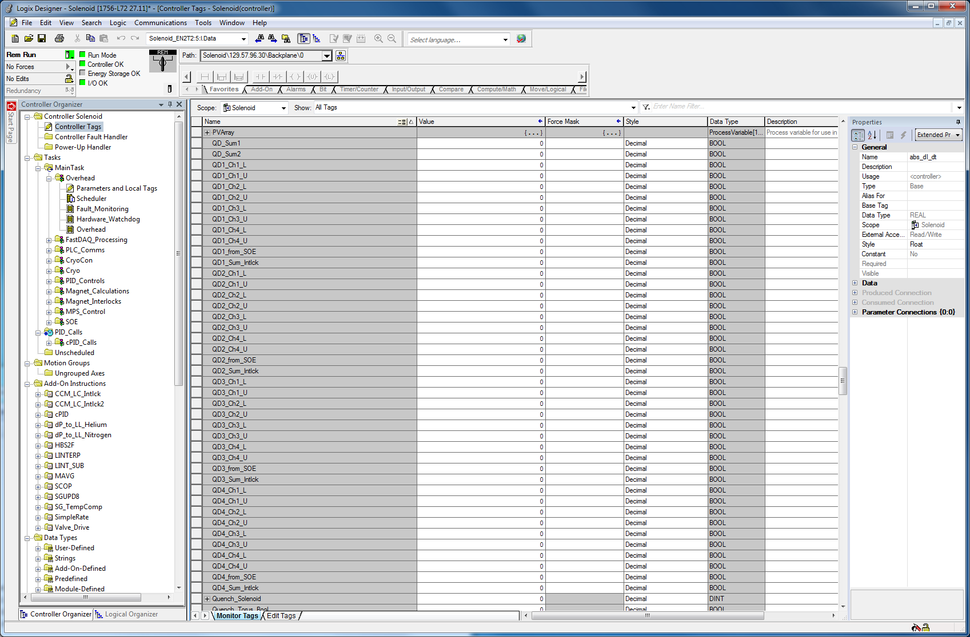

Slide 4
SOE Timestamps
Requires expanding a few levels down the SOE module’s tags
  Will be slow via remote desktop
Screenshots below hopefully show this process

Slide 5
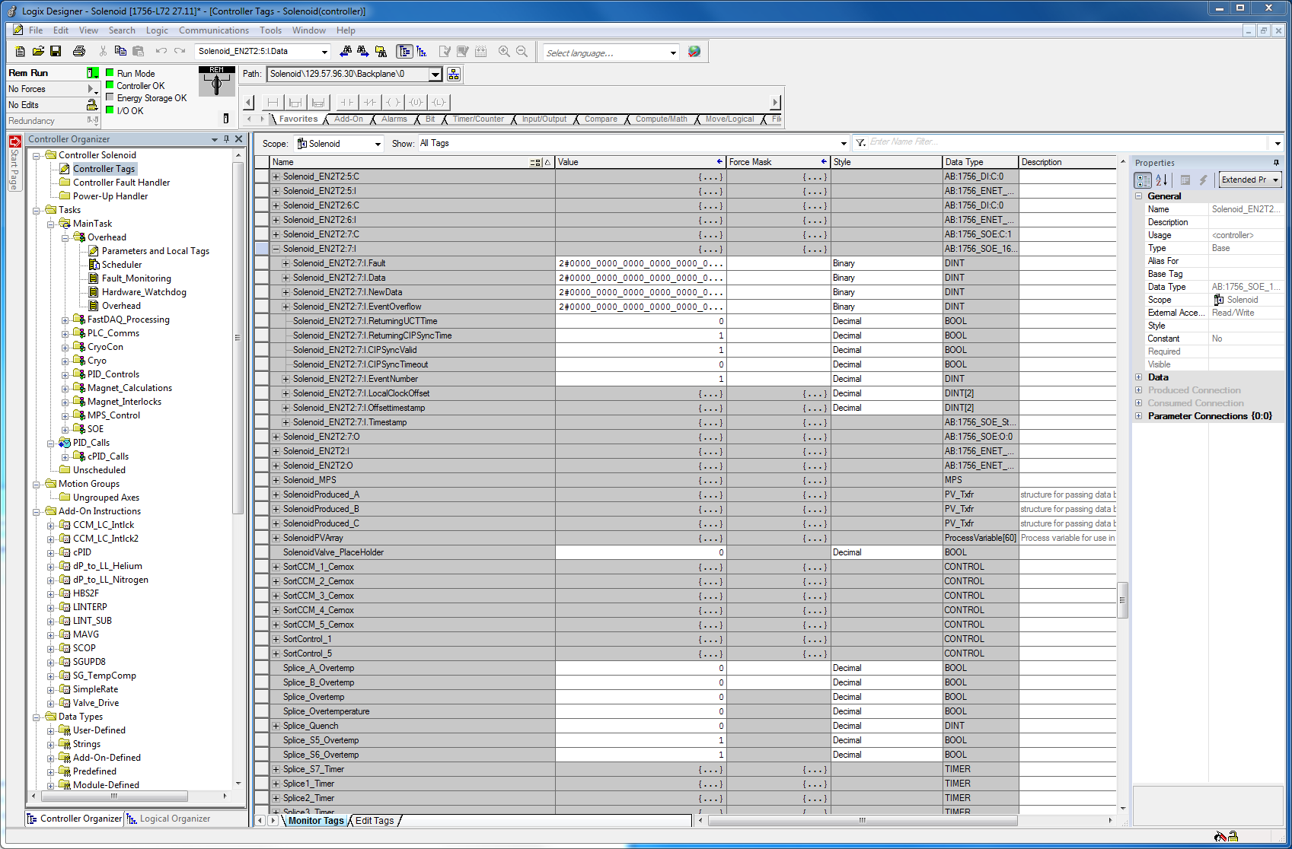
1/5 – Solenoid_EN2T2:7:I

Slide 6
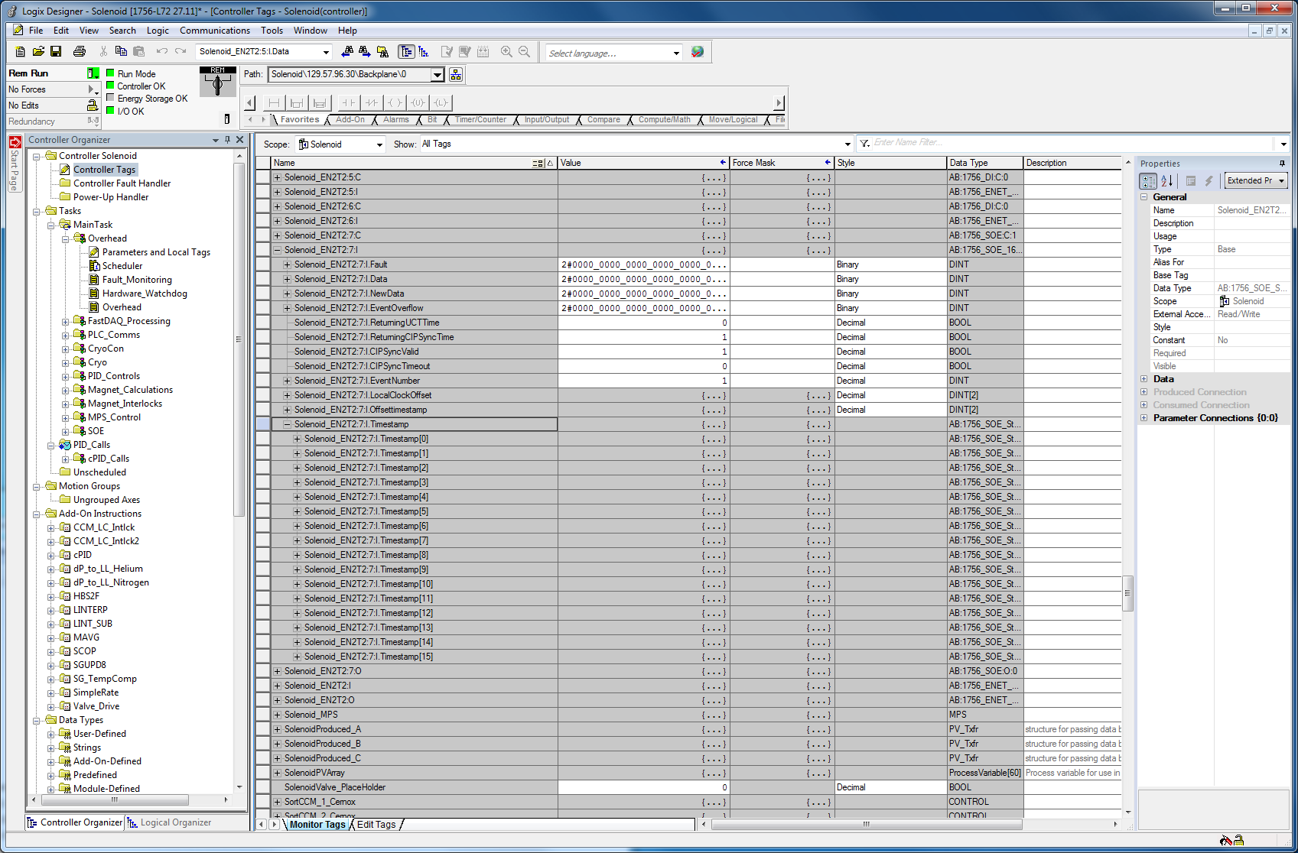
2/5 - Solenoid_EN2T2:7:I.Timestamp

Slide 7
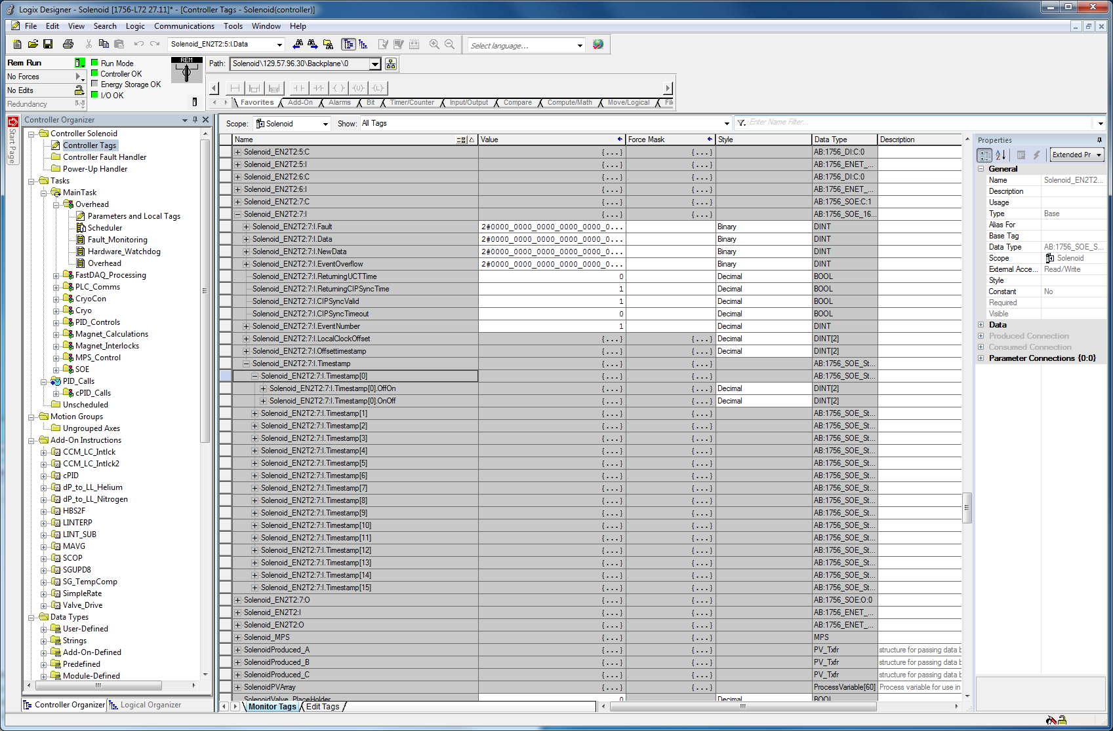
3/5 - Solenoid_EN2T2:7:I.Timestamp[x]
Must be done for all 16 channels

Slide 8
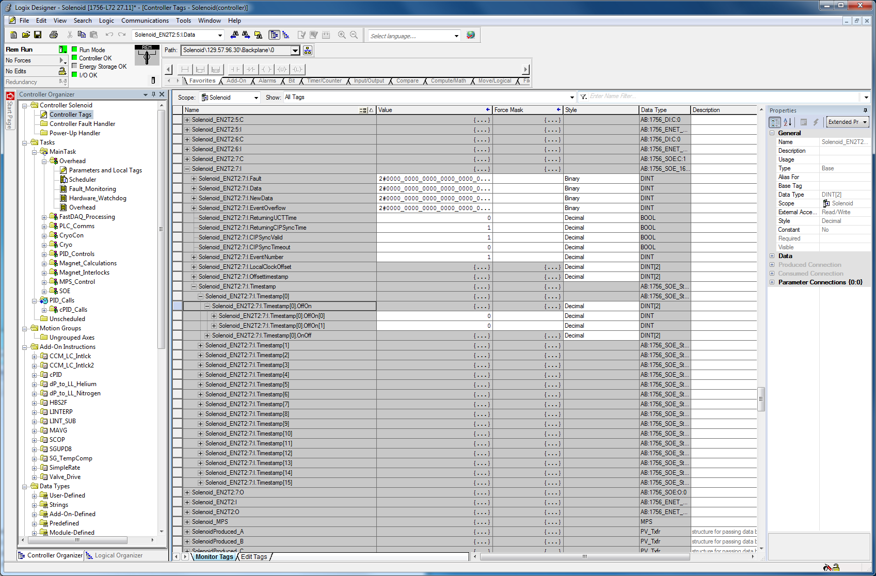
4/5 - Solenoid_EN2T2:7:I.Timestamp[x].OffOn
Again, expand for all channels

Slide 9
Last screenshot is an example with 3 channels expanded so far
In actual use once a channel shows up as 0, 0 it can be collapsed to make room for channels with actual timestamps in them when saving the screenshot

Slide 10
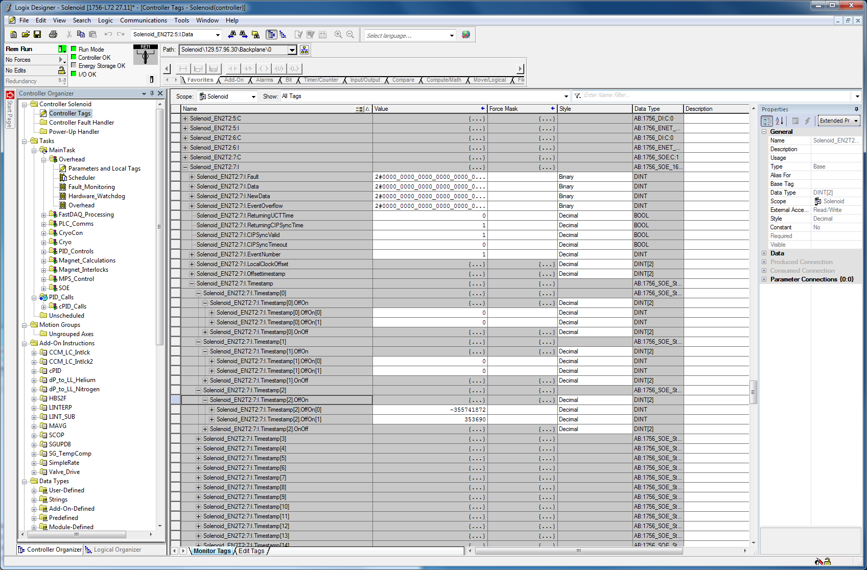
5/5 – Example of multiple channels expanded

Slide 11
Take raw SOE values and convert to human readable timestamps
https://userweb.jlab.org/~beng/SOE.html

