Slide 1

Hall B Magnet FastDAQ
Brian Eng
Detector Support Group
August 27, 2018

Slide 2
Overview
Issues with the current configuration
What the existing deployed looks like and how it performs
Current development code and performance
What worked and didn’t
Conclusion

Slide 3
Timestamp Jitter
Data is read from cRIO ADC modules and written to 2000 element EPICS arrays (which automatically add a timestamp) every 200 ms
  2000 element array is due to a bug in NI EPICS Server not being able to set a larger array size than the default
Calculating a time delta between sample timestamps
  < 100 ms considered duplicate
  > 300 ms considered a miss
Ideally this should be exactly 200 ms

Slide 4
Deployed Code
Single timed while loop with a sequence
  Each sequence runs at 100 ms
All calculations (min, avg, max) are done in the loop
Not all ADC channels are used
  Array manipulation to removed unused channels
Writing to EPICS & PLC done in the loop

Slide 5
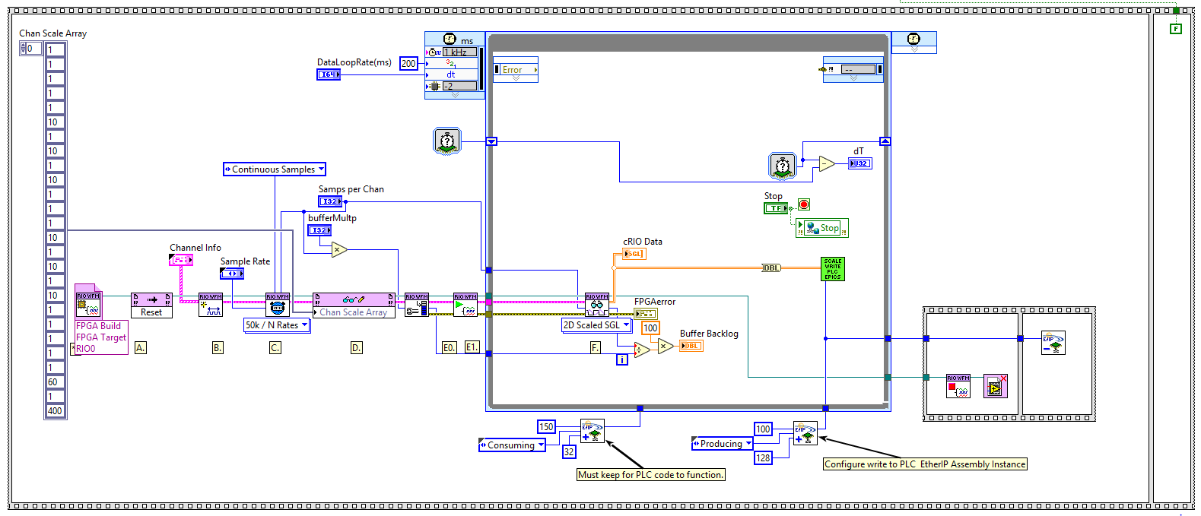
Deployed Code (Block Diagram)
ADC Read
Array manipulations
EPICS & PLC Write

Slide 6
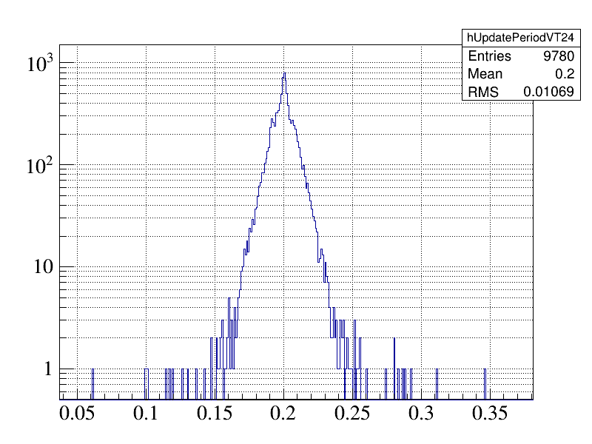
Deployed Code (Jitter)

Slide 7
Development Code (as of Today…)
Separate loops for reading ADC and all other functionality
  Use RT FIFO to pass data between the loops
Update cRIO Waveform Reference Library
  Can return the data as an interleaved 1D array (no array manipulations done)
Array manipulations and calculations done in a separate loop
Writing to EPICS and PLC are separate VI calls
Using 32-bit floating point instead of 64-bit

Slide 8
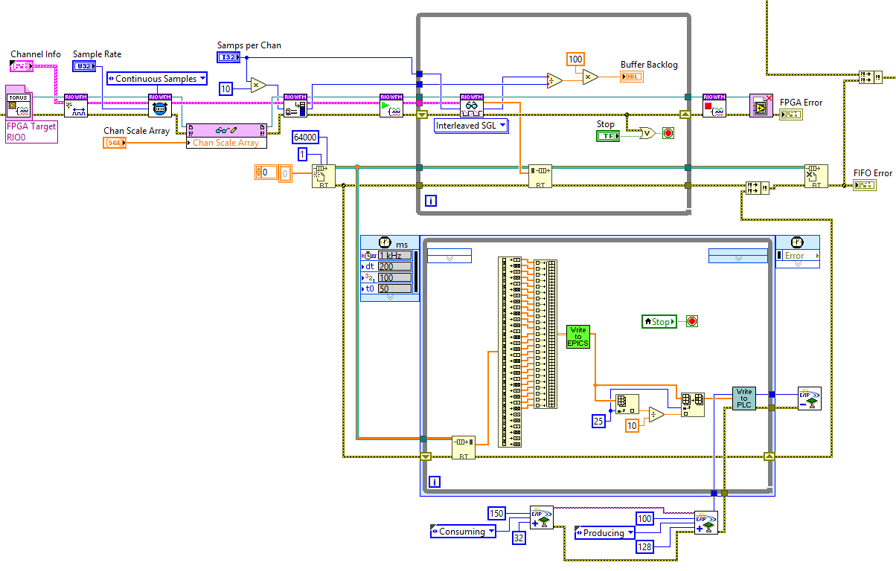
Development Code (Block Diagram)
RT FIFO
ADC Read
PLC Write
EPICS Write

Slide 9
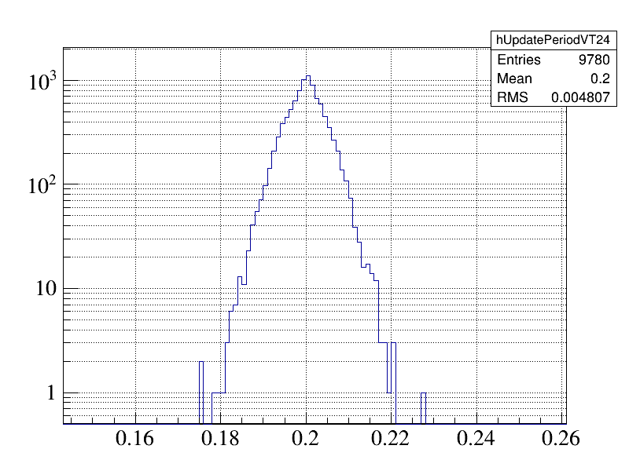
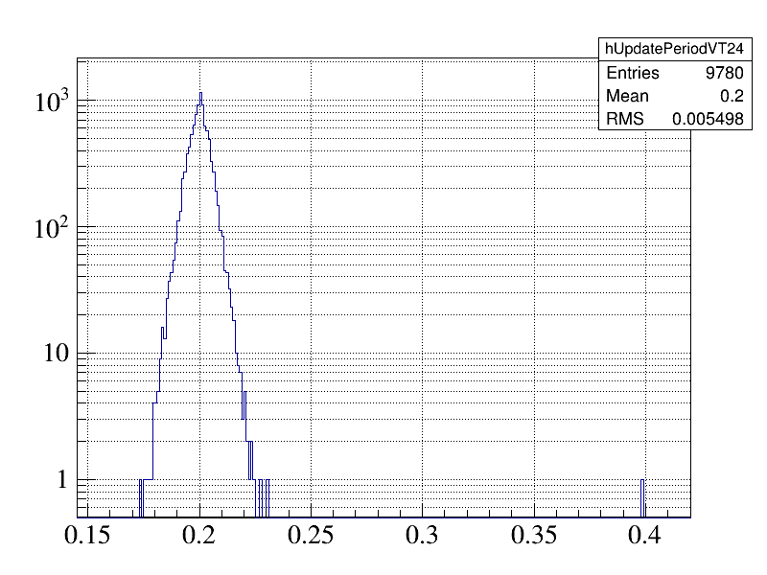
Development Code (Jitter)

Slide 10
The Good, Bad, and Ugly
Moving to 32-bit floating point was a big improvement
  Since data from ADC modules is 32-bit no loss of precision
Separating out functionality allowed easier measurement of timing of individual functionality
DAQmx API is much simpler and faster to deploy than FPGA, but worse timing (~13ms vs ~5ms RMS).
Adding timeouts to some functions (e.g. RT FIFO Read) completely killed any jitter gains, 2 peaks at 200ms & 400 ms

Slide 11
Conclusions
New code has significantly less jitter, but at the expense of completely missing a sample
  Still much less frequent than current code
    Most files have 0 timestamp issues
  Current code has timing issues on nearly every single file generated (2 GB ROOT files, ~30 min)
Still a work in progress
A slower ADC read rate would eliminate all timestamp issues independent of the code

Slide 12
BACKUPS

Slide 13
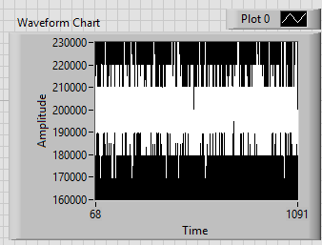
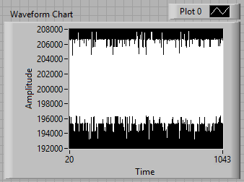
DAQmx (left) vs FPGA (right)

Slide 14
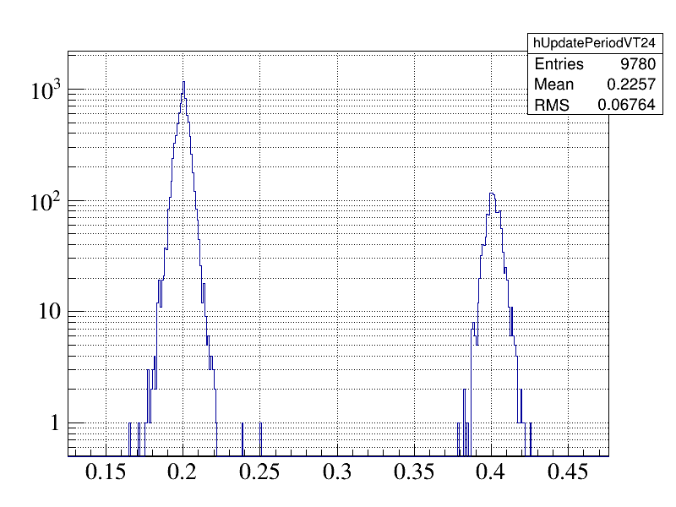
RT FIFO Read with Timeout

