Slide 1
Hall B Solenoid MPS Failure PLC Review
Review of PLC code related to apparent polarity change under load.
CRYO Group
Joshua Ballard
Robert Norton
11/16/2022

Slide 2
MPS Control By PLC (highly simplified)
PLC iterates through an array of commands to be sent to the MPS via RS232
Some are queries – get a value from the MPS
(‘AD 0’ = Return the value in AD Channel 0, Output Current)
Some are commands – set a value in the MPS
(‘DA 0, 100000’ = Set the output current to 100,000 ppm)
For each “command”, the PLC performs the following:
Build the command
Send a hard-coded string
OR
Build command by concatenating a combination of hard-coded string and operator setpoint
Send the command to the MPS over RS232
Receive and process the response from the MPS
Go to the next command in the array and start over

Slide 3
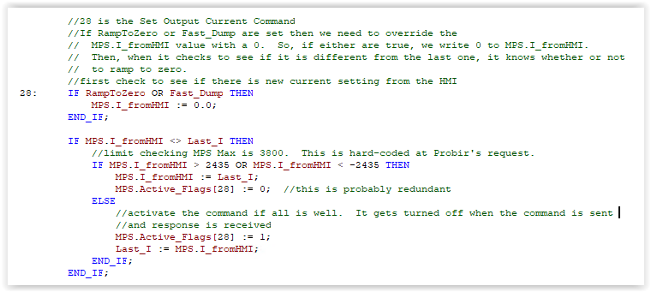
Adjusting Current Output Setpoint
When the ‘set output current’ command is processed, the PLC performs the following:
If a “ramp to zero” or a “fast dump” event has been initiated, set the desired current to 0 A (this overwrites the value from EPICS).
Determine if the setpoint has changed by comparing the desired current to the current setpoint stored from the last change.
If the setpoint has changed, verify that the new setpoint is within hard-coded limits (-2435 A < setpoint < 2435 A).
If the setpoint is out of bounds, ignore the change, use the stored value, go to the next command
If the setpoint is valid, store it for the next scan and send the command to the MPS.

Slide 4
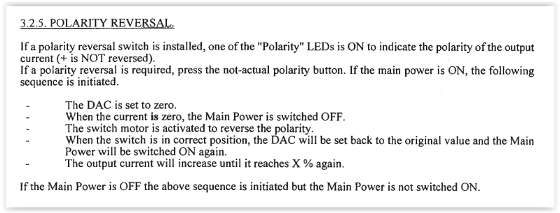
Polarity Reversal
Polarity reversal by PLC is the same as changing it on the Danfysik local control panel – simply change the sign of the current and the Danfysik takes the necessary steps.
From the Danfysik Manual (p14):
NOTE: The MPS internal sequence of operations for a polarity reversal is under control of the Danfysik controller – the PLC simply requests a new output current

Slide 5
Observations
Internal to the MPS, a polarity change requires two things to happen:
Send a 24 V pulse to the latching relay K8A. This changes the which K8A contact is connected to the motorized polarity switch (dwg 92131, sheet 4)
Turn OFF the MPS. This de-energizes relay K2A, which allows a NC contact to close providing 230 VAC to the motorized polarity switch (MPS_IS_OFF (230 V), dwg 92278)
This means it is possible for a polarity change event to be ‘staged’ while at high current. That is, the latching relay could be pulsed, which would change its state, but the polarity change couldn’t occur until the main contactor was disabled. Anything disabling the main contactor would make 230 VAC available to the motorized polarity switch, driving a position change. This could be initiated from any event that opens the dump circuit: a quench, an Estop, an operator initiated power-off, etc. Any of these events could be initiated while at high current with disastrous results.
Because the polarity change sequence is controlled by software within the Danfysik, an out of sequence pulse to the latching relay could occur due to any number of unforeseen issues: a firmware bug, programming errors, a malformed RS232 command, etc.
This type of failure can be prevented by interlocking the motorized polarity switch power source with an independent current measurement such that the 230V power is only available when there are ~0 A in the magnet.

Slide 6
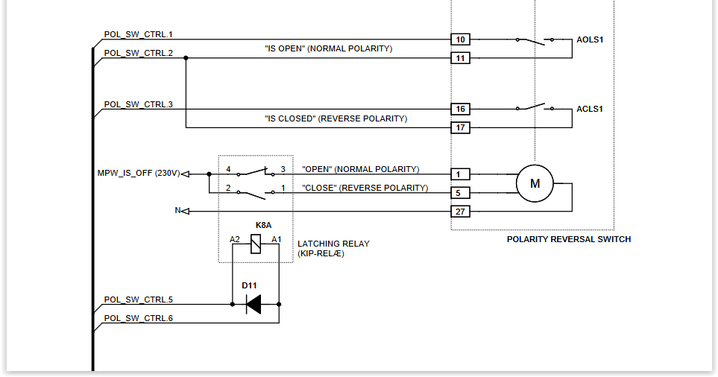
Hardware Recommendations
Hardware Recommendation
Interlock the 230V MPW_IS_OFF signal with an independent current measurement
Put a PLC-controlled relay with an NO contact between the K8A contacts and 230 V
Program the PLC to close the contact when -0.5 A < Current < 0.5 A
Ensure PLC current measurement independent of MPS measurement
PLC Controlled Relay

Slide 7
Software Recommendations
PLC Software Recommendations
Option A (simple to implement):
Modify logic so the ‘sign’ of the output current setpoint can’t be changed unless current is at ~0 A.
Option B (more difficult to implement):
Modify the PLC logic such that an output current setpoint with a different ‘sign’ from the actual current initiates a sequence of setpoint changes:
Ramp to 0
Ramp to new setpoint.

