Slide 1
The Hall B MVT Gas Mixing System George Jacobs Physics DSG 6/24/2016

Slide 2
The Hall B MVT Gas Mixing System
Mixing System location will be in the Bldg. 96B Gas Shed
System will Produce 2 Different Gas Mixtures
Mixture 1 - 10% C4H10 in Argon
Mixture 2 – 10% C4H10 10% CF4 in Argon
MKS Mass Flow Controllers, MFCs, will be used to Mix the Gasses
The MFCs are controlled by the cRio controller
Mixed gas pressures are monitored by an MKS absolute pressure transducer
Mixed Gas Pressure will be Automatically Controlled by Adjusting the MFC flows
Mixed Gas Flows into the Hall in Temperature Controlled Piping

Slide 3
Design Goals in System Operation
Prevent detector damage due to improper gas mixture.
Minimize any required operator actions.
Minimize human errors.
Automate system startup and shutdown.
Prevent HV operation with improper gas mixture
Prevent any flammable gas mixtures during maintenance or down times.
Closely monitor the fill levels of the CF4 and C4H10 liquid gas cylinders
Easy to adjust system operating parameters via GUI
Integration with EPICS and the Alarm Handler

Slide 4
Mixing System Details
Isobutane, C4H10, is a Flammable Gas with explosive limits of 1.4% to 8.3%
Pressure System Requirements apply
cRio Based Controls
EPICS Monitoring and the Alarm Handler
Trained Operators are Required to Replace the C4H10 and CF4 Gas Supply Cylinders (Liquid)
Uses two pre-existing 300 ft long temperature controlled ½” SS tubing runs between the Gas Shed and Hall B Level 1 Space Frame

Slide 5
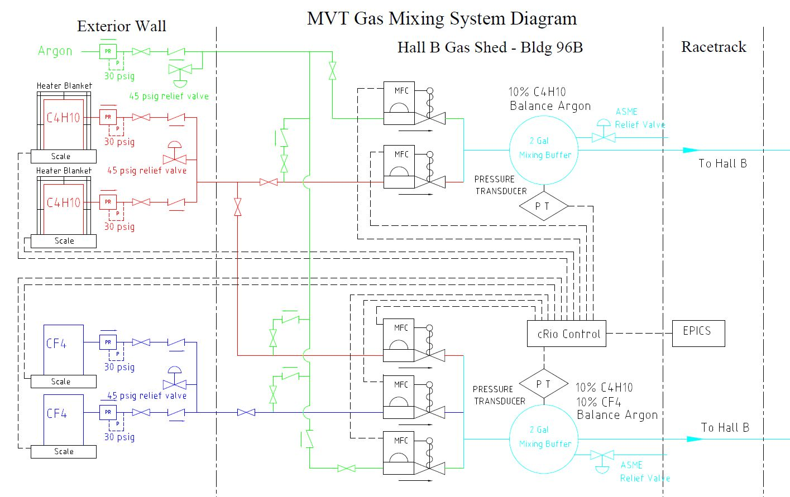

Slide 6
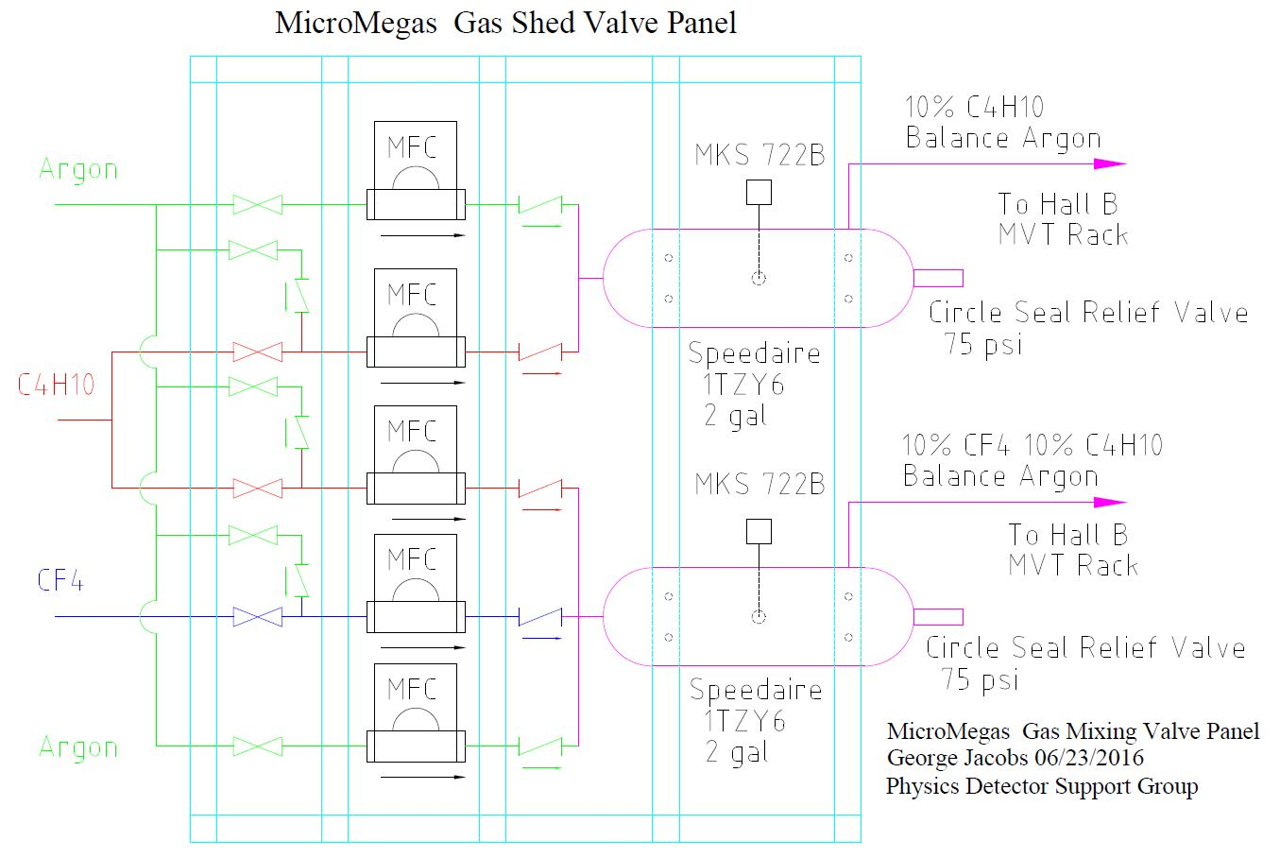

Slide 7
The System Startup Sequence
The MVT gas GUI has a System Startup button
When the System Startup Button is clicked the cRio runs the startup program
Argon Purge is initiated – The C4H10 and CF4 MFCs close, the argon MFCs flow at the purge rate of 650 sccm and 325 sccm
Argon Purge continues for 4 hours or 156 liters total flow for MIX1 and 78 liters total flow for MIX2
Mixed gas purge begins and continues for 2 hours or 78 liters total flow for MIX1 and 39 liters total flow for MIX2
Then the cRio program switches to normal mixing and pressure control operation

Slide 8
Mix 1 Pressure Control
Mix 1 – 10% C4H10 in Argon
Pressure is monitored by an MKS absolute Baratron transducer
Maintain line pressure 12-16 psi
Normal detector flow is 750 sccm
Vary flowrate between 400-900 sccm
@ 16 psi flow is reduced to 400 sccm
@ 12 psi flow is increased to 900 sccm
@ 17.2 psi flow is turned off
Purge flow of 1000 sccm
Vary flowrate between 500-1500 sccm
@ 16 psi flow is reduced to 500 sccm
@ 12 psi flow is increased to 1500 sccm
@ 17.2 psi flow is turned off

Slide 9
Mix 2 Pressure Control
Mix 2 – 10% CF4 10% C4H10 in argon
Pressure is monitored by an MKS transducer
Maintain line pressure 12-16 psi
Normal detector flow is 250 sccm
Vary flowrate between 200-300 sccm
@ 16 psi flow is reduced to 200 sccm
@ 12 psi flow is increased to 300 sccm
@ 17.2 psi flow is turned off
Purge flow of 325 sccm
Vary flowrate between 200-400 sccm
@ 16 psi flow is reduced to 200 sccm
@ 12 psi flow is increased to 400 sccm
@ 17.2 psi flow is turned off

Slide 10
The System Shut Down Sequence
The MVT gas GUI has a System Shut Down button
When the System Shut Down Button is clicked the cRio runs the shut down program
Argon Purge is initiated – The C4H10 and CF4 MFCs close, the argon MFCs flow at the purge rate of 650 sccm and 325 sccm
Argon Purge continues for 4 hours or 156 liters total flow for MIX1 and 78 liters total flow for MIX2
The cRio turns off the argon purge and turns off all the MFCs

Slide 11
Integration with the FT and Saclay PLC
Current gas distribution system in hall requires manual flow adjustments and operation of the valves in the distribution racks for system start, purge, and shut down.
Mixing System Startup Sequence automation
Mixing System Purge automation
Mixing System Shut Down Sequence automation
Automatic Mixing System Shut Down in case of Large Downstream Leak
EPICS Signals from Saclay PLC for EPICS GUI
Detector Total Gas Flow Signals for Mixing System Optimization.

Slide 12
Critical Path Includes
Purchase Components
Fabricate and Install Gas Shed Valve Panel
Fabricate and Install scales and regulators for the C4H10 and CF4 Cylinders
Fabricate and Install Controls Chassis and Cables
Run SS tubing in Gas Shed to Connect Valve Panel to Temperature Controlled lines to Hall B
Run SS Tubing in Hall B to Connect Temperature Controlled lines to the MVT and FT Gas Panels
Develop cRio Controls
Test cRio Controls
Test with Saclay and FT Gas Distribution Systems

Slide 13
Conclusion
Current detector gas distribution system is manpower intensive and requires manual valve operation and flow adjustment for system startup, purge, and shut down.
Further Controls Development required to automate the detector gas distribution equipment in the hall.
Estimated time for gas mixing system completion once all components are purchased is ~ 4 months.
Hall B Gas Shed location for flammable gas mixing system requires approval.

