Slide 1
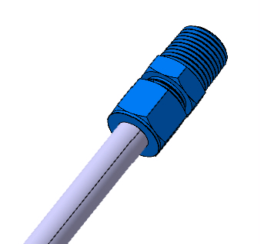
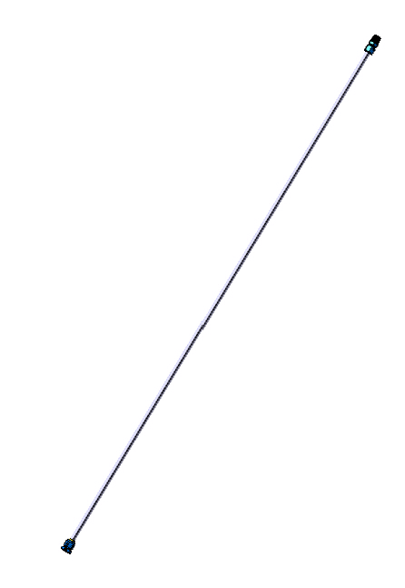
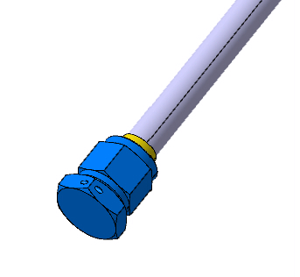
COD. 5182K135
Pipe OD: ½”
Length: 1500mm
Material: Stainless Steel
Quantity: 2
COD. 5482K84
COD. 5482K77
COD. 5482K308

Slide 2
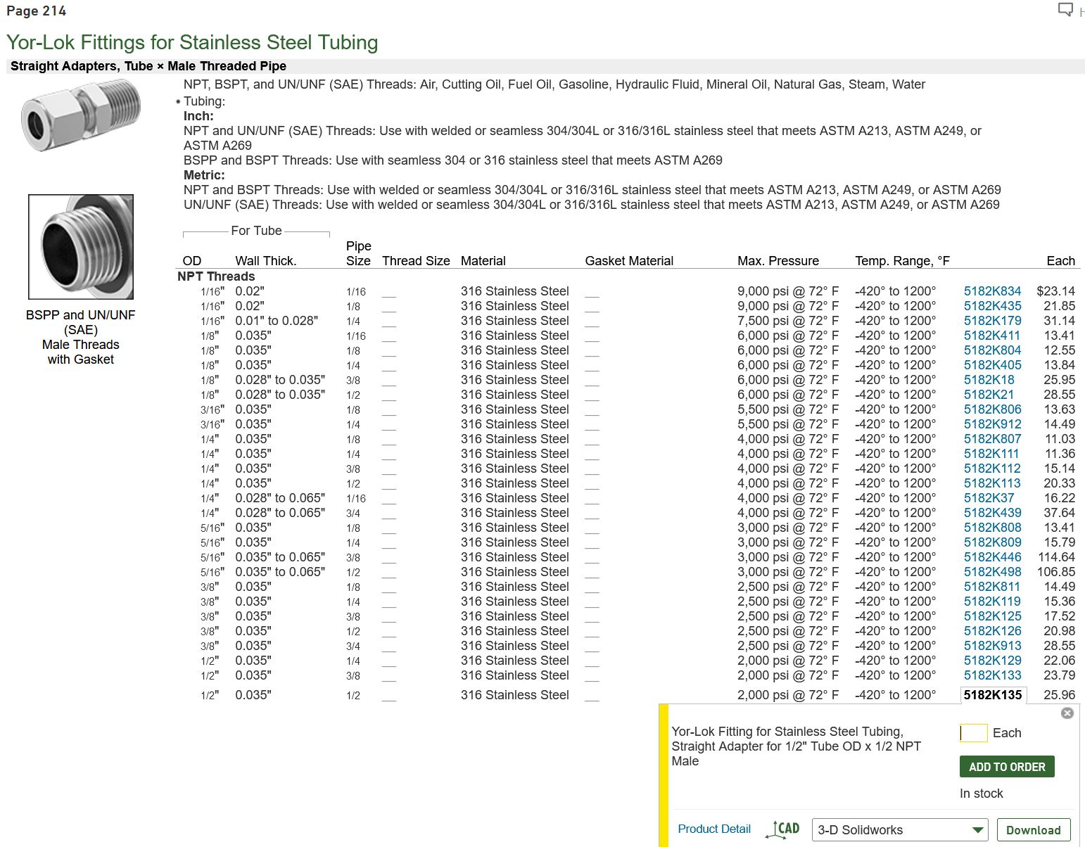
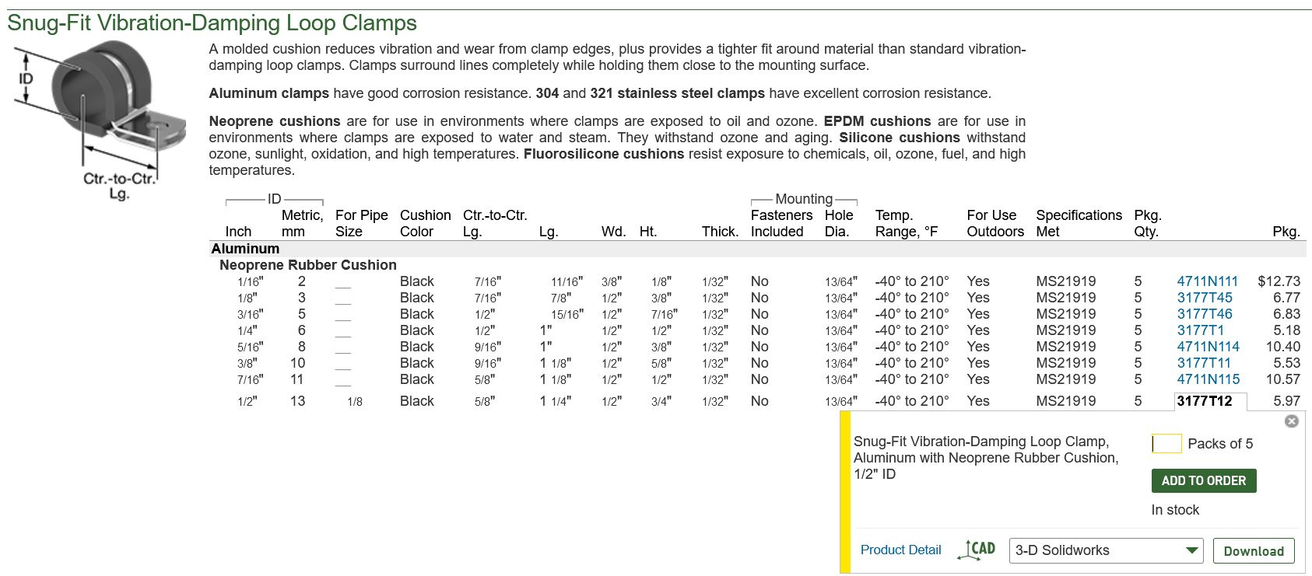
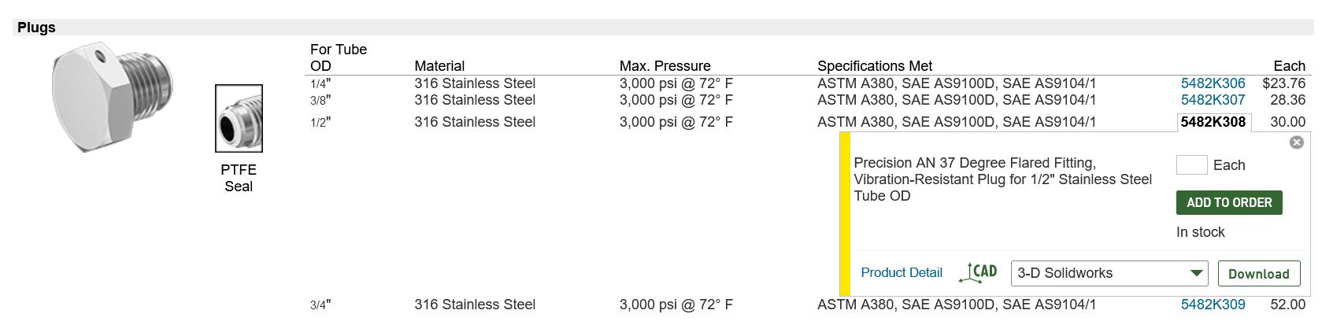
Minimum quantity required: 12
Minimum quantity required: 2
Minimum quantity required: 2

Slide 3
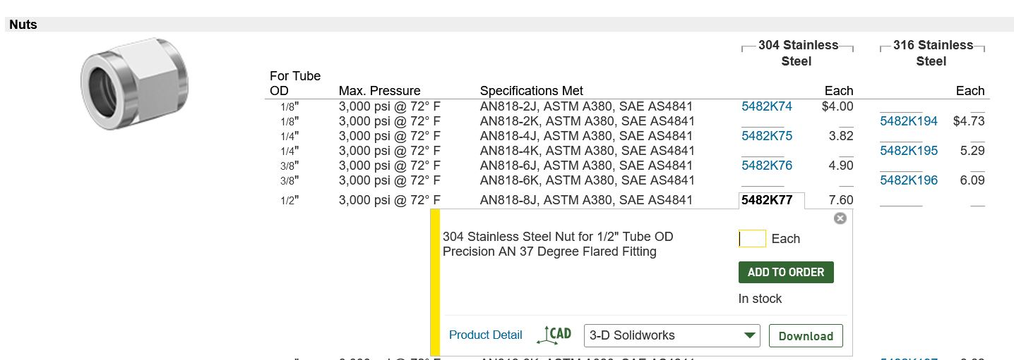
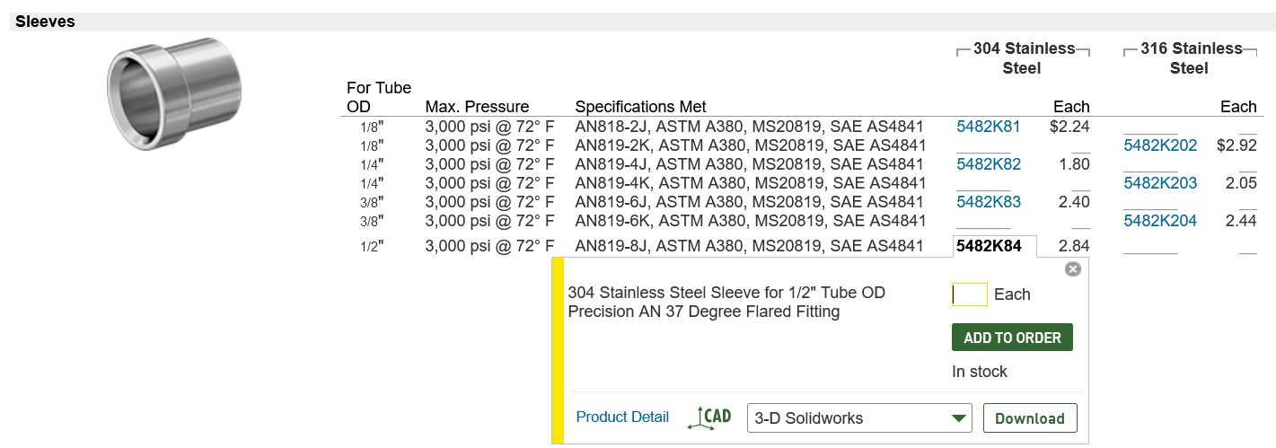
Minimum quantity required: 2
Minimum quantity required: 2

Slide 4
