Slide 1
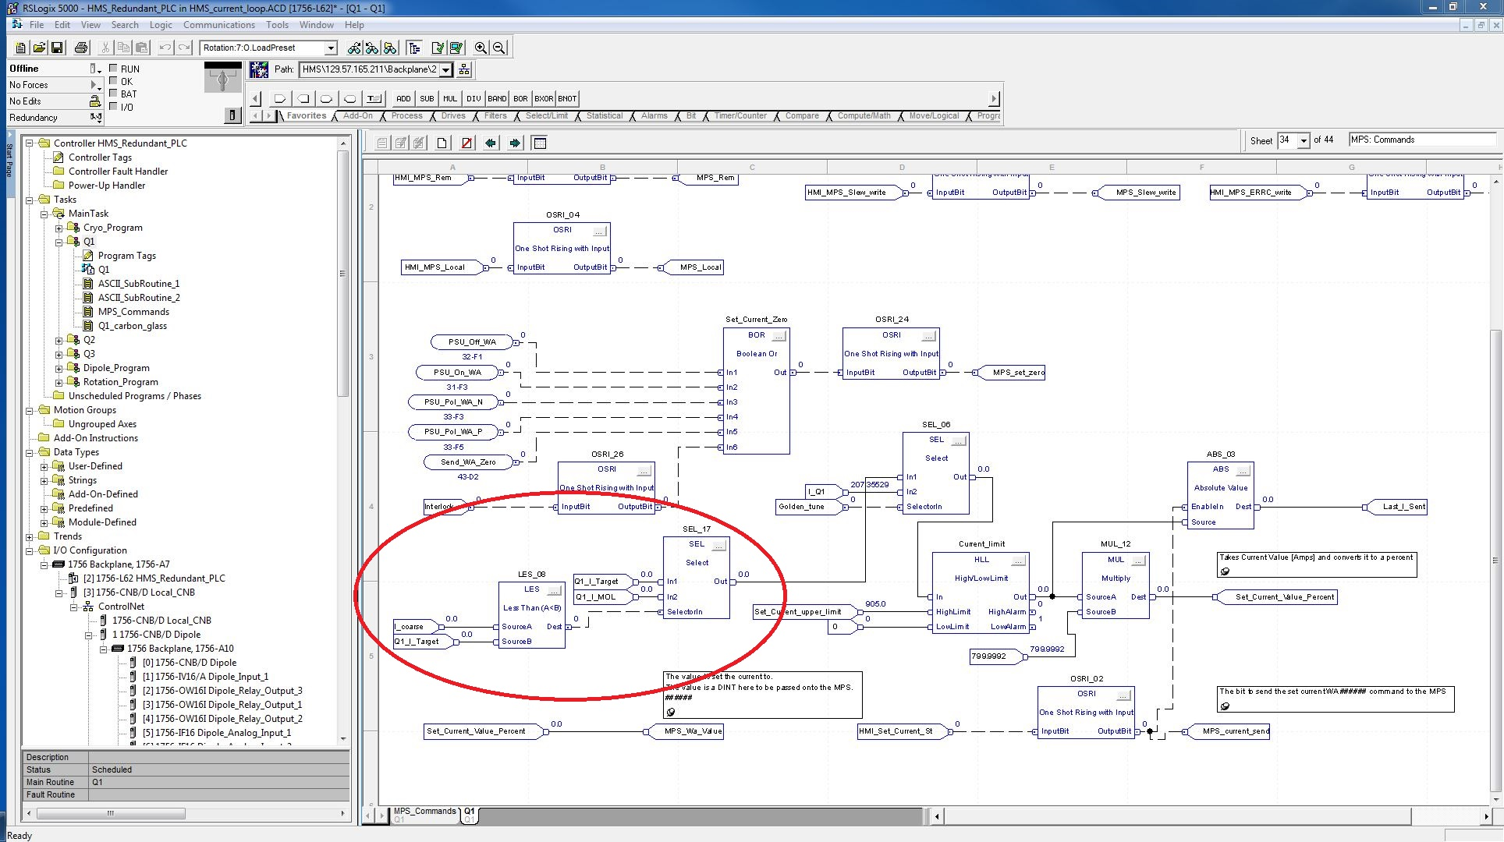
Golden_tune is for using the calculated value. True value should use I_Target/I_MOL
I_coarse is an analog read back from the power supply.
Recommend using Last_I_sent
Operator input that triggers Ladder logic.

Slide 2
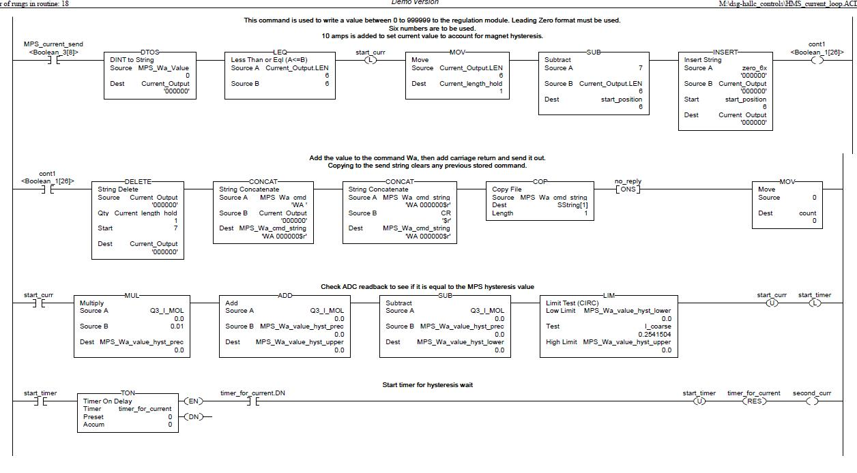
Command sends one of three current settings to the PSU.
I
I_Target
I_MOL
Command is started no matter what current is sent.
Rung is unlatched only when MOL test is satisfied, could stay latched forever.

Slide 3
Triggered when MOL test is satisfied. When does that happen?
Missing ONS

