Slide 1
DSG NPS Status
Aaron Brown and the
Detector Support Group
October 17, 2022

Slide 2
Contents
Priority Lists
Brad’s Email 09/13/2022
Brad’s Email 10/13/2022
HV Controls & Monitoring – Phoebus
Chiller Controls
Thermal Readback
LV Controls & Monitoring
LED Controls & Monitoring
Summary

Slide 3
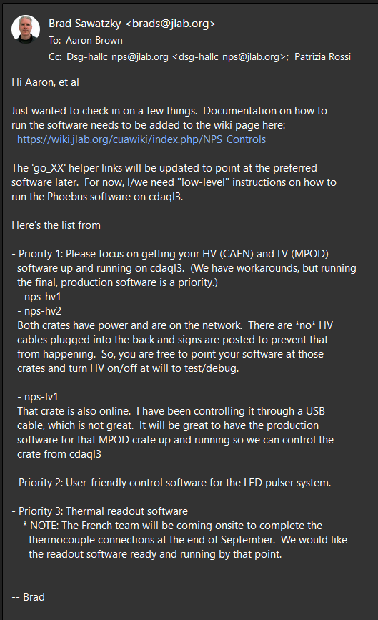
Priority List 1
Brad’s email from 09/13/2022
Priority 1: HV and LV controls
Priority 2: LED controls
Priority 3: Keysight readback

Slide 4
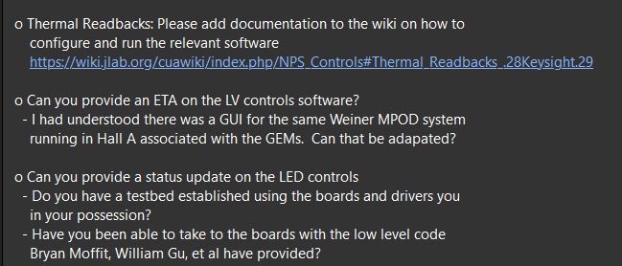
Priority List 2
What account? Cdsg was given by Brad; once we have the account we can provide startup instructions (would need access to other accounts)
Adding instructions developed by Mary Ann to the wiki
Peter and Pablo will look at the instructions
Brian will make a tarball
Independent VI controls work, will be installed on Brian’s spare cRIO
Instructions will be provided once installed
Pablo is installing a bridge between LabVIEW PVs and EPICS PVs for Phoebus
Aaron is revising LabVIEW program to reflect new channel connections
Aaron will finish testing the humidity sensors
Marc will fabricate power distribution box
Pablo will test the EPICS controls Phoebus screen
Peter will proof the documentation
SNMP iseg controls & monitoring (programmed in QT)
Brian has code from the halls, but Hall A only uses HV modules (yes this can be adapted), Tyler will setup the database
HV modules have different parameters
Need to know what to monitor for the low voltage cards
Need to know what account
Mary Ann will generate Phoebus screen
Brian has a testbed for LED controls
Missing software drivers between the VME LED Drivers and the Phoebus screen (most complex part)
Phoebus screen in development by Mary Ann
ETC unknown
Brad’s email from 10/14/2022

Slide 5
Summary
To deal with requests in 10/14/2022 email
DSG needs 3 weeks at least (without time contingency)
Unknown amount of time required for developing missing software drivers between the VME LED Drivers and the Phoebus screen (most complex part)

