Slide 1
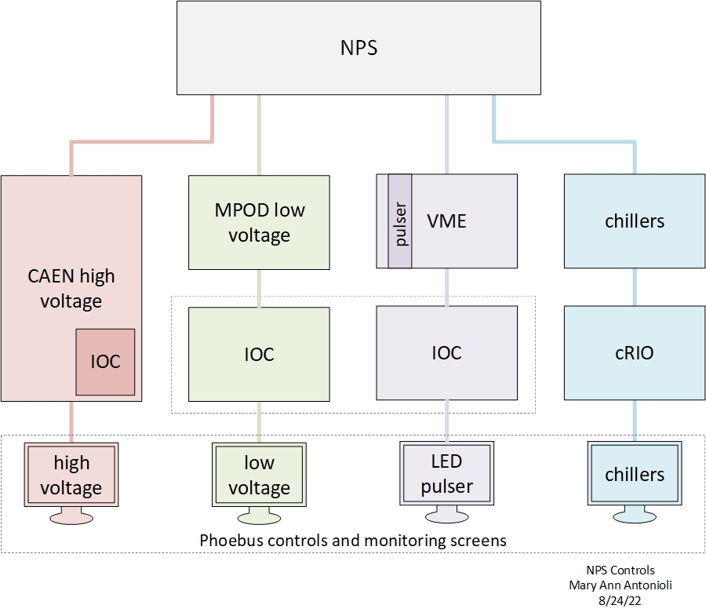
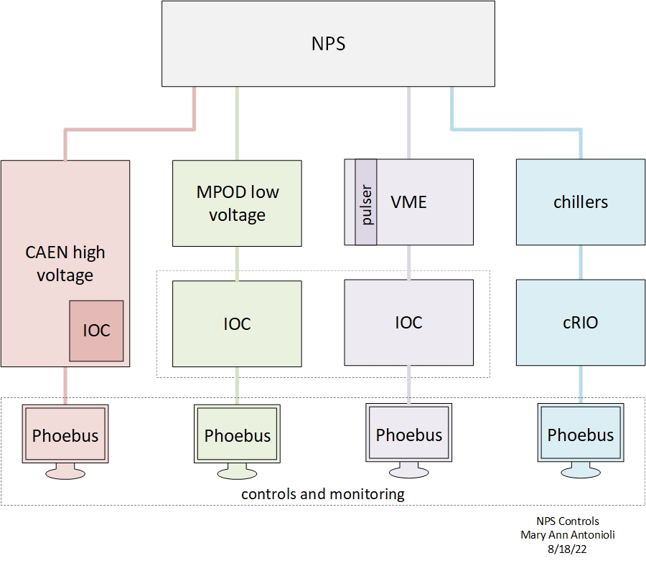
NPS Controls & Monitoring System

Slide 2
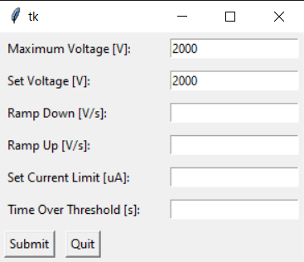
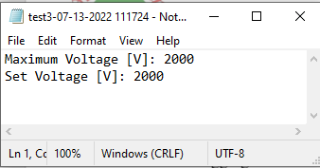
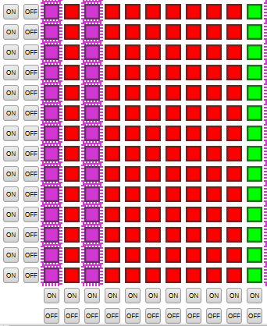
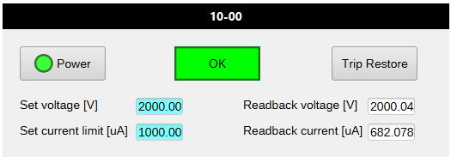
High Voltage Controls & Monitoring System
Adding instructions to wiki
Startup instructions on cdsg
Will be available on other accounts
once DSG has access to them
Controls & Monitoring System ready
GUI to set high voltage parameters for all channels and modules
Value inputs are saved to a timestamped text file
Changes to individual channels handled with HV EPICS pop-up screens
PMT status screen
Phoebus detailed screen
Each rectangle is clickable – opens the PMT status screen
Phoebus overview screen
Each LED is clickable – opens the PMT status screen

Slide 3
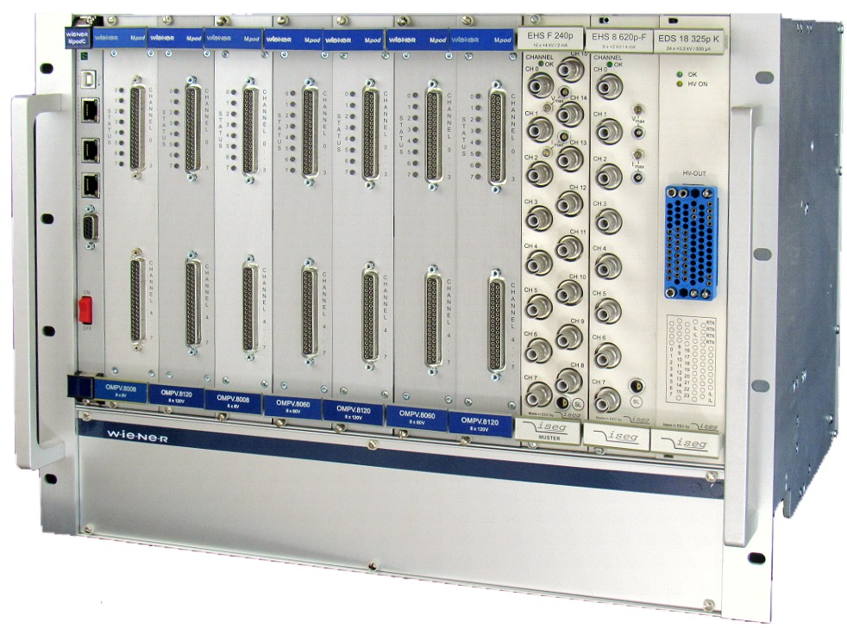
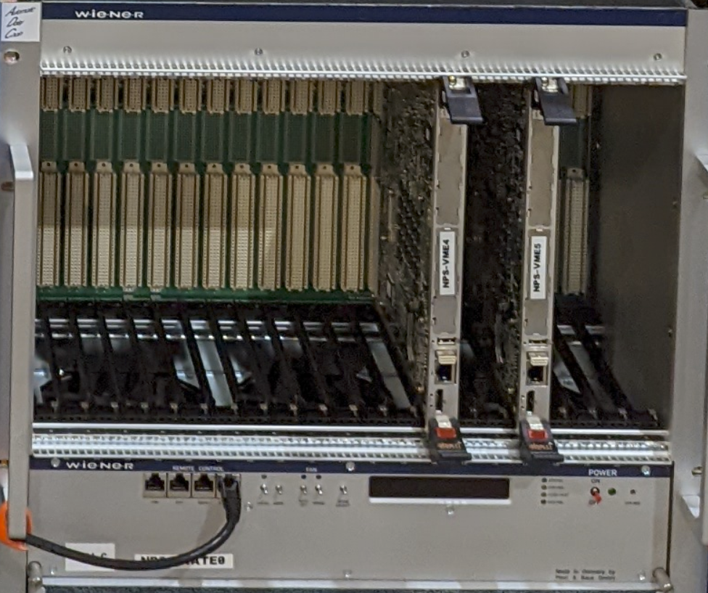
LV and LED Controls & Monitoring System
LV controls software
SNMP iseg controls & monitoring (programmed in QT)
Hall A uses code for HV modules
Code can be adapted
Setting up database
HV modules have different parameters
Generating Phoebus screens
Estimated date of completion (EDC) 12/02/2022
Weiner MPOD crate with low voltage modules
LED controls software
Missing software drivers between the VME LED Drivers and the Phoebus screen (most complex part)
Installing EPICS drivers onto the VME LED module
Procuring LEDs to use for testing.
Developing Phoebus screen
EDC unknown
Trying for 12/02/22
Weiner MPOD crate with VME LED module controllers

Slide 4
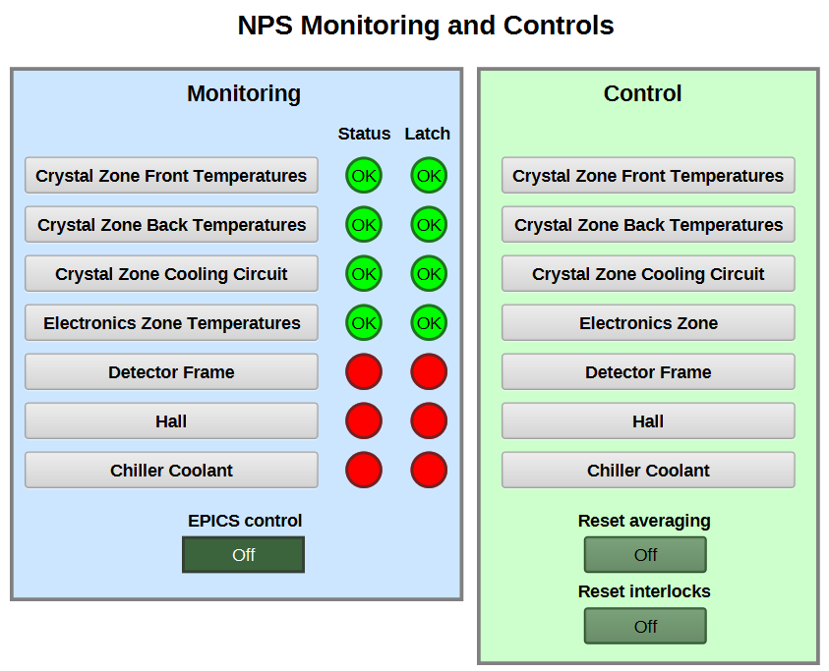
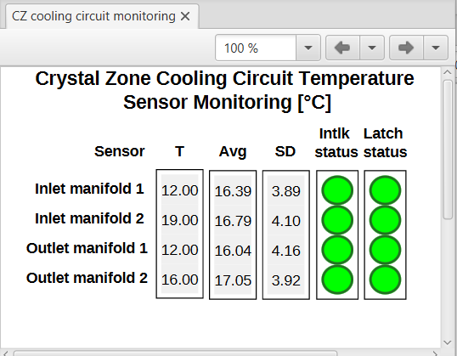
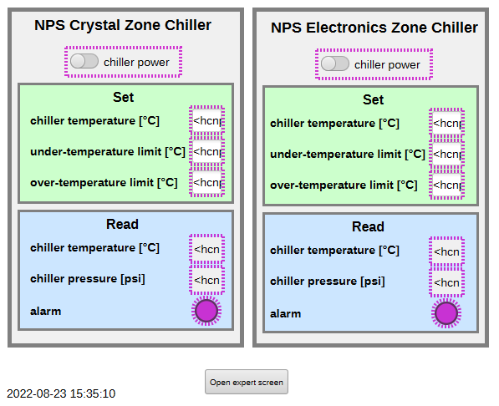
Thermal Readbacks
Revising LabVIEW program to reflect new channel connections for the Keysight readback
Completed testing 12 of 12 relative humidity sensors Developed Phoebus screens
Tested 4 of 12 of the temperature and humidity readback Phoebus screens.
Fabricating power distribution box
Adding documentation
EDC 12/02/22
Phoebus screens
Independent VI chiller controls work
Configuration , run, and control Instructions will be provided once chiller controls are installed
Installing bridge between LabVIEW PVs and EPICS PVs for Phoebus
Temperature & humidity sensor readback (Keysight) LabVIEW screen
Displays averages, std. deviations, dew point, alarm limits, and trip delays
EPICS server
PVs used in Phoebus screens

Slide 5
Summary
DSG needs 3 weeks (without time contingency) to address the items mentioned in the previous slides
Unknown amount of time required for developing missing software drivers between the VME LED Drivers and the Phoebus screen (most complex part)

