Slide 1

NPS Status
Aaron Brown and the
Detector Support Group
Thursday, November 3, 2022

Slide 2
Contents
Controls & Monitoring Systems
  Overview
  High Voltage
  Low Voltage
  VME LED Drivers
  Thermal Readbacks and Chiller
Summary

Slide 3
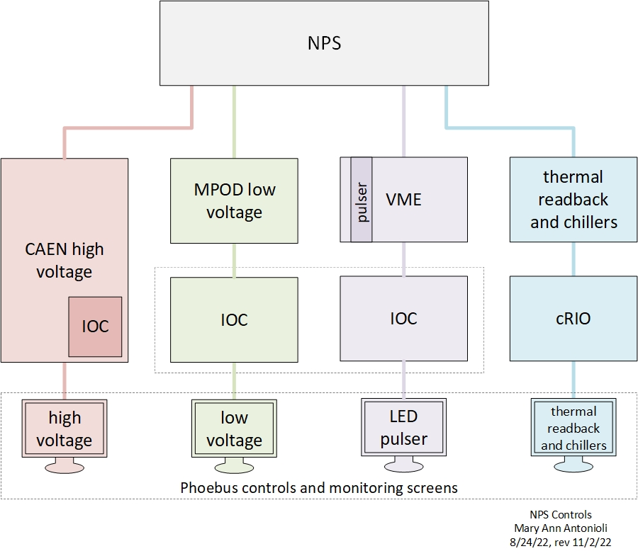
NPS Controls & Monitoring System
Ready
Ready by 12/02/22
In progress
Ready

Slide 4
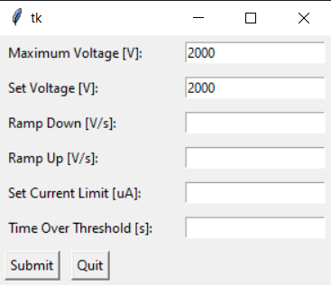
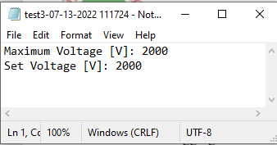
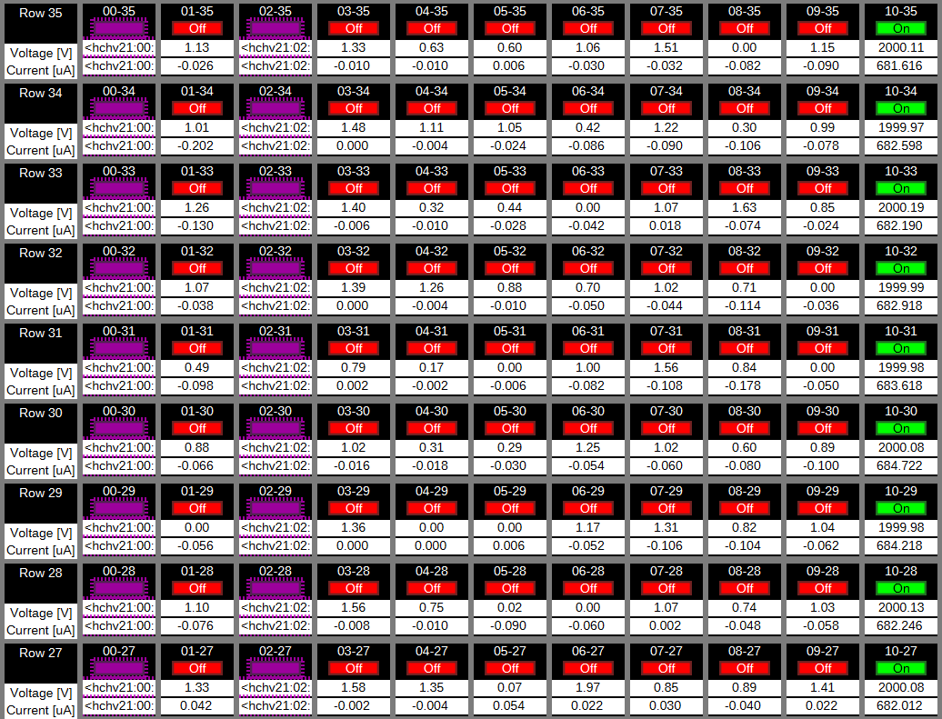
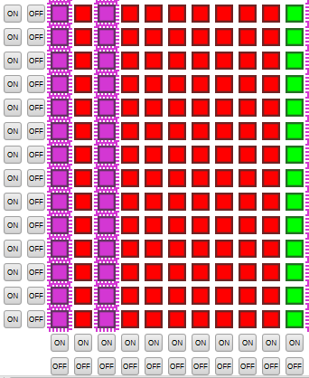
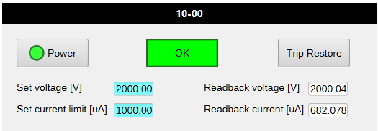
High Voltage Controls & Monitoring System
Adding instructions to wiki
Startup instructions on cdsg (dev. account)
Ready
Python-based expert GUI to set high voltage parameters for all channels at start-up
Input values saved to a timestamped text file
Changes to individual channels handled with PMT status screens
PMT status screen
Phoebus detailed screen
Each rectangle is clickable – opens the PMT status screen
Phoebus overview screen
Each LED is clickable – opens the PMT status screen

Slide 5
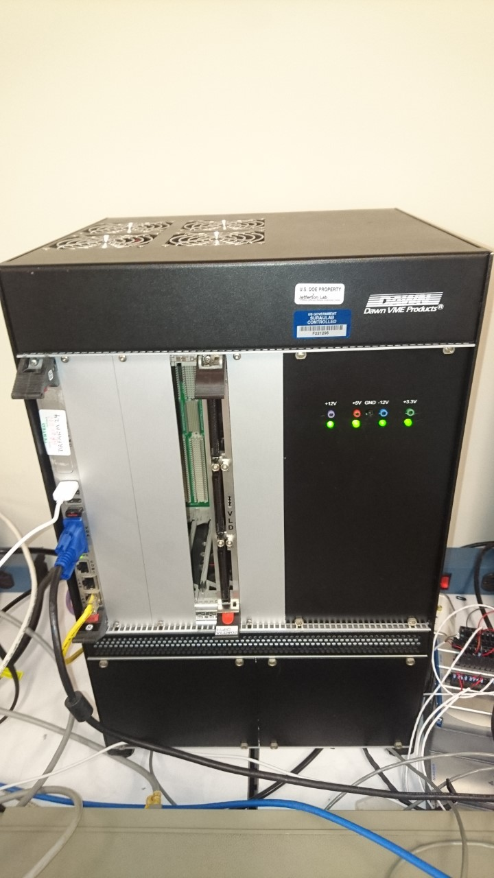
LV and LED Controls & Monitoring System
  Low Voltage
  PV list and a general procedure to prepare the EPICS soft IOC on cdsg is ready
  Next step is to build IOC with the PVs and SNMP application to communicate to the MPOD
  Generating Phoebus screens
  Estimated date of completion 12/02/2022
VME controller
  VME LED Drivers (VLD)
  Received on May 13 cards 02 and 03
  Cards had only test scripts to validate the board manually via VxWorks
Received on August 22 the low level Linux drivers adapted from the test scripts
Received on October 18 examples on how to generally integrate drivers, not related to the VLD
If the VLD is needed by a specified date, DSG suggests someone else address EPICS Linux drivers development
  DSG will generate Phoebus screen when PVs are available
  Estimated date of completion uncertain
VME
LED Driver
VME crate with LED module(Test stand)

Slide 6
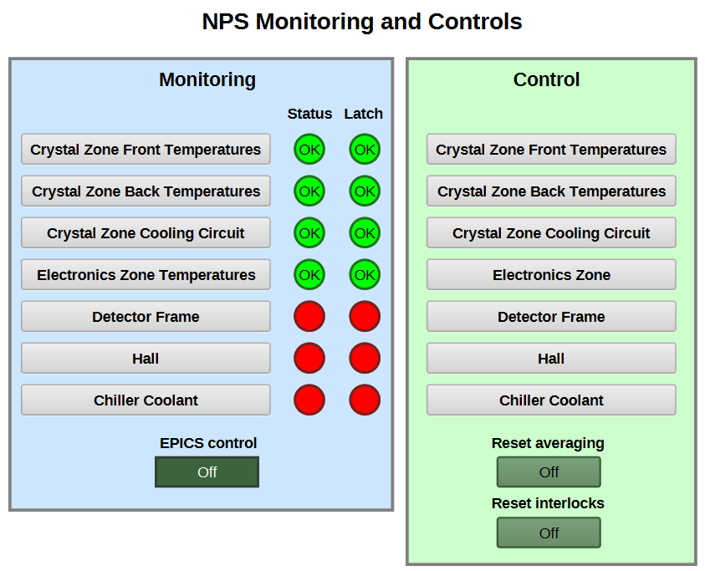
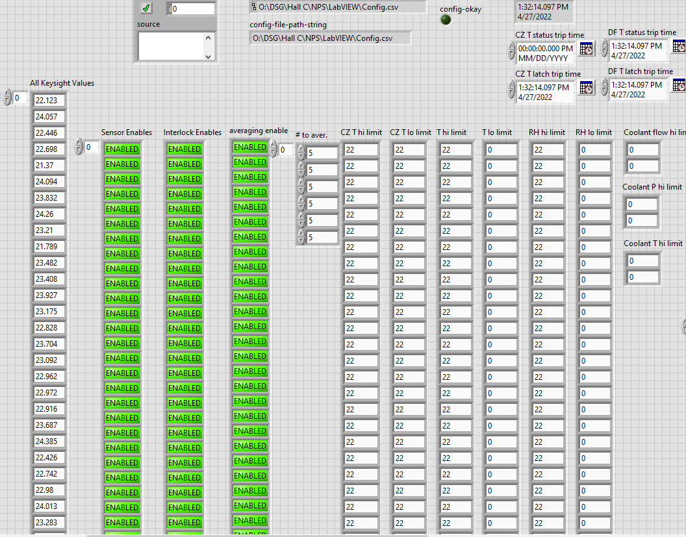
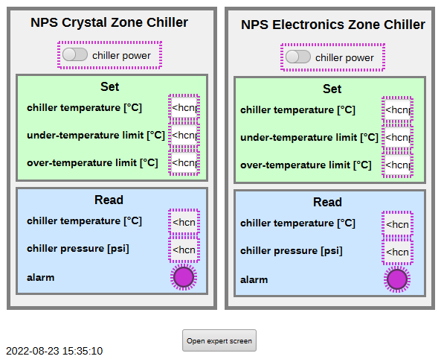
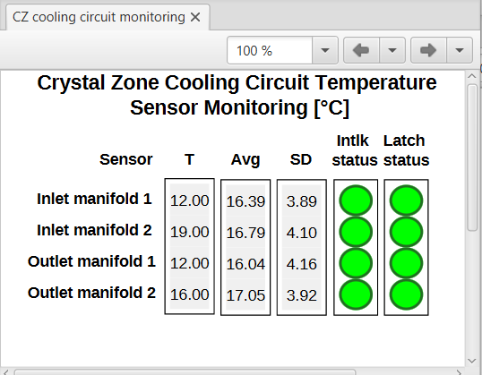
Thermal Readbacks & Chiller Controls & Monitoring
  Revised LabVIEW program reflects new channel connections given on October 11, 2022
  All 12 relative humidity sensors hardware tested
  All 17 chiller, temperature, and humidity readback Phoebus screens tested
  Procured 5-V power supplies on 6/19/22
  Fabricated 5 V power distribution box for relative humidity sensors
  Adding documentation
Temperature & humidity sensor readback (Keysight) LabVIEW screen
  Displays averages, std. deviations, dew point, alarm limits, and trip delays
Generates EPICS server
  PVs used in Phoebus screens
Phoebus screens

Slide 7
Summary
Except for VLD, DSG needs three weeks (without time contingency) to address the items mentioned in the previous slides
Time required unknown for developing missing software drivers for the VLD
  Task should be reassigned if needed by a specific date
  DSG is willing to develop the Phoebus screens once EPICS PVs are provided
DSG personnel is limited during December

