Slide 1
J/Psi-TCS with GEMC-2.6/COATJAVA-4a.5.5 at Various TORUS Field Settings
Joseph Newton
June 29, 2017
J/Psi-TCS Meeting

Slide 2
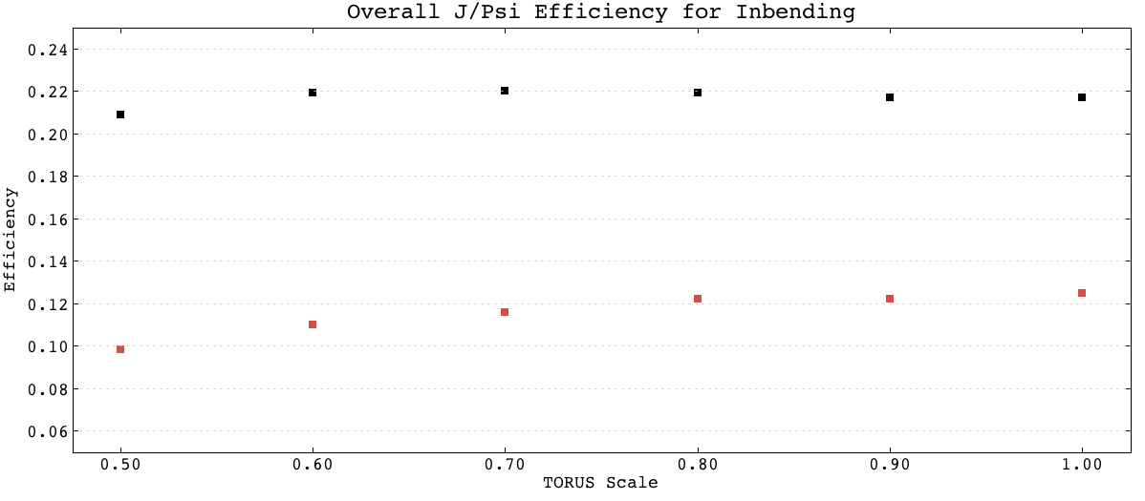
BLACK = e+e-
RED = e+e-p
T/T0 | e+e- | e+e-p
0.5 | 0.209 | 0.0984
0.6 | 0.219 | 0.110
0.7 | 0.220 | 0.116
0.8 | 0.219 | 0.122
0.9 | 0.217 | 0.122
1.0 | 0.217 | 0.125

Slide 3
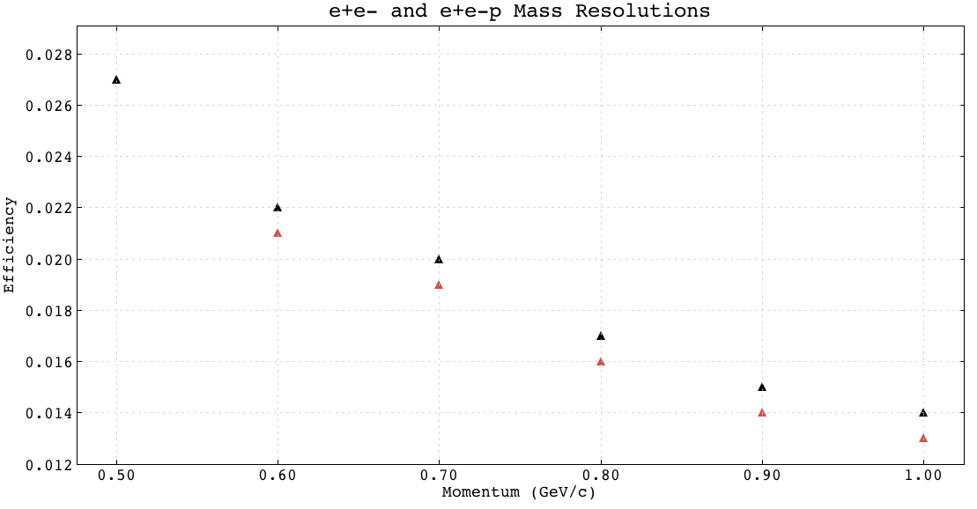
Black = e+e-p
RED = e+e-
Mass Sigma | e+e- | e+e-p
0.5 | 27 MeV | 27 MeV
0.6 | 21 MeV | 22 MeV
0.7 | 19 MeV | 20 MeV
0.8 | 16 MeV | 17 MeV
0.9 | 14 MeV | 15 MeV
1.0 | 13 MeV | 14 MeV

Slide 4
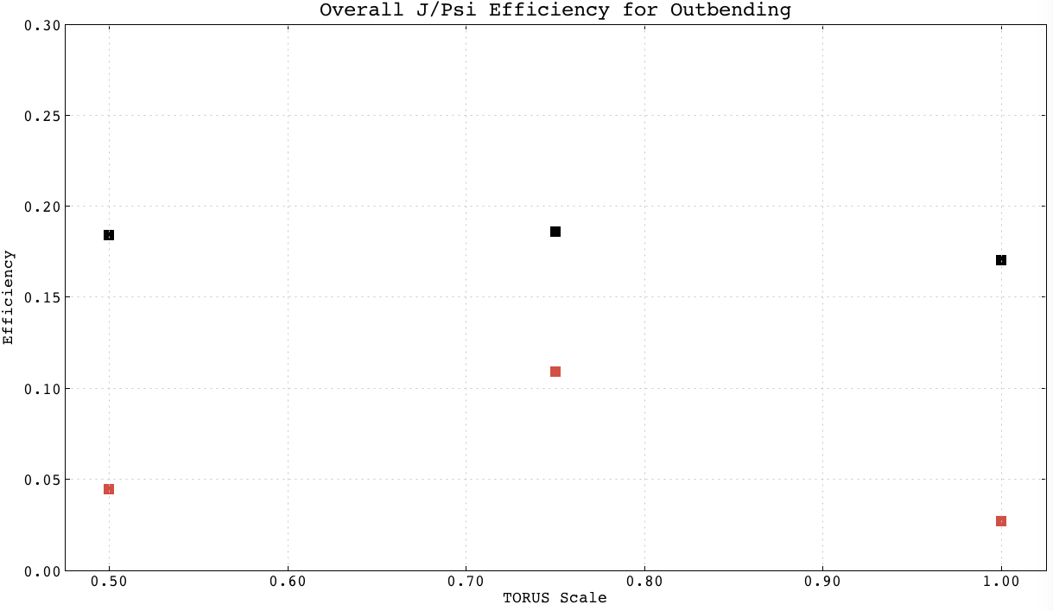
BLACK = e+e-
RED = e+e-p
T/T0 | e+e- | e+e-p
0.5 | 0.184 | 0.0443
0.75 | 0.186 | 0.109
1.0 | 0.170 | 0.0270

Slide 5
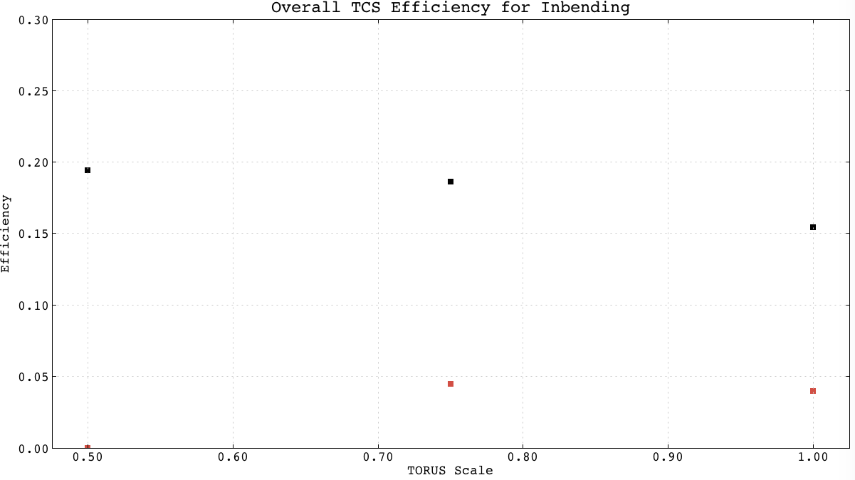
BLACK = e+e-
RED = e+e-p
T/T0 | e+e- | e+e-p
0.5 | 0.194 | 0.000
0.75 | 0.186 | 0.0444
1.0 | 0.154 | 0.0398

Slide 6
TORUS Setting Summary
75% of the TORUS with In-bending Electrons is the optimal run condition for the magnetic field
J/Psi T/T0 (In) | e+e- | e+e-p
0.5 | 0.209 | 0.0984
0.6 | 0.219 | 0.110
0.7 | 0.220 | 0.116
0.8 | 0.219 | 0.122
0.9 | 0.217 | 0.122
1.0 | 0.217 | 0.125
J/Psi T/T0 (Out) | e+e- | e+e-p
0.5 | 0.184 | 0.0443
0.75 | 0.186 | 0.109
1.0 | 0.170 | 0.0270
TCS T/T0 (Out) | e+e- | e+e-p
0.5 | TBD | TBD
0.75 | TBD | TBD
1.0 | TBD | TBD
TCS T/T0 (In) | e+e- | e+e-p
0.5 | 0.194 | 0.000
0.75 | 0.186 | 0.0444
1.0 | 0.154 | 0.0398

Slide 7
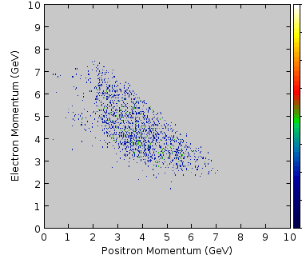
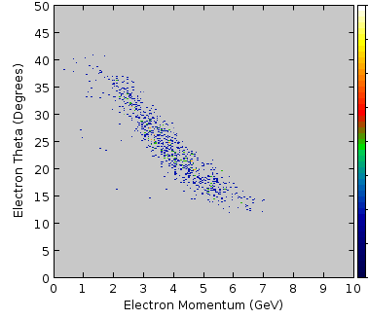
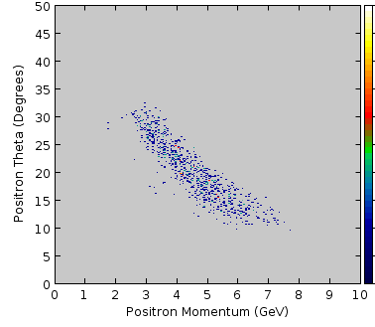
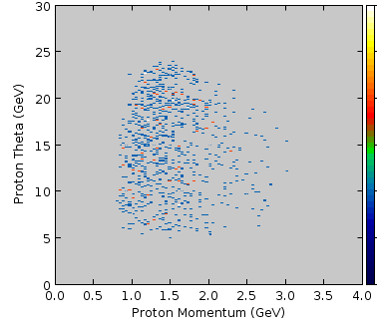
J/Psi Reconstruction Kinematics

