Slide 1
Thomas Jefferson National Accelerator Facility
C100 SRF VACUUM TRAINING
Jim Kortze
Thomas Jefferson National Accelerator Facility, 12000 Jefferson Avenue, Newport News, Virginia USA 23606
Operated by the Southern Universities Research Association for the U. S. Department of Energy

Slide 2
2L22-2L25 Zone Layout
1 Convectron Gauge (PGA Interlocks to Pump A)
2 Beamline Ion Pumps, 8 Waveguide Ion Pumps
2 Gate Valves
1 Quatto Gauge
1 Air Handle switch, 1 Pressure Transducer

Slide 3
2L22-2L25 CONTROL CHASSIS

Slide 4
2L22-2L25 CONTROL CHASSIS
Crate REMOTE/ LOCAL/ RESET LED’s- Control is limited to current state, except Reset, which always clears faults

Slide 5
2L22-2L25 CONTROL CHASSIS
Crate REMOTE/ LOCAL/ RESET LED’s- Control is limited to current state, except Reset, which always clears faults
PGA OK lit green when PGA is NOT faulted. PGA fault must be cleared to turn on IPA. PGB is NOT used, will always be un-lit

Slide 6
2L22-2L25 CONTROL CHASSIS
Crate REMOTE/ LOCAL/ RESET LED’s- Control is limited to current state, except Reset, which always clears faults
PGA OK lit green when PGA is NOT faulted. PGA fault must be cleared to turn on IPA. PGB is NOT used, will always be un-lit
IP OK LEDs lit when no fast or slow trip. IPA requires PGA OK to turn on. IP1-8 and IPB do not require interlock to operate. DNSTRM OK is “IPA” interlock from next RF Zone. 2L22 IP1-8 are not installed (will remain dark).

Slide 7
2L22-2L25 CONTROL CHASSIS
Crate REMOTE/ LOCAL/ RESET LED’s- Control is limited to current state, except Reset, which always clears faults
PGA OK lit green when PGA is NOT faulted. PGA fault must be cleared to turn on IPA. PGB is NOT used, will always be un-lit
IP OK LEDs lit when no fast or slow trip. IPA requires PGA OK to turn on. IP1-8 and IPB do not require interlock to operate. DNSTRM OK is “IPA” interlock from next RF Zone. 2L22 IP1-8 are not installed (will remain dark).
AIR HANDLE- lit when Instrument Air valve open, Pressure Transducer- lit when Instrument Air is > 60psi

Slide 8
2L22-2L25 CONTROL CHASSIS
Crate REMOTE/ LOCAL/ RESET LED’s- Control is limited to current state, except Reset, which always clears faults
PGA OK lit green when PGA is NOT faulted. PGA fault must be cleared to turn on IPA. PGB is NOT used, will always be un-lit
IP OK LEDs lit when no fast or slow trip. IPA requires PGA OK to turn on. IP1-8 and IPB do not require interlock to operate. DNSTRM OK is “IPA” interlock from next RF Zone. 2L22 IP1-8 are not installed (will remain dark).
AIR HANDLE- lit when Instrument Air valve open, Pressure Transducer- lit when Instrument Air is > 60psi
INSULATING VACUUM OK- not currently implemented, will be unlit

Slide 9
2L22-2L25 CONTROL CHASSIS
Crate REMOTE/ LOCAL/ RESET LED’s- Control is limited to current state, except Reset, which always clears faults
PGA OK lit green when PGA is NOT faulted. PGA fault must be cleared to turn on IPA. PGB is NOT used, will always be un-lit
IP OK LEDs lit when no fast or slow trip. IPA requires PGA OK to turn on. IP1-8 and IPB do not require interlock to operate. DNSTRM OK is “IPA” interlock from next RF Zone. 2L22 IP1-8 are not installed (will remain dark).
AIR HANDLE- lit when Instrument Air valve open, Pressure Transducer- lit when Instrument Air is > 60psi
INSULATING VACUUM OK- not currently implemented, will be unlit
VALVES- Status LEDs show current position, position requests, and faults. Push Buttons only work when crate is “LOCAL”. Valves fault on beamline ion pump faults (including DNSTRM), air handle and pressure transducer faults, and if the PSS isn’t made up

Slide 10
2L26 Zone Layout
2 Convectron Gauges (PGA Interlocks to Pump A) (PGC Interlocks to Pump C)
3 Beamline Ion Pumps, 8 Waveguide Ion Pumps
3 Gate Valves
1 Quatto Gauge
1 Air Handle switch, 1 Pressure Transducer

Slide 11
2L26 CONTROL CHASSIS
2L26 is a special zone because it is at the end of the LINAC. It includes an additional Ion Pump (IPC), convectron (PGC), and gate valve (BVC). BVC gets its downstream permit based on the DP Station (all other Zones get their downstream permit from IPA in the next RF zone). 2L26 is a “Zone in transition” right now, so the only relevant indicators on the chassis are IPA and PGA.

Slide 12
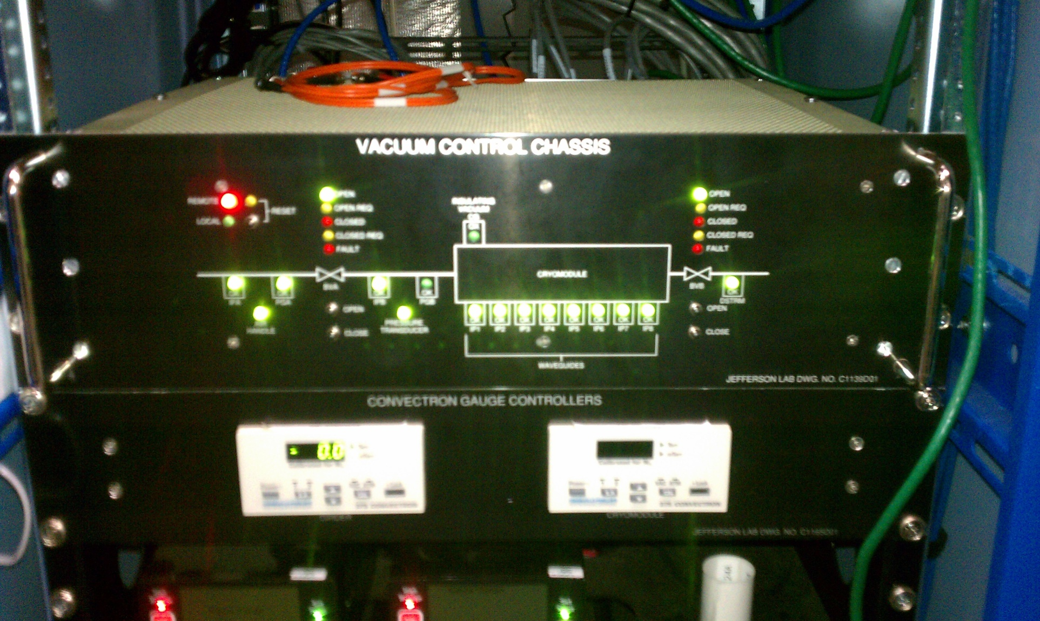
CONTROLS CHASSIS/ CONVECTRONS

Slide 13
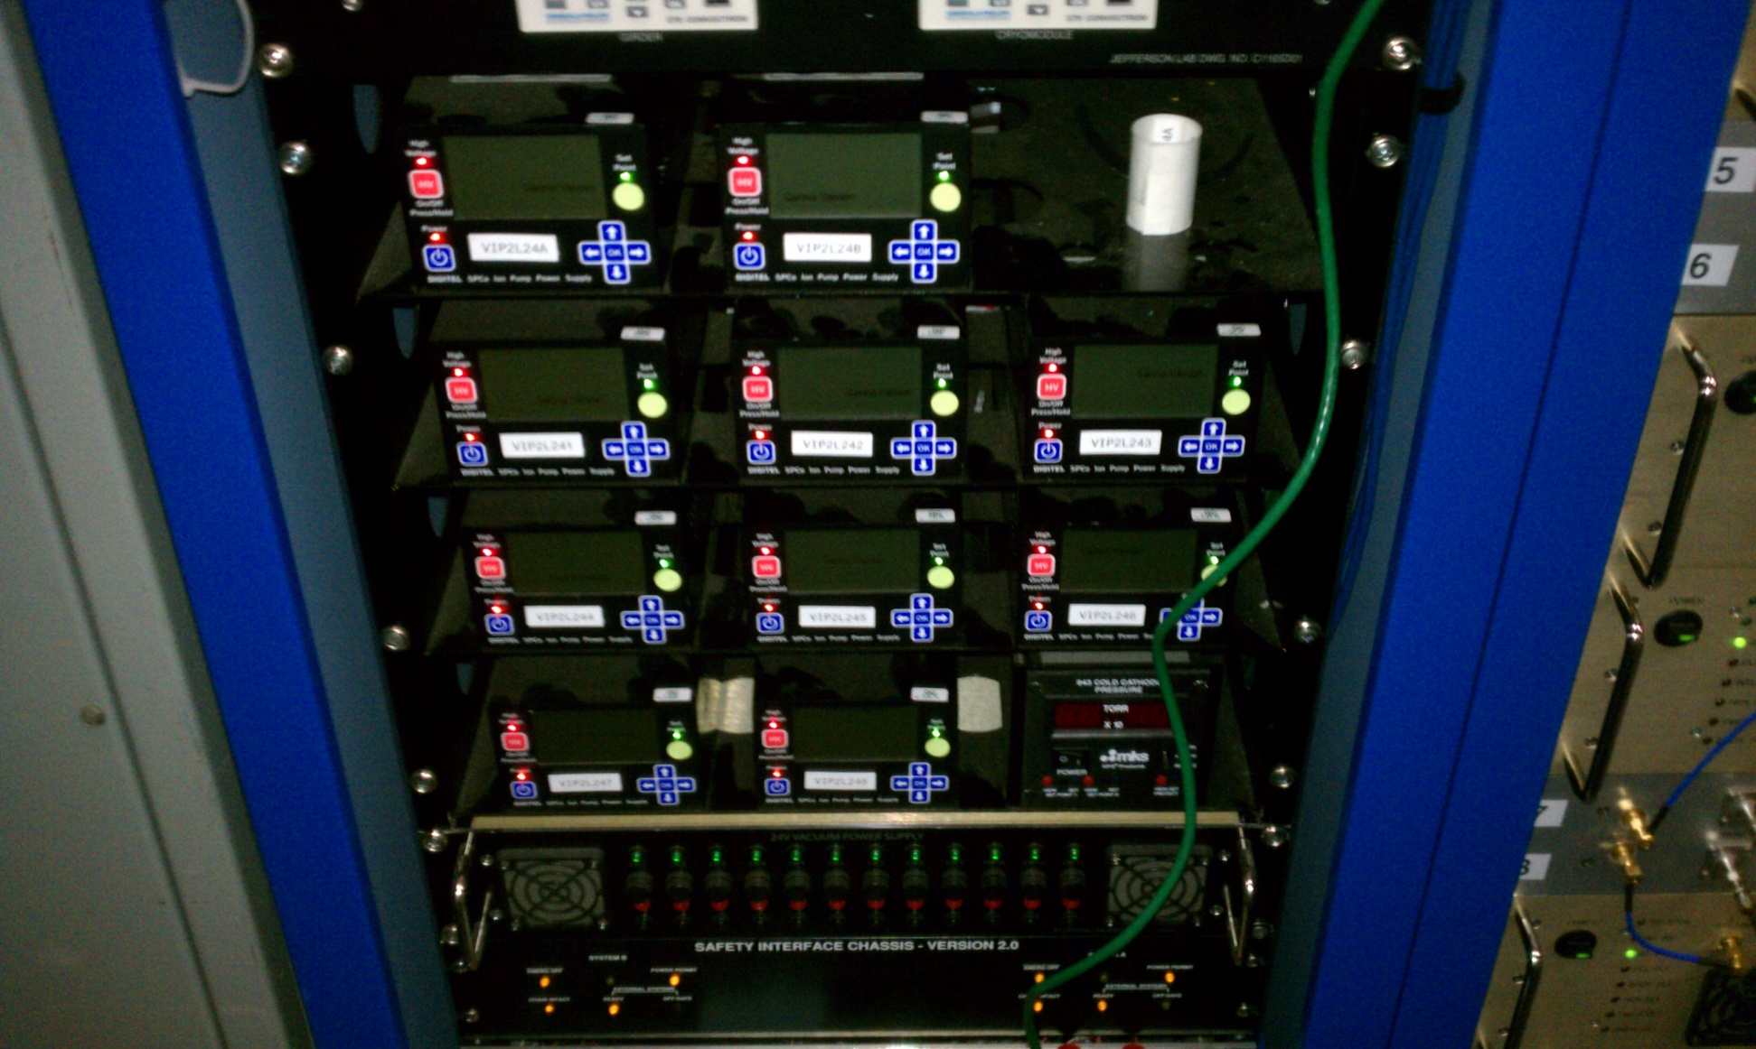
ION PUMP POWER SUPPLIES

Slide 14
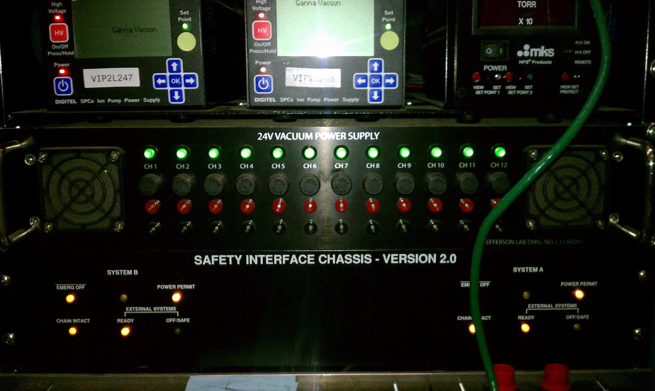
PUMP POWER SUPPLY CHASSIS

Slide 15
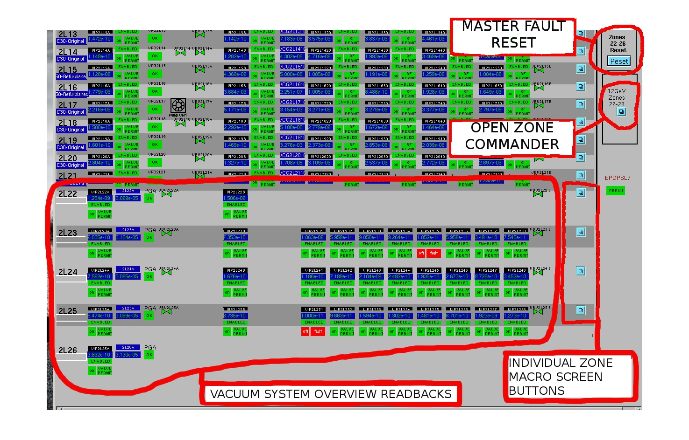
CONTROLS- OVERVIEW SCREEN

Slide 16
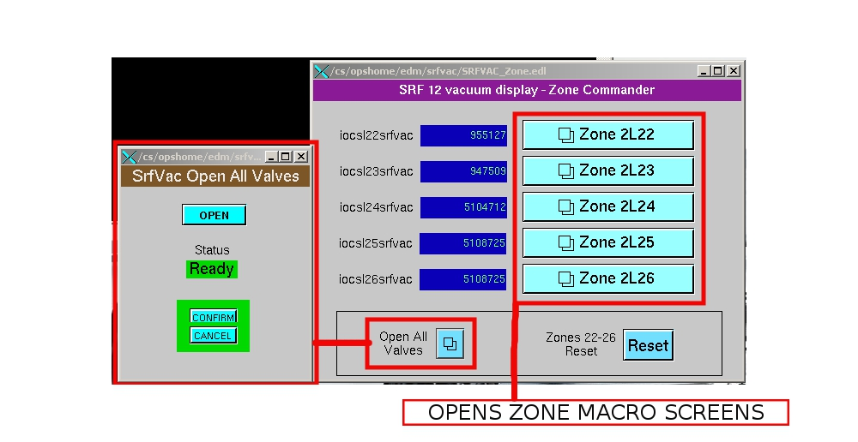
CONTROLS- ZONE COMMANDER

Slide 17
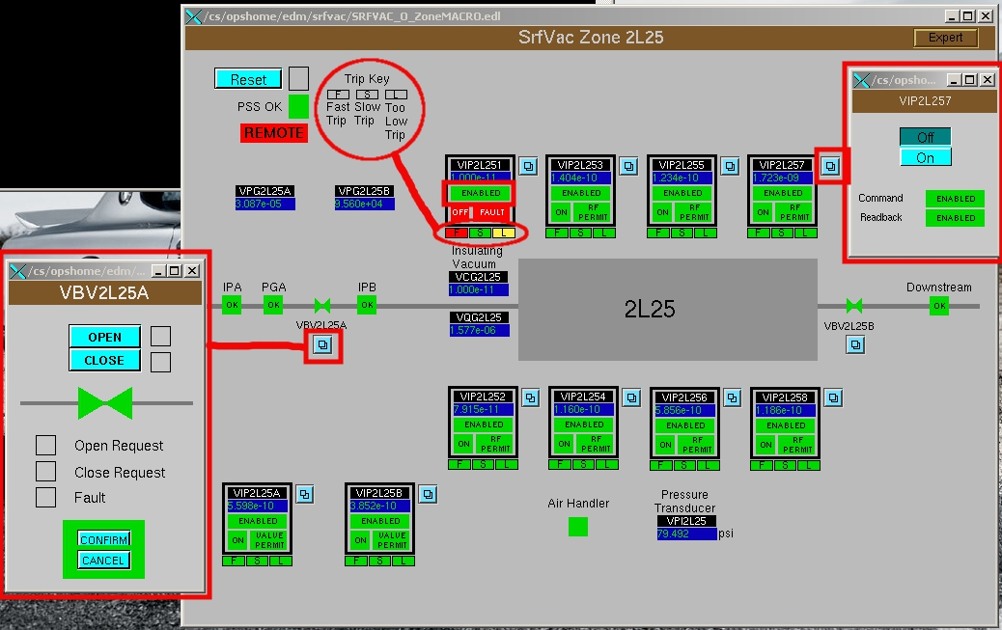
CONTROLS- MACRO SCREEN

Slide 18
MAIN DIFFERENCES
IPPS Operation- Pumps recovering from vacuum trips must be turned on via EPICS
Additional IPPS Status read backs
IPPS Fast trips located on power supply, slow trip on Control Chassis- different from old system, which housed both in the Control Crate
Many settings available on IPPS- Be DO NOT press buttons on supplies unless instructed to by support!

Slide 19
RECOVERING FROM A TRIP
Immediately log a screen shot of the Overview Screen, and the Macro Screen of the affect zone (before hitting any buttons)- Helps I&C Troubleshoot system problems!
Do a vacuum system reset- either on the overview screen, or on the macro screen.
If a pump has tripped off, open its corresponding control screen, turn it on, and allow time for the vacuum read back to settle. Once settled, reset again.
If the trip was a beamline pump, and closed a valve, once the vacuum level has settled, open the valve with the valve control screen.
If you’re uncessful clearing the fault, try steps 2-4 one more time.
If the valves cannot open or the fault persists, call support- make sure you have logged the screen shots to help us troubleshoot!

