Slide 1
Summary (starting Feb. 1, 2024
The 2nd IR optics design is nearly completed, over the time we made a few corrections to the 41,100 and 275 Gev lattices
We are preparing a design document for the 2nd IR. It could be a standalone report, then part of it will be integrated into the full EIC TDR
In responding a request from EIC IR L2 manager Elke Aschenauer (BNL), we are working on the Au lattice (at 110 GeV/u). The deliverables are magnet layouts and Twiss functions for the different colliding cases
IR L2 manager Angelika Drees (BNL) gave a Wednesday EIC seminar, we provided materials (drawing and plots) for the 2nd IR

Slide 2
IR8 Status
Randika Gamage

Slide 3
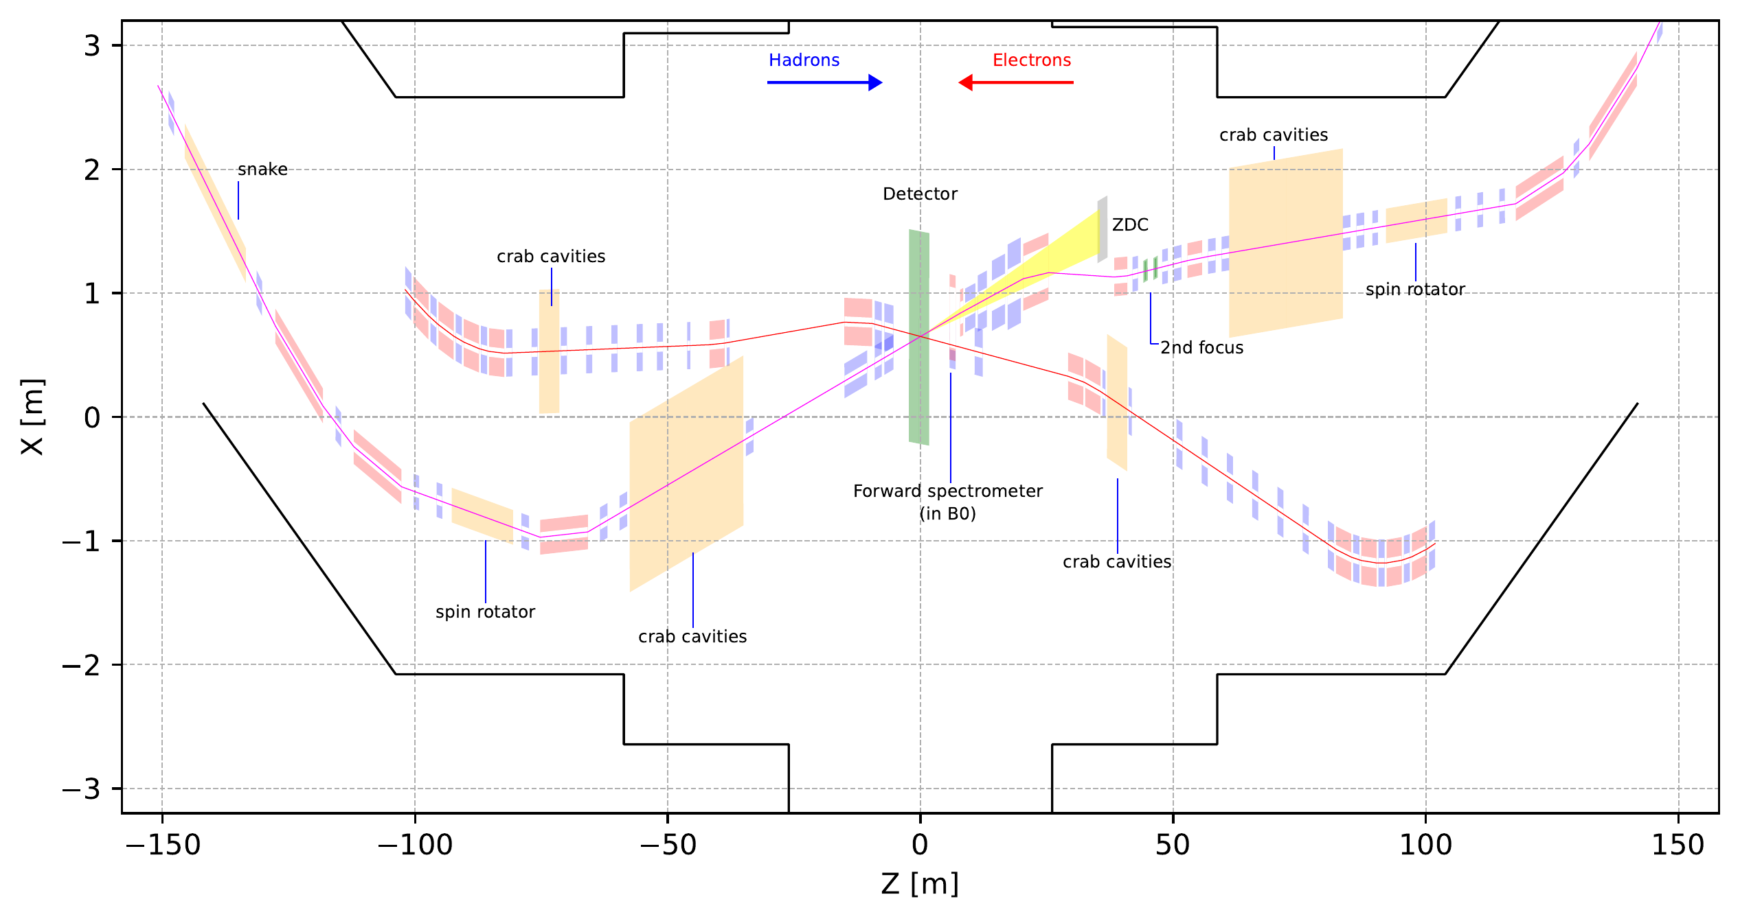
IR8 full layout (colliding)
35 mrad crossing angle (driven by accelerator geometry).
Second focus point at ~45m.
Space for similar accelerator equipment as IR6.

Slide 4
IR8 near IR layout
Space available for luminosity monitor, low Q2 tagger etc..
All ancillary detectors in outgoing hadron beam side (Forward) integrated

Slide 5
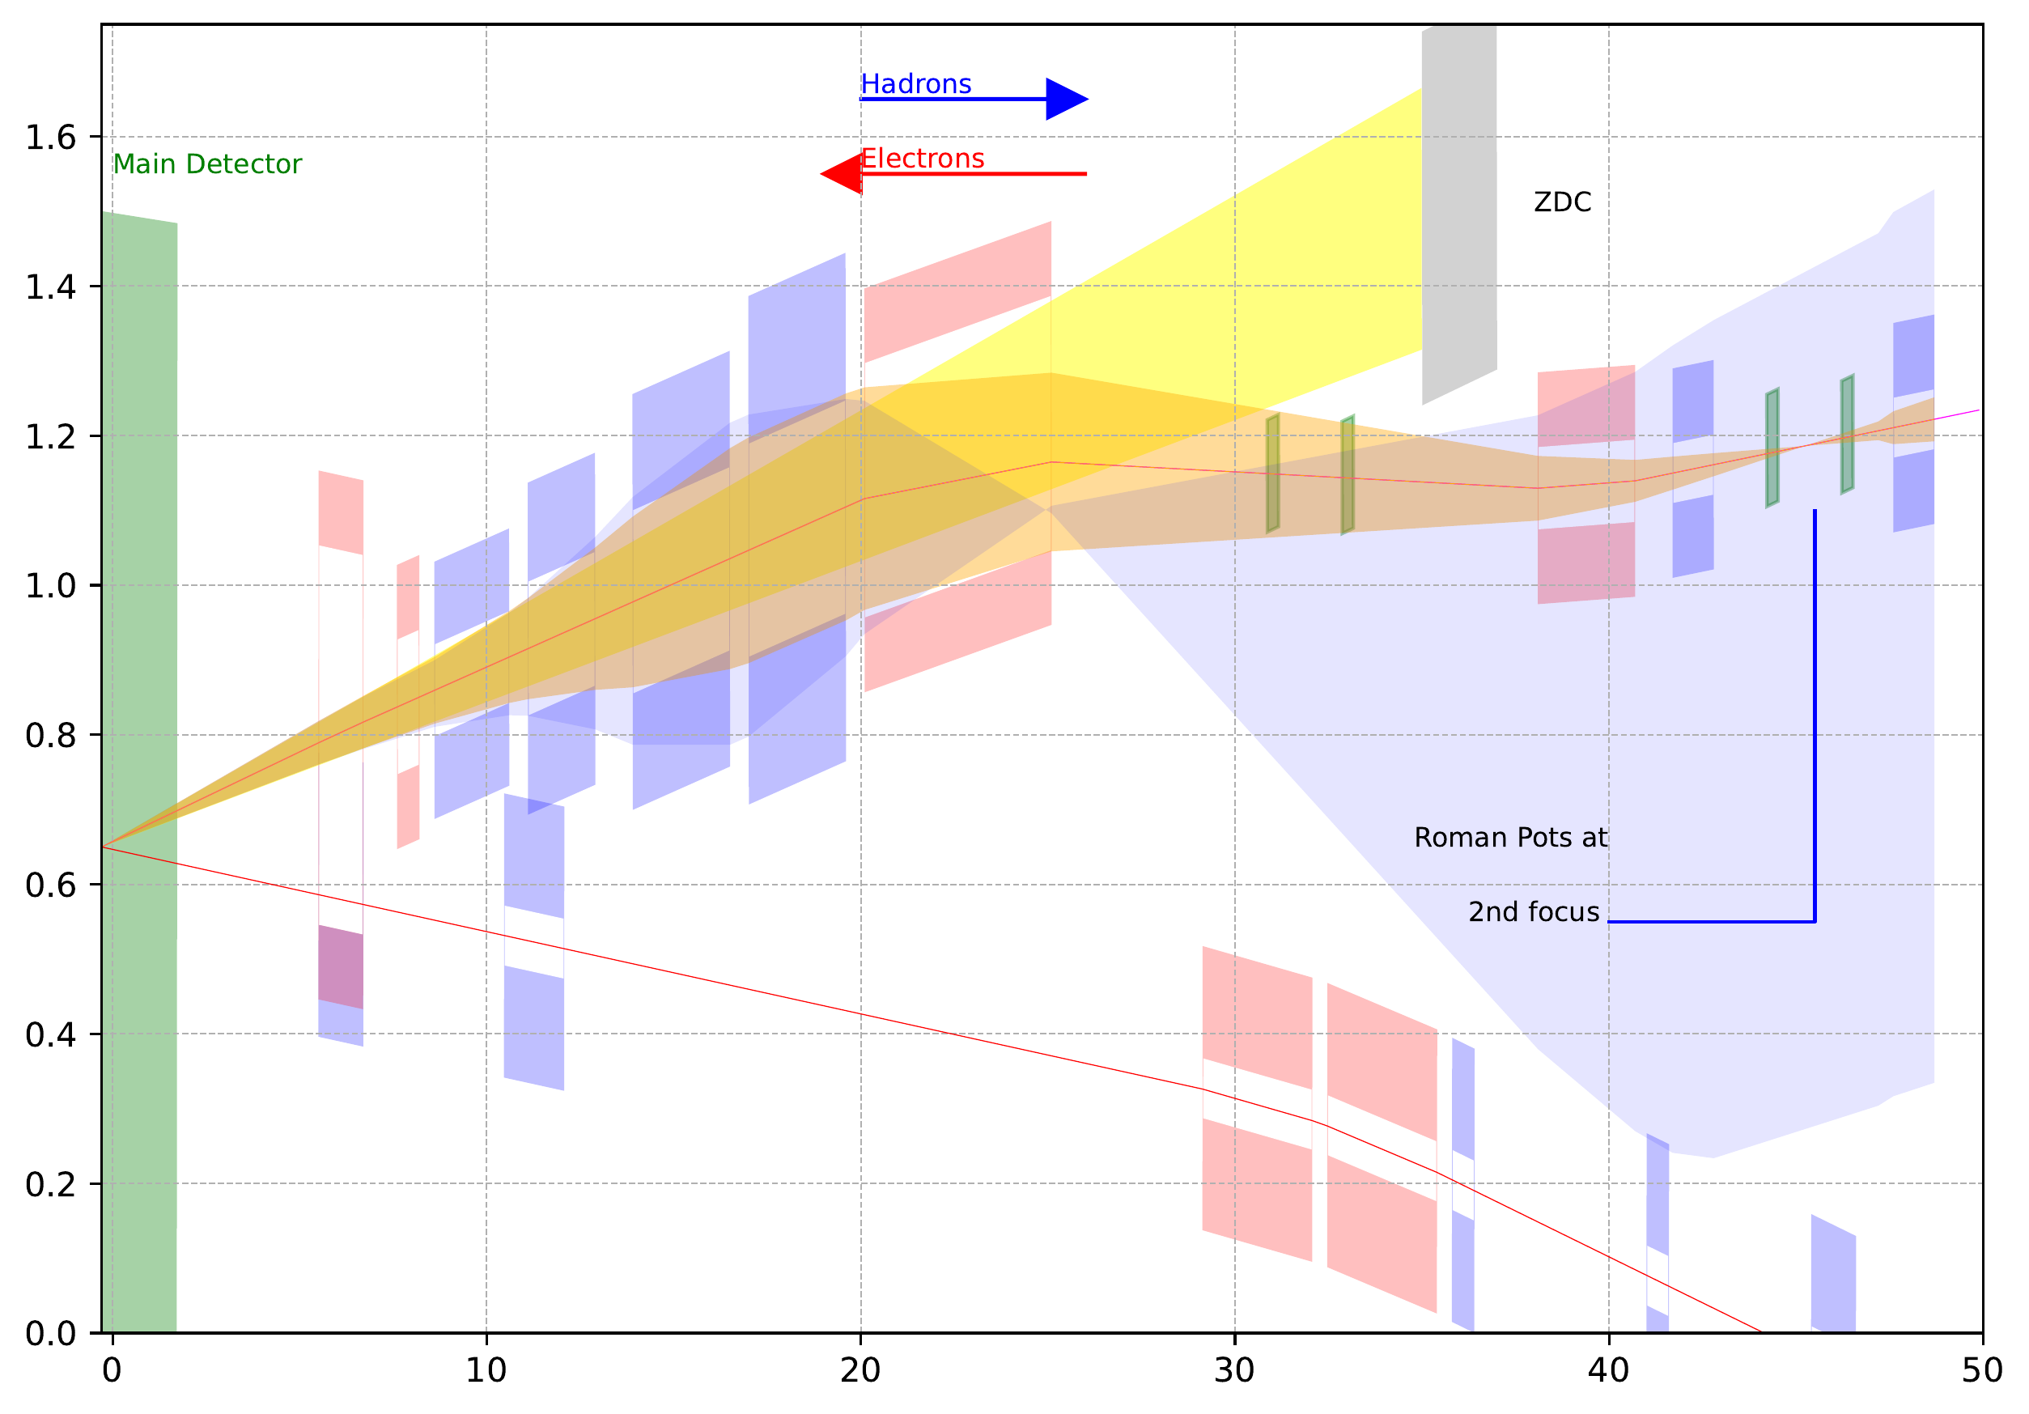
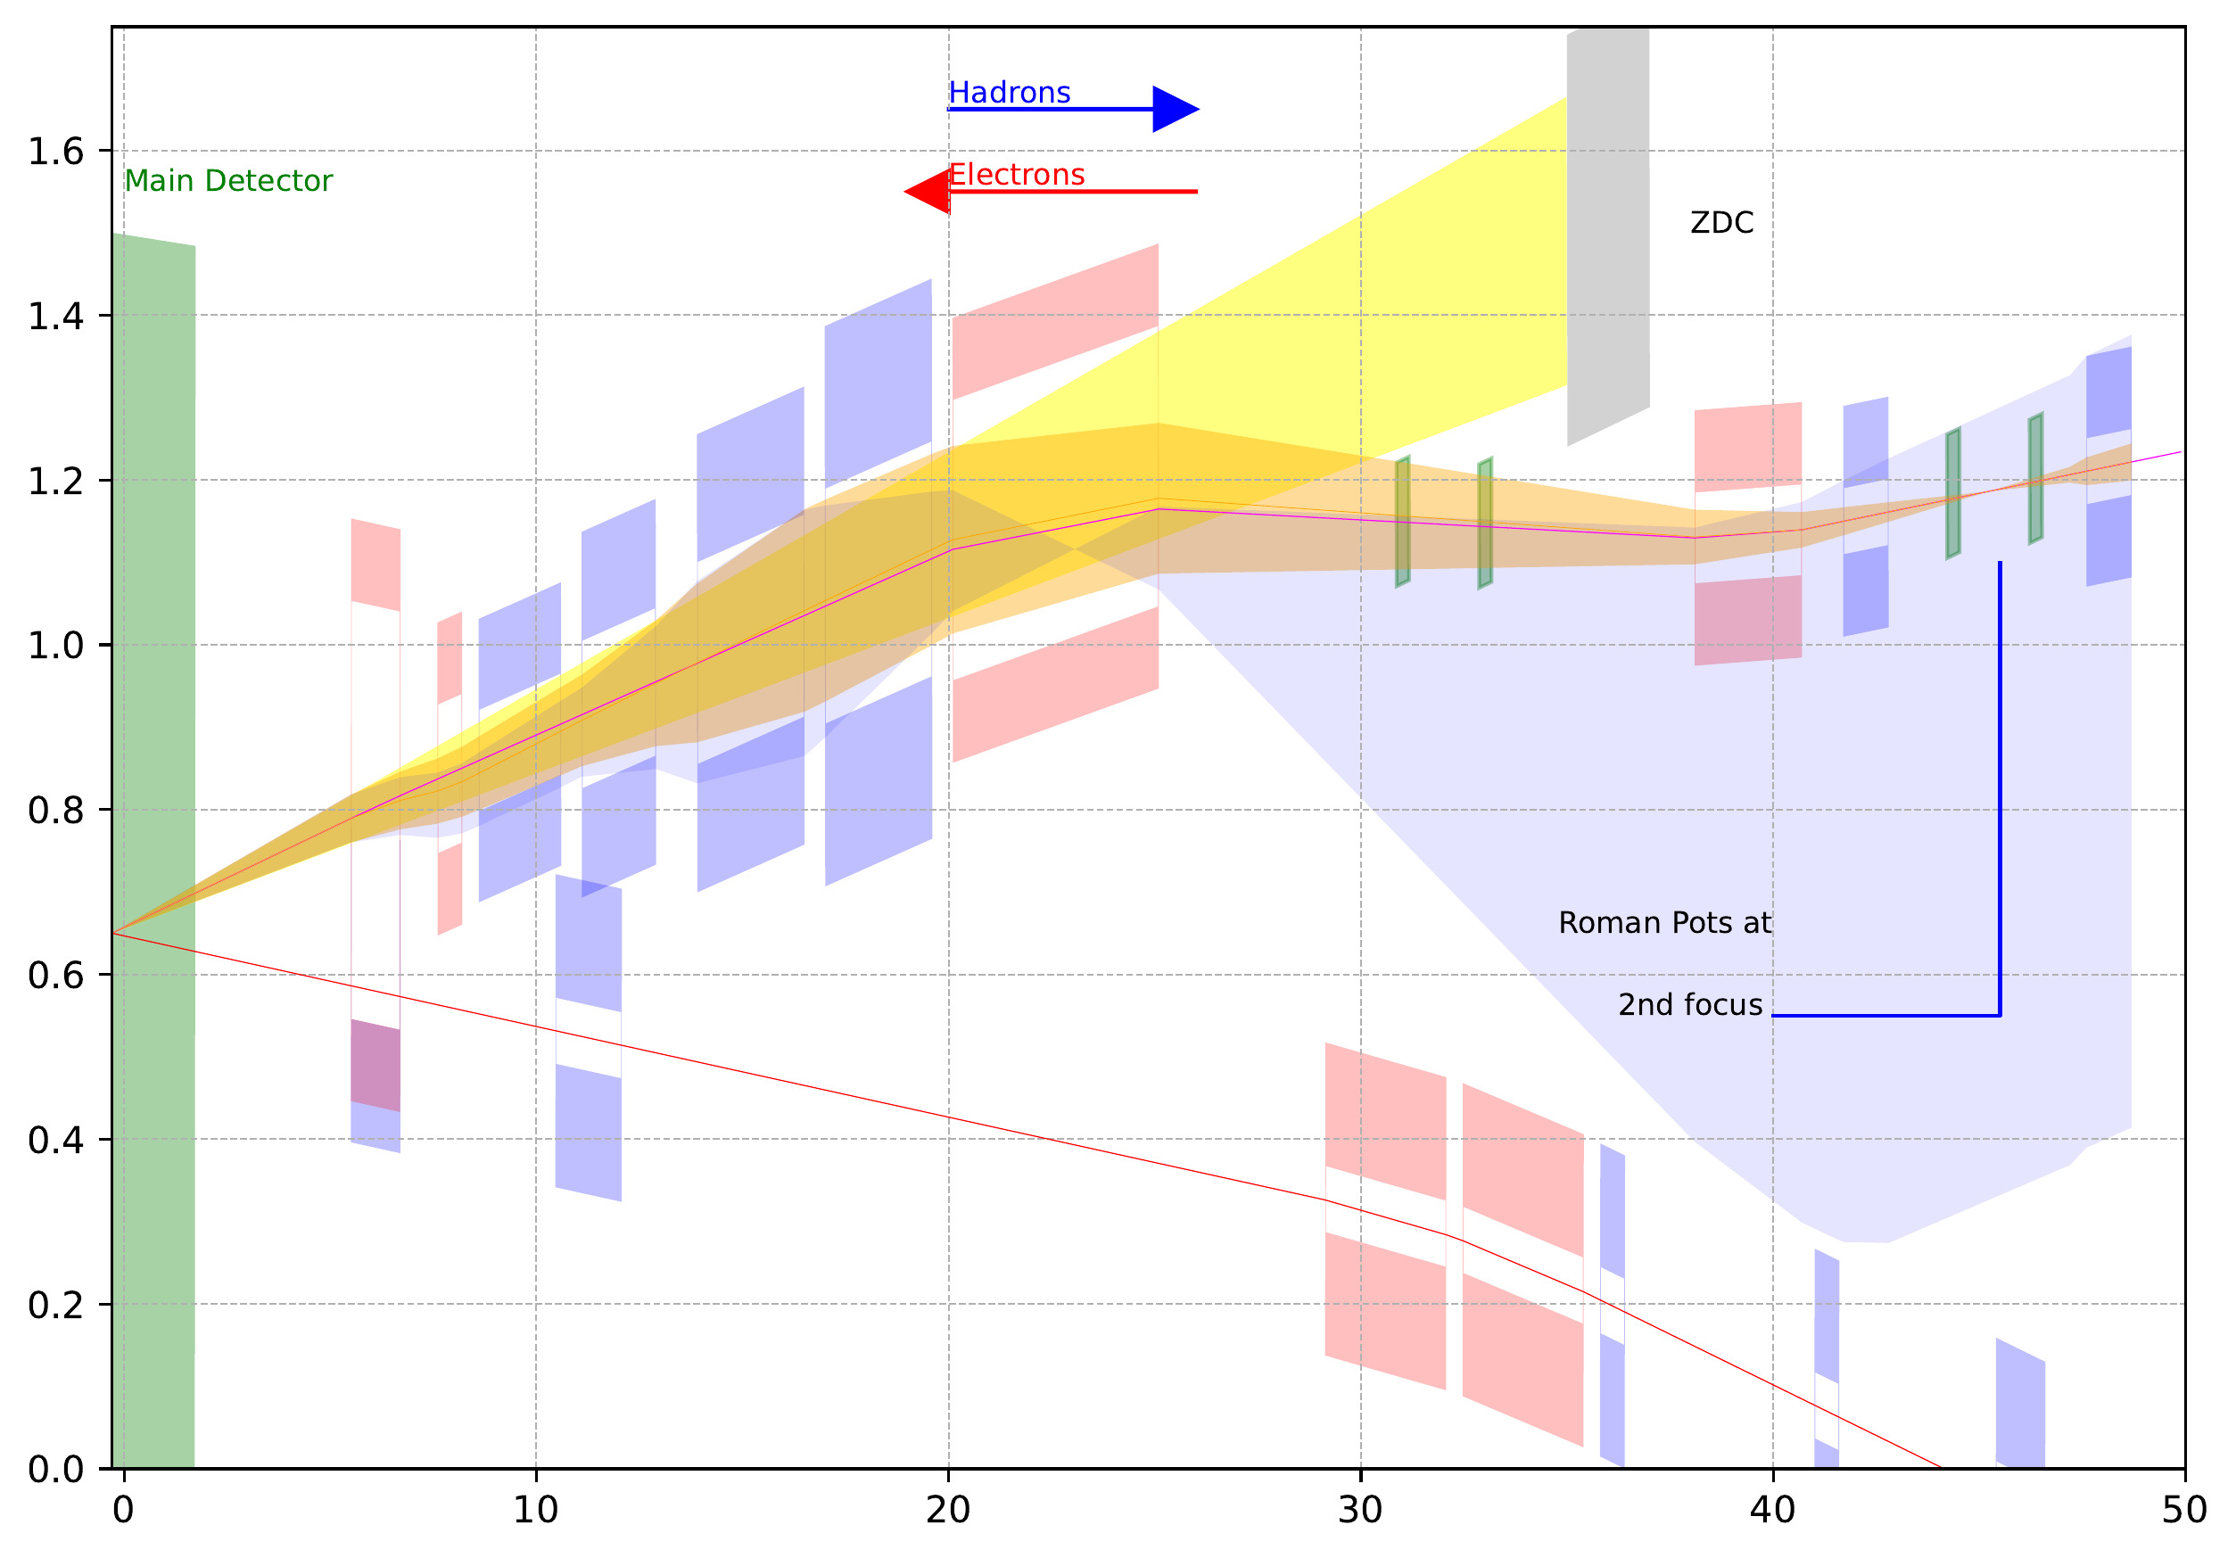
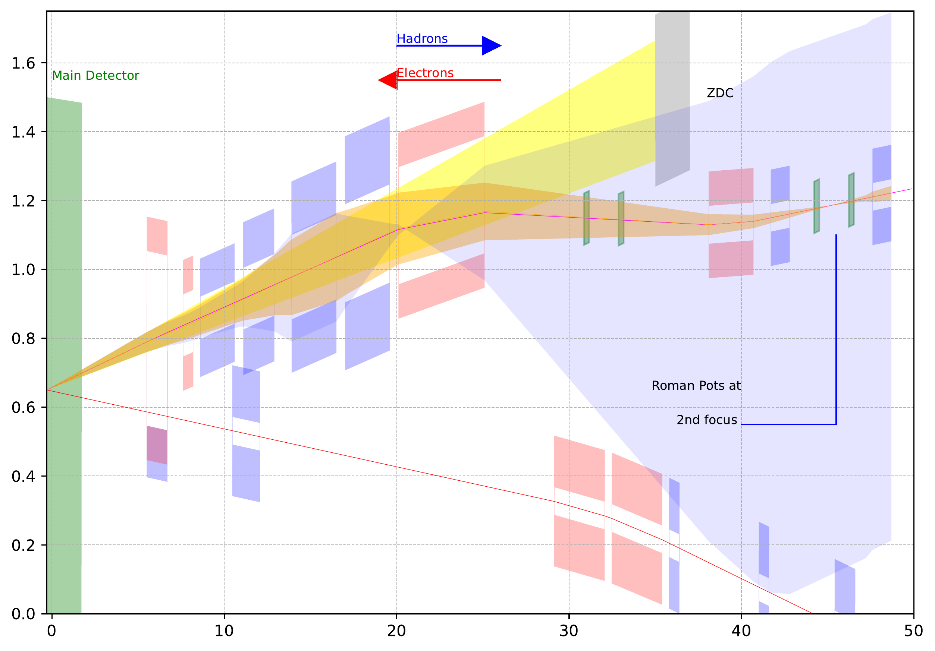
IR8 forward acceptance
Neutrons $±5$ mrad
Protons $±5$ mrad $x_{L}=1$
Protons $±5$ mrad $x_{L}=0.5$
275GeV
This is using NbTi magnets.
Final focusing quads and the dipoles properties (apertures, lengths etc..) was optimized for forward scattering neutron and proton acceptance.
41GeV
100GeV

Slide 6
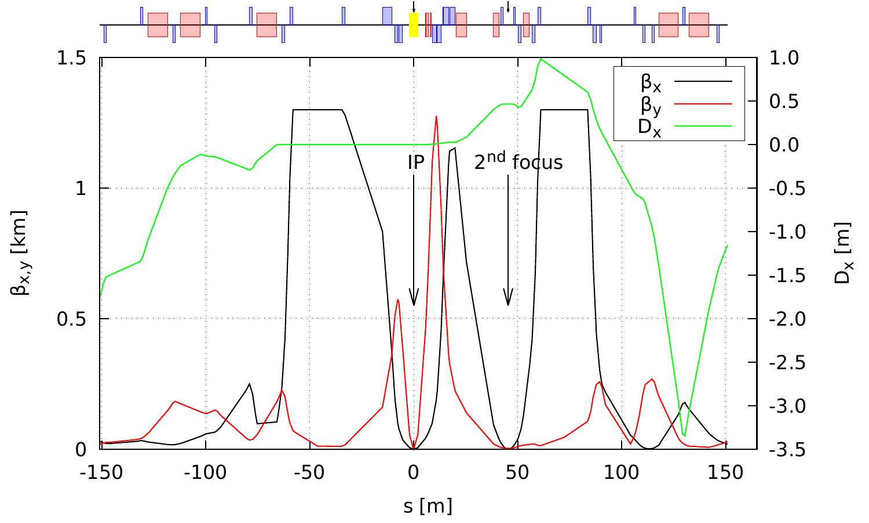
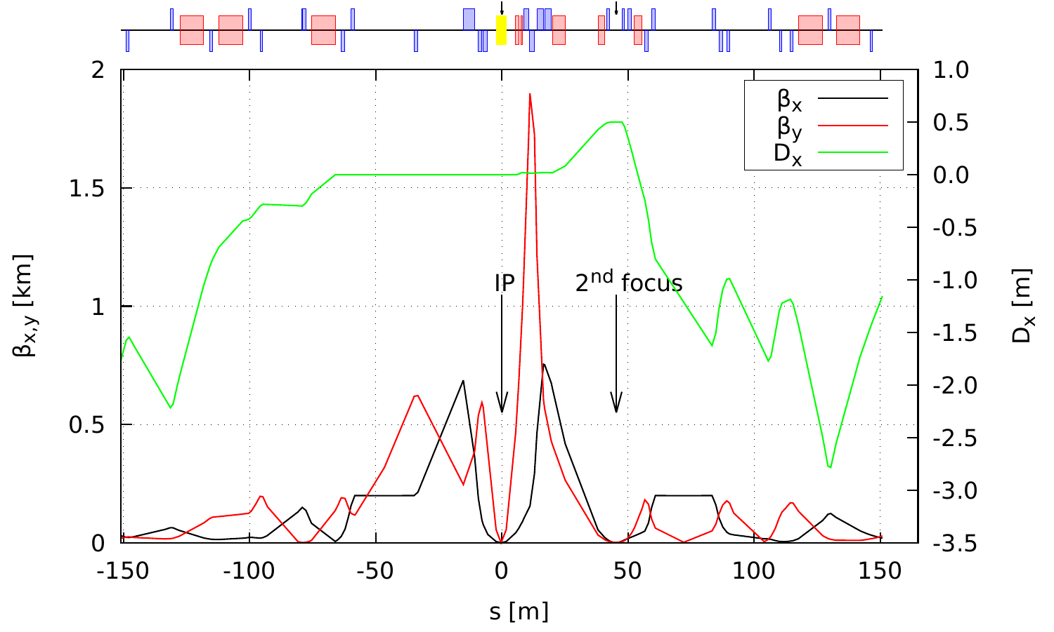
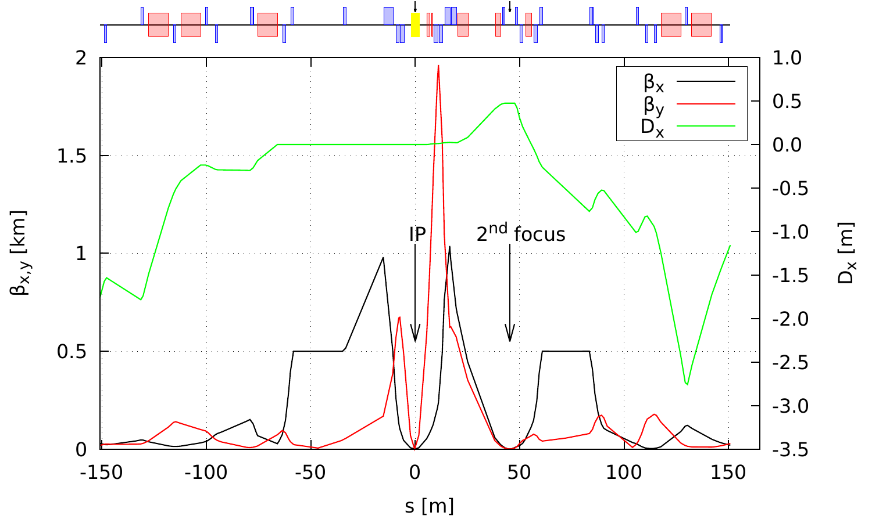
IR8 hadron optics
$β^{∗}$same as high divergence case for IR6
Limited matching space requires some high gradient magnets (quadrupoles) than what is available from existing RHIC magnets.
Near IR magnet include 7 FFQs, 2 Dipoles, 1 corrector and B0. These are all new.
All magnets are assumed to be NbTi
275GeV
Magnets | RHIC | New
Quadrupoles | 12 | 10
Dipoles | 5 | 0
41GeV
100GeV

Slide 7
Summary 2nd IR (IR8)
IR8 information
Second colliding IR and detector not in project, but the ability to have one is in the project scope.
This is a Pre-conceptual design.
The IR8 with the second focus adds complementarity to IR6.
Work to be done includes,
Crab cavity space requirement for the 35 mrad crossing angle.
Clearance check for the RCS (Rapid Cycling Synchrotron) bypass.
Account for luminosity sharing by moving the IP by 0.2975m away from IR6.
Low energy lattices (41,100 for protons and 5,10 for electrons)
Further study needed for the feasibility of the IR magnets.
Nb3Sn magnets are being evaluated as an option.
Chromaticity compensation with two IR’s

