Slide 1

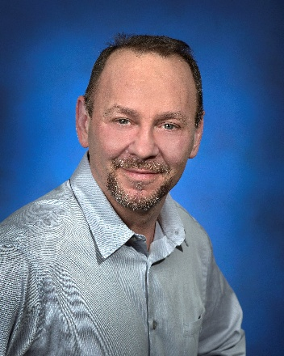
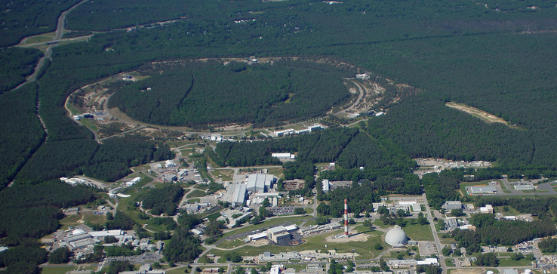


About the Speaker
Electron-Ion Collider Department Seminar
C-AD Seminar
Title: Vacuum Systems for the Electron-Ion Collider
C-AD Seminar
Title:
Charles (Charlie) Hetzel
Vacuum Systems, Electron-Ion Collider
Thursday, July 24, 2025 2:00PM (EST) Building 911, Snyder Auditorium / ZoomGov
Prior to joining NSLS-II, Charles Hetzel worked as a Lead Project Engineer for a manufacturing company. He was responsible for the design, manufacture and assembly of automated industrial machinery. In total, Charles worked in industry for over 15 years before joining Brookhaven National Laboratory.
Upon joining the NSLS-2 project in 2009, Charles was responsible for the design, procurement and fabrication of the storage ring vacuum chambers. This effort included the qualification and integration of these chambers into the magnet-girder assemblies and final installation in the storage ring tunnel.
Charles took over as the vacuum group leader at NSLS-2 in 2014 and continued resource planning and scheduling major installation efforts as additional beam lines were added to the accelerator.
After developing the pre-conceptual vacuum designs for the electron rings under an MOU, Charles joined the EIC project full time in October of 2020 to focus on more detailed engineering designs.
Abstract:
The Electron-Ion Collider (EIC) will be a new, state of the art nuclear physics research facility will collide high energy (up to 18 GeV) polarized electrons with polarized protons (up to 275 GeV) and heavy nuclei with a peak design luminosity of 10³⁴ /cm/s. To achieve this level of performance, significant vacuum system design challenges will need to be overcome. The electron accelerator and storage ring will rely on thin films and surface treatments to reduce photon stimulated desorption as well as longitudinal impedance. The superconducting hadron ring, which will suffer from electron cloud due to the high bunch charge (1.9x10¹¹ ppb) and short bunch spacing (10ns) will require amorphous carbon coating. This talk will provide an overview of the primary vacuum system designs as well as the current status.
Electron-Ion Collider
Department

