Slide 1
6.XX – Name of your WBS FPD Status Update
Your Name, L2 WBS Manager
June 28-30, 2022

Slide 2
Outline
Scope Description
Accomplishments
Resource Profile
Cost
Schedule
Design Maturity
Long Lead Procurements
Highest Risk Areas
Plan to CD-2/3A
Conclusion
See the last slide in this deck and clip your area out for this spot on the outline slide. Remove this text box (and this arrow) when you are done.

Slide 3
WBS.XX Scope Description
WBS L2 scope with L3 breakdown (Project Controls will provide WBS table)
WBS L2 Dictionary and Assumptions (you don’t have to read the dictionary part but it should be here. You should, though, talk about the assumptions associated with your Level 2 WBS)

Slide 4
Accomplishments
Including any lessons learned that you took into account in your planning so far

Slide 5
Resource Profile
Detailed profile to support readiness for CD-2/3A (Project Controls will provide information out of the Resource Comparison Tool [RCT])

Slide 6
Resource Profile
Long-term profile (Project Controls will provide information out of the Resource Comparison Tool [RCT])

Slide 7
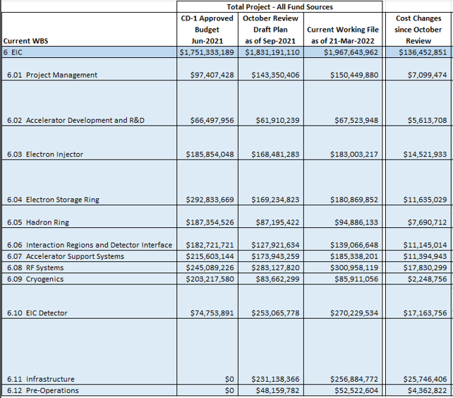
Cost Comparison
L2 with L3 breakdown will be provided by Project Controls

Slide 8
Schedule
(Project Controls will provide output from P6)

Slide 9
Plans for Design Maturity
System | Estimated Preliminary Design or Specification Complete Now | Estimated Preliminary/Final Design or Specification Complete at CD-2/3A | Estimated Final Design or Specification Completion Date
 | #% | #% | ##/##/####
 | #% | #% | ##/##/####
 | #% | #% | ##/##/####
 | #% | #% | ##/##/####
 | #% | #% | ##/##/####
 | #% | #% | ##/##/####
 | #% | #% | ##/##/####
Note: Preliminary Design = 30%; Final Design = >85%

Slide 10
Long Lead Procurements
(List to be provided by Project Controls)

Slide 11
Highest Risk Areas
This should be the few items that come out of risk registry as the highest risks in your area.
XXX
XXX
XXX

Slide 12
WBS 6.XX – WBS Name Plan to CD-2/3A
Activity | Planned Finish Date | Status
Activities required to get to CD-2/3A

Slide 13
Conclusion
Summarize and end on a positive note.
XXX
XXX
XXX

Slide 14
Thank you!

Slide 15
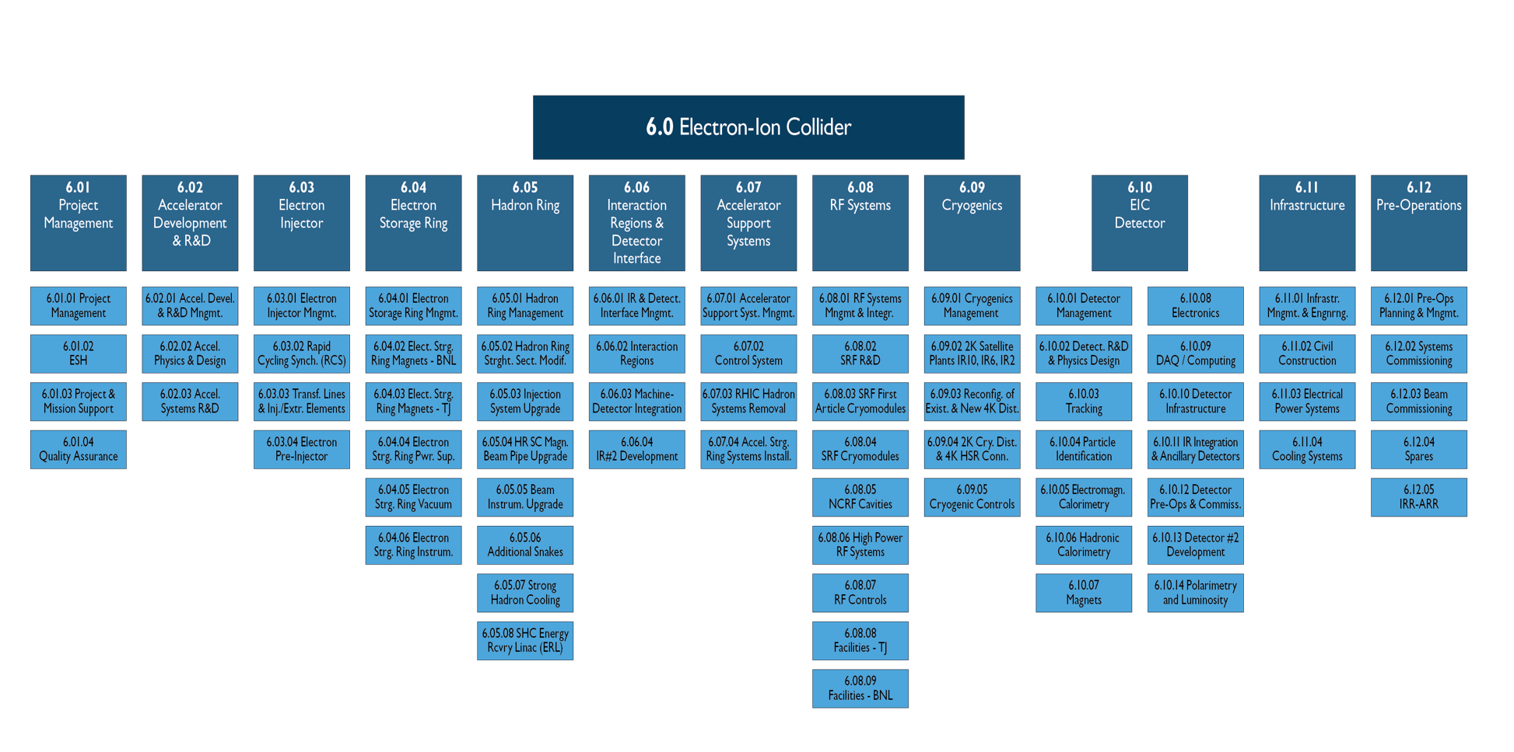
Discard this slide after you clip your area out.

