Slide 1
General Notes

Slide 2
EIC CD-3A Slide Deck Template
This is the standard 16x9 template for EIC.
Note that it includes a general set of “Slide Masters”.
Everyone should have a basic understand of slide masters and layout slides.
They have benefits, but also drawbacks to be aware of.
The closer you can stick to the slide masters, the easier it will be to QA the slides prior to posting.
Obviously, presenters may need to deviate at times.
CD-3A Review presentations will all start with the standard slides:
Title Slide
About Me
Charge Questions Addressed (modified with grey text to highlight what part of the charge is not being addressed).
Outline
Use presentation section separator slides between “major” sections.

Slide 3
This is the general content slide - Bulleted
Charge X, Y
Charge tag is offset down a bit to allow for slide title to use full width.
Standard bullets and indent levels.
Level 1 – Arial 24
Level 2 – Arial 20
Level 3 – Arial 18
Level 4 – Arial 16
Level 5 – Arial 16
There are two other versions of this in the slide layouts.
Two text boxes arranged side by side.
Two text boxes arranged one above the other.
These are useful for example where one text box would be removed and replaced by visual content.

Slide 4
This is the general content slide - Numbered
Charge X, Y
Charge tag is offset down a bit to allow for slide title to use full width.
Standard bullets and indent levels.
Level 1 – Arial 24
Level 2 – Arial 20
Level 3 – Arial 18
Level 4 – Arial 16
Level 5 – Arial 16
There are two other versions of this in the slide layouts.
Two text boxes arranged side by side.
Two text boxes arranged one above the other.
These are useful for example where one text box would be removed and replaced by visual content.

Slide 5
Some General Guidance - I
Stay “in the box”.
Below the blue title line, above the black footer line, and generally inside the horizonal space bounded by those lines left and right.
Do not move title text boxes.
If needed, shrink the font. But try to keep your title concise anyway.
Do not move the charge tags.
Note that it’s trivial to copy and paste charge tags from an existing slide to a new one.
When you copy from one slide and paste to another, by default, the pasted object will be positioned exactly where it was on the source slide.

Slide 6
Some General Guidance - II
Learn how to use features that leverage the slide templates you’re using.
Choose or Change a Slide Layout: To choose a slide layout, right click on the slide in the list at left, select “Layout>”, then look through the available layouts and choose what best suits your need.
Reset a Slide to its Layout Defaults: Right click on the slide in the list at left, select “Reset Slide”.
Do not paste in complete slides from other presentations, unless you post them in using the “destination” (this) format.
Regardless, you will most likely need to edit afterward.
Put in the effort now to conform to this template and you won’t need to do it again in the future.
See what works best for you – pasting in a complete slide, or copy and pasting content from slides.

Slide 7
Some General Guidance - III
Use Ctrl+z (Undo) and Ctrl+y (Redo).
It is a common occurrence to accidentally select and drag or delete some existing object.
Ctrl+z is the easy fix to put it back exactly as it was.
Stay with the Arial font. If you paste in text, edit font if needed.
Again, the slide reset will do this for you, but it will also enforce the overall layout as chosen for that slide.
The footer text is set in the main slide master. You cannot edit on a regular slide – by design.

Slide 8
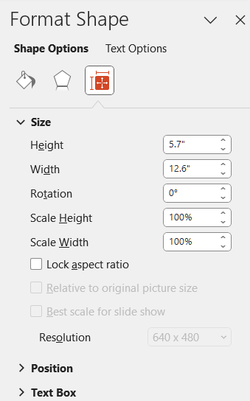
Some General Guidance - IV
When you’re pasting in pictures, plots, etc. – set the sizing to “Lock Aspect Ratio” to avoid distorting them.
Right click on the content.
Select “Format Shape …”.
Select the sizing icon.
Click on “Lock Aspect Ratio”.

Slide 9
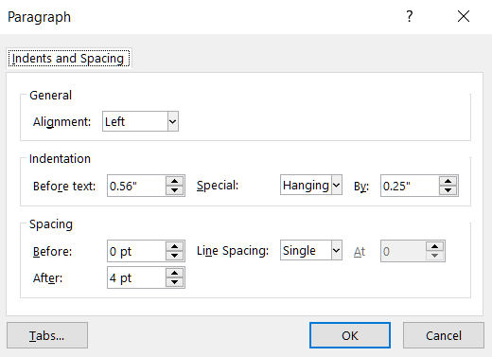
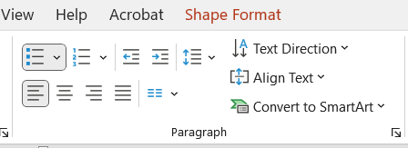
Some General Guidance - V
Don’t be lazy. Put in the simple effort to make your presentation look professional.
Take the time to properly format.
e.g. Use superscripts and subscripts as appropriate: “x²” and not “x^2”.
Spell and grammar check.
PowerPoint does this for you. Just do what it tells you to do.
Learn line and paragraph spacing.
It is preset to look decent in this template. “Spacing” settings are most important.
Settings are here, in the “Paragraph” section, in the pulldown (the arrow thingy):

Slide 10
Slide Deck Template

Slide 11
Project Management Overview and CD-3A LLP Package
<No Secondary Title in this instance>
Luisella Lari
EIC Project Manager
<No secondary role or title in this instance>
Plenary Session 1
EIC CD-3A Review
November 14-16, 2023

Slide 12
About Me – Luisella Lari
EIC Current Role: EIC Project Manager
Senior Scientist
Experience: 25+ years in accelerators and industry
Fermilab (FNAL) - PIP-II Project
In-Kind Contribution Manager (2019 - 2022)
Deputy Project Manager (2018 - 2019)
Associate Project Manager for planning and reporting (2016 - 2018)
European Spallation Source (ESS) (Sweden) - ESS Accelerator Project
Senior Project Planning Manager & Senior Scientist (2014 - 2016)
CERN (Switzerland) - LHC Main Ring Project And Its Upgrade
System/Planning Engineer & Applied Physicist (2002 - 2014)
Thales Alenia Space (Italy) - International Space Station Project
Assembly, Integration and Verification Engineer (1998 - 2002)
Education: PhD in Physics, Ecole Politecnique de Lausanne EPFL – Switzerland
Nuclear Engineer, Politecnico Di Torino – Italy
PMP Certified (PMI) – US
DOE Project Leadership Institute (PLI) Certification - US

Slide 13
Charge Questions Addressed
Is the project team effectively executing the work? Are technical issues appropriately and proactively being addressed?
Are R&D and design efforts yielding sufficiently advanced designs and mitigating technical risks, particularly in strong hadron cooling? Are the proposed CD-3A long-lead procurements appropriate and do they support project risk mitigation? Have the proposed CD-3A long-lead procurements attained final design?
Is the project making adequate progress developing the performance baseline? Is the project scope defined well and logically? Are the schedule and cost estimates credible? Do plans include adequate scope, schedule, and cost contingency? Are estimates for the proposed CD-3A long-lead procurements appropriate? Can these procurements be tracked properly?
Are ES&H and QA properly addressed given the project’s current stage of development?
Is the project being properly managed? Are risks being effectively managed? Is a management team in place to successfully execute the project including the CD-3A scope? Are roles and responsibilities documented and understood?
Has the project satisfactorily addressed recommendations from previous DOE SC reviews?
Is the project ready for CD-3A approval?

Slide 14
Outline
Presentation Section 1
Topic 1.1
Topic 1.2
Presentation Section 2
Topic 2.1
Topic 2.2
⁞
Topic 2.n
Presentation Section 3
Topic 3.1
Topic 3.2
Summary

Slide 15
Presentation Section 1

Slide 16
Topic 1.1 – Example
Charge 1, 2
Charge tag is offset down a bit to allow for slide title to use full width.
General content slide - bullets with standard indent levels and fonts.
Layout Name – “Content 1 – Bulleted”
Level 1 – Arial 24
Level 2 – Arial 20
Level 3 – Arial 18
Level 4 – Arial 16
Level 5 – Arial 16
Right click on slide on left and select “Layout >” to see which layout this is (Content 1 – Bulleted), and which others are available.

Slide 17
Topic 1.2 – Example
Charge 1, 2
Charge tag is offset down a bit to allow for slide title to use full width.
General content slide – numbered with standard indent levels and fonts.
Layout Name – “Content 1 – Numbered”
Level 1 – Arial 24
Level 2 – Arial 20
Level 3 – Arial 18
Level 4 – Arial 16
Level 5 – Arial 16
Right click on slide on left and select “Layout >” to see which layout this is (Content 1 – Numbered), and which others are available.

Slide 18
Presentation Section 2

Slide 19
Presentation Section 3

Slide 20
Summary

Slide 21
Summary
Summary Statement 1
Summary Statement 2
⁞
Summary Statement N-1
Summary Statement N

Slide 22
Backup Material

Slide 23
End of General Template
Some Added Content for a Variety of Uses Follows

Slide 24
WBS Chart and Subgroup Snips

Slide 25
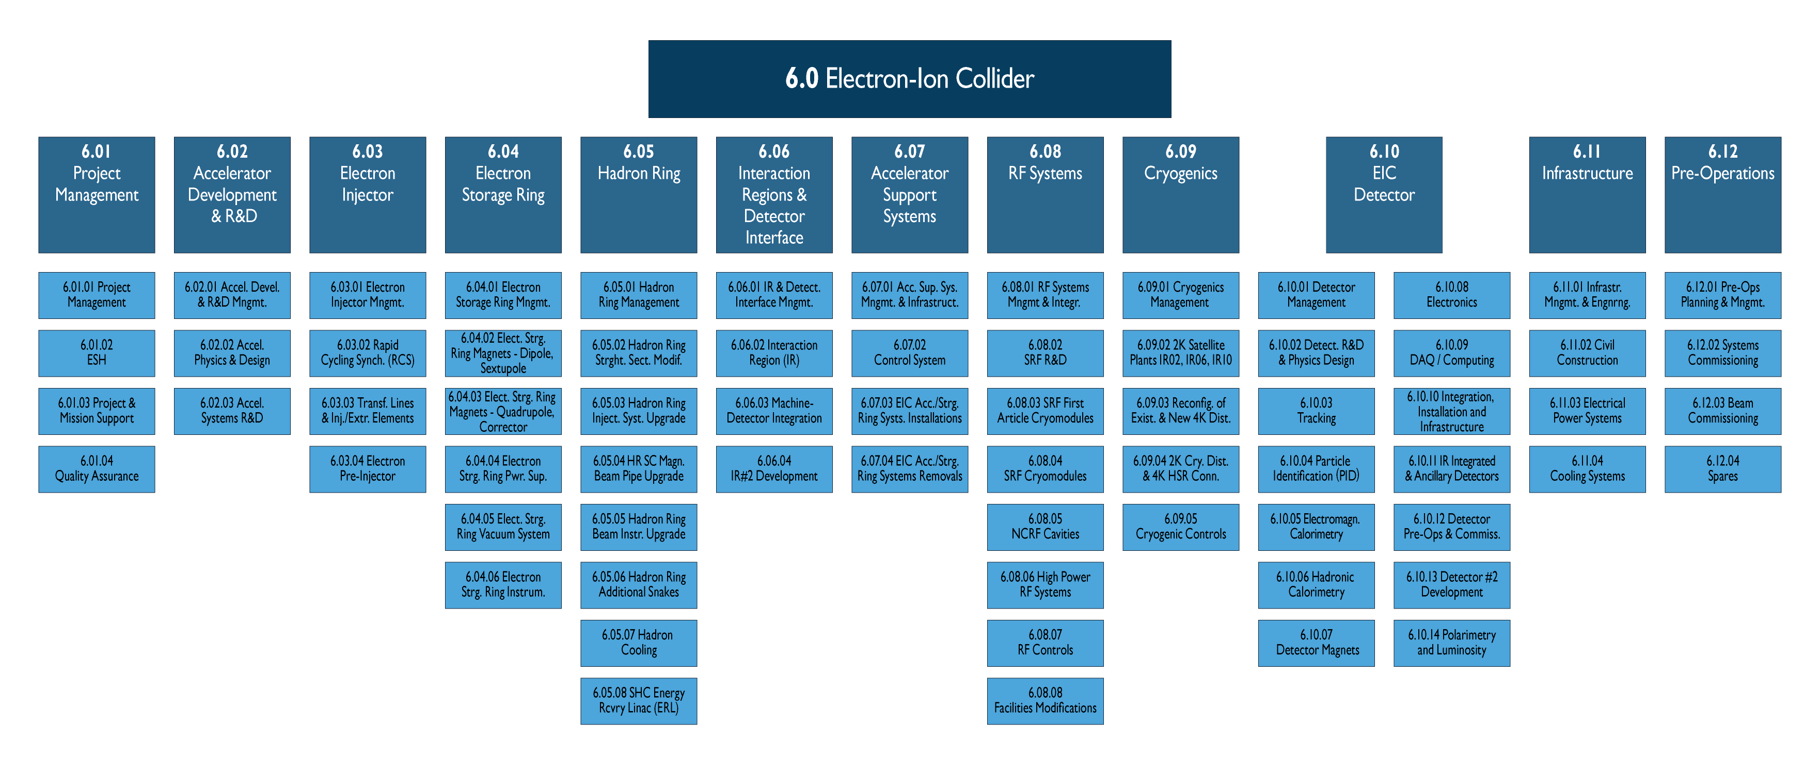
Full WBS Chart - Clean

Slide 26
Full WBS Chart – Standard Acc/Det/Infra Groups
Accelerator
ORN: #F68A1F
Detector
BLU: #0070C0
Infrastructure
GRY: #7F7F7F

Slide 27
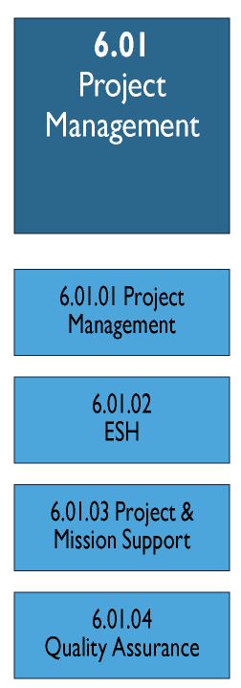
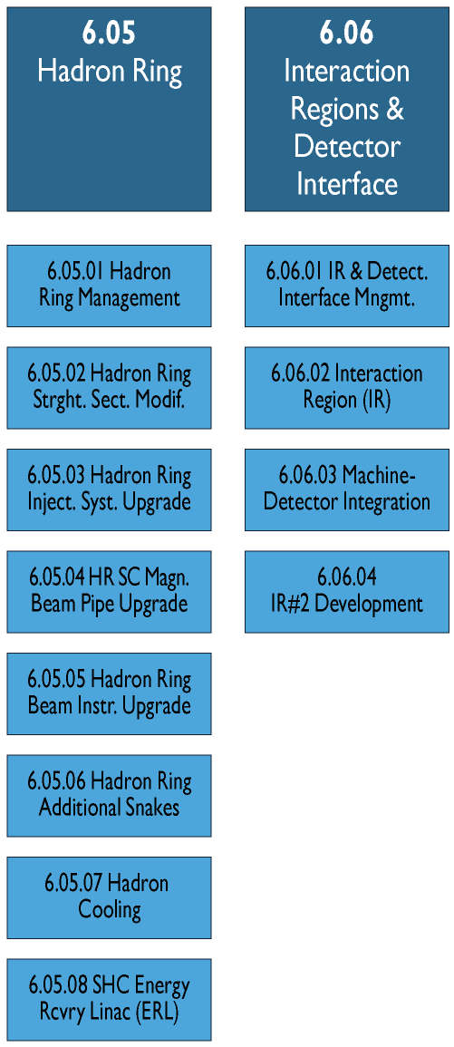
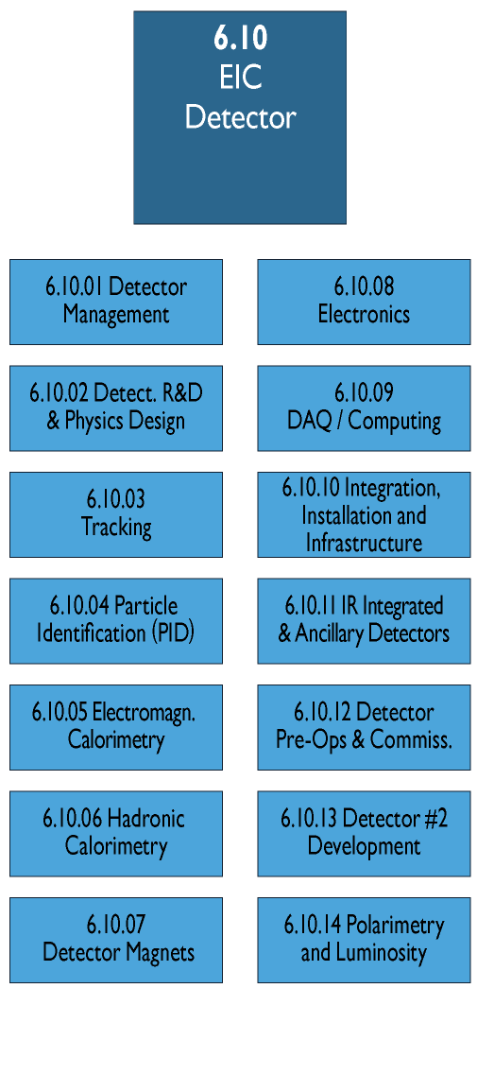
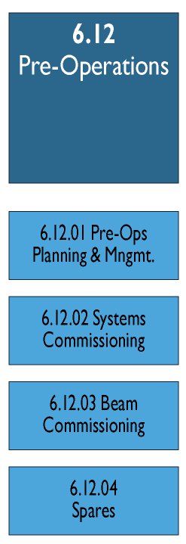
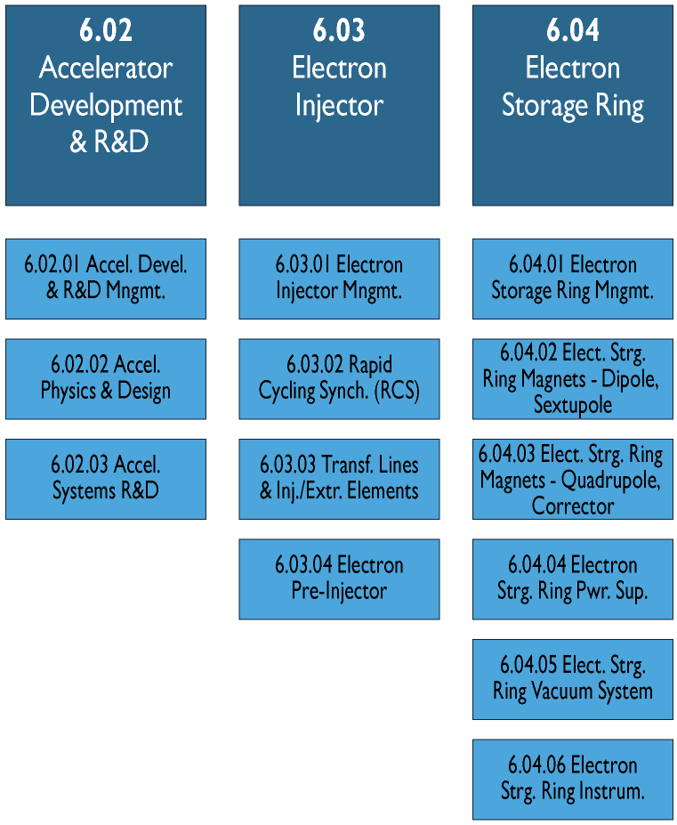
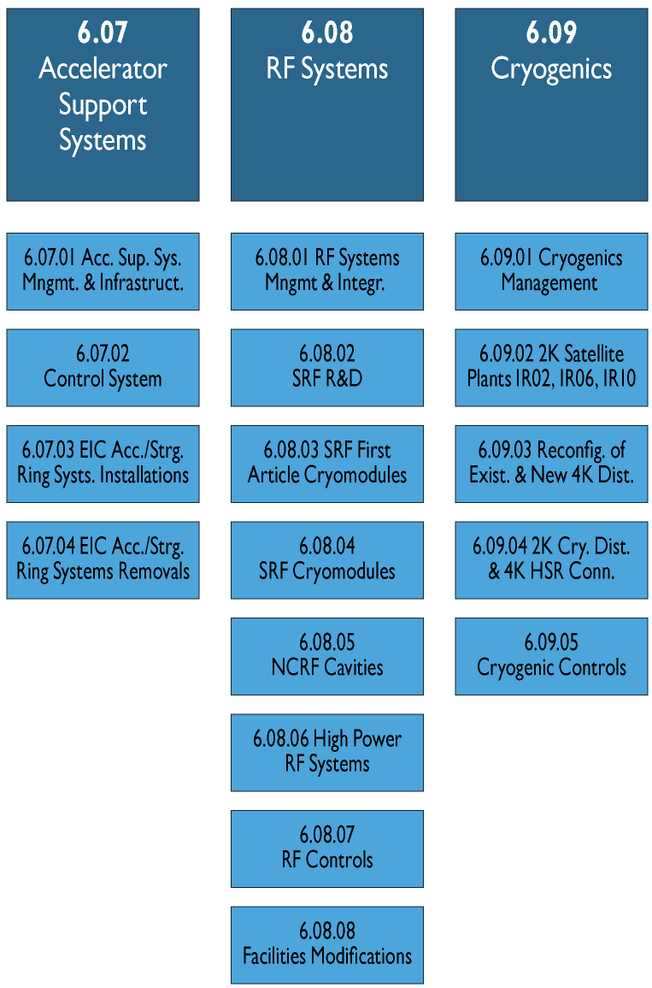
CD-3A WBS Chart Subgroups

Slide 28
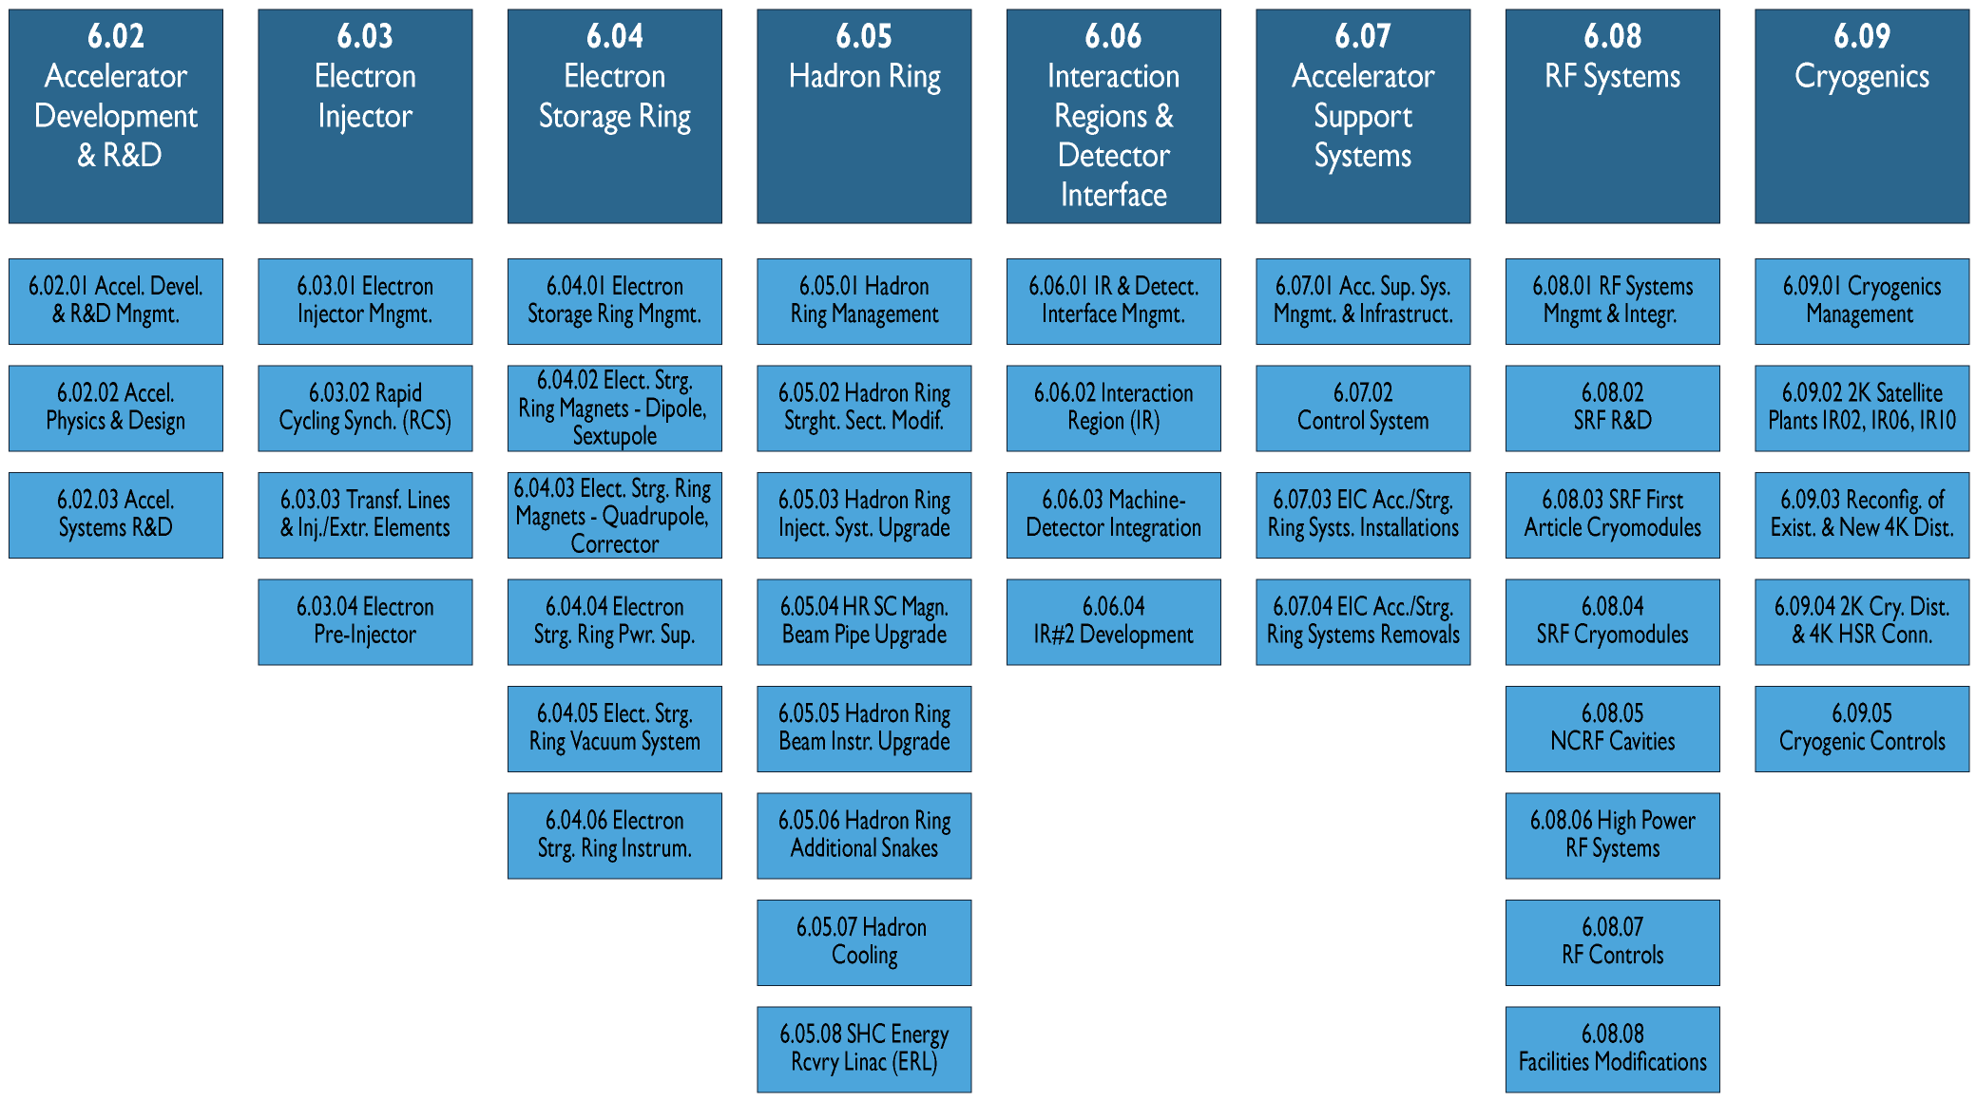
CD-3A WBS Chart Accelerator Subgroup

Slide 29
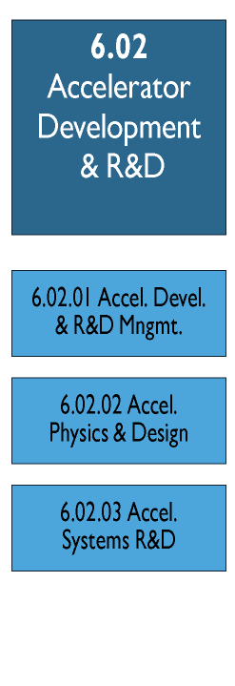
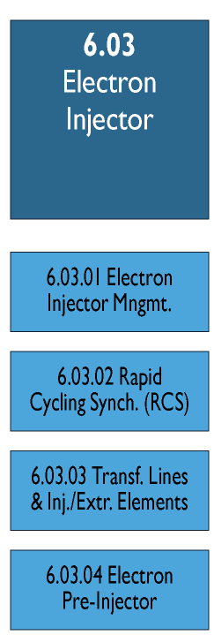
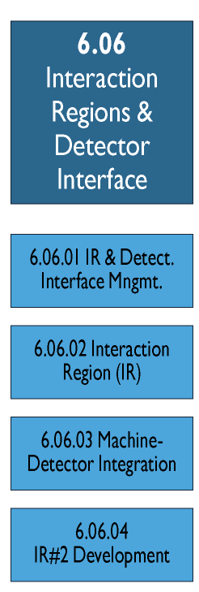
WBS Chart – Individual L2 Subgroups

Slide 30
Other Handy Material for Presenter Use
Follows Below

Slide 31
Commonly Used Symbols
αβγδεζηθικλνξομπρστυφχψωΩ
|¦±¯~≈≠≤≥°|ǁǀƩ‖•…⁞∆∞∙←↑→↓↔↕ꞇΦ
αβγδεζηθικλνξοπρστυφχψω

