Slide 1
All-Hands Safety Meeting and Stand-Down
28 July 2016
Will Oren

Slide 2
Outline
Why we are here?
Review of the Integrated Safety Management System – ISMS
Next steps

Slide 3
Why We Are Here?
Three events in less than 2 weeks
LERF brought to beam permit without minimum staffing
Changing conditions, made previously understood procedures obsolete
LERF electrical shock
Trim coil induced 87 volts into the main magnet bus (like a transformer) What could happen if?
Stored Energy
Breach of marked radiation area boundary
Boundary violated by leaning ladder across delineating rope and removing equipment within that boundary, improper use of folding ladder
Following your training, Communication

Slide 4
Why We Are Here (cont.)
Other Precursors (I have heard of)
Fabrication of a pressure system without following Design Authority instructions – Training
Unreported damage to a private vehicle by a JLab vehicle – Training, Reporting
Lack of PPE, (All observed and corrected)
Hearing protection
Handling of cryogenic materials
Safety glasses

Slide 5
Engineer Division Notable Event Root Cause and Contributing Causes Data, 2010-2015
Top 5 (from Paul Collins, DSO)
Hazard recognition
Work planning less than adequate
Communication and coordination
Clear roles and responsibilities
Deviation from standard practices
Sound familiar???

Slide 6
A Reminder - Jefferson Lab’s Safety “Mantra”
Jefferson Lab Considers no activity to be so urgent or important that we will compromise our standards for environmental protection, safety, or health.
Empowering JSA employees, subcontractors, and users with the responsibility and expectation- without reprisal- to:
Report concerns and/or injuries, and
Stop work that endangers people, environment, and/or property
Involving all levels of the organization in establishing ESH&Q objectives and targets

Slide 7
How do we work here?
ISM 5 Core Functions
1. Define the Scope of Work
Analyze the hazards
Develop and implement Hazard Controls
Perform work within controls
Provide feedback and continuous improvement

Slide 8
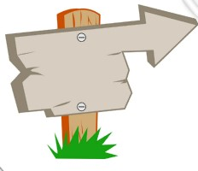
“How We Work”
Finish
Inform & Coordinate with Adjacent Activities
Basic human nature leads us to take the most direct path to a goal: the straightest possible route.
Training, Orientation
Analyze & Mitigate the Hazards
Plan the Job
Start
This is rarely the safest path, however. Doing a job safely is an intentional action – to override our “hard-wired” instinct for the most direct.

Slide 9
“How We Work Here”
Integrated Safety Management (ISM)
Use your experience and others’ advice to anticipate hazards.
Include safety aspects as if they were tools or materials.
Plan/Design the job
Feedback for
improvement
5 Core Functions of ISM:
Define the scope of work;
Identify and analyze hazards associated with the work;
Develop and implement hazard controls;
Perform work within controls; and
Provide feedback on adequacy of controls and continue to improve safety management.
Act
to adjust your plan
Do the work according to the plan
If conditions change, or you think the plan isn’t adequate…
Check:
Is it working? Did you overlook something?

Slide 10
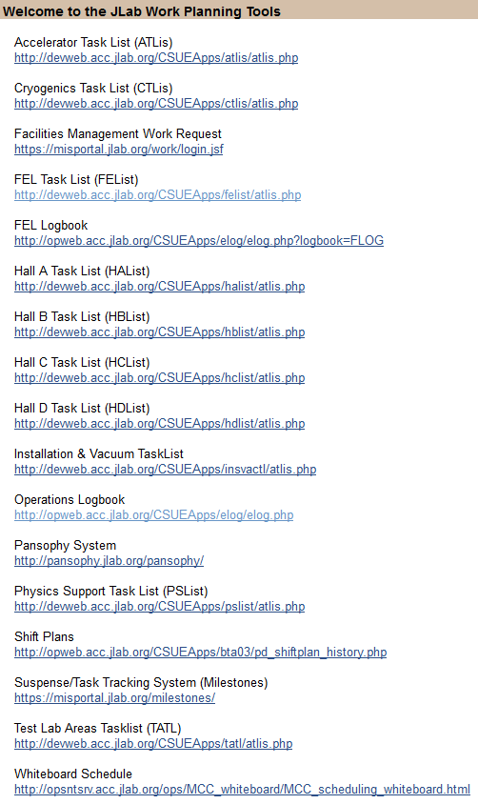
Define the Scope of Work
Perform preliminary planning
Utilize area specific Tasklist
(ATList, CTList, etc.)
Do your preliminary THA

Slide 11
Analyze the Hazards
Is this task understood and normal?
Is current training adequate?
Have you evaluated your risks?
What is the risk code with standard protections?

Slide 12
Develop and Implement Hazard Controls
Is the formal Task Hazard Analysis (THA) required?
Is a Work Control Document needed?
OSP
TOSP

Slide 13
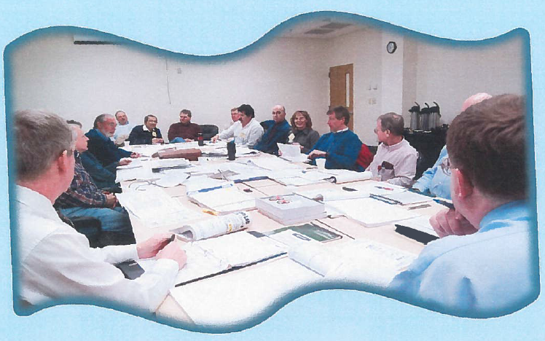
Perform Work Within Controls
Pre-job briefing
Is the plan changing? – Stop and re-plan
Insert photo

Slide 14
Feedback and Continuous Improvement
Work Observation Program
I will talk more about this in next week’s departmental “all-hands” meetings

Slide 15
Take Aways
There have been 3+ events in the last 2 weeks with no injuries – This puts us on warning!
Think about how such events would happen in your area and then take measures to avoid them.
If you see something, say something
Keep your training up to date and use it!

Slide 16
What Next?
We will still have Departmental “all-hands” meetings next week
We remain in stand-down until 4:00pm
Departments to have detailed discussions
Cryogenics go to the MCC
Mechanical Systems including Machine Shop go to TED Lunch Area
EES stay in CEBAF Ctr. Auditiorium

Slide 17
Detailed Discussions
Department Heads will lead the discussions and all staff will participate
Work planning and hazard recognition for ongoing work (ATLis, CTLis….), Changing conditions?
Communication/coordination within the group and with external groups – issues, concerns
Training – supervisor and employee responsibilities -> correct training, training current, application of that training
Department Heads – please keep notes

