Slide 1
TestBeamAvailableAtBNL102424 Xiaodong Jiang

Slide 2
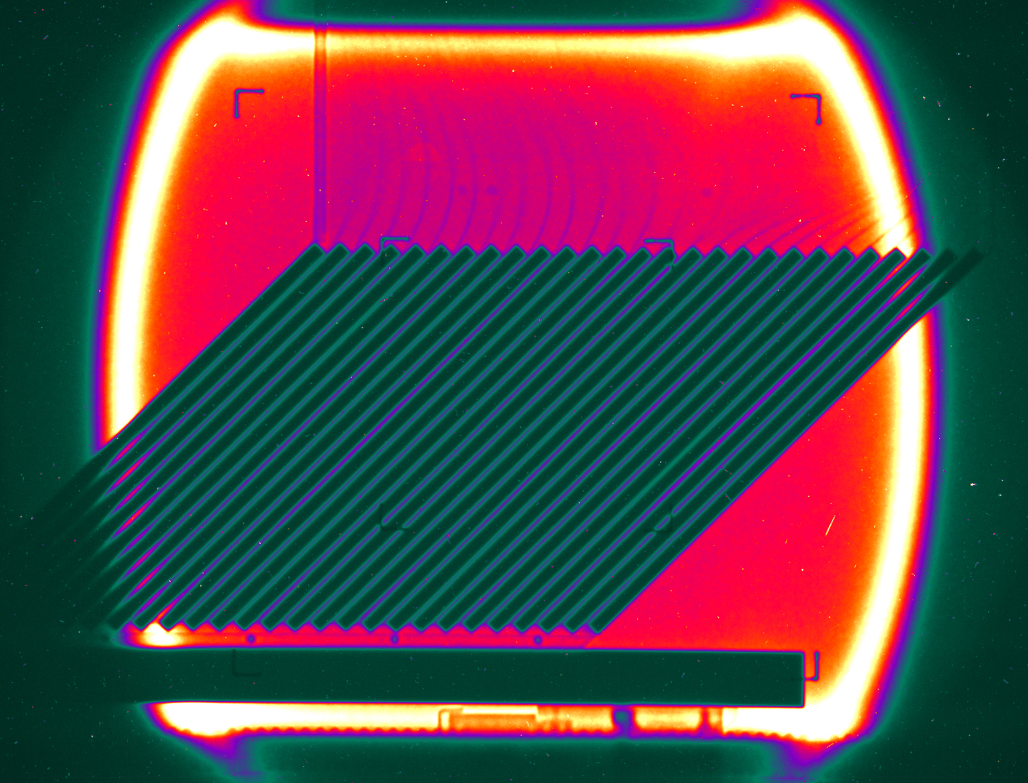
Test Beam Available at BNL at the BNL NASA Space Radiation Laboratory (NSRL) beam line
Beams Available:
Protons: up to 2.5 GeV kinetic energy, 2x10¹¹ protons per spill (a Booster extraction spill: 4.2 sec).
Ions (₄He to ₂₀₉Bi). For example, ₅₆Fe kinetic energy up to 1.0 GeV/n, 2x10⁹ Fe-ions per spill.
Quick changes of beam energy and species, in minutes.
Beam Shapes:
Uniform square beam: 10x10, 20x20, … 60 x 60 cm²
or pencil beam ~1 cm spot size.
Tools and Supports Available:
Remote controlled tables for rotation and positioning
Patch panels for HV, signal, ethernet cables.
Electronics for a trigger setup, a simple DAQ, ADCs TDCs.
Easy and Fast access to the experimental area.
Operated 2400 hrs in FY-2024.
(biology and space electronics tests).
PHENIX Zero-Degree Calorimeter being calibrated with a ₅₆Fe-beam (1000 MeV/n), beam size: 20x20 cm²
More details at: https://www.bnl.gov/nsrl/
Please plan ahead and tell us what you need.
Michael Sivertz: sivertz@bnl.gov
Xiaodong Jiang: xjiang3@bnl.gov

