Slide 1
Git outta here.
A very quick rundown of some basic Git functions and options.
2023/02/03
Ryan Bodenstein

Slide 2
First thing is first – make an account and install Git on your machine(s)
https://blog.scottlowe.org/2015/01/14/non-programmer-git-intro/ goes through the steps for this
Depends on your OS, so follow the relevant instructions.
And here are a few more basics to get started: https://blog.scottlowe.org/2015/01/26/using-git-with-github/
If you don’t like command line, there’s also a desktop application: https://desktop.github.com/
This can make things easier at times (thought not always).

Slide 3
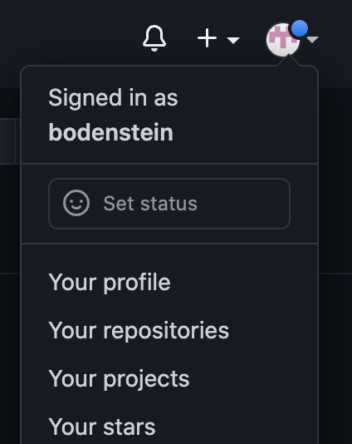
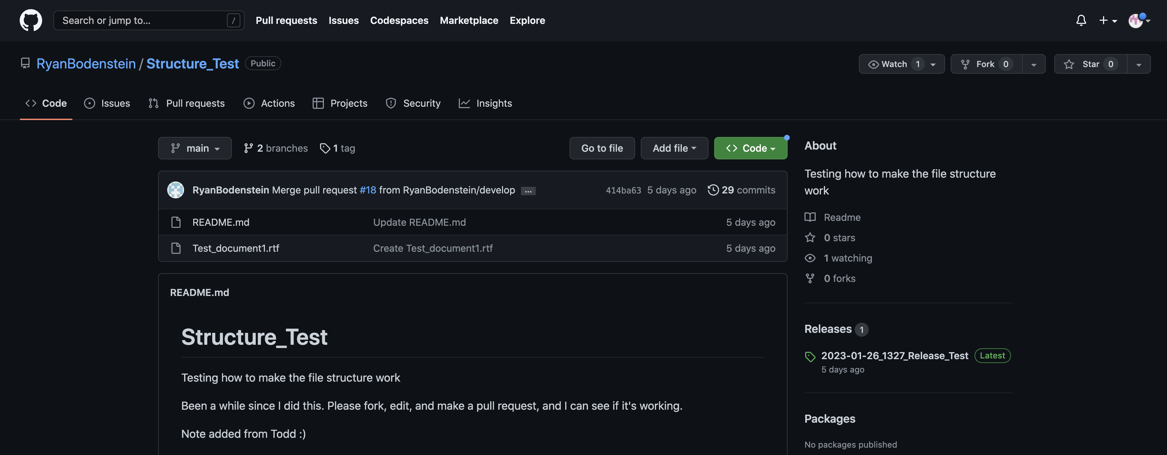
My second account logged in. You’ll only need one, but I needed to show what it looks like.
This is what the page will look like (for example).

Slide 4
My second account logged in. You’ll only need one, but I needed to show what it looks like.
This is what the page will look like (for example).
This is the main branch.
If we’re going to fork, you can fork from the “main.”
If we’re going to use Git Flow, then change to develop.

Slide 5
My second account logged in. You’ll only need one, but I needed to show what it looks like.
To use Git Flow, you need to be a collaborator. To fork, you do not need to be a collaborator (but can be).
This is where you fork.
This is what the page will look like (for example).
This is the main branch.
If we’re going to fork, you can fork from the “main.”
If we’re going to use Git Flow, then change to develop.

Slide 6
If we’re going to fork…
You don’t need to be a collaborator, but you can be. But you can just fork into your own repository, then clone that locally and do what you wish with it – it cannot change anything with the origin that you forked from until you make a pull request.

Slide 7
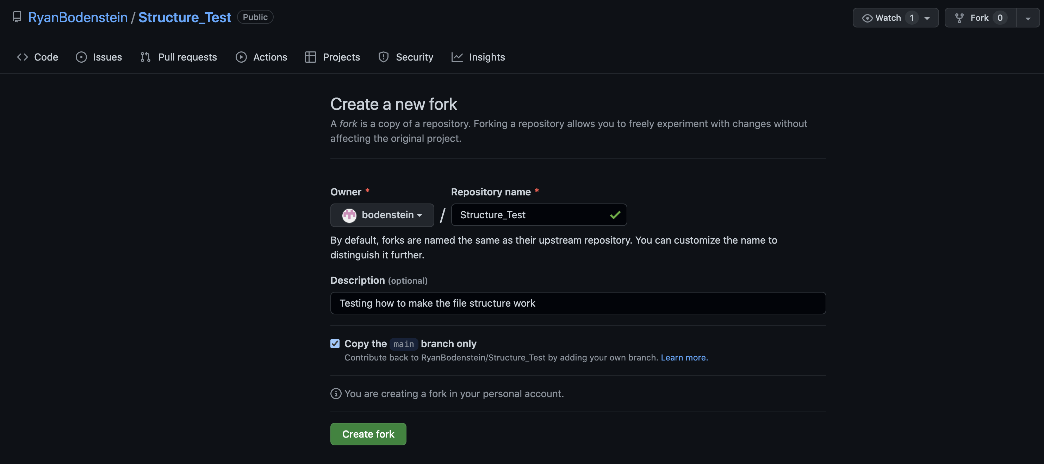

Slide 8
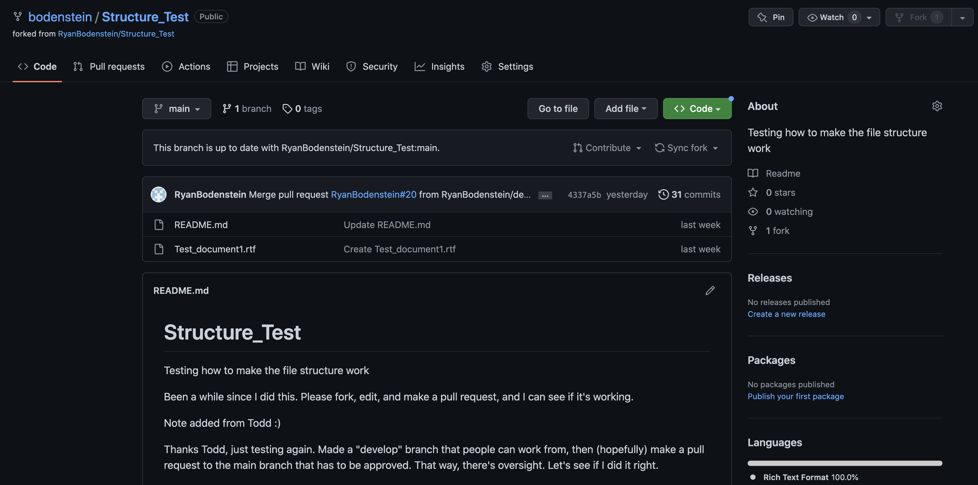

Slide 9
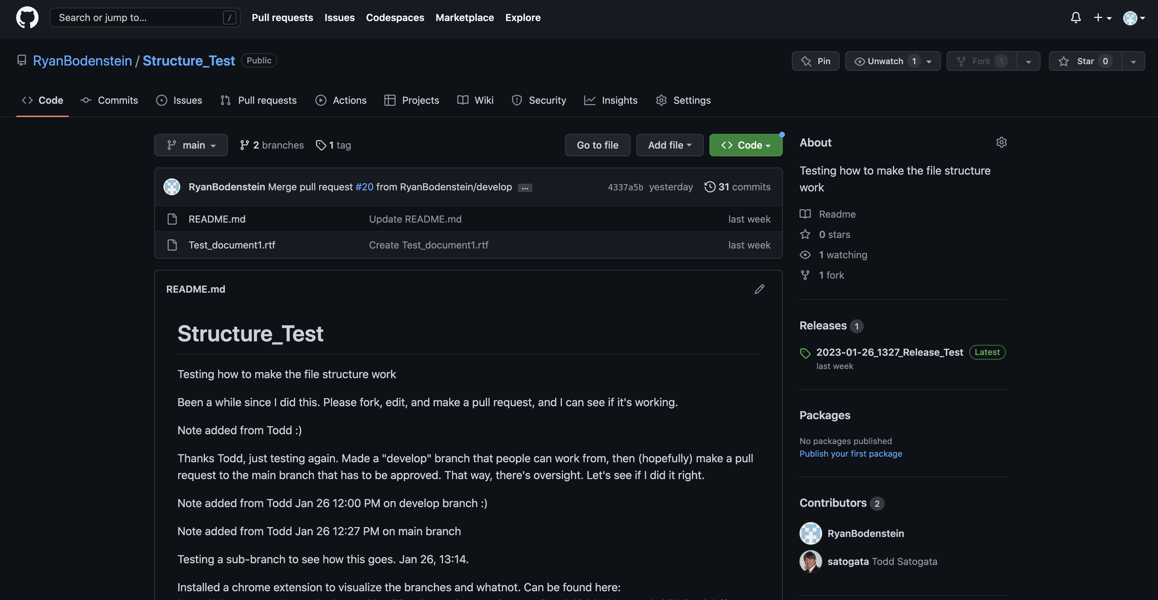

Slide 10
If we’re going to branch (Git Flow)…
Here, you’ll need to be a collaborator. So I’ll need to send you an invitation to join, you’ll have to accept it, and then we can go from there. You can ALSO fork as a collaborator.

Slide 11
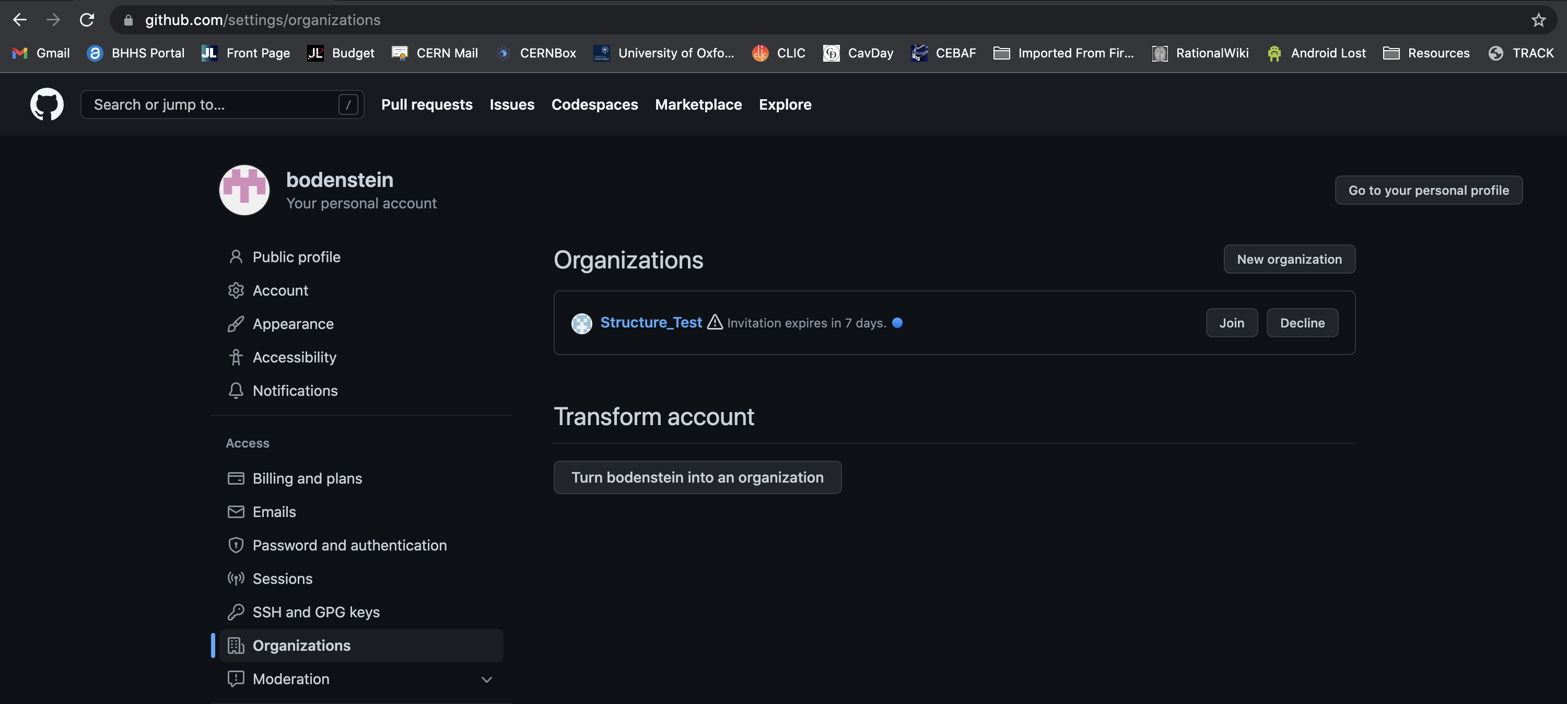

Slide 12
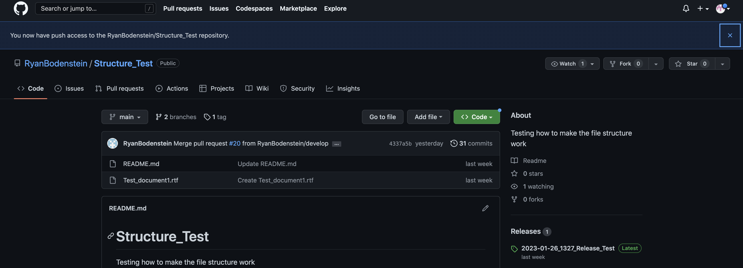

Slide 14
Cloning Locally…
This is very easy, but can be done several ways. Some prefer the Desktop app, some prefer command line, some like SSH.
It makes a local file system/folder structure on your computer.

Slide 15
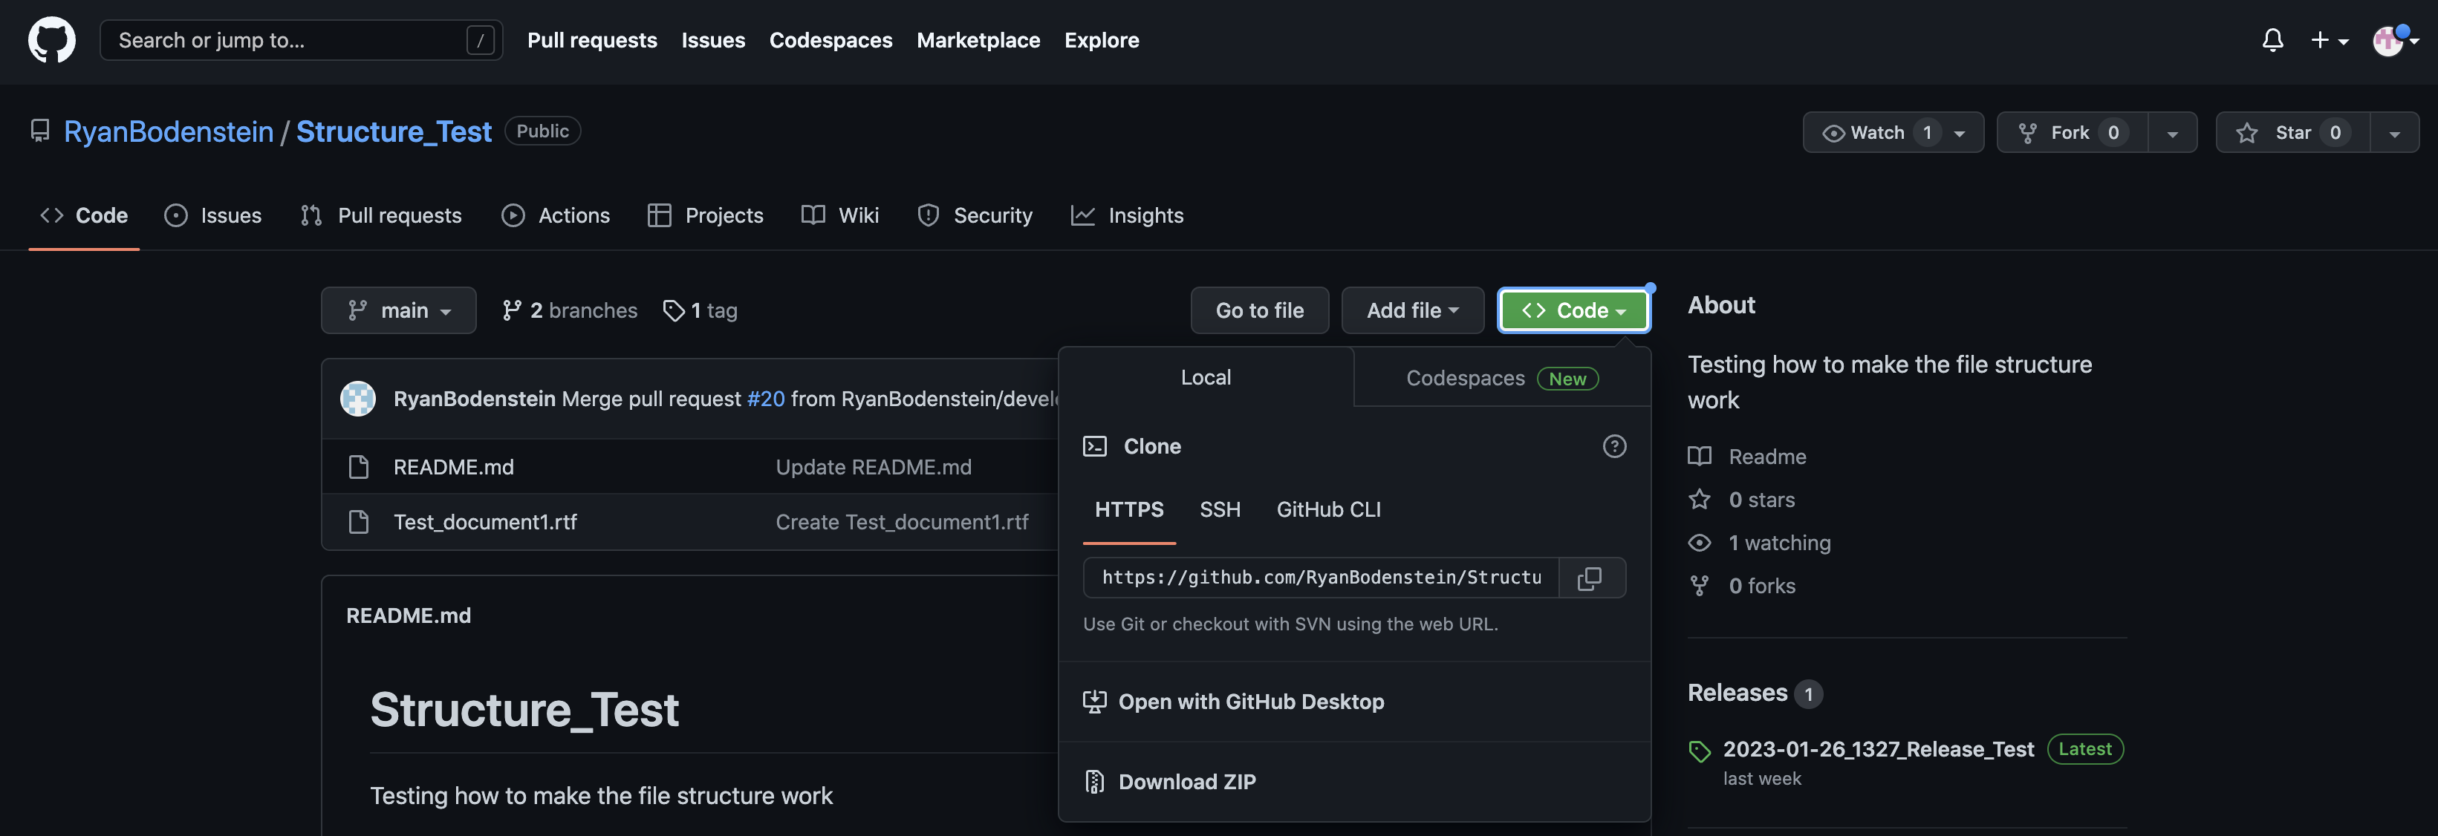
If using the desktop app, you can press this and most of the work is done.
You’ll need this one if you’re using the command line.

Slide 16
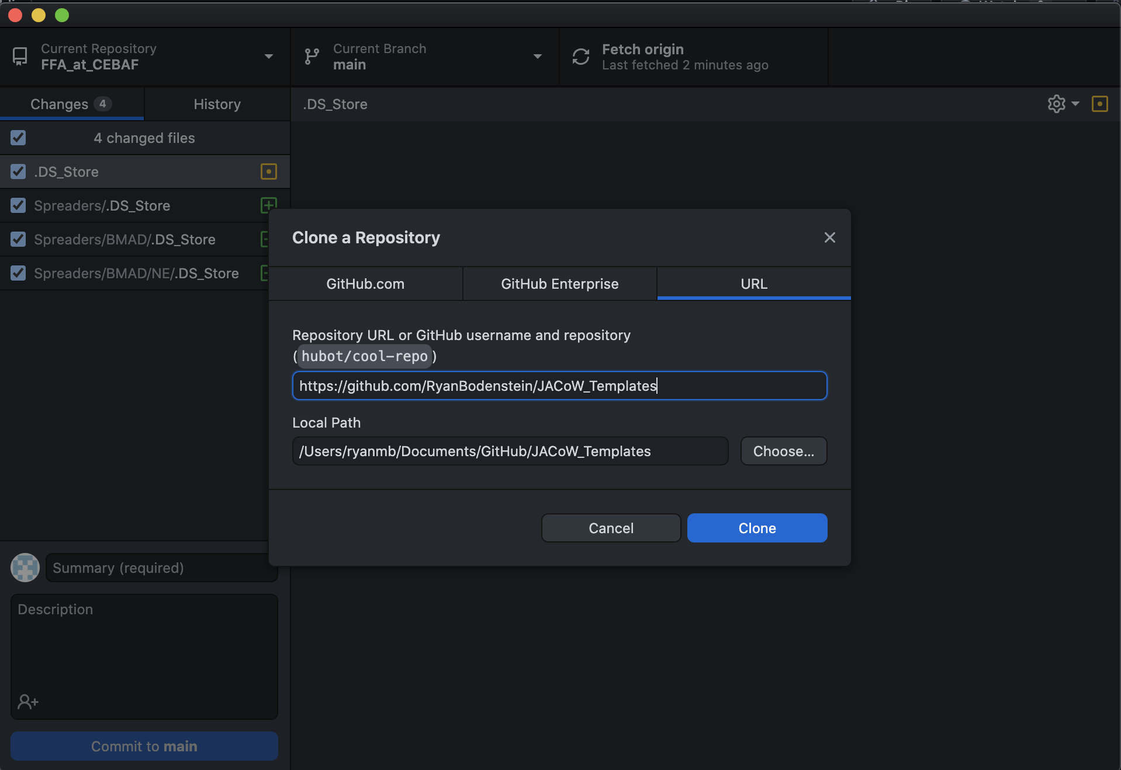
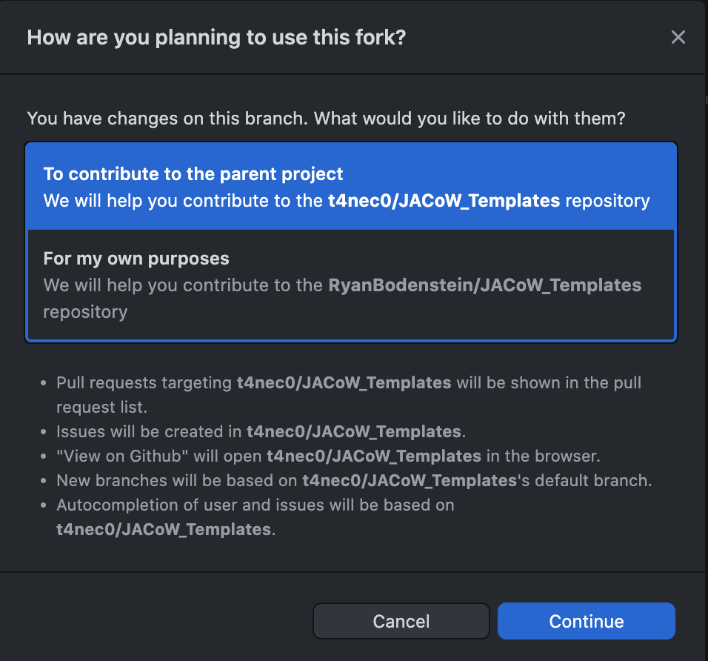

Slide 17
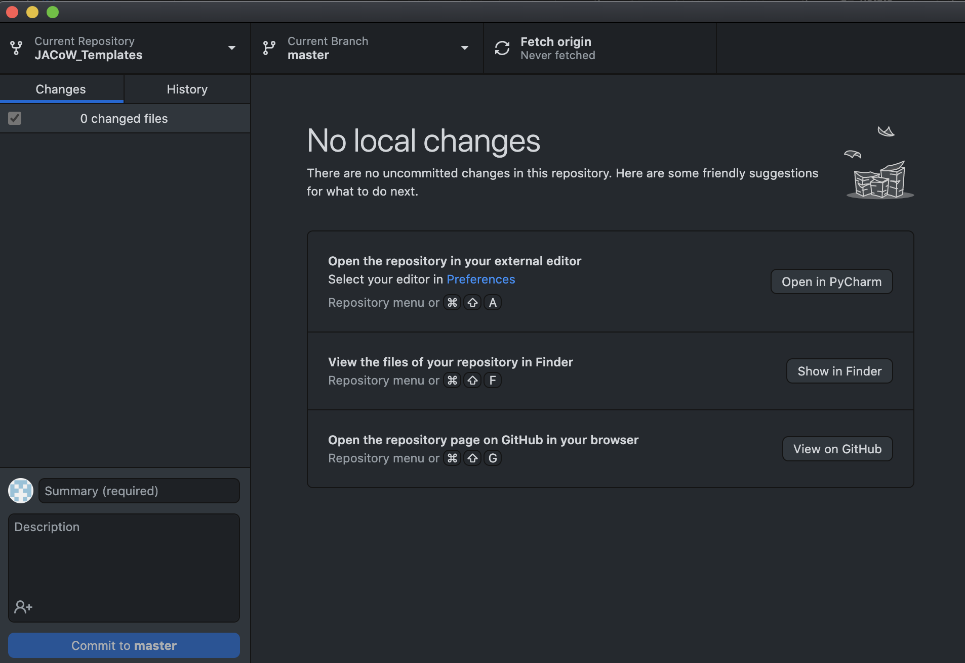

Slide 18
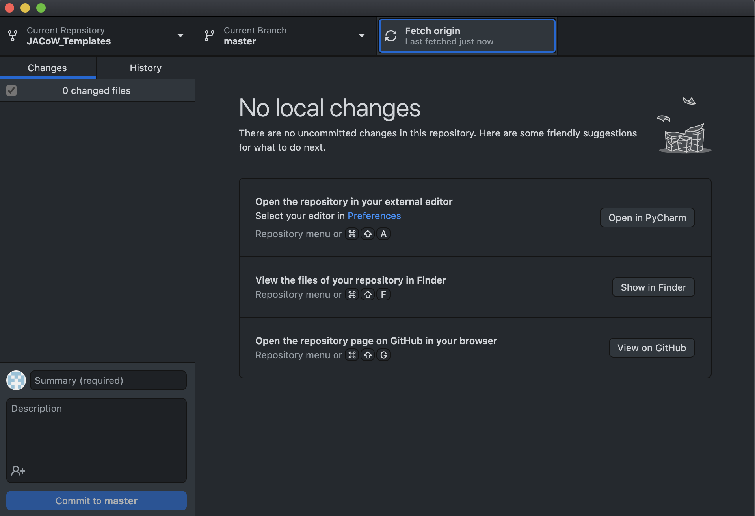

Slide 19
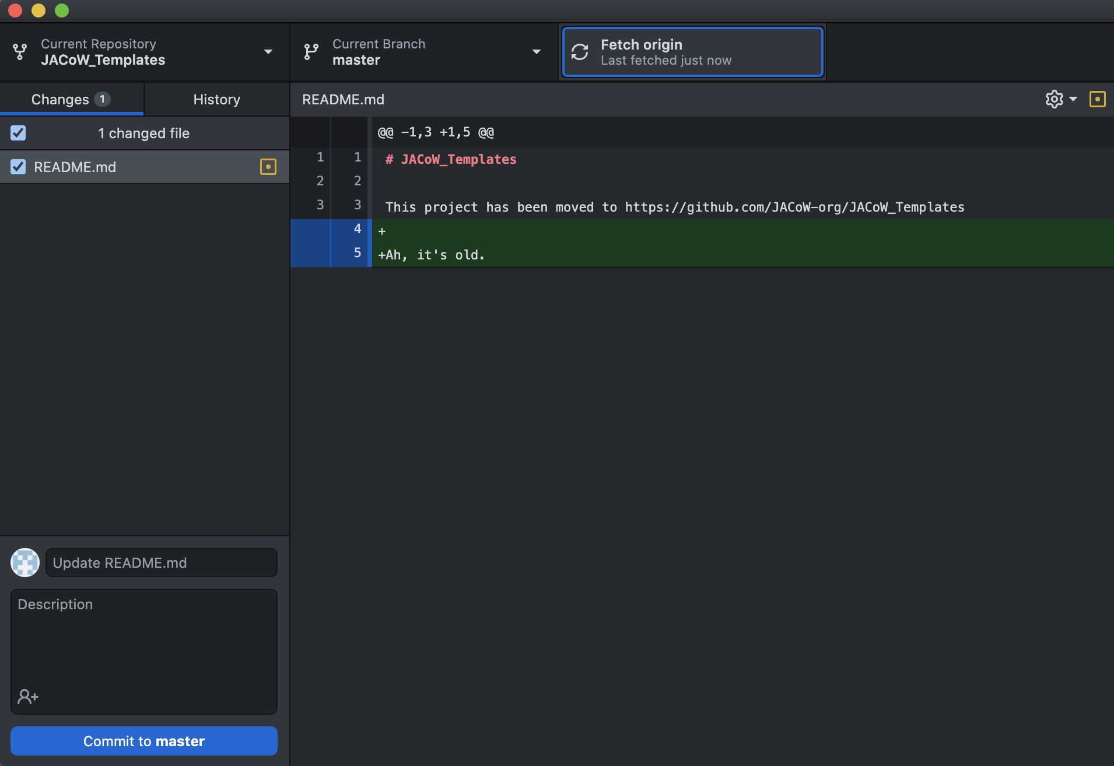

Slide 20
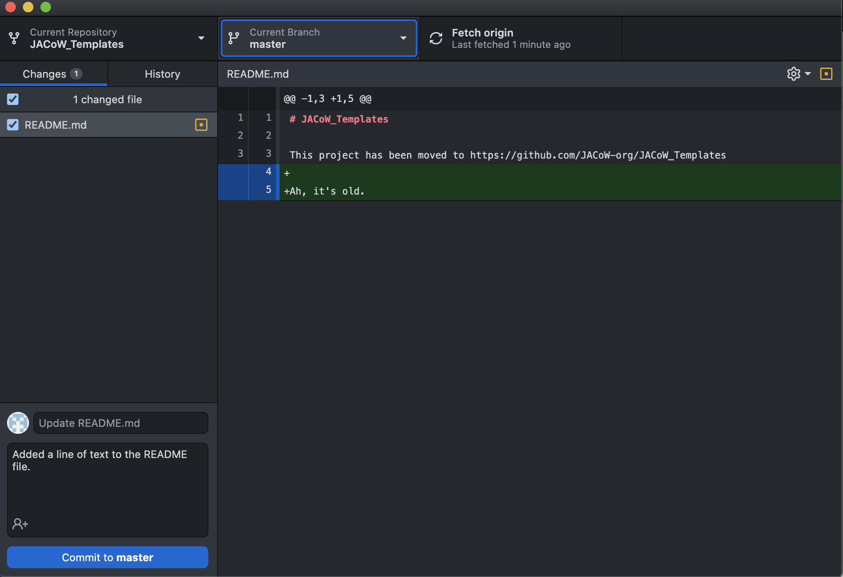

Slide 21
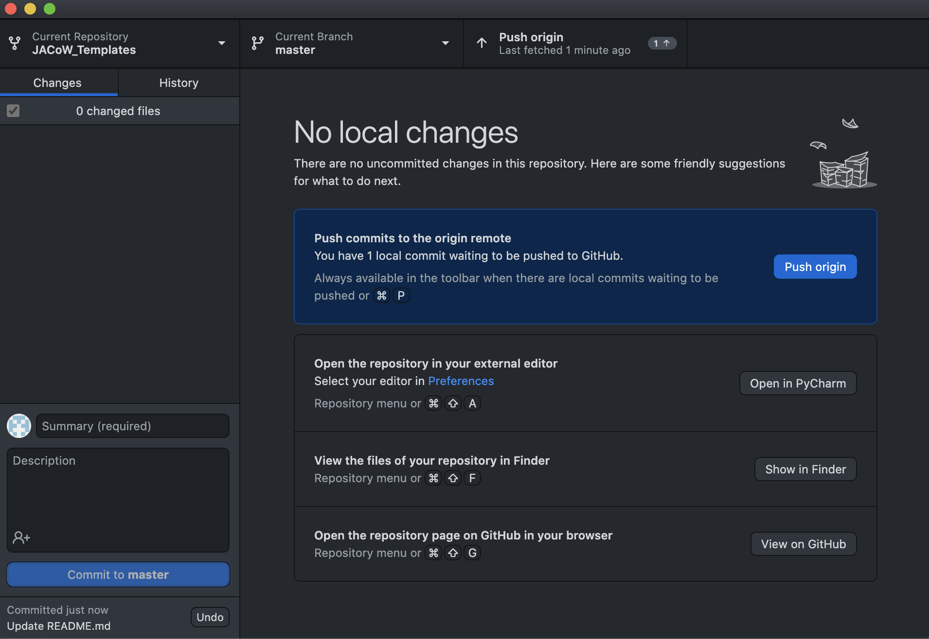

Slide 22
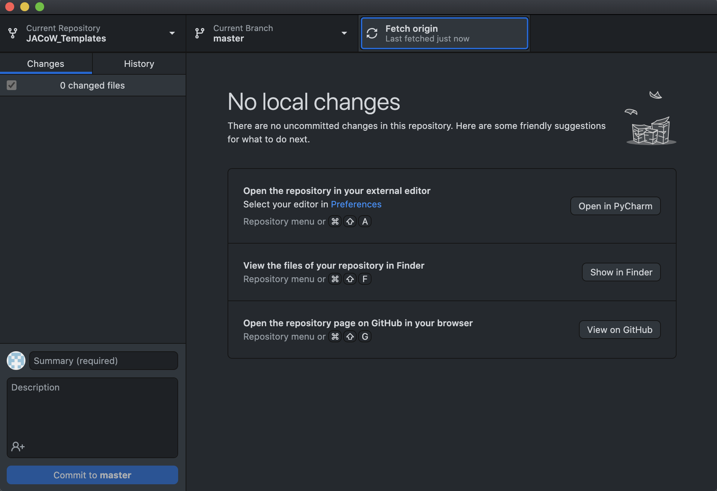

Slide 23
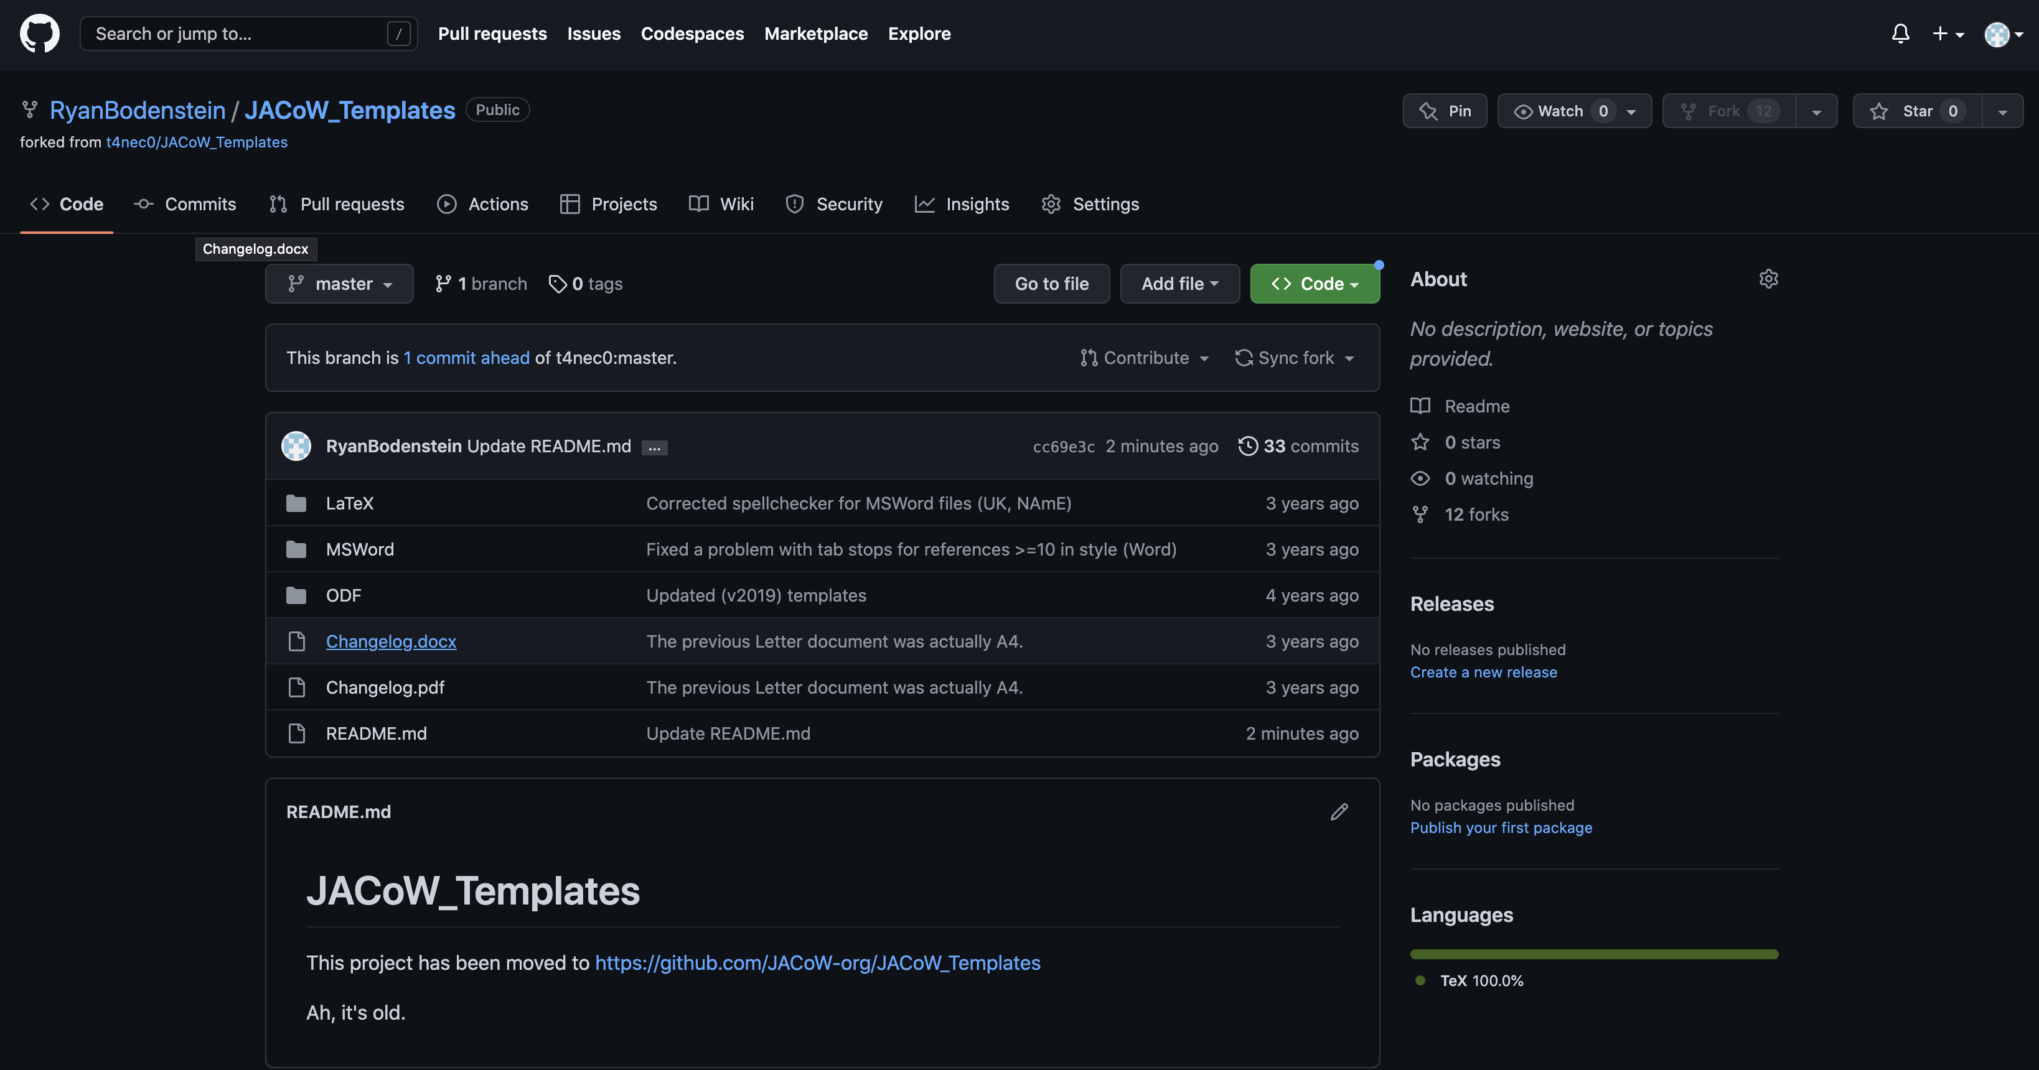

Slide 24
A few more resources
Set Up Git: https://docs.github.com/en/get-started/quickstart/set-up-git
Cloning and forking: https://docs.github.com/en/desktop/contributing-and-collaborating-using-github-desktop/adding-and-cloning-repositories/cloning-and-forking-repositories-from-github-desktop#managing-fork-behavior
Pull requests: https://docs.github.com/en/pull-requests/collaborating-with-pull-requests/proposing-changes-to-your-work-with-pull-requests/about-pull-requests
https://www.freecodecamp.org/news/how-to-fork-a-github-repository/

