Slide 1
To Fork or To Branch,
that is the question…
FFA@CEBAF Weekly Meeting
2023/01/27 (and 2023/02/03)
Ryan Bodenstein

Slide 2
GitHub Workflows
Please note: you’ll all need a GitHub account.
Two main styles of workflows with git:
  Branch
  Fork
Branch:
  Easier to use, but also easier to make errors
  Everyone has some level of version control
  Several different styles of this workflow
Fork:
  A bit more complicated (extra steps)
  Maintainer has final say on version control
  Free to “mess with things” since you can’t mess with the original

Slide 3
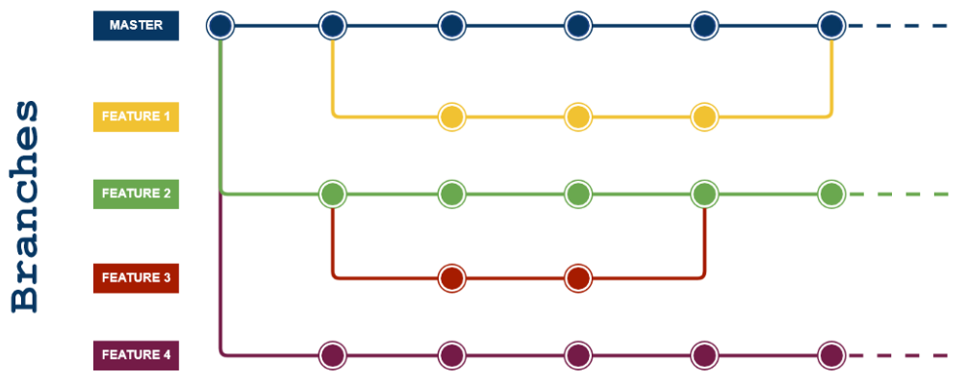
Branch Workflow Option 1: Feature Branch
Advantages:
It is friendly for the Continuous Delivery and Continuous Integration.
A simpler alternative to Git Flow (next page).
It is ideal when it needs to maintain a single version in production.
Disadvantages:
The production code can become unstable most easily.
Are not adequate when it needs the release plans.
It doesn’t resolve anything about deploy, environments, releases, and issues.
It isn’t recommended when multiple versions in production are needed.
https://www.programmingnotes.io/2021/08/03/five-different-git-workflows/

Slide 4
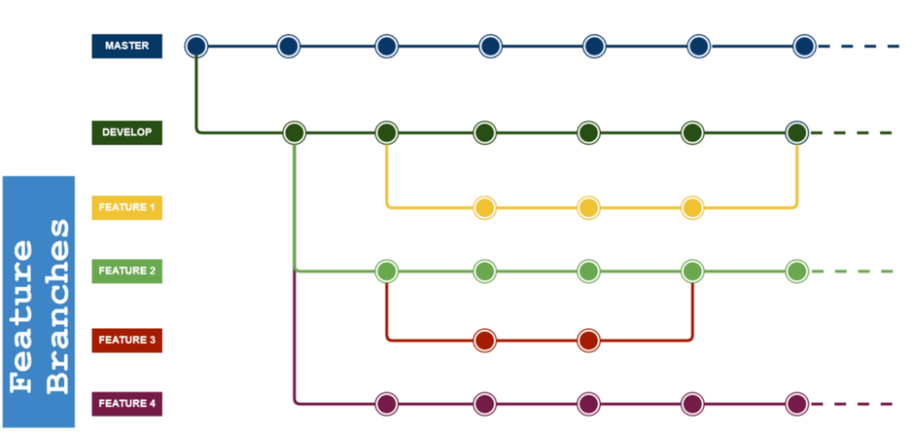
Branch Workflow Option 2: Git Flow
Advantages:
Git Flow is used by a lot of distributed, open-source teams that have varying skill levels.
The project maintainers can review and approve every line of code going into releases.
Disadvantages:
Can slow things down when having to look at large pull requests if you are trying to iterate quickly.
Releases are hard to do more than once a week.
The Project history is full of merge commits and makes it hard to see the actual work.
https://www.programmingnotes.io/2021/08/03/five-different-git-workflows/

Slide 5
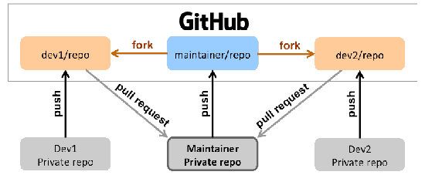
Fork Workflow:
Advantages:
Maintainer is the only one that can make updates to the main repository.
Each contributor has their own fork, local copy, and branch structure.
Disadvantages:
Adds a layer of complexity.
Time required to check pull requests.
https://i.stack.imgur.com/5BqbJ.png

Slide 6
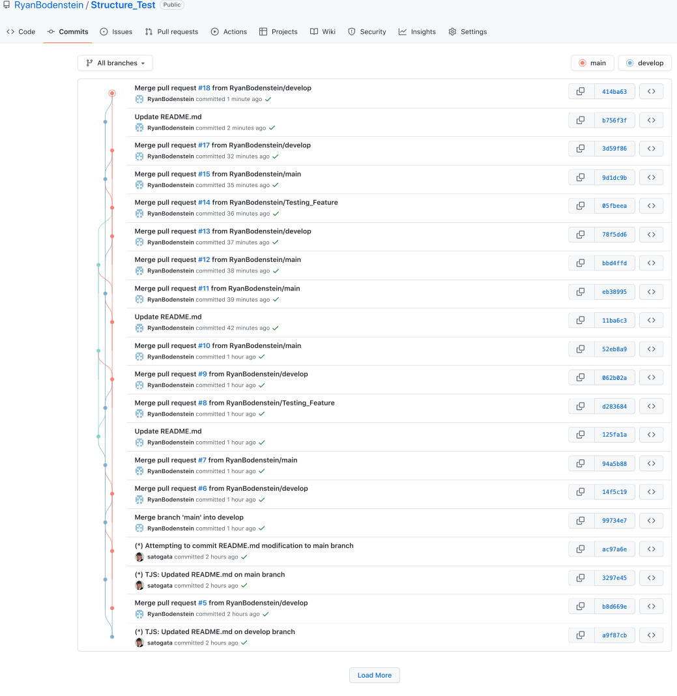
Tested Git Flow
Todd and I tested a simple Git Flow
  I had it set at private at the time, so not all functionality
  I think it’s fixed now, and public
If set correctly, everyone works from the ”develop” branch, sub-branching as needed
Still requires lots of keeping up-to-date
Without fork, will be working on “live” version with everyone
If you want to try things out this way, the link is: https://github.com/RyanBodenstein/Structure_Test
We an also test the forking method here, but you’ll need to fork the repository yourself, clone it locally, then make a pull request back to the main.

Slide 7
If you want to fork:
Other good resources:
https://www.freecodecamp.org/news/how-to-fork-a-github-repository/ (with video)
A developer ‘forks’ an ‘official’ server-side repository. This creates their own server-side copy.
The new server-side copy is cloned to their local system.
A Git remote path for the ‘official’ repository is added to the local clone.
A new local feature branch is created.
The developer makes changes on the new branch.
New commits are created for the changes.
The branch gets pushed to the developer’s own server-side copy.
The developer opens a pull request from the new branch to the ‘official’ repository.
The pull request gets approved for merge and is merged into the original server-side repository.
https://www.pluralsight.com/blog/software-development/the-definitive-guide-to-forks-and-branches-in-git
I’m willing to test the options out with people first, so we can decide. I suspect we’ll do “Git Flow” or ”Fork Workflow” so that there’s an extra layer of protection. It’ll let us figure out how things work best for all of us.
https://www.programmingnotes.io/2021/08/03/five-different-git-workflows/

Slide 8


Let’s do a poll…
I’ve made a poll to help us decide the agreed upon workflow.
Let’s set the deadline to next week.
Poll here: https://forms.gle/3gRjhUvPs6CZWGTB8
Testing GitHub:
Poll Link:

