Slide 1
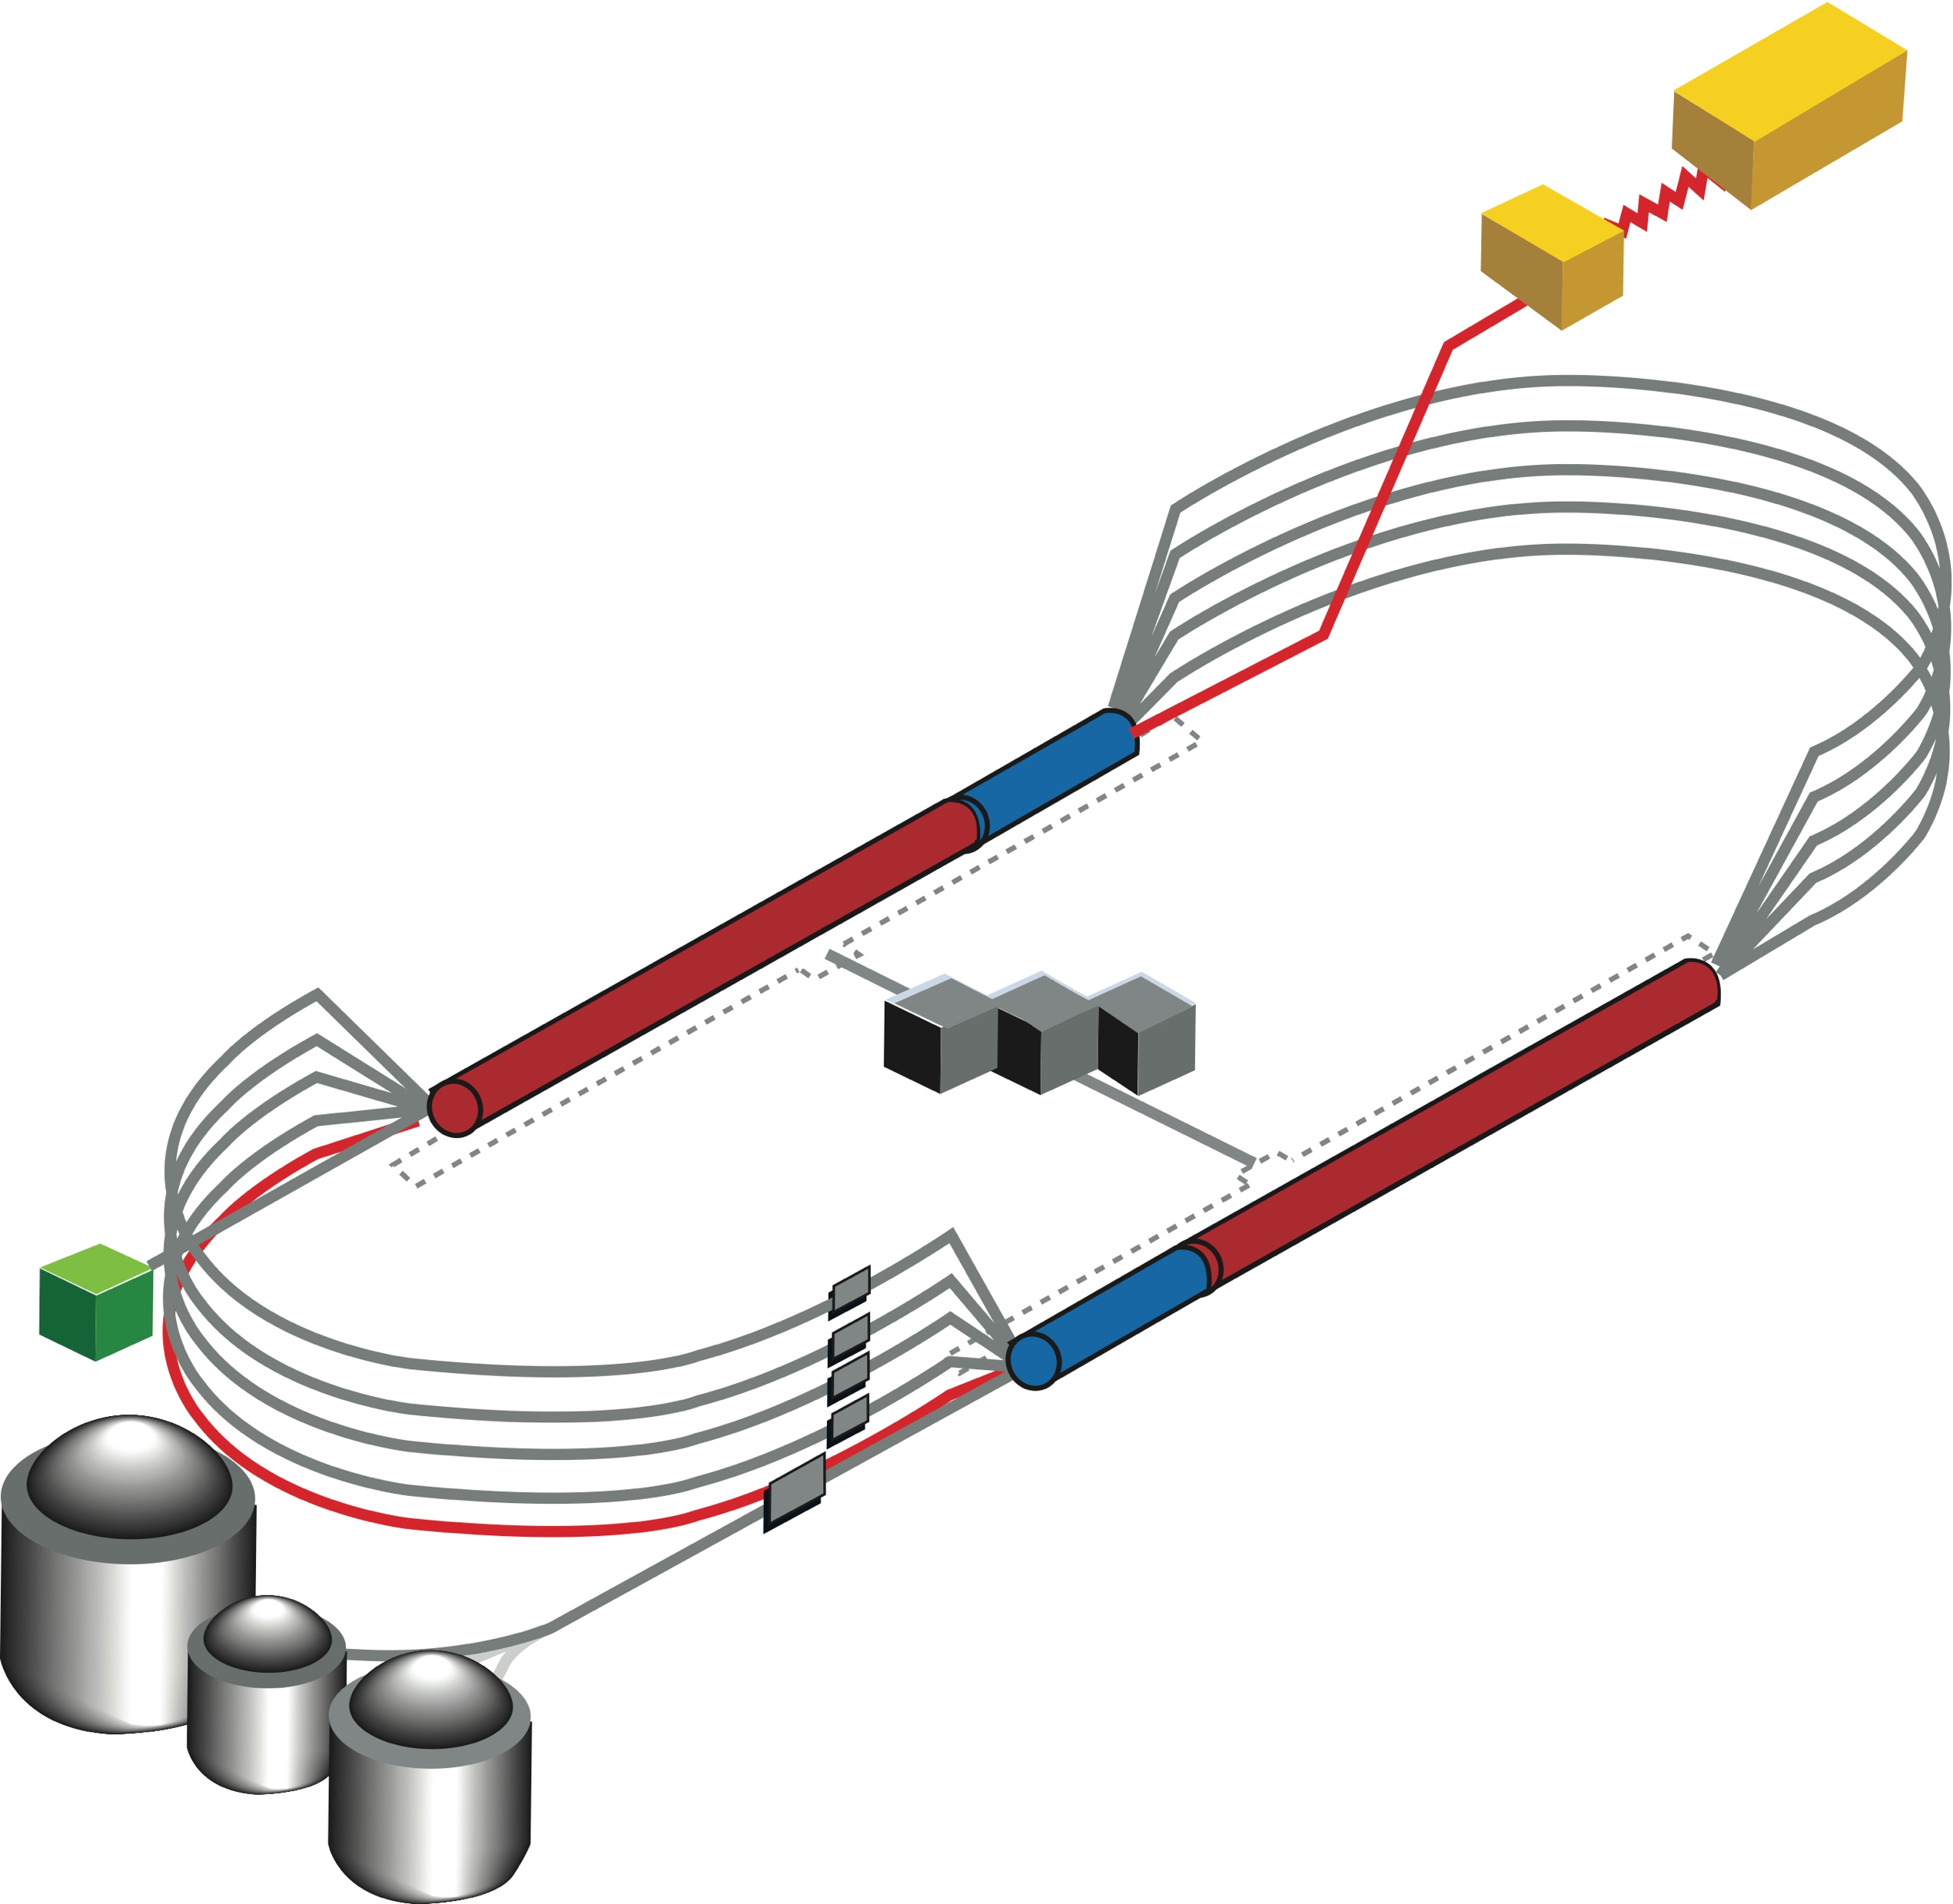
22 GeV CEBAF Energy Upgrade – State of the Concept
Feasibility study for additional FFA racetrack in the existing CEBAF tunnel to reach the top energy of about 22 GeV
TOF
650 MeV
TOF
Alex Bogacz (first nine slides) Jay Benesch (last four)

Slide 2




The FFA@CEBAF Collaboration
†

Slide 3


Overview
Current baseline: 650 MeV inj + 4-pass CEBAF + 6.5-pass FFA
FFA Arc Architecture – -style
  Non-scaling FFA based on high-gradient permanent magnets
  650 MeV injector upgrade
Modified CEBAF ‘switchyard’, Arcs 1-8 and TOF correction ‘splitters’
Reality (Benesch)
Question for Users

Slide 4
CEBAF FFA Upgrade – Baseline under Study
  Starting with 12 GeV CEBAF
  NO new SRF (1.1 GeV per linac)
  New 650 MeV recirculating injector
  Remove the highest recirculation pass (Arc 9 & A) and replace them with two FFA arcs including time-of-flight chicanes aka splitters
  Recirculate 4 + 6.5 times to get to 22 GeV
TOF
650 MeV
TOF
Enabling Technology:
Novel permanent magnets, -like used for power and cost savings

Slide 5
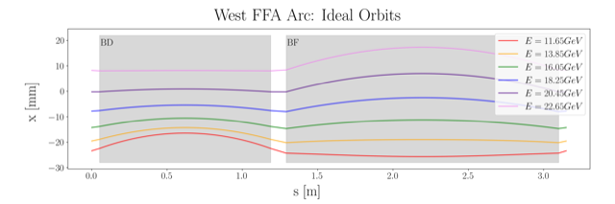
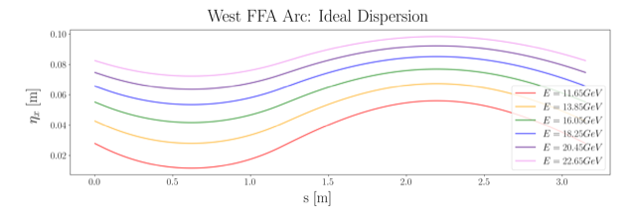
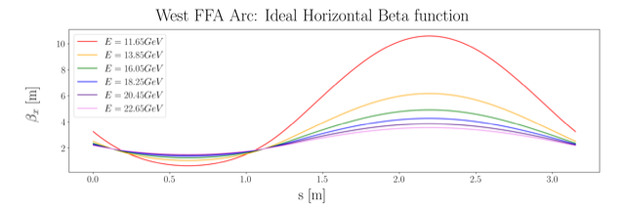
FFA Arc − Compact FODO Cell
orbits
Large momentum acceptance FFA cell, configured with combined function magnets capable of transporting six beams with energies spanning a factor of two
Arc composed of 75 cells, L_{cell} = 3.15 m
Closely spaced orbits for all six beams (~ 4 cm)
Low betas (~ a few m)
Extremally low dispersions (a few cm) - Virtue of combined function FFA magnets
dispersions
beta functions

Slide 6
Permanent Magnet Design – Open Mid-plane Geometry
10 cm
10 cm
10 cm
10 cm
Focusing Magnet BF
G_{F}= -41.13 T/m
L_{QF}= 1.67 m
B_{F}= -0.812 T
Defocusing Magnet BD
G_{D}= 43.44 T/m
L_{BD}= 1.24 m
B_{D}= -0.593 T

Slide 7
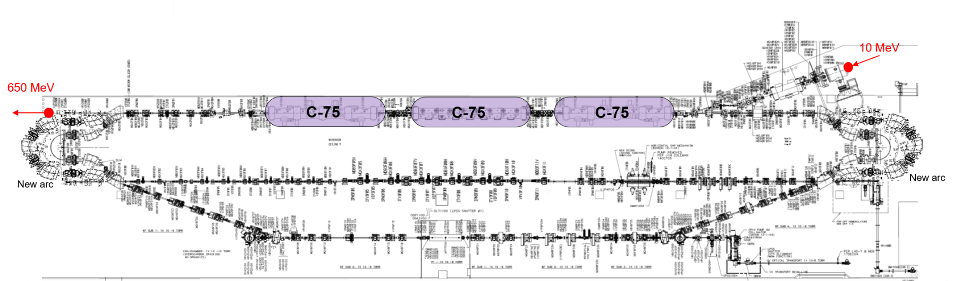
Injector Upgrade − 650 MeV Recirculating Injector
With the present 123 MeV injector, the difference in the first and final pass energies in the North Linac is too large (1:175) to effectively control the beam.
650 MeV recirculating injector (3-pass) based on LERF will allow a manageable difference in energies (1:33)

Slide 8
Electron/positron injector vault is required for 12 GeV e⁺ and 22 GeV e⁻
123 MeV e⁺ and 650 MeV e⁻
‘Green beamline’ is a cost effective option for staging positron and energy upgrades:
123 MeV e⁺ for 12 GeV CEBAF
650 MeV e⁻ for 22 GeV CEBAF Energy Upgrade

Slide 9
Current Baseline Design: Layout (K. Deitrick schematic)

Slide 10
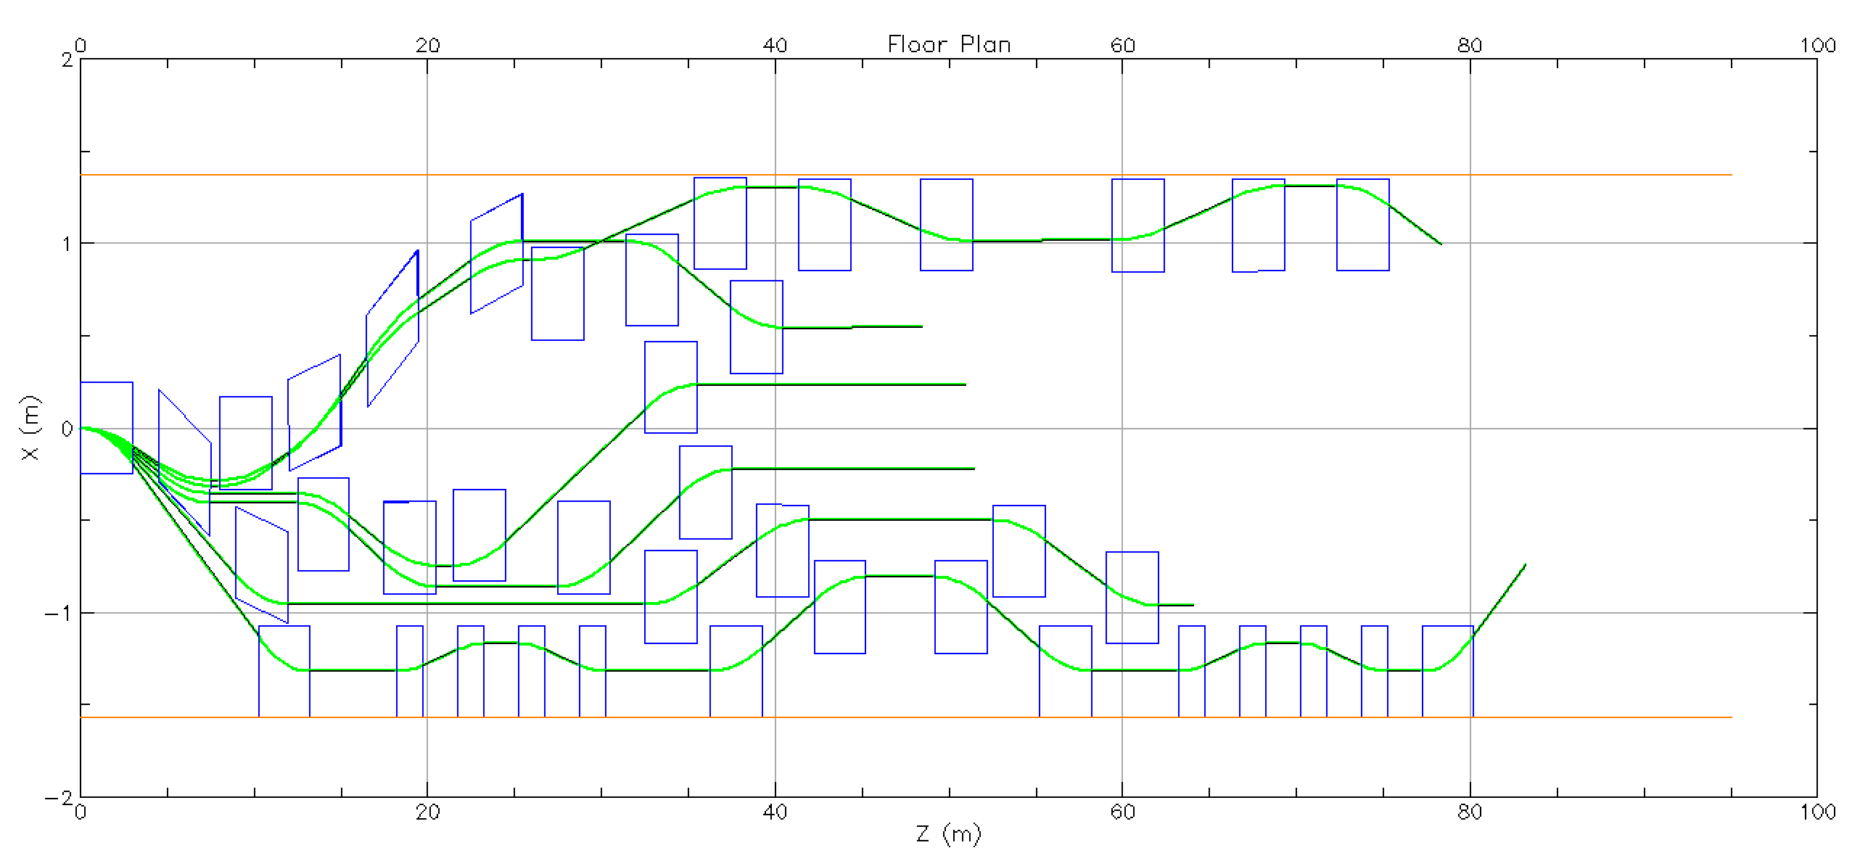
Splitter status (Ryan Bodenstein plot)
Partial dipole layout for a splitter. Tunnel is 3.96 m wide. Orbit closure, optics and pathlength compensation not yet completed. Raised floor and ramps will be required for cryomodule transport.

Slide 11

Summary
Present Baseline (1.1 GeV per linac):
  650 MeV Recirculating Injector (additional three C-75 cryomodules)
  Recirculate 4 passes with the current CEBAF
  Plus Additional 6 passes via a single FFA: 10 – 22 GeV
FFA Arc Architecture configured with compact FODO cells
  Beta and dispersion matching to the linacs through cell-by-cell variation (length, bend)
  Open mid-plane permanent magnet design: B-field ≤ 1 T, Gradient ≤ 50 T/m
Synchrotron Radiation impact on beam quality:
  Net transverse emittance dilution (normalized): 60 mm mrad
  Net natural energy spread: 1.1×10⁻³
  Net synchrotron radiated energy: 0.9 GeV
Outlook
  Engineering analysis and cost estimates have been done
  Submitted to NSAC Long Range Planning
  Ready for testing components with beam at CEBAF
$$σ=\sqrt{β\frac{ε_{N}}{γ}}$$
at 22 GeV, β = 20 m → σ = 150 microns
at 22 GeV → ΔE = 24 MeV

Slide 12
Reality
The working group does not yet have an end-to-end layout.
The emittance values previously provided are not valid and will not be until there is a layout. We don’t know how big the beam will be.
The magnets cannot be enlarged because the field is already at the limit for NdFeB. Radiation damage may be amplified by choosing higher fields.
Permanent magnets have good field region sufficient for only six passes at exactly 1100 MeV/linac and not lower.
Reduced linac energy is not compatible with this design.
C100 in SL23 suffered a major helium leak, 94 MeV lost. More than 100 MeV headroom needed in each linac.

Slide 13
Reality II
Extraction will take place from NE splitter to D at a half-pass below the other halls. If it can be managed at all.
Extraction to A/B/C will occur in SW splitter and may require physically moving magnets, aka all halls get same energy.
The permanent magnet layout can only accommodate six passes at exactly 1100 MeV/linac, giving discrete output energies of ~12, 14, 16, 18, 20 or 22GeV.
If the number of passes were reduced to five, 1000-1100 MeV/linac possible. One might be able to stretch this range so a continuous range of energies 10-20 GeV are available (TBD)
Electromagnet and optics designs for 22 GeV to A/B/C exist. D will copy B. 20 GeV would reduce saturation. See Jay’s TNs.

Slide 14
Question for Users
What is more important,
  22 GeV maximum with discrete energies (~12, 14, 16, 18, 20 or 22GeV)
  or 20 GeV maximum with substantial continuous flexibility?
FFA working group does not expect an answer today. We would appreciate an answer by the end of the fiscal year.

