Slide 1
What’s Still Missing?
FOA 24 Proposal Development
Friday, February 16, 2024

Slide 2
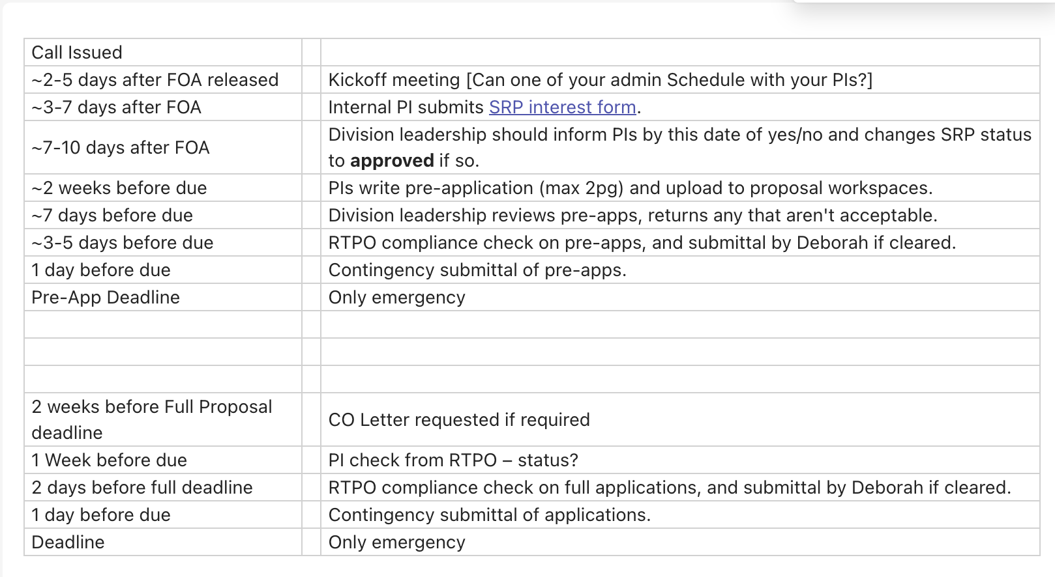
From the RTPO Manager
Final Deadline is March 4th. CO letter request due Monday 19th (with PIF). Status check 26th with RTPO.
Downselect is essentially due today to get letter, etc…

Slide 3
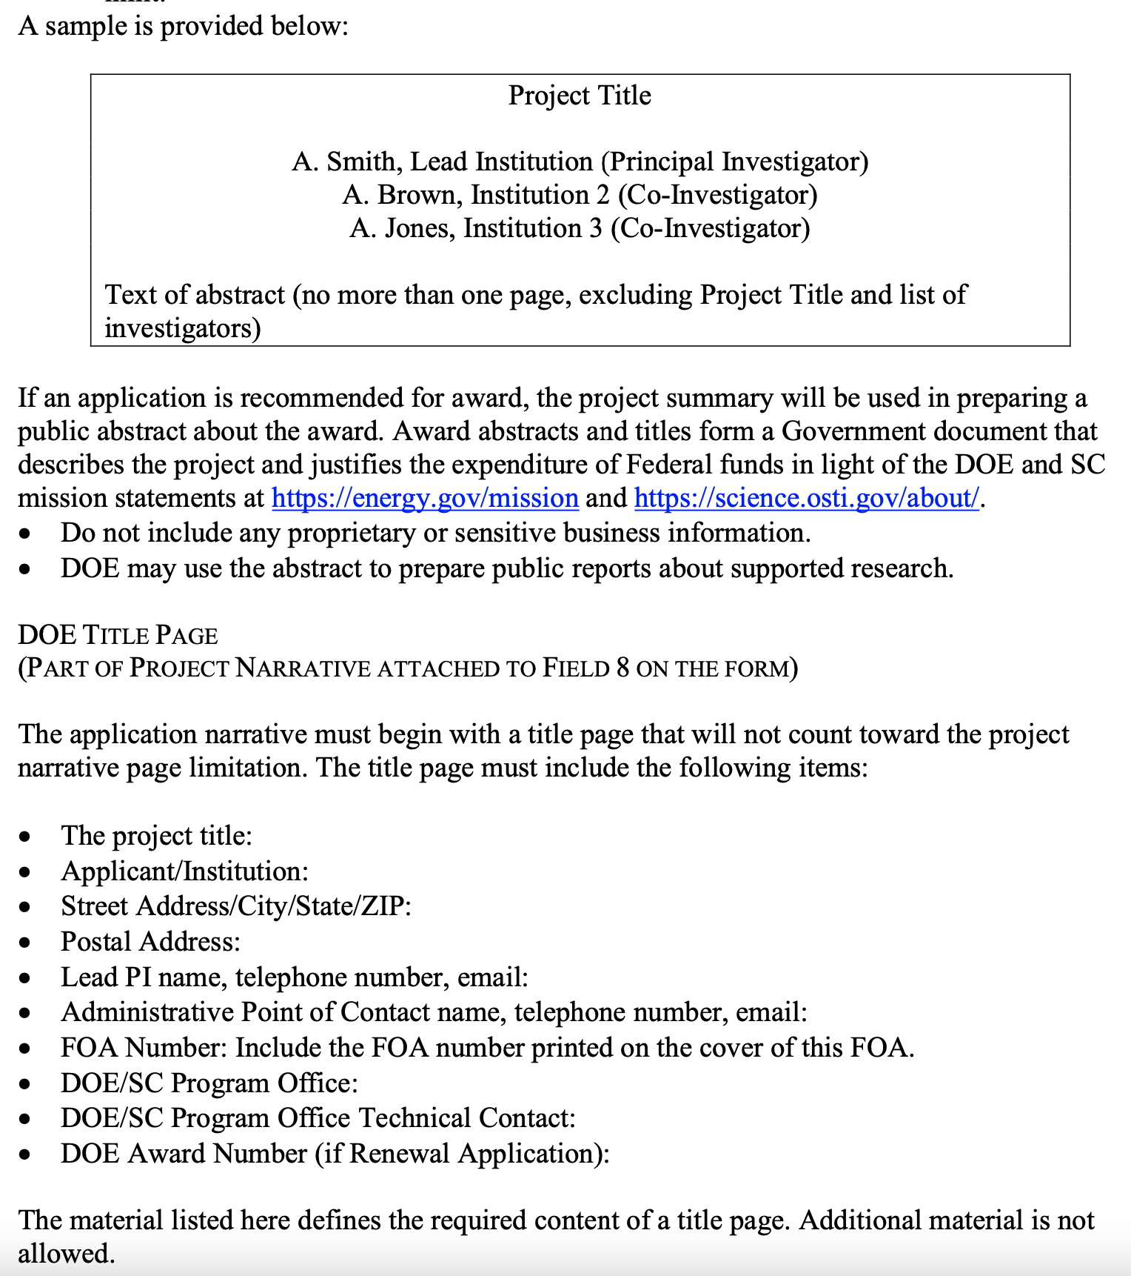
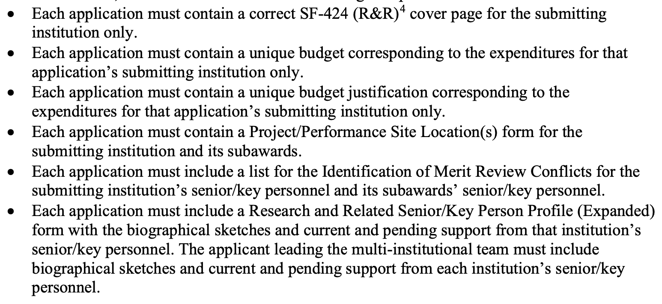
Front pages need updating (pages 14 and 15)

Slide 4
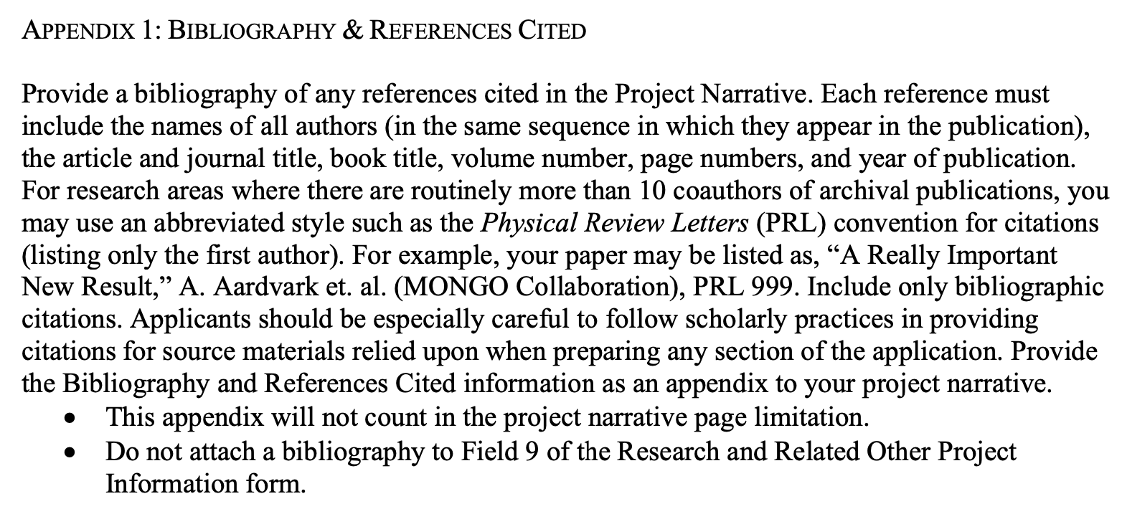
Updated front end to be specific to this year’s call
Some edits made, but it’s not done
Examples:
Still talking about adiabatic transitions
Still talks about making and measuring magnets
Previous/other funding funding might be good to mention (3 x LDRDs, agreement between JLab/BNL, etc…)
References need updating
More recent work added, etc…

Slide 5
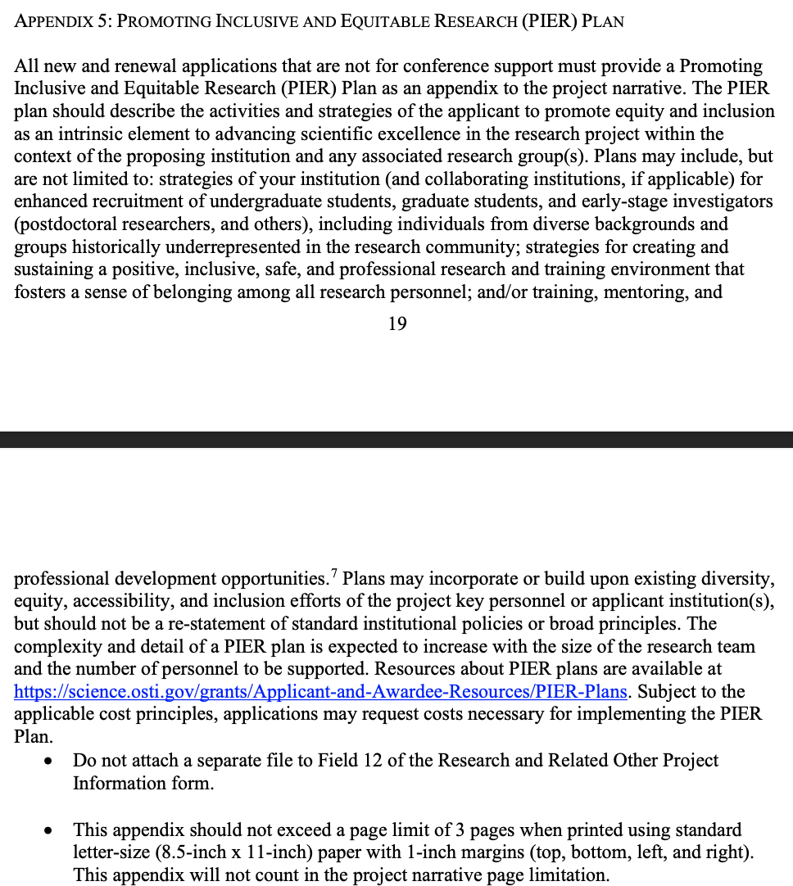
PIER
Starter uploaded
MUST be edited thoughtfully

Slide 6
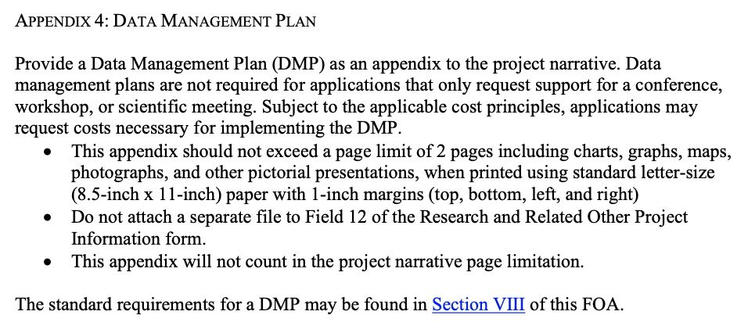
Data Management

Slide 7
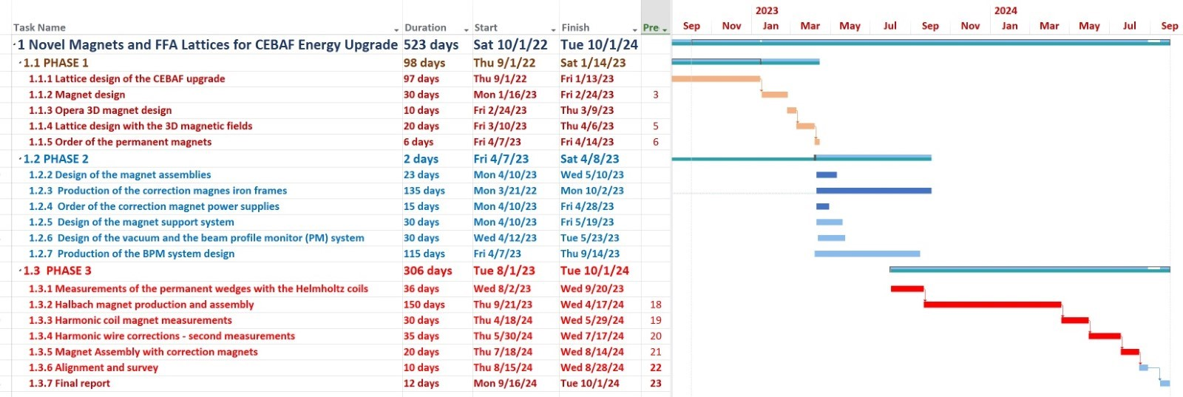
Timeline for major activities (milestones, deliverables)
Ours is from the last FOA (see below for an example)
Personnel assignments for activities
Careful about mixing “colors of money”

Slide 8
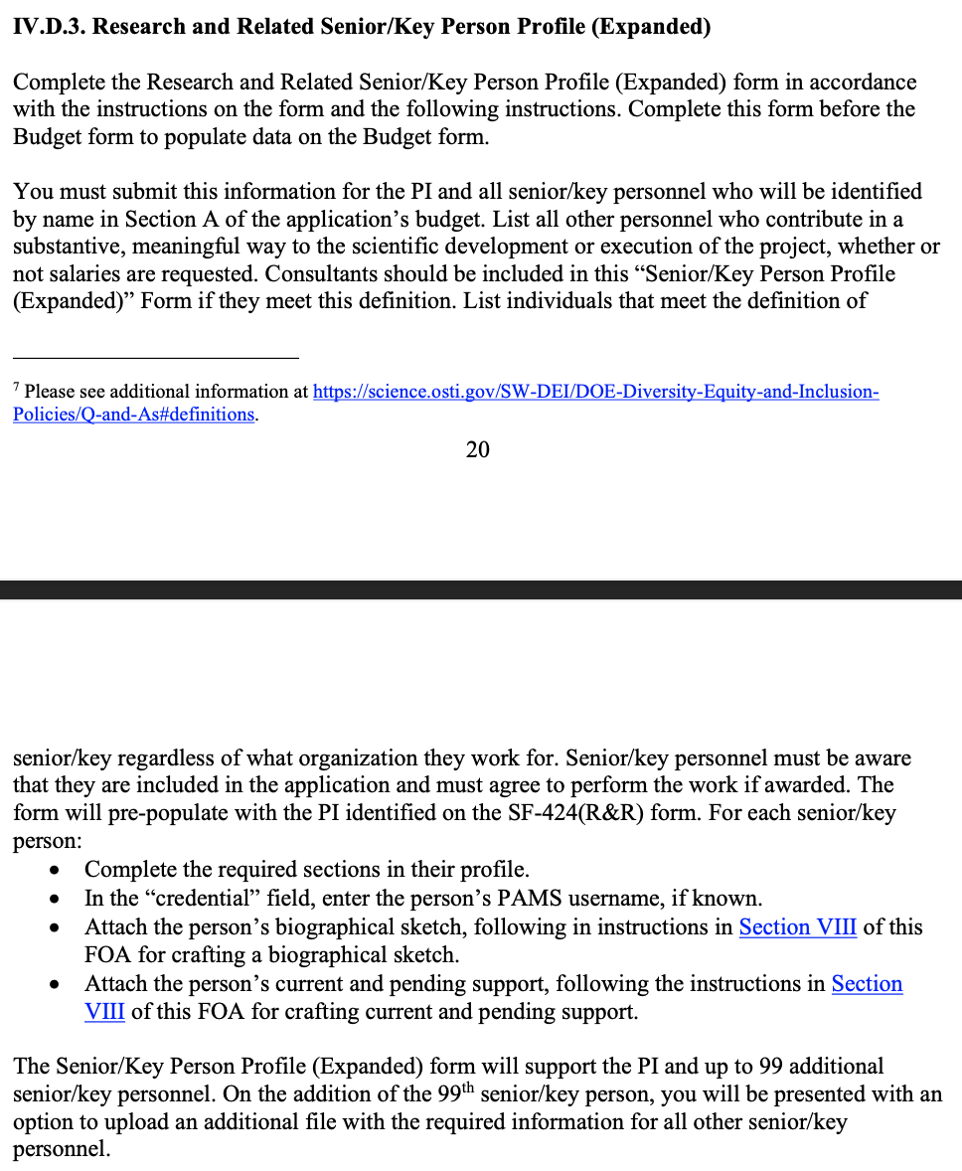
Page 20 – key personnel

Slide 9
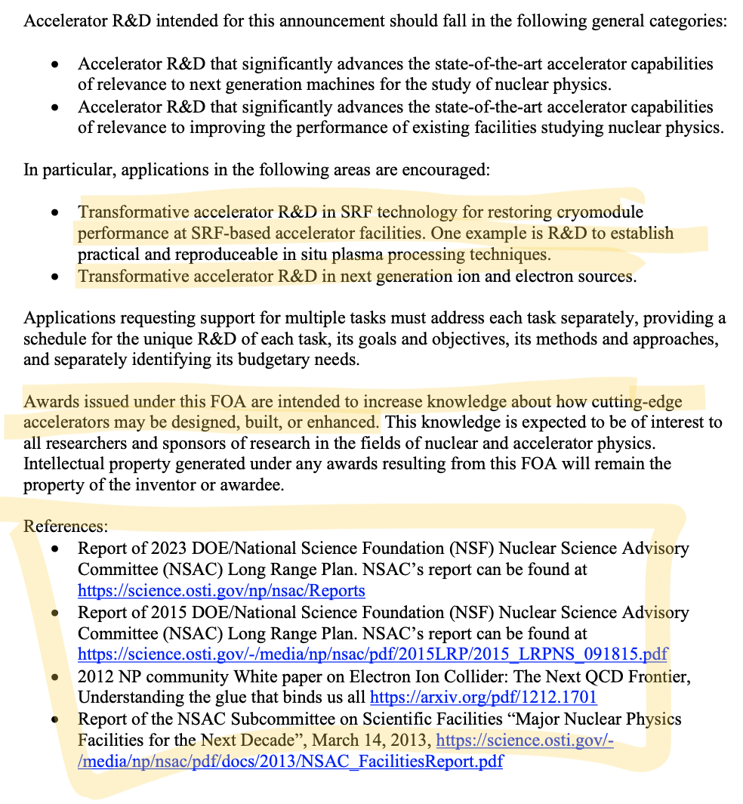
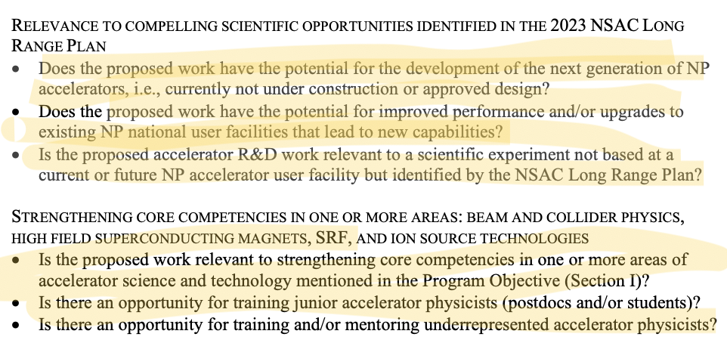
We *MUST* make sure we keep referring back to our goals in a manner which addresses THIS FOA call.

Slide 10
Nitpicks:
Switchyard > Spreader or Splitter, unless we’re talking about BSY
Need to decide if we’re hammering in on 22 GeV or being more general

Slide 11
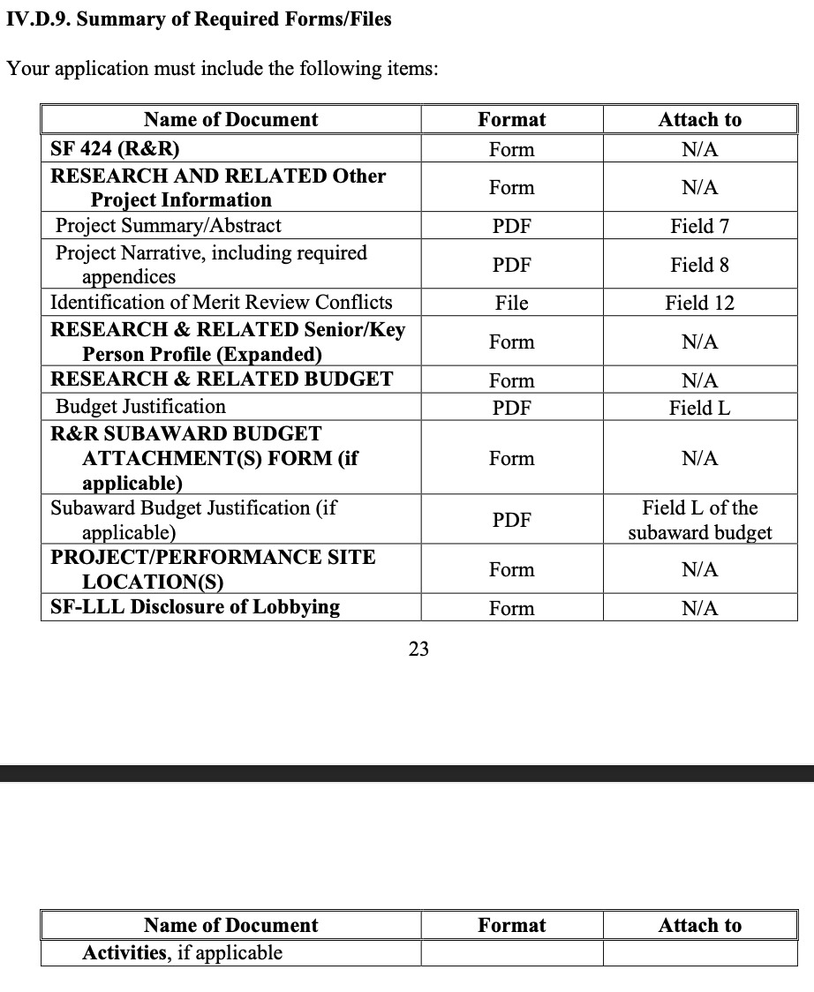
PLEASE READ THE FOA!!
There’s a lot of details, and much of it has to do with online submissions, etc…
Some are for individuals!

