Slide 1
the uncertainty from different Cuts
Haiyun Lu
G14

Slide 2
Section
30 or 15 phi bins
Cuts on beam polarization
Polarization or Edge distance cut
Sigma

Slide 3
Effects of Different Phi Binning
Missing momentum 180MeV and Beam Polarization > 5%
Same Data, different binning of 15 and 30
Compare G from 15 and 30 bins
No significant difference observed (almost identical)

Slide 4
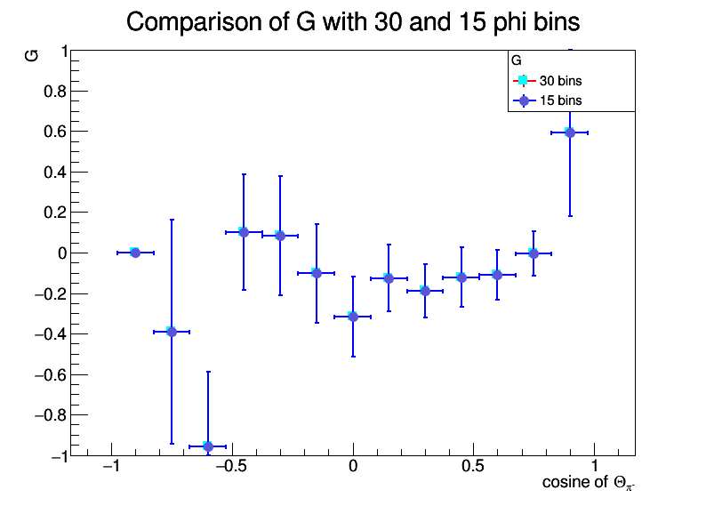
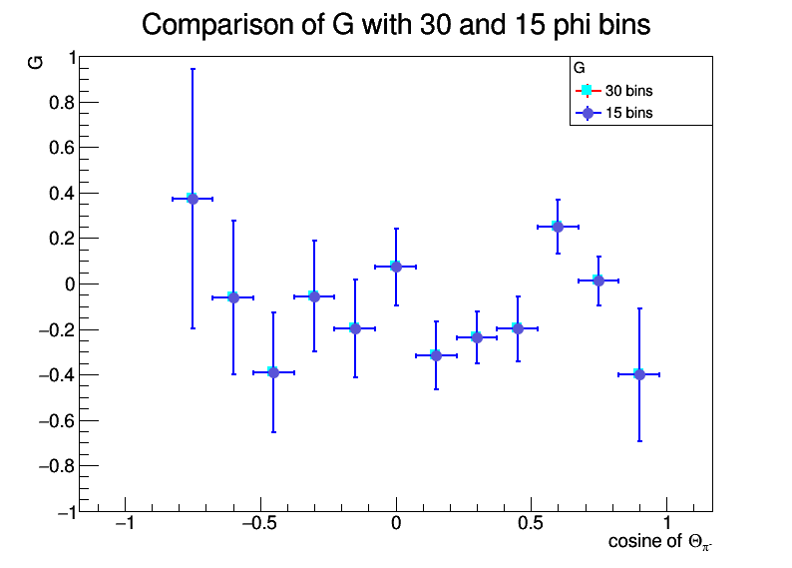
Lowest W
1820 – 1900 MeV
1900 – 1980 MeV

Slide 5
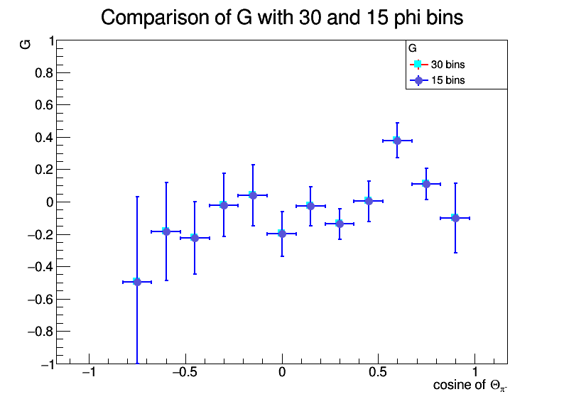
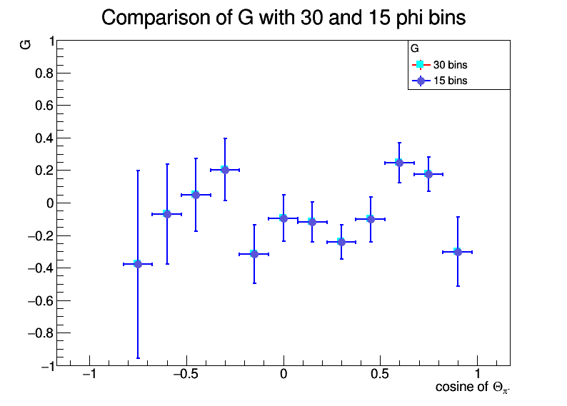
Medium W
1980 – 2060 MeV
2060 – 2140 MeV

Slide 6
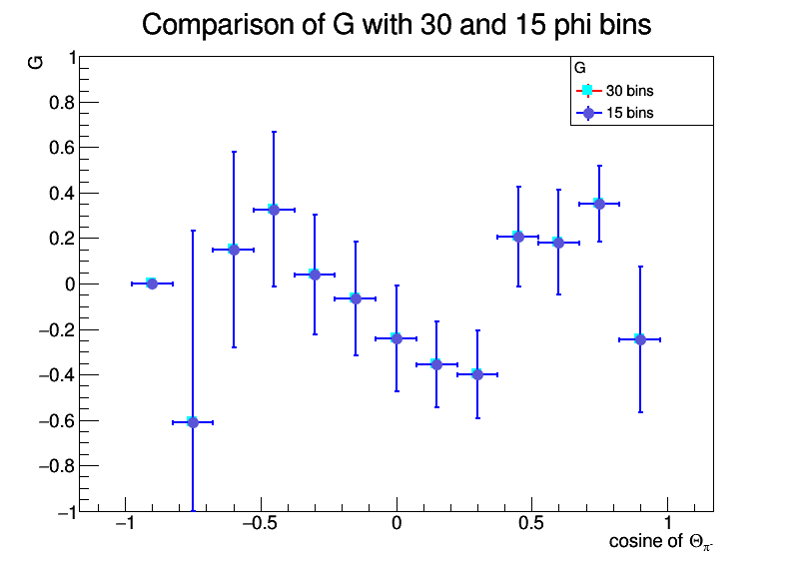
Highest W
Almost identical from different binning when the statistics is great enough
As expected, when the binning is in a “sweet zone”, the results are independent
Binning will not be mentioned in the following study
2140 – 2220 MeV

Slide 7
Compare different beam polarization cuts
Missing momentum 180MeV
Beam Polarization requirements: >5%, >10%, >15%, >20%

Slide 8
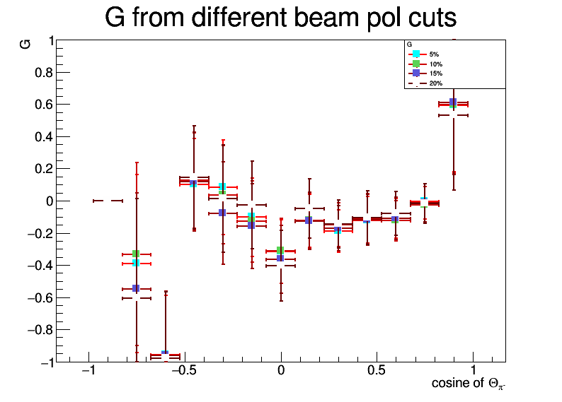
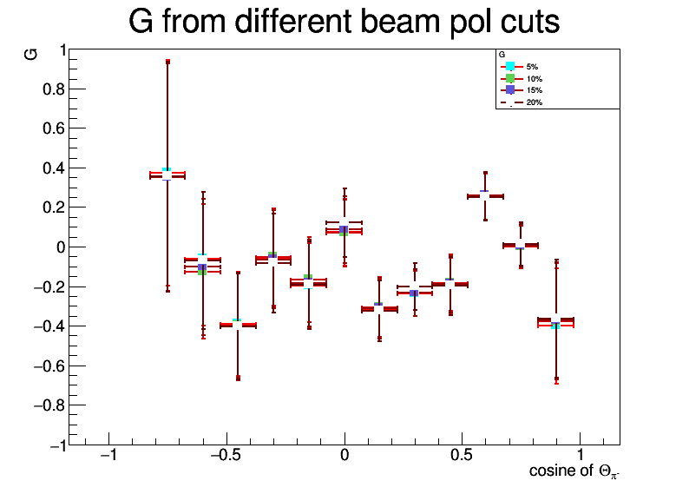
Lowest W
1820 – 1900 MeV
1900 – 1980 MeV

Slide 9
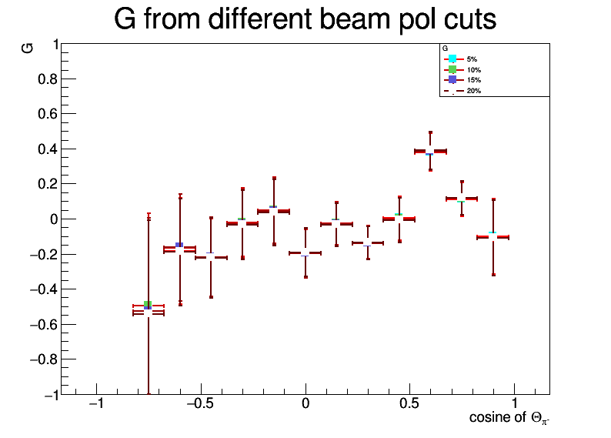
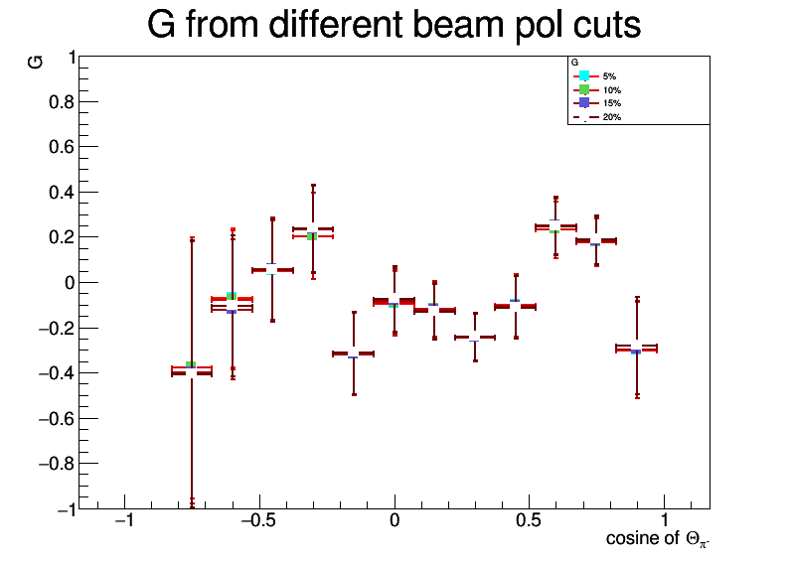
Medium W
1980 – 2060 MeV
2060 – 2140 MeV

Slide 10
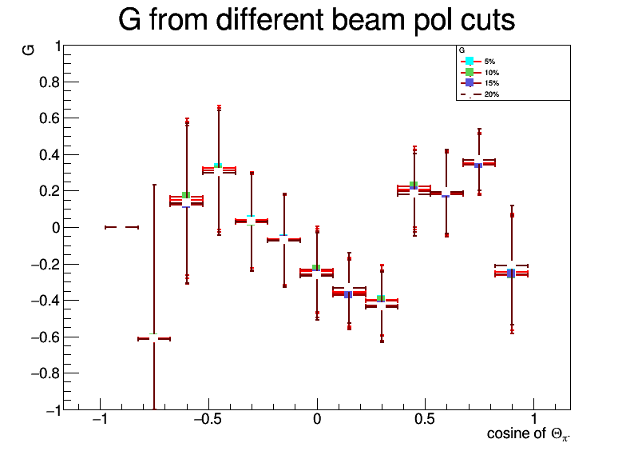
Highest W
Results are consistent from different polarization cuts
Very little shift of the G values
The uncertainties were affected most at the lower W indicating that lower W with lower beam polarization
2140 – 2220 MeV

Slide 11
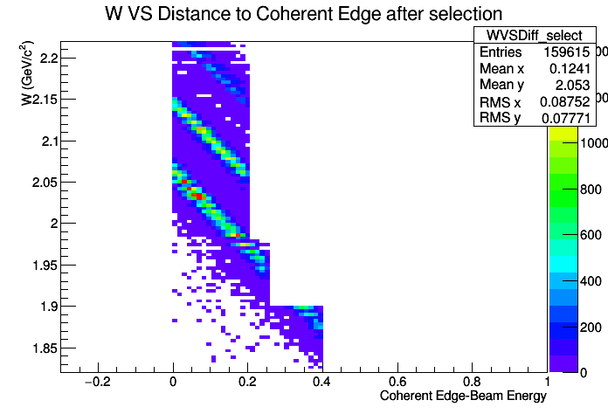
Compare G from beam polarization cuts and Edge distance cut
Missing momentum 180MeV
Beam Polarization requirements: >20%
Edge distance selection: 0.4, 0.25, 0.2 GeV

Slide 12
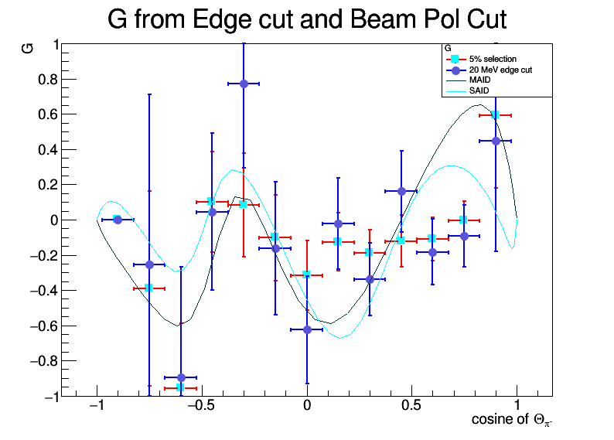
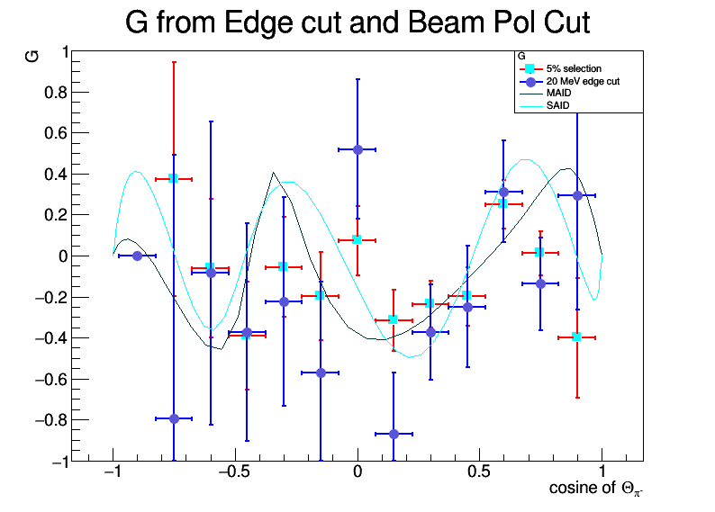
Lowest W
1820 – 1900 MeV
1900 – 1980 MeV

Slide 13
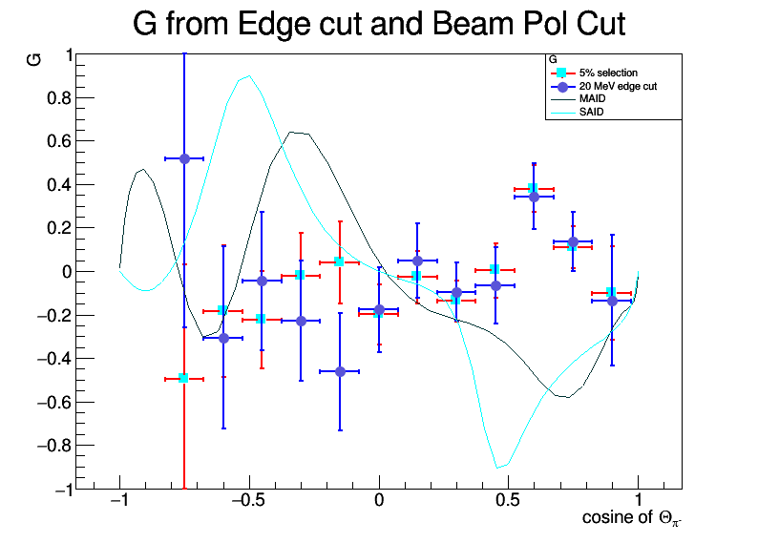
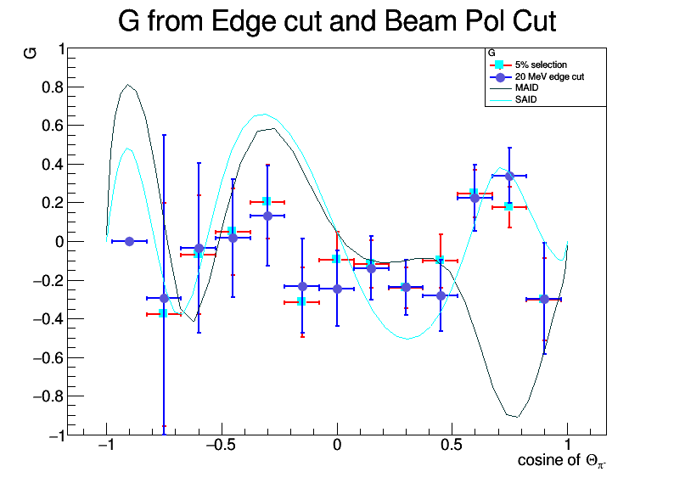
Medium W
1980 – 2060 MeV
2060 – 2140 MeV

Slide 14
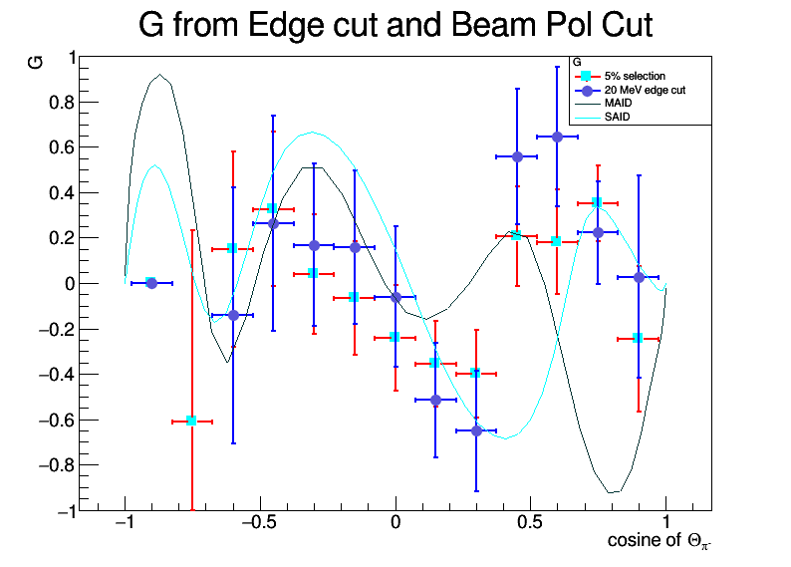
Highest W
Results are consistent overall
G from edge cut is with greater uncertainty
G from beam pol cut moves more smoothly bin-to-bin
G from edge cut are “jumpy”
2140 – 2220 MeV

Slide 15
Compare Sigma From beam polarization cuts and Edge distance cut
Missing momentum 180MeV
Beam Polarization requirements: >5%
Edge distance selection: 0.4, 0.25, 0.2 GeV

Slide 16
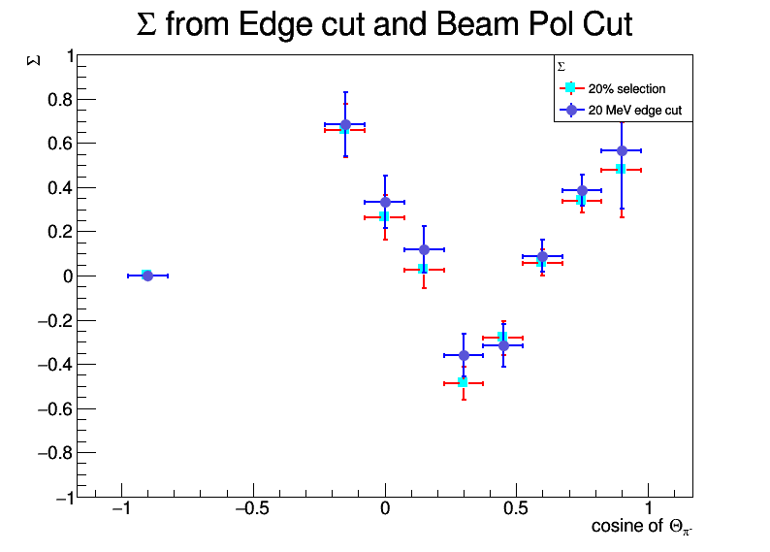
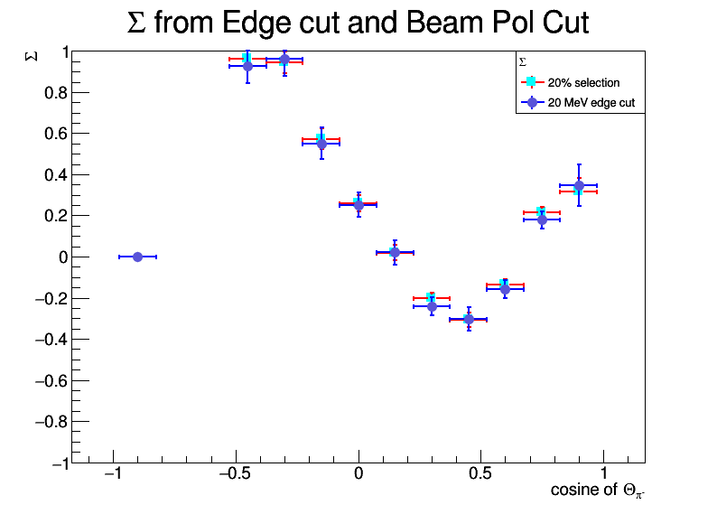
Lowest W
1820 – 1900 MeV
1900 – 1980 MeV

Slide 17
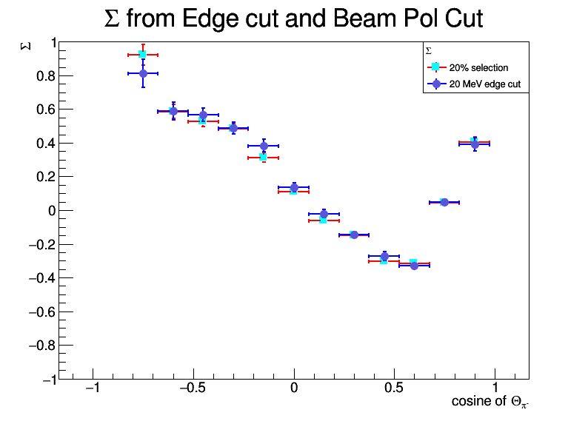
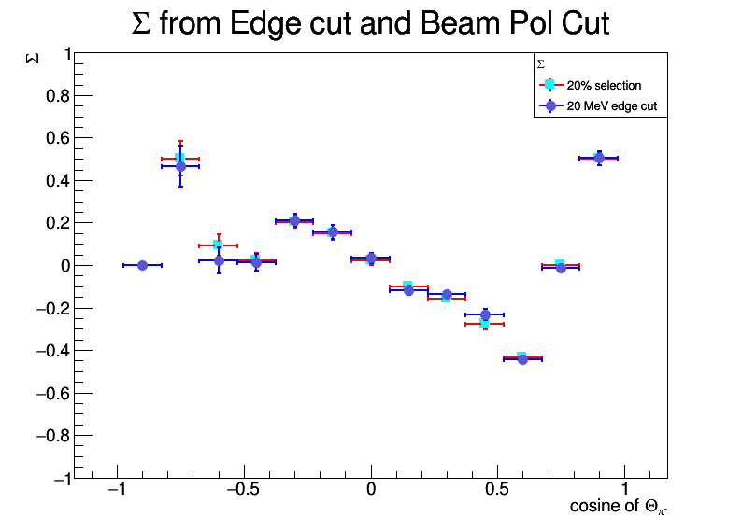
Medium W
1980 – 2060 MeV
2060 – 2140 MeV

Slide 18
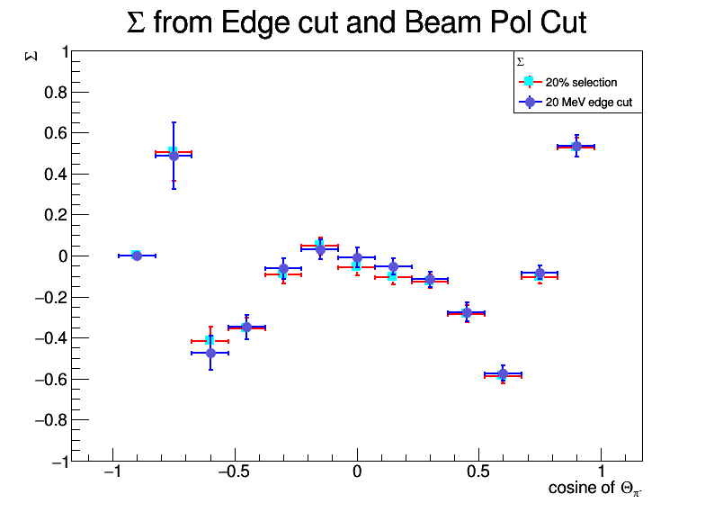
Highest W
Results are consistent overall
Most W do not need an overall correction factor from the hypothesized “incorrectly extracted beam polarization”
The lowest W might need this correction factor
2140 – 2220 MeV

Slide 19
Results
The beam polarization cut gives the consistent publishable G results
An overall factor might be needed for the lowest W bin to correct for the inefficient reconstruction of the beam polarization
The results are close to final

Slide 20
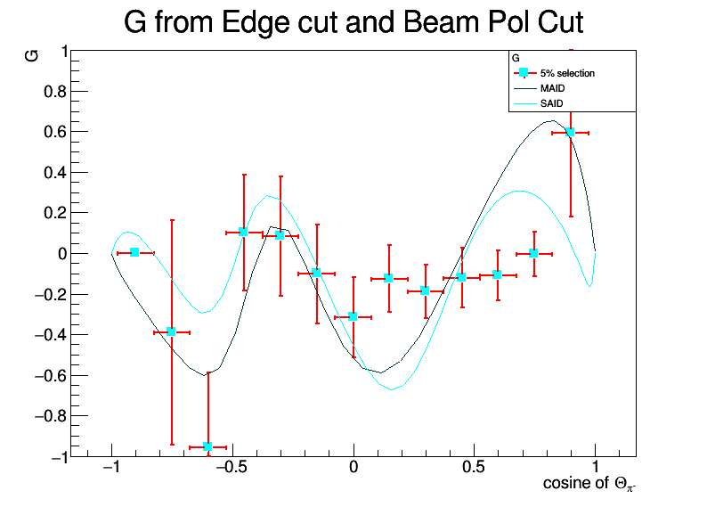
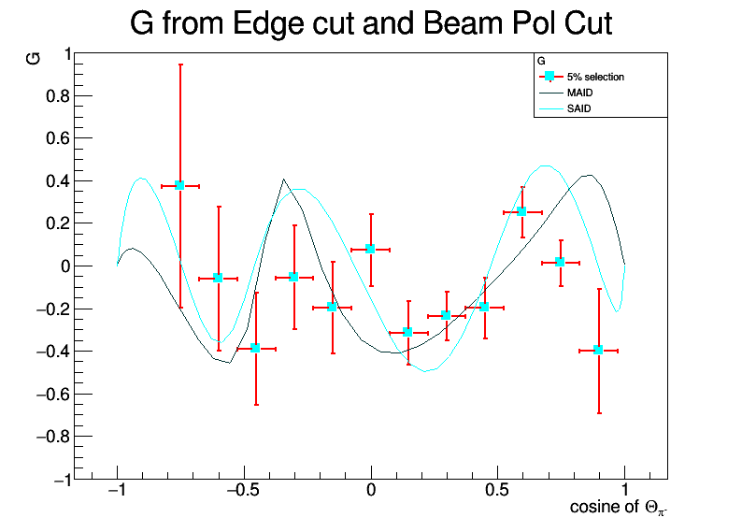
Lowest W
1820 – 1900 MeV
1900 – 1980 MeV

Slide 21
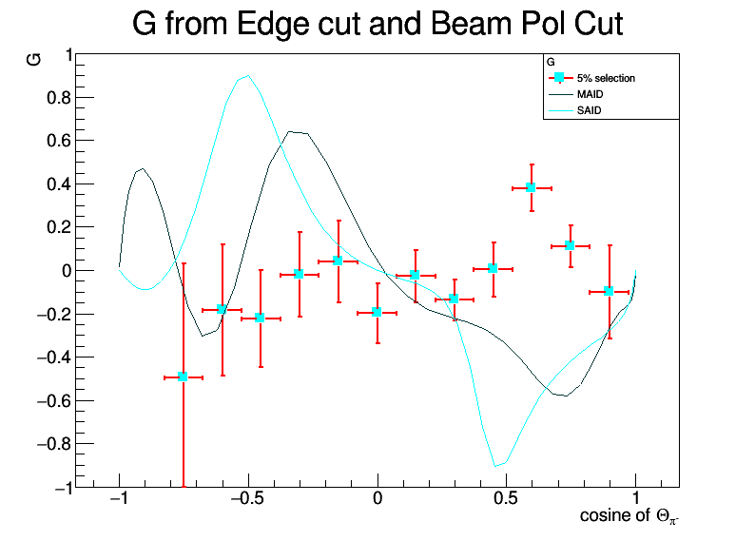
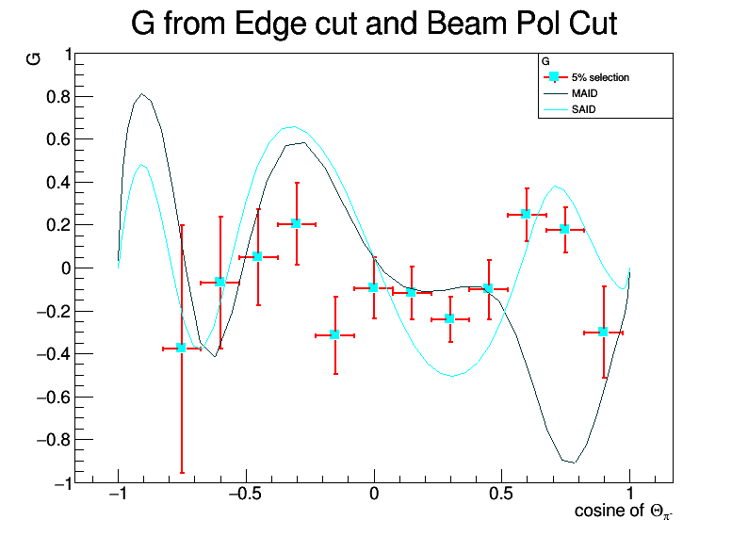
Medium W
1980 – 2060 MeV
2060 – 2140 MeV

Slide 22
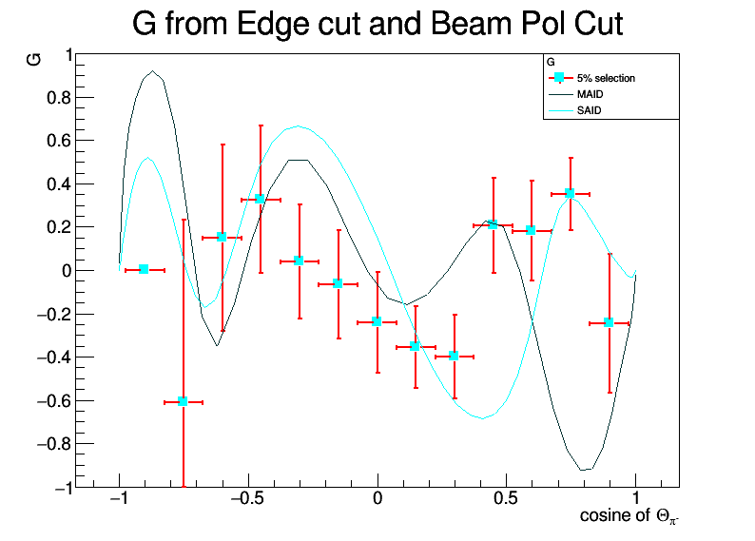
Highest W
2140 – 2220 MeV

