Slide 1
Study Beam Polarization Away from coherent edge
Haiyun Lu, g14

Slide 2
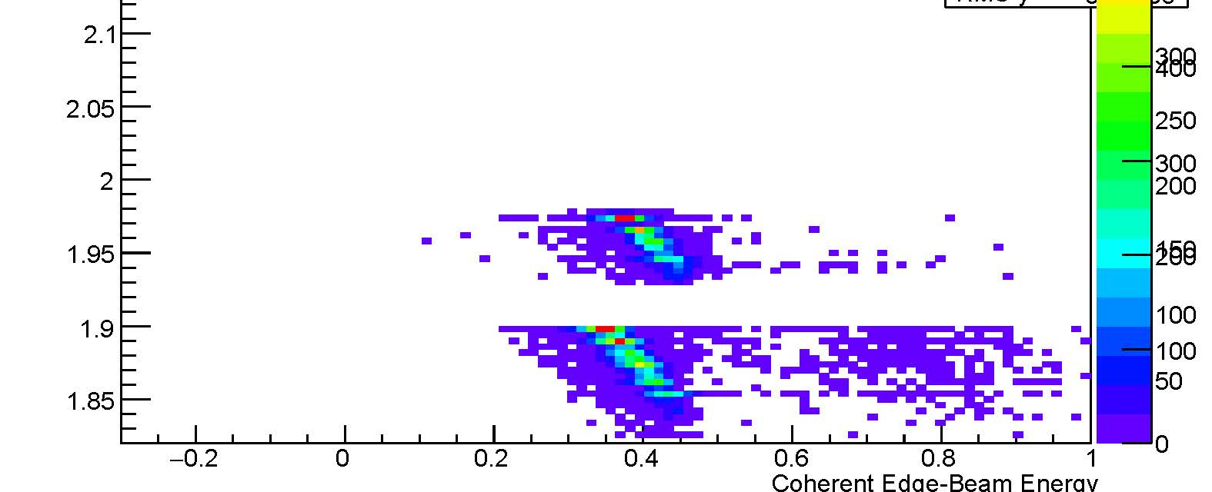
Idea of the study
Upper from 2000 MeV, below from 1800 MeV. They are similarly distance away from the coherent edge. The upper is used to extract Sigma and compare with 1800 MeV at the same W

Slide 3
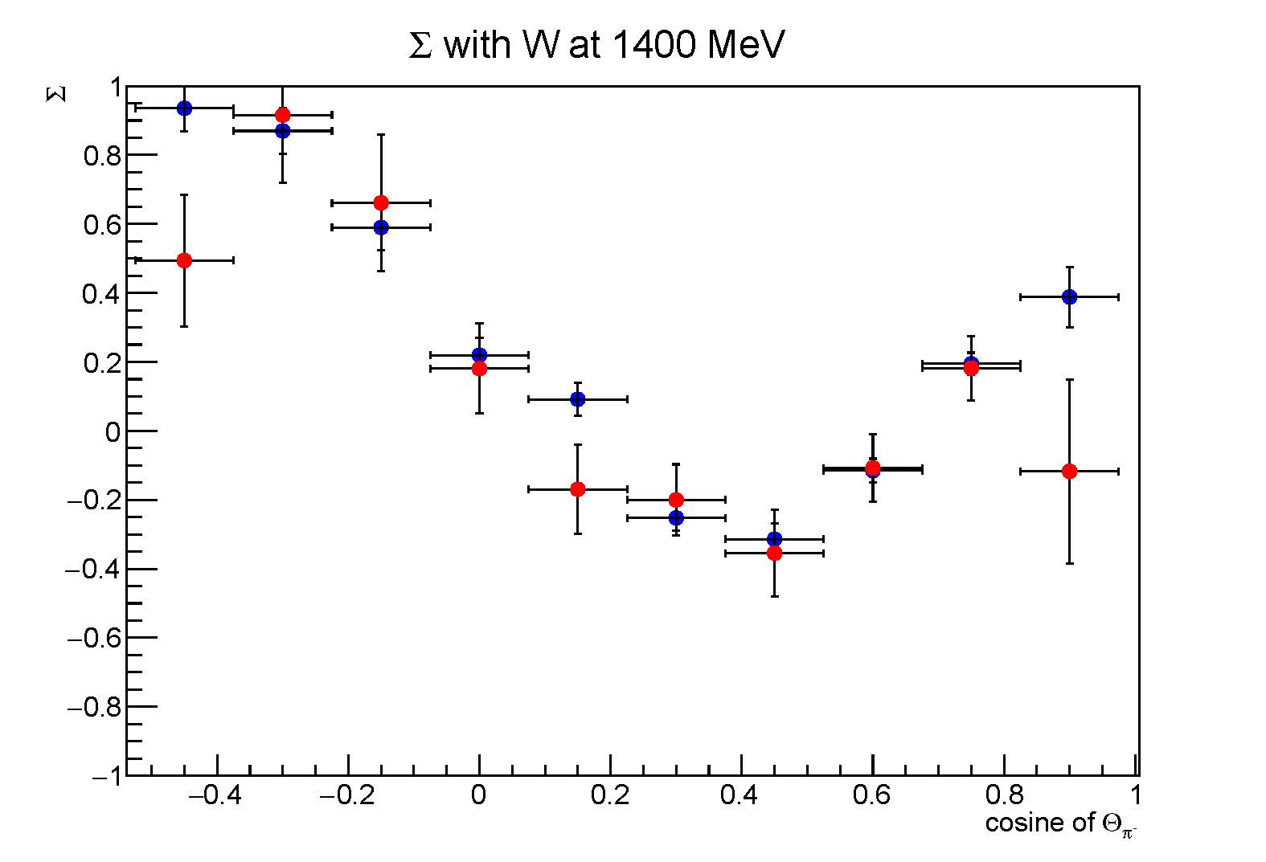
Directly compare Sigma
Blue from 1800 MeV runs
Red from 2000 MeV runs
A factor of 1.107 is fitted to match the two

Slide 4
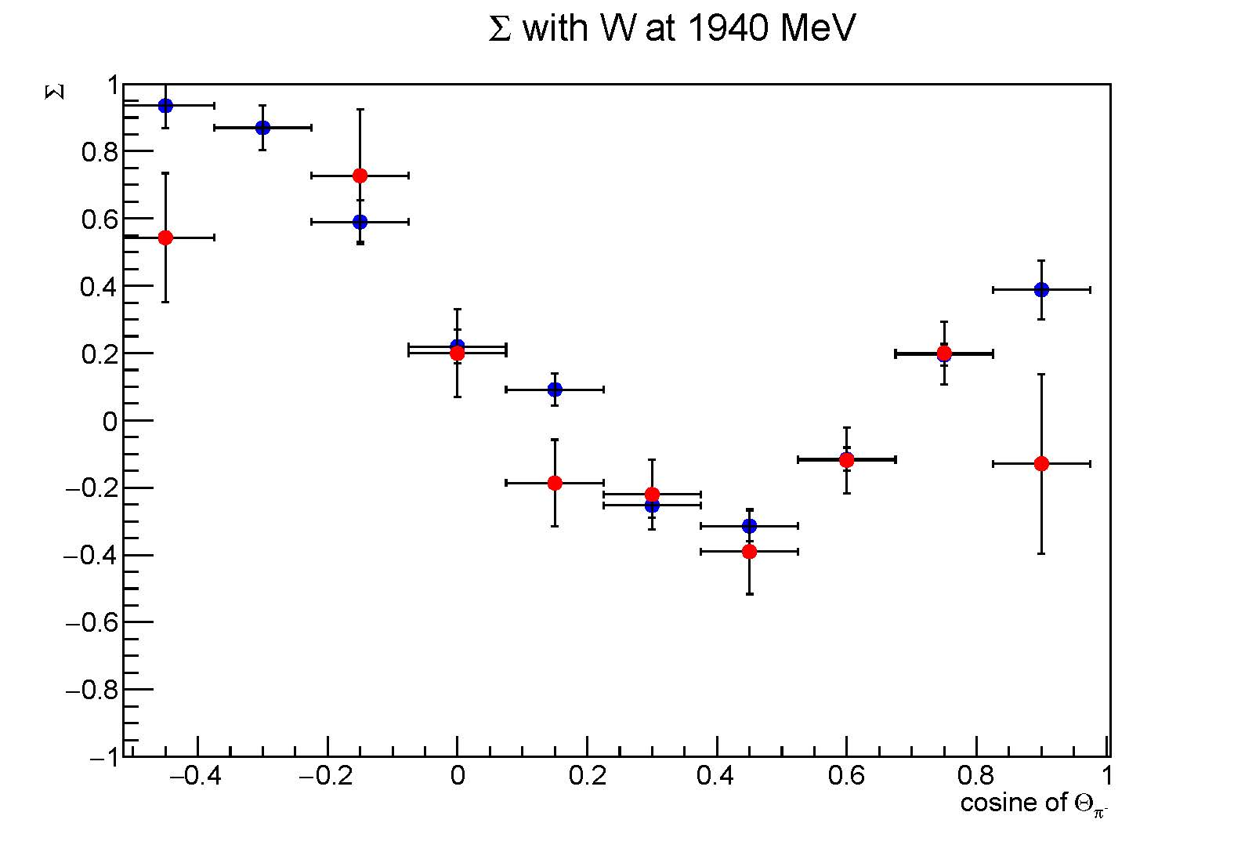
Directly compare Sigma
A factor of 1.107 is applied on red.
The red points above zero move higher and below zero move lower.
The points at ~0.75, 0.6, 0.3, 0 are closer after the factor applied

Slide 5
Conclusion
A factor of 1.107 could be applied, or 10.7% uncertainties could be quoted.

