Slide 1
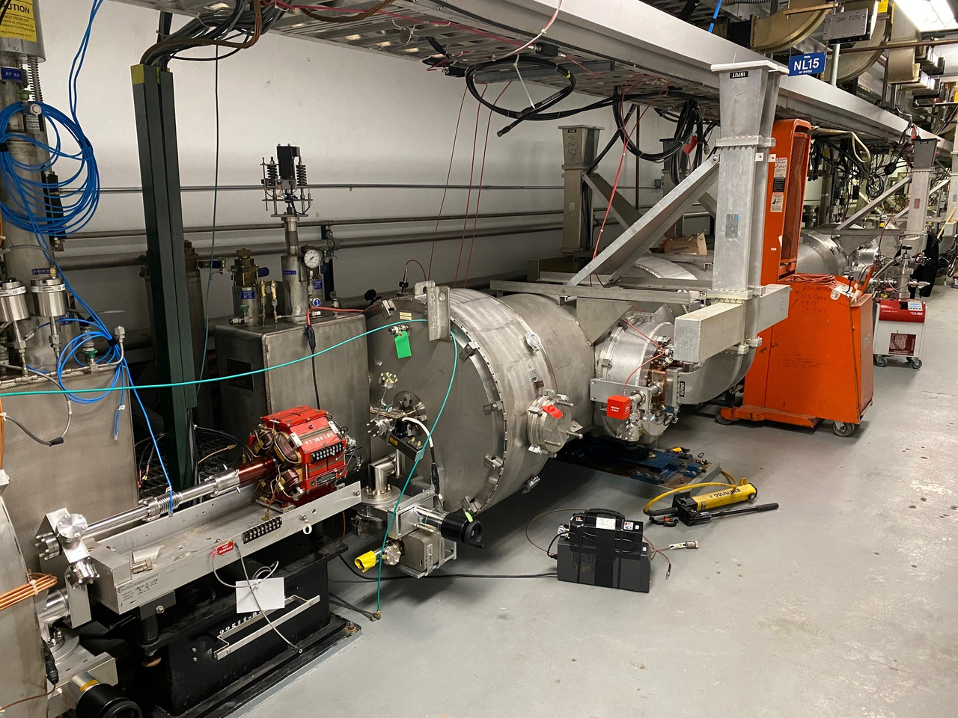
Possible Work list
Agenda:
RF status and Maintenance Coordination
- (Maintenance day: 2/28/24)
M. McCaughan
Monday, February 26, 2024

Slide 2
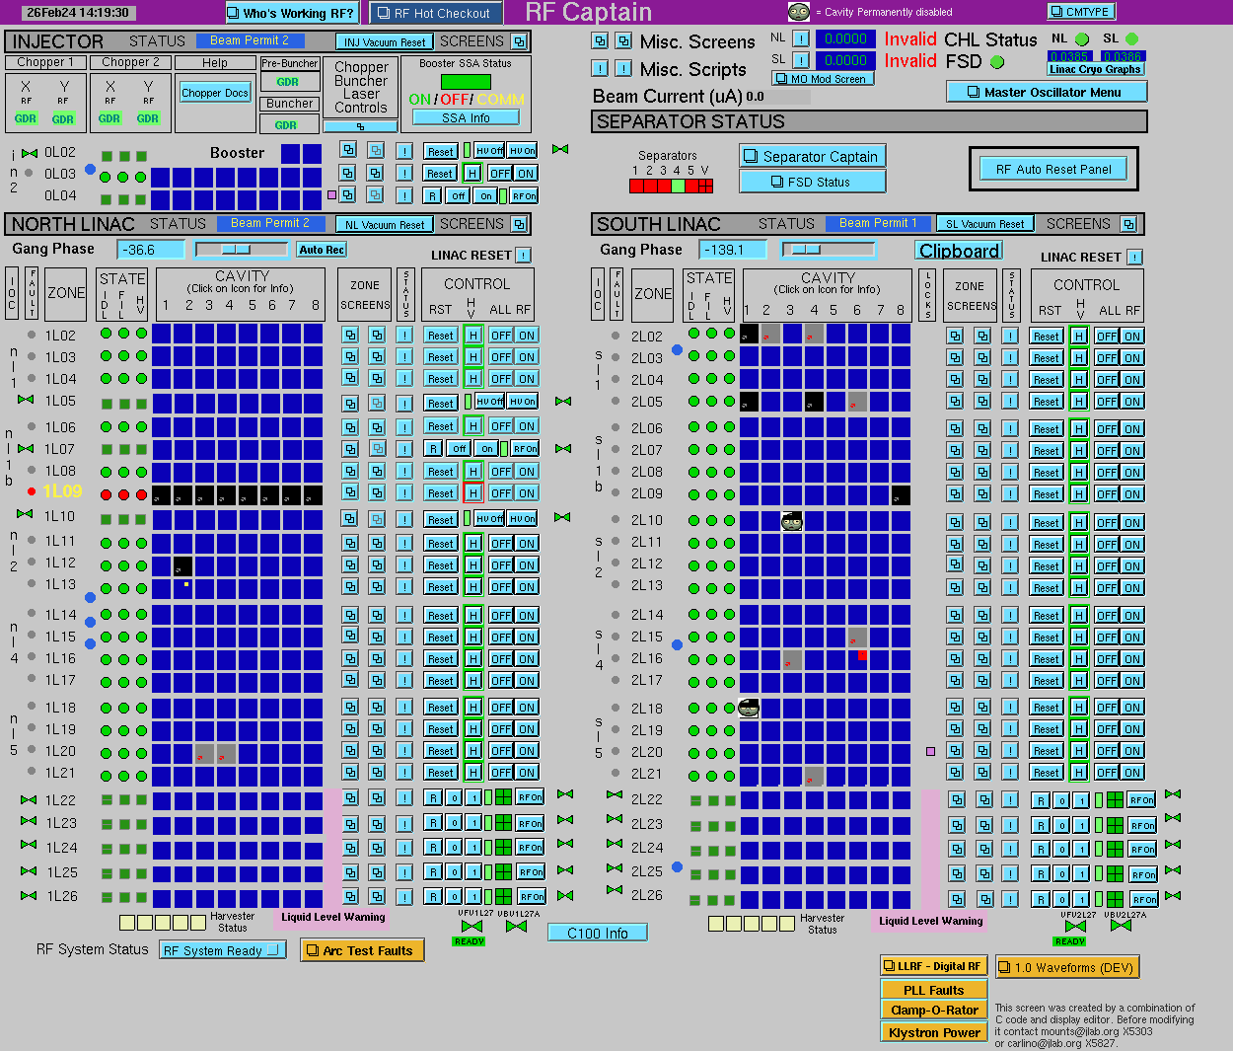
Present State (2/19/24): [MDay: 2/28/24]
2

Slide 3
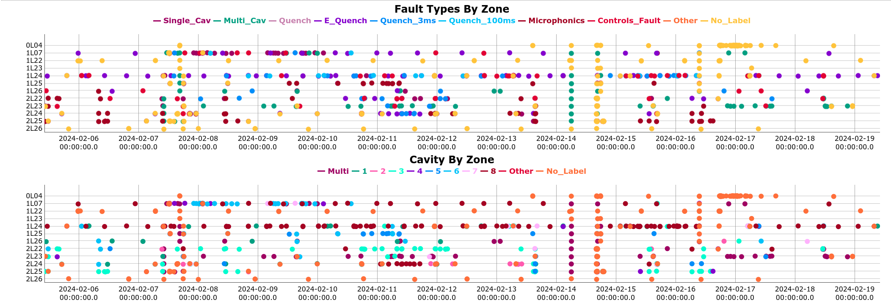
LLRF 2/3 faults (2/5/24-2/19/24):
1L07-8 pulse processed 2/7 and raised +2 MV/m to 13.8; perhaps back off that some.
1L24-8 electronic quenching; pulse processing required. Derated 0.5 MV/m 2/19.
1L25, 2L24, and 2L25 many microphonics trips.
<number>

Slide 4
Issues & Plans (INJ/NL):
INJ: 0L04 Field emission [Plasma processing planned for SAD.]
NL:
1L02-6 tube saturating since 2.5W amp replacement (4252856); RFCM swap (4254506); still unstable CRFP/high GLDER; derated to 4 MV/m. Should support 8.5 MV/m arc limited.
1L06-2 2.5W amp (Maybe push to 10 MV/m?)
C75 tuner motors [1L10-1/2]; velocity/accel. changes to avoid resonances (110959)
1L11-2 bad arc detector; in operation (109182)
1L14-3 KRRP limited; circulator load? (4169140) RFCM replacement required for low output (11.83 dBm; Kerns) (4236739) (Presently 9.6 MV/m)
1L15-3 bad 2.5W amp per Kerns (4197295) RFCM/amp swapped – still 4kW for 3MV/m; TS required (11.3 MV/m 9/11/23; presently 6)(+5.1 MV/m)
1L20-3/4 Arc detector replacement (+13.4 MV/m)
1L22-8 low IFPW (0.5 mW vs ~3 mW) (4170916, 4179508) Ditto 1L26-8.
1L24-8 – pulse process (4189864)
1L24 Add tuner bead bags as available (M. Weaks++). Cav 8 microphonics ~1/shift (1/29/24)
1L25-2 arc detector requires replacement (4254528)
1L26-1 Tuner microphonics outbursts; tuner motor/harmonic drive swapped. Issue persists
<number>

Slide 5
Issues & Plans (SL):
SL:
2L02-1 - (+7.4 MV/m) Klystron shorted(4229526; 12/1/23); fil. Bad (4246166)(4252390) tube swap req’d per Davis
2L02-2 – (+8.2 MV/m) Pfwd instability @ 8.2 MV/m. (1/14/24)(4239287) 2.5 W amp swapped; RFCM swap required per Kerns (4246206)(4252687)
2L02-4 – (+7.1 MV/m) No CRFP; need to check RFCM output per Davis (4252411)
2L05-1 Low fil. Voltage; zone HV trips (1/31/24). Fil. board swap 2/14; TS req. (+6.7 MV/m)
2L05-6 failing arc detector (2/20/24) (4254718) (+4.9 MV/m)
2L07-1 - (On@10 MV/m) 127mA KBCU. Cabinet access required to get klystron SN to determine if aging effect. (4234652)
2L09-8 KMAI; jumper pulled (1/31/24)(Kerns) (+11.8 MV/m)
2L12-7 GLDE spikes (4021391)
2L13-6 OLTed and derated for multiple CWWT. Warm IR in place. Double check tune & push. (4253951)(6.9 MV/m?)
2L15-6 Noisy drive (4256077); new RFCM required per Kerns 2/26.(+5.0 MV/m)
2L16-3 - (+6.7 MV/m) CWVF/IIR2 vacuum faults; RFCM/cables swapped ​(4226944; 11/8/23)
2L16-40 pair WG activity. (4255525) Raise trip point to 5e-7 (EES-IC) and add supplementary pump (SRFVac) 2/28. Cav. 5 was at 9.9 MV/m; cav. 6: 8 MV/m.
2L16-7 bad KCCU readback (3938124)(11/6/21)
2L17-8 KCCU low (0.9A; 0.65 mA KMAI. KFVS: 6; KFVM: 5?)(4241879)
2L21-4 (+7.5 MV/m) Gradient measure fault 2/16 (4253295) No CRFP read back (4172248)
2L23-3 - (On@22 MV/m) Bad IR readback; cable or US hardware. Verified locally w/ heat gun & cable swaps. (4168553, 4177321)​ (8/18/23)
2L24-1 ~335 Hz oscillation; FCC replaced pre-2/7. (4249344) Alter sample clock to check for aliasing?
2.5W amps: 2L07-6, 2L09-1, 2L10-5, 2L10-7, 2L19-6, 2L21-1, & 2L21-8
SL LO stability: 4255709
<number>

Slide 6
Biggest *Bang* gradient items:
NL:
1L15-3 bad 2.5W amp per Kerns (4197295) RFCM/amp swapped – still 4kW for 3MV/m; TS required (11.3 MV/m 9/11/23; presently 4)(+11.2 MV/m)
1L15-2 KBCU; bypassed. (4252439)(+10.6 MV/m)
1L03-2 low fil. Voltage (4252445)(+6.7 MV/m)
SL:
2L09 burnt CPS cable; MDP down to replace 2/20/24 (4253236) (+77.7 MV/m w/o cav 8)
2L09-8 KMAI; jumper pulled (1/31/24)(Kerns) (+11.8 MV/m)
2L02-2 – (+8.2 MV/m) Pfwd instability @ 8.2 MV/m. (1/14/24)(4239287) 2.5 W amp swapped; RFCM swap required per Kerns (4246206)(4252687)
2L02-1 - (+7.4 MV/m) Klystron shorted(4229526; 12/1/23); fil. bad (4246166)(4252390)
2L02-4 – (+7.1 MV/m) No CRFP; need to check RFCM output per Davis (4252411)
<number>

