Slide 1
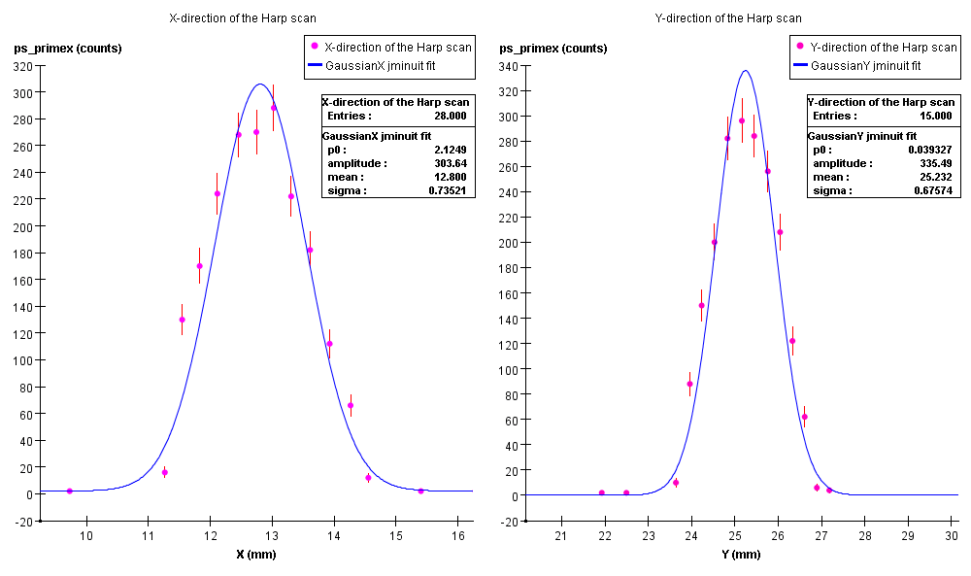
Photon beam profile

Slide 2
First event reconstruction from HD target

