Slide 1
DOE LOTO Events
EFCOG-ESTG
Electrical Safety Month
May 2017

Slide 2
DOE LOTO Events
The DOE complex has recently experienced a negative trend of LOTO events. In the month of March and April there were 12 events reported as either a failure to follow a hazardous energy control process, the discovery of an uncontrolled hazardous energy, or an incorrect method was used for implementing Lockout/ Tagout.

Slide 3
DOE LOTO Events
3/15/17 - Hanford Site
Workers discovered an uncontrolled circuit after the Lockout/Tagout work was released
3/23/17 - Carlsbad Field Office
Failure to follow a prescribed hazardous energy control process on a roll-up door

Slide 4
DOE LOTO Events
3/23/17 - Brookhaven National Laboratory
Failure to follow a prescribed hazardous energy control process regarding LOTO locks
3/27/17 - Pacific Northwest National Laboratory Discovery of a uncontrolled hazardous energy on a power connector

Slide 5
DOE LOTO Events
3/28/17 - Hanford Site
A Lock and Tag violation occurred during breaker cubicle corrective maintenance activities
3/28/17 - Oak Ridge National Laboratory
Failure to follow a Lockout/Tagout process during construction activities

Slide 6
DOE LOTO Events
3/29/17 - Idaho National Laboratory
Failure to follow a hazardous energy control process while performing maintenance on a firewater pump
4/4/17 - Argonne National Laboratory
Missed step during the zero electrical energy verification process

Slide 7
DOE LOTO Events
4/4/17 - Idaho National Laboratory
Hazardous energy identified during breaker maintenance
4/7/17 - Lawrence Berkeley National Laboratory Procedural violation during breaker maintenance

Slide 8
DOE LOTO Events
4/13/17 - Idaho National Laboratory
Lockout/Tagout installed on the incorrect breaker
4/17/17 - Savannah River Site
Incorrect method of installing Lockout/Tagout tag

Slide 9
DOE LOTO Events Analysis
Preliminary examination of these events has shown that the contributing factor to the majority of these events has been inattention to detail. Some examples include not fully understanding site specific LOTO procedure requirements, missing steps during the implementation of a Lockout/Tagout, or not meeting NFPA 70E requirements during the LOTO process when establishing an electrically safe work condition.

Slide 10
DOE LOTO Events Analysis
Fortunately the errors that occurred during these events did not result in any injuries yet it is the consensus of the EFCOG Electrical Safety Task Group that awareness needs to be communicated to the DOE complex about this disturbing trend and provide suggestions on how to mitigate them.

Slide 11
DOE LOTO Discussion
Everyone develops a knowledge of safety during the course of their career. It can be defined as the experience retained by that individual to perform work in an unpredictable environment. This experience is gained throughout our lives through training and classes but most of all, through real life situations.

Slide 12
DOE LOTO Discussion
Depending on the length of time an individual has spent performing servicing and maintenance on equipment requiring Lockout/Tagout, a worker may not be fully aware of all the requirements that need to be followed to implement a successful program.

Slide 13
DOE LOTO Discussion
People are fallible and easily become distracted when they are overloaded or adverse conditions come up. Factors like starting a new job with the company, working on an unfamiliar system, or even personal matters in life can affect the daily performance of a worker.

Slide 14
DOE LOTO Discussion
When situations like these arise, it is always recommended that you pause what you are doing, seek the help of another employee with more experience or familiarize yourself better with the task you are performing.

Slide 15
DOE LOTO Discussion
The isolation of hazardous energy is one of the most important steps in protecting personnel from injury or death. In the process of establishing the isolation of hazardous energy, there are several barriers that are put in place to achieve this condition.

Slide 16
LOTO Barriers
Qualified personnel
Equipment shut-down
Isolate the energy
Apply locks and/or tags
Verify isolation

Slide 17
LOTO Barriers
While it is possible that one of these barriers could fail without any physical consequence to a worker, it does show a trend in which a significant event will occur if actions are not taken to prevent it from happening again.

Slide 18
LOTO Considerations
Something to consider in having a successful LOTO program is how well a user of the program understands it. Most DOE sites have implemented procedural requirements into their LOTO program that are specific to that site. This could become an error precursor which can cause confusion when outside companies are on site and are not familiar with the program or new employees are hired. Other error precursors to consider are shown on the next slide.

Slide 19
Error Precursors
Time Pressure | High Workload | Multiple Tasks
Unfamiliarity with Task | Lack of Knowledge | Improper Communication
Inexperience | Unclear Roles & Responsibilities | Mental Shortcuts
Illness or Fatigue | Distractions/Interruptions | Stress
Old Habits | Assumptions | Complacency
Unexpected Conditions | Workarounds | New Techniques

Slide 20
LOTO Considerations
Work planning plays a key role when developing and implementing a Lockout/Tagout. Work is often planned as imagined but it is not executed and performed in the same manner. When aligning a system for the preparation of Lockout/Tagout, every effort must be made to ensure all the steps are followed in the site’s LOTO program and they align with the planning process. Any deviations should cause a worker to pause and re-evaluate.

Slide 21
LOTO Considerations
Some other suggestions include;
Ensure sub-contractors are aware of site specific requirements
Workers involved with the isolation of electrical energy understand the requirements of NFPA 70E
The LOTO program contains a clear definition of when the isolation of hazardous energy will be controlled by Lockout/Tagout or another standard involving employee protection. I.E. machine guarding, physical separation, clearance orders, etc.

Slide 22
LOTO Considerations
Provide detailed descriptions of work activities during daily pre-job briefings when Lockout/Tagout is being utilized.
Develop a demonstrated proficiency checklist for Lockout/Tagout users which can be used as a real-time assessment for employees.

Slide 23
LOTO Considerations
The most important role of implementing a successful isolation of hazardous energy is ensuring all employees working under the Lockout/Tagout process are familiar with all of the requirements of the program and are focused on each step of the process. Missing one of these steps will result in an error which could lead to an event.

Slide 24
LOTO Considerations
The Electrical Safety Task Group has compiled some aids from various DOE sites to assist with communicating to employees the importance of isolating hazardous energy and the need for continuous education involving the Lockout/Tagout program used at DOE sites.

Slide 25
LOTO Aids

Slide 26
LOTO Aids

Slide 27
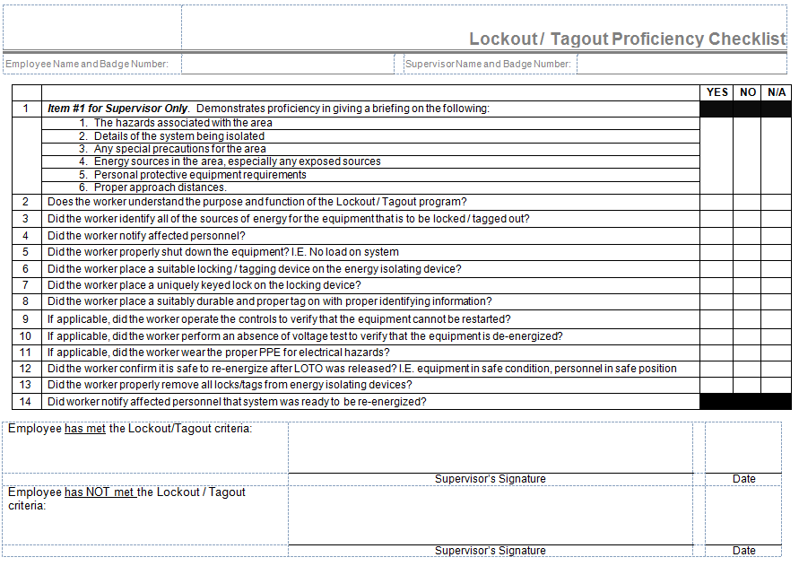
LOTO Aids

Slide 28
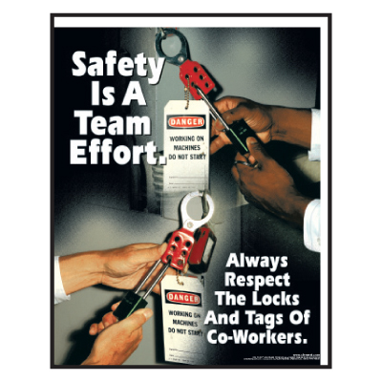
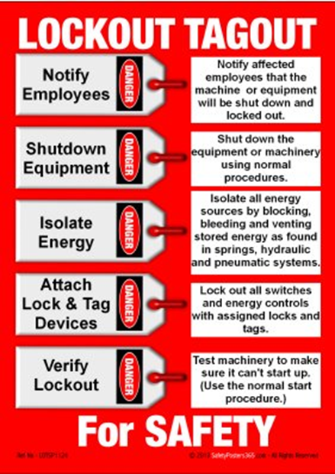
LOTO Aids

Slide 29
LOTO Aids

Slide 30
LOTO Aids

Slide 31
LOTO Aids

Slide 32
Conclusion
The increase of events involving hazardous energy control throughout the DOE complex are creating a negative trend which could become a catalyst for a greater event involving injury or death.
While no injuries were involved with any of these events, actions must be taken to reduce the number of errors that are occurring.
Help provide a safer workplace for everyone by evaluating your LOTO program, personnel, and precursors.
Detecting and correcting error precursors will remove latent weaknesses and help prevent a significant event from occurring.
You hold the key to a successful Lockout/Tagout

