Slide 1
CHL Cold Box Work at Elevation using Dual Self-Retractable Lanyards
07/25/17

Slide 2
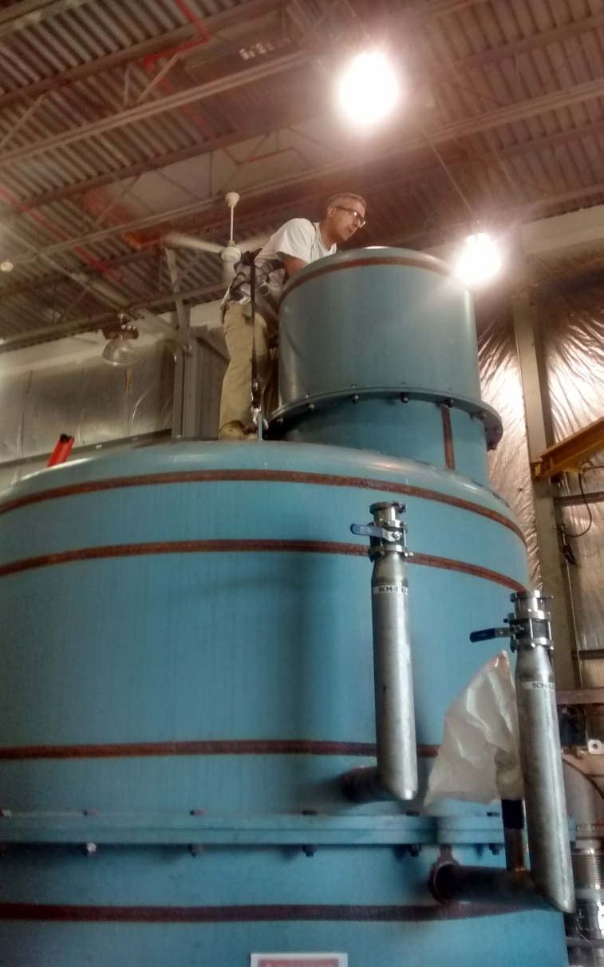
Self Retractable Lanyard Attached to East Lifting Lug (Lifting lugs approved for fall arrest anchorage by Kelly Dixon)

Slide 3
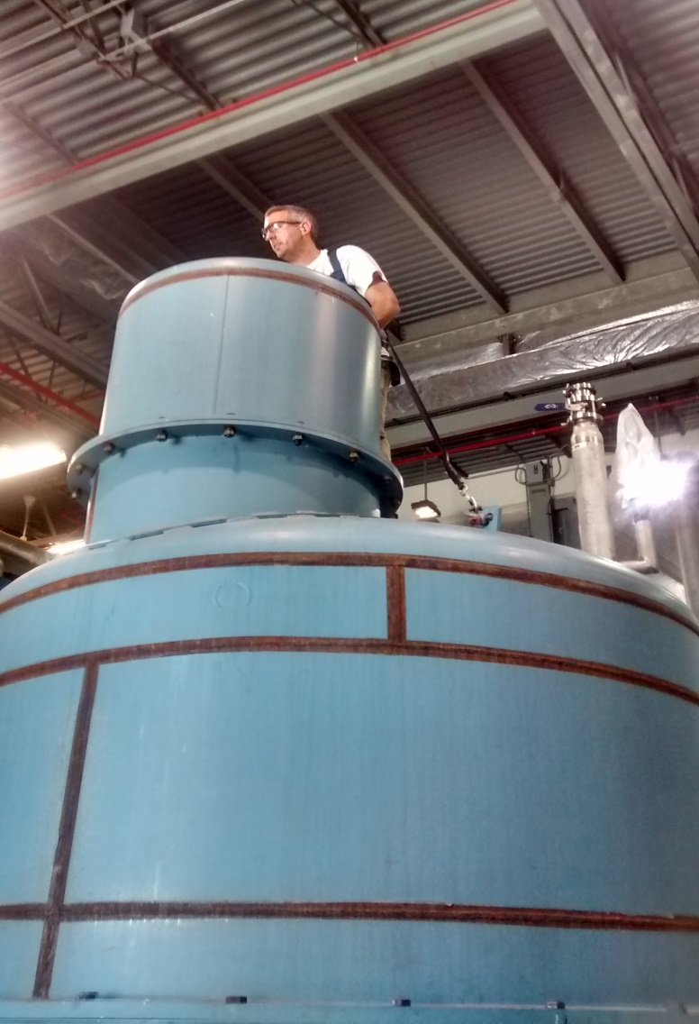
Self Retractable Lanyard Simultaneously Attached to West Lifting Lug

Slide 4
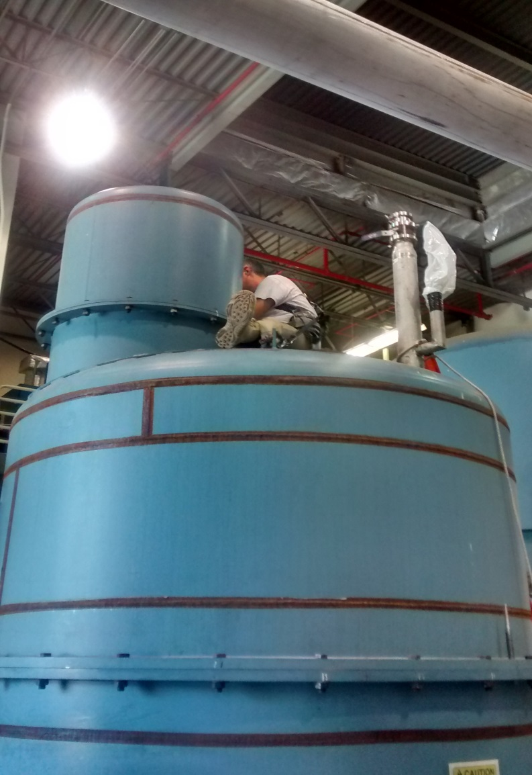
A ‘Sitting’ Work Position was used during Performance of Work (Tightening Bolts)

Slide 5
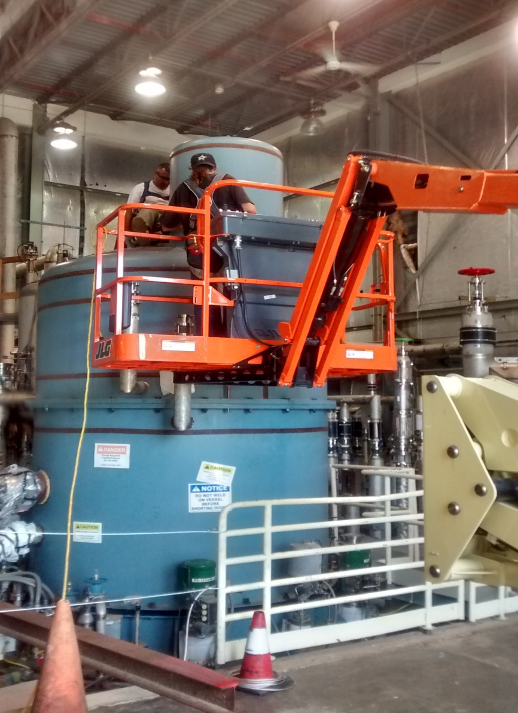
Aerial Lift also Employed to Access Cold Box to Tighten Bolts

Slide 6
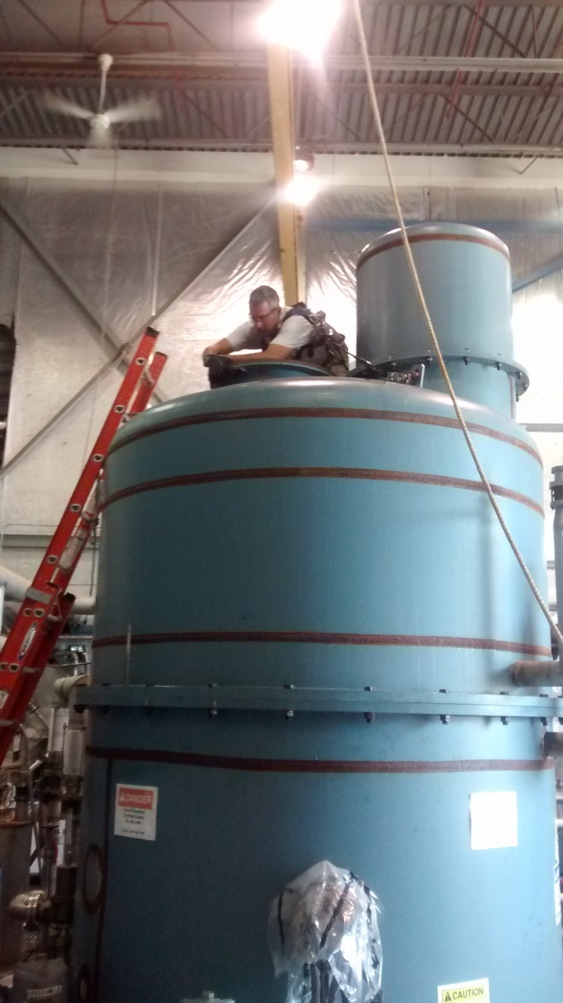
Dual Self-Retractable Lanyards was used for Installation of Manhole Cover

Slide 7
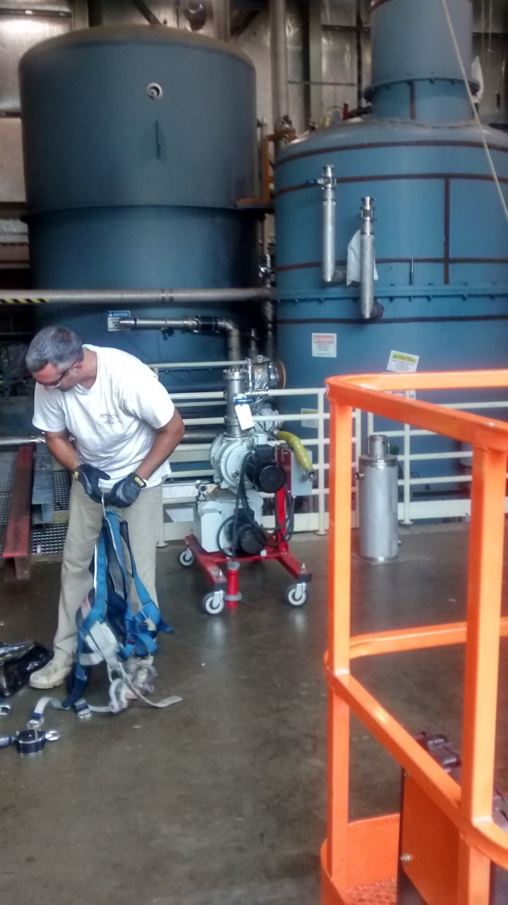
Work Completed by 4 pm

