Slide 1
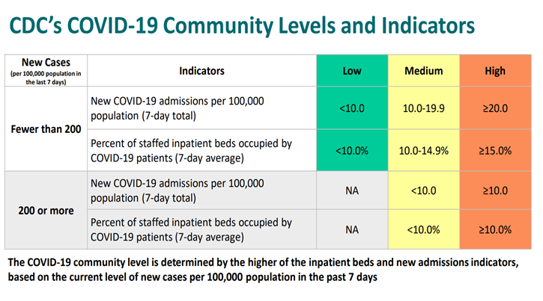
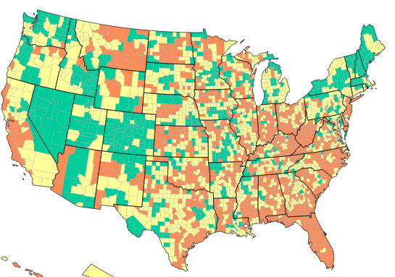
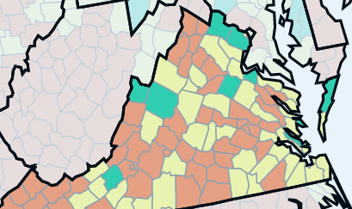
Lab Status = MEDCON 3; Community Level = Medium (since 5/18)
CDC COVID Data Tracker: Home
244/222
6.6/5.8
JLab Composite
3.8/3.7
Last wk/this wk
What’s new:
Weekend work if potentially exposed:
See next slide
19.39%/19.8% counties in low
Update 8/16/22

Slide 2
COVID exposure on off hours
If you have been exposed to a positive COVID-19 case, please follow the guidance below:
If you are fully vaccinated:
  Notify Occupational Medicine on Monday. You do not need to quarantine or be restricted from site after exposure (unless a household contact). As a precaution, please wear a mask if you have to work around others.
  If you develop symptoms, please stay home and inform Occupational Medicine.
  If you are a household contact, please stay home and inform Occupational Medicine.
If you are not fully vaccinated/undisclosed:
  Notify Occupational Medicine on Monday. Stay home and do not report to work. You will be restricted from site for seven days from the date of exposure.
  If you develop symptoms, please notify Occupational Medicine.

