Slide 1
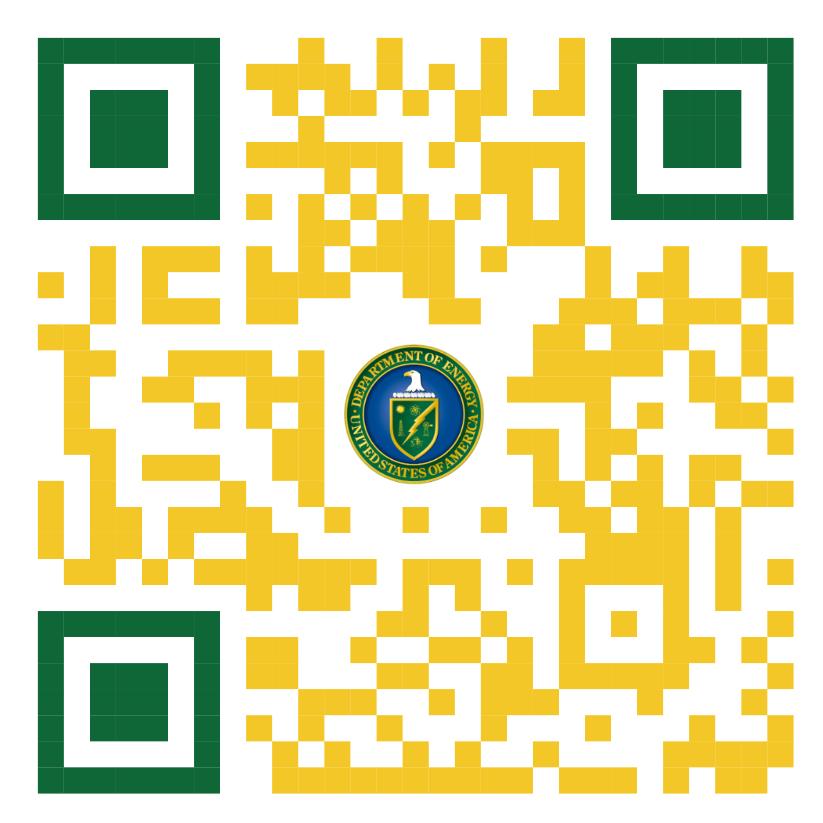
Interested in collaborating with us?
The Office of Science Graduate Student Research Program – SCGSR provides funding for students to conduct part of their PhD thesis research at DOE National Labs
Scientists in Residence: SCGSR Awardees lead 3-12 month long projects in collaboration with a National Laboratory scientist
Awardees receive stipends of up to $3,600/month + up to $2,000 for transportation
2 application windows per year:
February to May
August to November (current closes November 8, 2023)
Learn more about the program at:
https://science.osti.gov/wdts/scgsr
Or reach it through the QR code:

