Slide 1
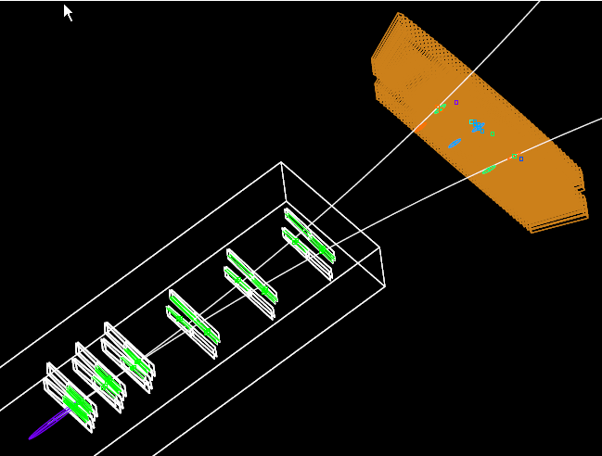
HPS Engineering Run Update
Run 5623 Event 62 N. Graf
HPS Collaboration May 19, 2015

Slide 2
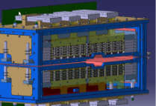
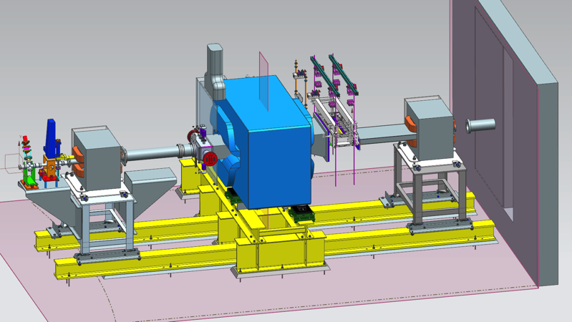
HPS Setup in Hall B Alcove
Si Vertex Tracker Installed Feb 23, 2015
PbWO₄ Ecal Installed September, 2014
e⁻
A magnet chicane directs the CEBAF 12 electron beam onto a W foil, producing heavy photons. They decay to e⁺e⁻ pairs, which are measured by the Si vertex tracker inside an analyzing magnet. A PbWO₄ ECal provides a fast trigger. https://confluence.slac.stanford.edu/display/hpsg/Heavy+Photon+Search+Experiment

Slide 3
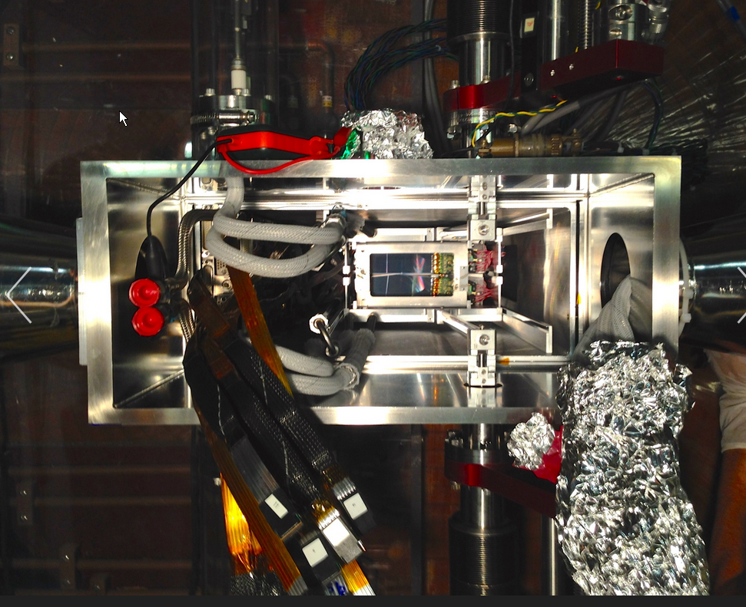
Beam’s Eye View of SVT

Slide 4
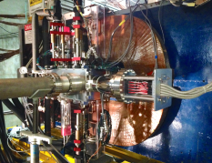
Spring Engineering Run
Installed SVT end of February
Commissioned Hall B beamline March-April * Calibrated bpms & established orbit locks * Set up SVT Protection Collimator * Checked beam position stability
CEBAF down after power outage
Commissioned Trigger and Integrated SVT DAQ late April
Explored SVT backgrounds as moved SVT closer to beam
Production running at 1.5 mm started May 1
Production running at 0.5 mm started May 12
Run 5623 Event 62 N. Graf
Layer 1 silicon sensors are just 0.5 mm above and below beam. Min opening angle is θ_{y}= 15 mrad.

Slide 6
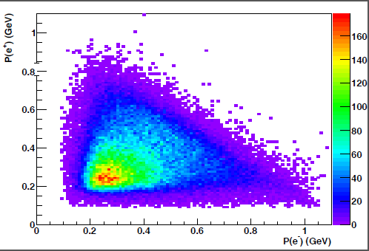
Tracked Pairs at 1.5 mm
Plots from M. Graham
A’ candidates have P_{e+} + P_{e-} ≈ P_{beam} = 1.05 GeV

Slide 7
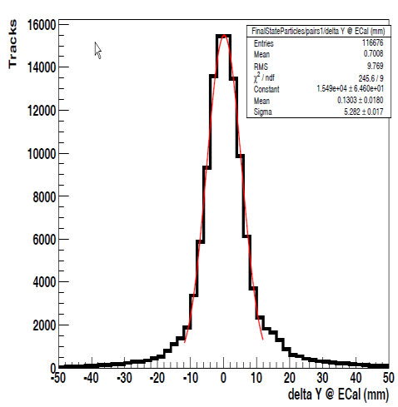
Track Matching at Ecal
Alignment fine tuning needed, but close

Slide 8
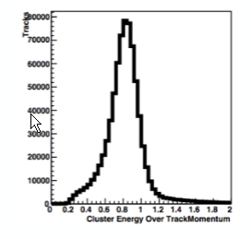
SVT Momentum/ ECal Energy Match
Further Ecal Calibration/Tracker Alignment Needed

Slide 9
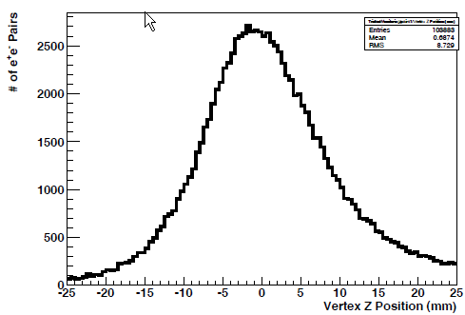
Pairs Vertex at the Target

Slide 10
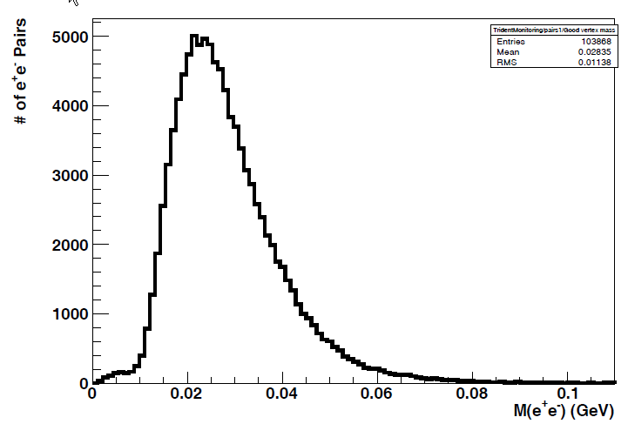
Pairs Mass Distribution

Slide 11
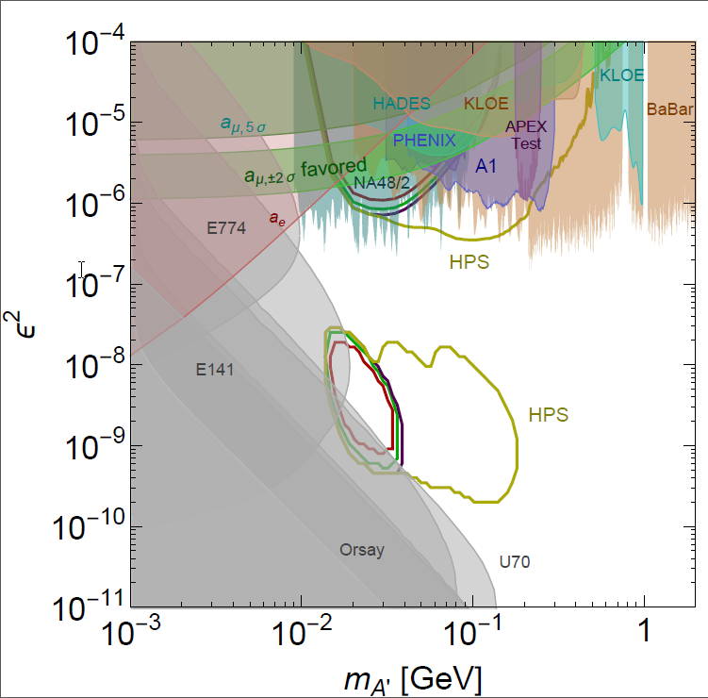
Reach vs Runtime
Assumes coverage to 15 mrad
1 GeV Contours:
1 PAC week 5/7 PAC week 3/7 PAC week
Measurement assured, but no new territory

Slide 12
Physics Measurement?
We have roughly 1/3 PAC week with Si at 0.5 mm (15 mrad acceptance)
Beamline, Ecal, Trigger and SVT all worked well
Lots of Work to Do… Check Trident Yield in the data Ecal energy calibration and alignment SVT alignment Understand the Vertex Tails
But a physics result may be in reach

