Slide 1

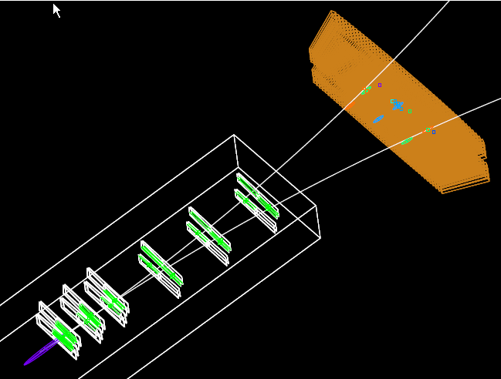
HPS Update
Run 5623
Event 62
N. Graf
HPS Collaboration
May 29, 2015

Slide 2

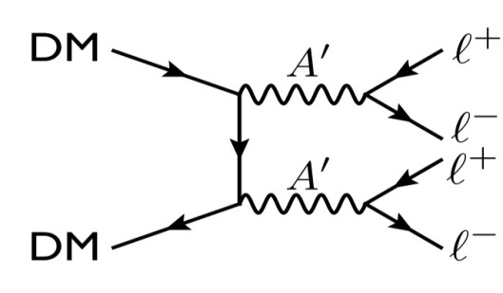
Heavy Photon Search
The astrophysical evidence for Dark Matter is compelling, but so far, there’s no proof DM has been produced at colliders, interacted with sensitive detectors, or been seen annihilating or decaying.
This can make sense if Dark Matter resides in a “hidden sector” and carries a “hidden sector” charge (analogous to electric charge) which couples to a “heavy photon” (A’).
But then, we should be able to produce heavy photons! They couple indirectly to regular electric charge by virtue of their mixing with the photon. Accordingly, they can be produced by, and decay into electrons and positrons.
The Heavy Photon Search is a search for a massive vector gauge boson radiated by electron beams, decaying to e⁺e^{-.}

Slide 3
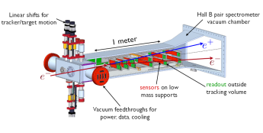
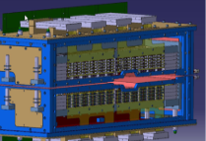
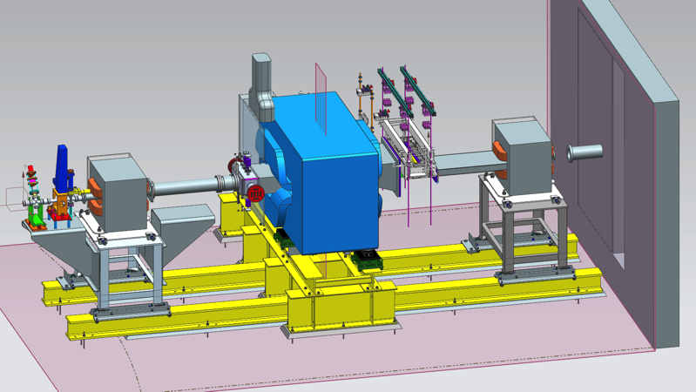
HPS Setup in Hall B Alcove
Si Vertex Tracker Installed Feb 23, 2015
PbWO₄ Ecal Installed September, 2014
e⁻
A magnet chicane directs the CEBAF 12 electron beam onto a W foil, producing heavy photons. They decay to e⁺e⁻ pairs, which are measured by the Si vertex tracker inside an analyzing magnet. A PbWO₄ ECal provides a fast trigger. https://confluence.slac.stanford.edu/display/hpsg/Heavy+Photon+Search+Experiment

Slide 4
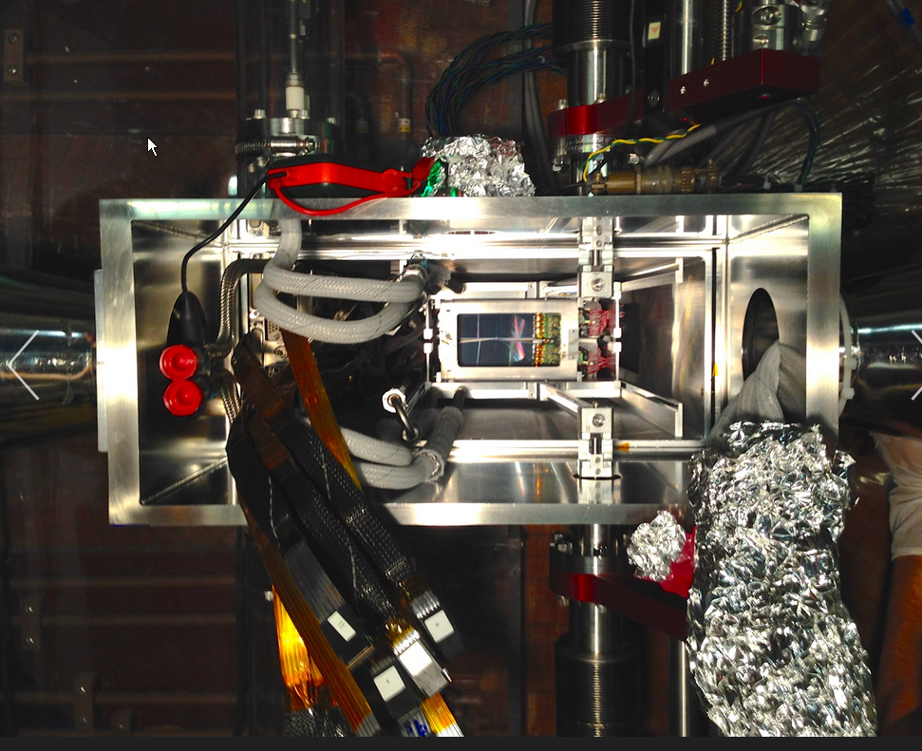
Beam’s Eye View of SVT

Slide 5
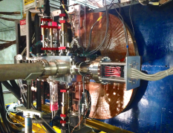
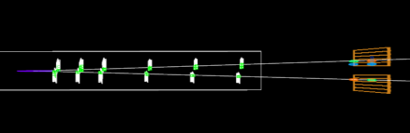
Spring Engineering Run
Installed SVT end of February
Commissioned Hall B beamline March-April
* Calibrated bpms & established orbit locks
* Set up SVT Protection Collimator
* Checked beam position stability
CEBAF down after power outage
Commissioned Trigger and Integrated SVT DAQ late April
Explored SVT backgrounds as moved SVT closer to beam
Production running at 1.5 mm started May 1
* SVT @ 1.5 mm is still fully shielded by collimator
Production running at 0.5 mm started May 12
Run 5623
Event 62
N. Graf
Layer 1 silicon sensors are
just 0.5 mm above and below beam. Min opening angle is θ_{y}= 15 mrad.

Slide 6
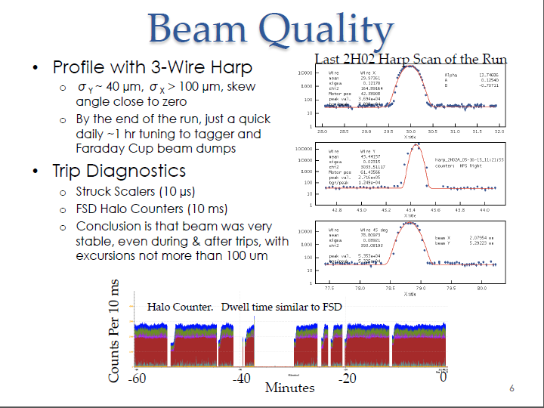

Slide 7
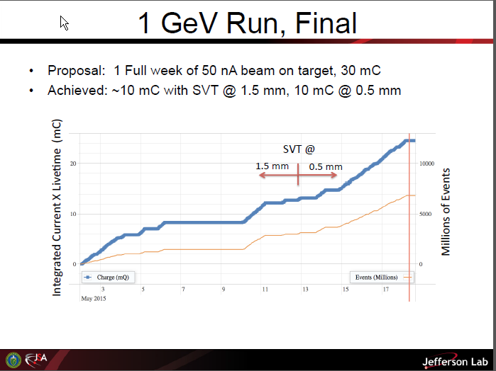

Slide 8
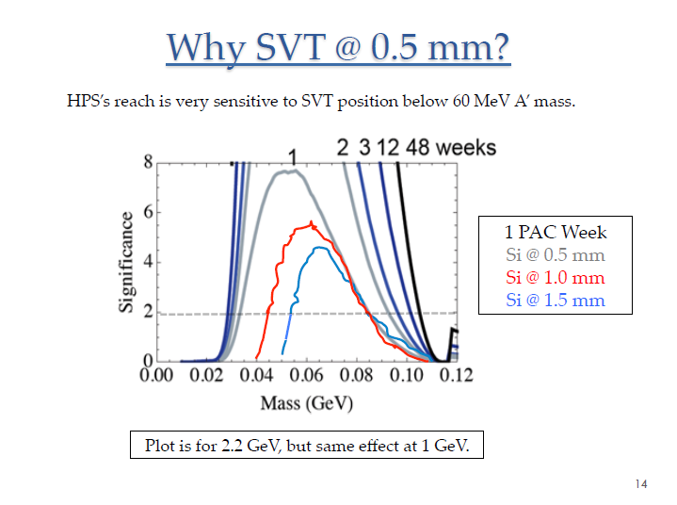

Slide 9
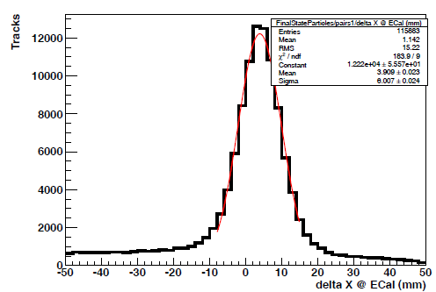
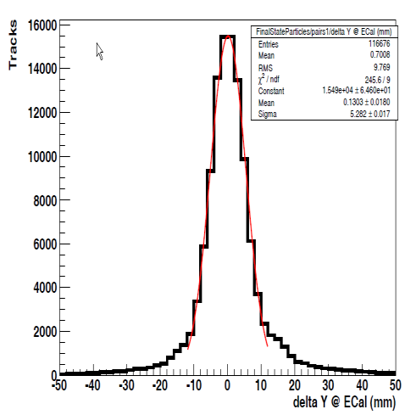
Track Matching at Ecal
Plots from
M. Graham
Before Shower Depth Correctio (Significant in the Bend Plane X)
Alignment fine tuning needed

Slide 10
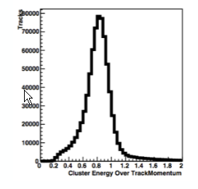
SVT/ECal Energy Matching
Ratio of Ecal Cluster Energy and SVT Track Momentum
Prior to ~10% Ecal Shower Loss Corrections
Further Ecal/SVT Alignment and Calibration In Progress

Slide 11
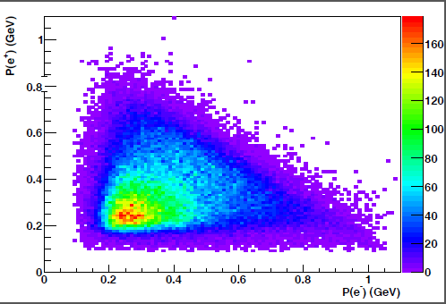
Tracked Pairs at 1.5 mm
A’ candidates have P_{e+} + P_{e-} ≈ P_{beam} = 1.05 GeV

Slide 12
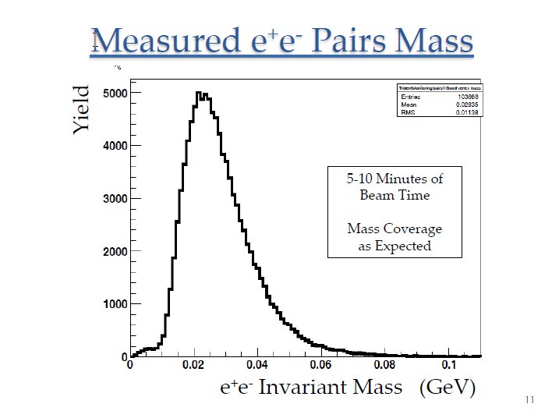

Slide 13
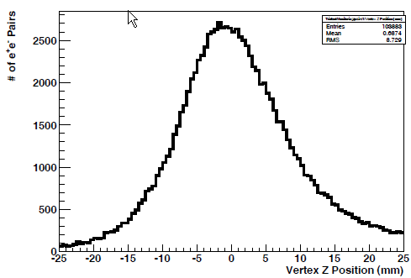
Pairs Vertex at the Target

Slide 14
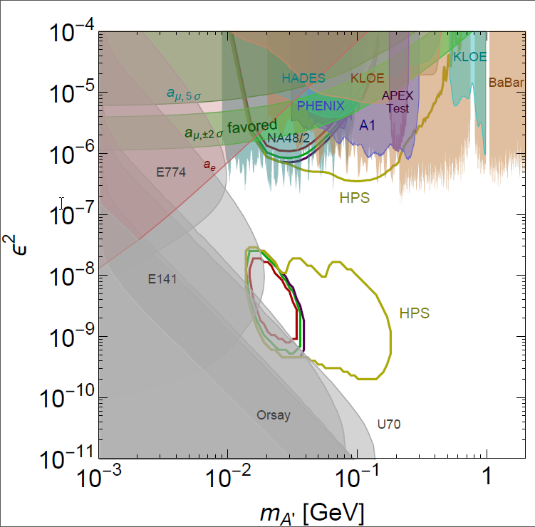
Reach vs Runtime
Assumes coverage
to 15 mrad
1 GeV Contours:
1 PAC week
5/7 PAC week
3/7 PAC week
Measurement assured,
but no new territory

Slide 15
Physics Measurement?
We have roughly 1/3 PAC week with Si at 0.5 mm
(15 mrad acceptance)
Beamline, Ecal, Trigger and SVT all worked well
Lots of Work to Do…
Check Trident Yield in the data
Ecal energy calibration and alignment
SVT alignment
Understand the Vertex Tails
But a physics result may be in reach

Slide 16
Plans for FY2016
HPS used roughly 1/3 of its first allotment of 25 PAC days in the Spring Engineering Run
HPS is on the FY2016 fall schedule for “opportunistic physics”, contingent on not interfering with 12 GeV Program
Top priority for Fall FY2016
* Establish good beams at 2.2 GeV
* 1 PAC week data taking at 2.2 GeV
HPS must demonstrate full physics capability to get its next allotment of running time from JLAB management. Hopefully Summer 2015.
Top priority for Spring FY2016
* Establish good beams at 4.4 GeV
* 2 PAC weeks data taking at 4.4 GeV
Longer term:
* 3 PAC weeks at 6.6 GeV
* 2 Additional PAC weeks at 2.2 GeV
* 2 Additionall PAC weeks at 4.4 GeV

Slide 17
Conclusions
HPS Spring Engineering Run was a success!
* CEBAF delivered stable, small beam spots with little halo
* all detector systems, trigger and DAQ worked as designed
* took 1/3 PAC week of data with SVT at 0.5 mm
Data analysis is underway
* Pass 0 complete
* Ecal Energy calibration and SVT alignment under way
* e+e- pairs measured
* checking trident rates, mass and vertexing resolution
* Search for A’ at 1 GeV!
Next Step: Confirm HPS Physics Capability
Prepare for running in FY2016 at 2.2 and 4.4 GeV

