Slide 1
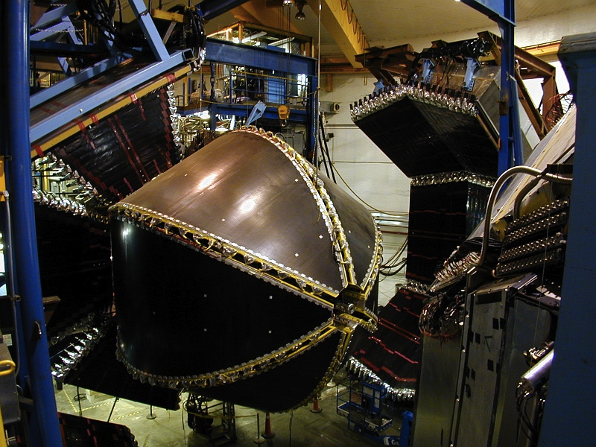
Updates on the Studies of N* Spectrum and Structure with the CLAS Detector
V.I. Mokeev,
Jefferson Lab
Hall-B Staff Meeting, September 21, 2015

Slide 2
Major Directions in the Studies of N*-Spectrum and Structure with CLAS
The experimental program on the studies of N* spectrum/structure in exclusive meson photo-/electroproduction with CLAS seeks to determine:
  γ_{v}NN* electrocouplings at photon virtualities up to 5.0 GeV² for most of the excited proton states through analyzing major meson electroproduction channels
  extend knowledge on N*-spectrum and on resonance hadronic decays from the data for photo- and electroproduction reactions with multiple mesons in the final state.
A unique source of information on different manifestations of the non-perturbative strong interaction in generating different excited nucleon states as relativistic bound systems of quarks and gluons.
Review papers:
I.G. Aznauryan and V.D.Burkert, Progr. Part. Nucl. Phys. 67, 1 (2012).
I.G. Aznauryan et al., Int. J. Mod. Phys. E22, 133015 (2013).
I.C. Cloët and C.D. Roberts, Prog. Part. Nucl. Phys. 77, 1 (2014).

Slide 3
Excited Nucleon States and Insight to Non-Perturbative Strong Interaction
Studies of N* spectrum/structure suggest that ground
and excited nucleon states consist of three dressed
(constituent) quarks (C.Q.) coupled by non-perturbative
strong interaction (ovals in the plot).
C.Q.
C.Q.
Emergence of dressed quarks and gluons
C.Q.
dressed quark
bare quark
dressing kernel
In the regime of large α_{s} that is relevant for N* formation, dressed quarks and gluons are substantially different with respect to the bare quarks and gauge gluons. They acquire dynamical structure and momentum-dependent mass.
dressed gluon
bare gluon
dressing
kernel
ghost

Slide 4
Dressed Quark Evolution from pQCD to Confinement Regimes
quark/gluon confinement
Consistent results from two different based on QCD approaches:
LQCD - P.O.Bowman, et al., PRD 71,
054505 (2005) (points with error bars).
DSEQCD – C.D.Roberts, Prog. Part. Nucl. Phys. 61, 50 (2008) (lines).
more than 98% of dressed quark (N/N*) masses as well as their dynamical structure are generated non-perturbatively through dynamical chiral symmetry breaking (DCSB). The Higgs mechanism accounts for less than 2% of the nucleon & N* mass.
the momentum dependence of the dressed quark mass reflects the transition from quark/gluon confinement to asymptotic freedom.

Slide 5
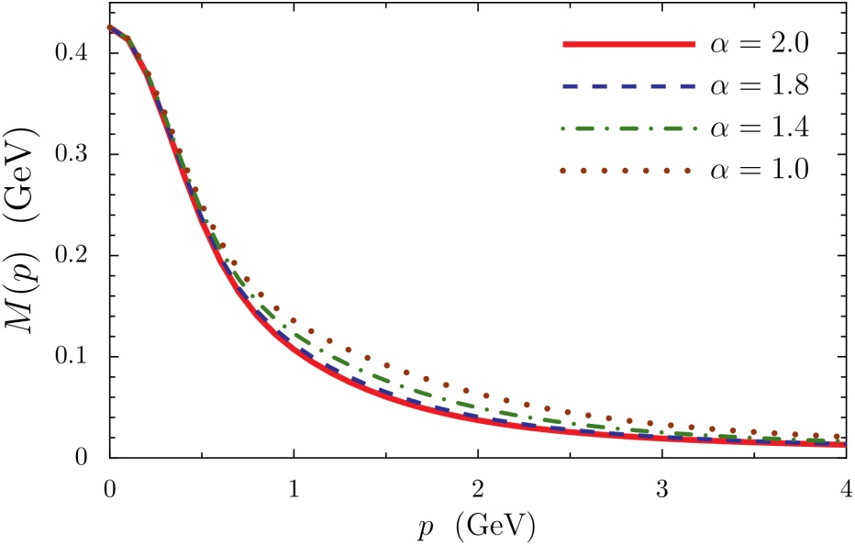
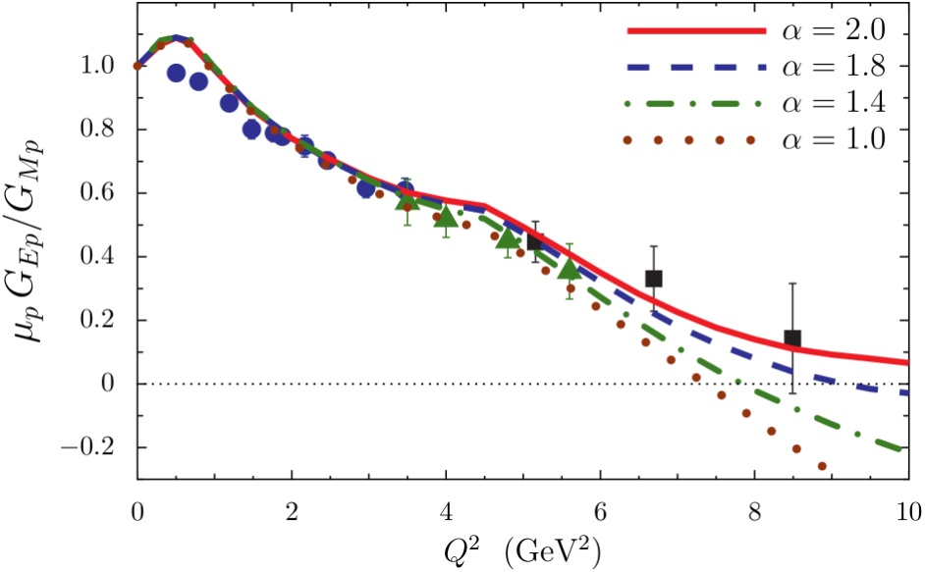
Mapping –out Quark Mass Function
I.C.Cloët, C.D.Roberts, A.W.Thomas,
Phys. Rev. Lett. 111, 101803 (2013).
elastic form factors are sensitive to momentum dependence of quark mass function.
mass function should be the same for dressed quarks in the ground and excited nucleon states.
consistent results on dressed quark mass function determined from the data on elastic form factors and transition γ_{v}NN* electrocouplings are critical for reliable extraction of this quantity.
results on transition γ_{v}NN* electrocouplings offer
an access to dynamics of quark-gluon vertex
dressing beyond simplified rainbow-ladder
truncation.
Quark mass
function
μ_{p}G_{E}/G_{M} (Q²)
in DSEQCD
.
Studies of γ_{v}NN* electrocouplings (transition N→N* form factors) represents the central direction in
the exploration of strong interaction in non-perturbative regime.

Slide 6
Extraction of γ_{v}NN* Electrocouplings from the Exclusive Meson Electroproduction off Nucleons
Resonant amplitudes
Non-resonant amplitudes
e’
π, η, ππ, KY,…
π, η, ππ, KY,…
γ_{v}
e
*
N*,△
+
N
N’
N’
N
Real A_{1/2}(Q²), A_{3/2}(Q²), S_{1/2}(Q²)
or
G₁(Q²), G₂(Q²), G₃(Q²)
or
G_{M}(Q²), G_{E}(Q²), G_{C}(Q²)
I.G.Aznauryan and V.D.Burkert, Progr. Part. Nucl. Phys. 67, 1 (2012).
Definition of N* photo-/electrocouplings
employed in the CLAS data analyses :
Γ_{γ} stands for N* electro-
magnetic decay widths at
W=M_{N*} on the real energy axis.
  Consistent results on γ_{v}NN* electrocouplings from different meson electroproduction channels and different analysis approaches demonstrate reliable extraction of these quantities.

Slide 7
Summary of the CLAS Data on Exclusive Meson Electroproduction off Protons in N* Excitation Region
Hadronic final state | Covered W-range, GeV | Covered Q²-range, GeV² C | Measured observables
π⁺n | 1.1-1.38 1.1-1.55 1.1-1.7 1.6-2.0 | 0.16-0.36 0.3-0.6 1.7-4.5 1.8-4.5 | dσ/dΩ dσ/dΩ dσ/dΩ, A_{b} dσ/dΩ
π⁰p | 1.1-1.38 1.1-1.68 1.1-1.39 | 0.16-0.36 0.4-1.8 3.0-6.0 | dσ/dΩ dσ/dΩ, A_{b},A_{t},A_{bt} dσ/dΩ
ηp | 1.5-2.3 | 0.2-3.1 | dσ/dΩ
K⁺Λ | thresh-2.6 | 1.40-3.90 0.70-5.40 | dσ/dΩ P⁰, P’
K⁺Σ⁰ | thresh-2.6 thresh-2.6 | 1.40-3.90 0.70-5.40 | dσ/dΩ P’
π⁺π⁻p | 1.3-1.6 1.4-2.1 | 0.2-0.6 0.5-1.5 | Nine 1-fold differential cross sections
dσ/dΩ−CM angular
distributions
A_{b},A_{t},A_{bt}-longitudinal
beam, target, and
beam-target asym-
metries
P⁰ P’ –recoil and
transferred polarization
of strange baryon
Almost full coverage
of the final hadron
phase space in
πN, π⁺π⁻p, ηp, and KY electroproduction.
The data on exclusive electroproduction for all listed final states are available from CLAS and
stored in the CLAS Physics Data Base http://clas.sinp.msu.ru/cgi-bin/jlab/db.cgi.

Slide 8
Approaches for Extraction of γ_{v}NN* Electrocouplings from the CLAS Exclusive Meson Electroproduction Data
Analyses of different pion electroproduction channels independently:
π⁺n and π⁰p channels:
Unitary Isobar Model (UIM) and Fixed-t Dispersion Relations (DR)
I.G.Aznauryan, Phys. Rev. C67, 015209 (2003).
I.G.Aznauryan et al., CLAS Coll., Phys Rev. C80, 055203 (2009).
I.G.Aznauryan et al., CLAS Coll., Phys. Rev. C91, 045203 (2015).
ηp channel:
Extension of UIM and DR
I.G.Aznauryan, Phys. Rev. C68, 065204 (2003).
Data fit at W<1.6 GeV, assuming S₁₁(1535) dominance
H.Denizli et al., CLAS Coll., Phys. Rev. C76, 015204 (2007).
π⁺π⁻p channel:
Data driven JLAB-MSU meson-baryon model (JM)
V.I.Mokeev, V.D.Burkert et al., Phys. Rev. C80, 045212 (2009).
V.I.Mokeev et al., CLAS Coll., Phys. Rev. C86, 035203 (2012).
Global coupled-channel analyses of the CLAS/world data of πN, γ_{r,v}N → πN, ηN, ππN, KΛ, KΣ exclusive channels:
T.-S. H. Lee , AIP Conf. Proc. 1560, 413 (2013).
H. Kamano et al., Phys. Rev. C88, 035209 (2013).

Slide 9
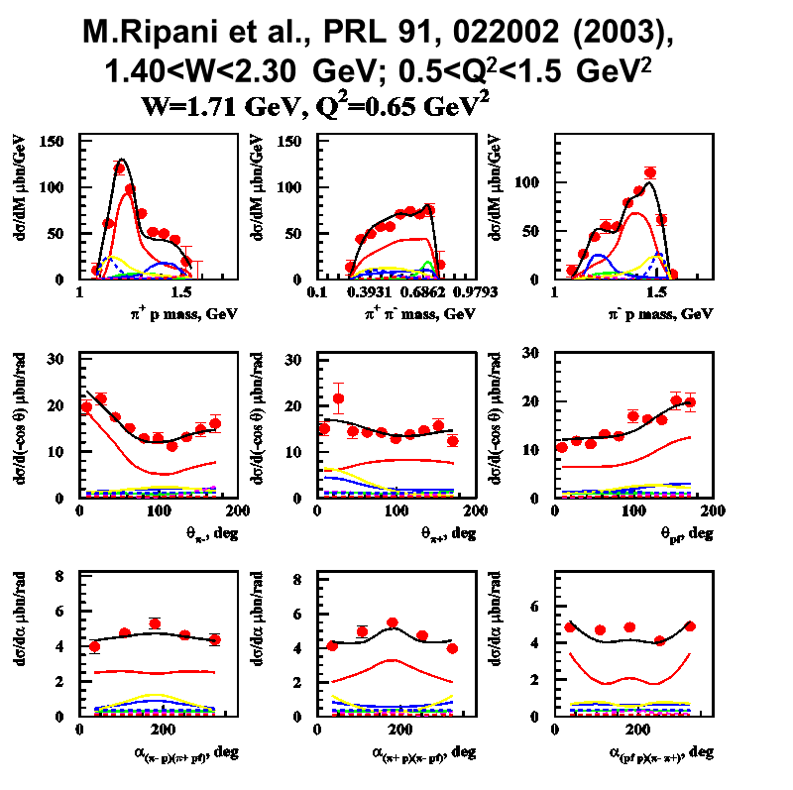
Fits to Differential Cross Sections
γ_{v}p→π⁺n
γ_{v}p→π⁺π⁻p
K.Park et al., Phys. Rev. C91, 052014 (2015).
M.Ripani et al., PRL 91, 022002 (2003),
1.40<W<2.30 GeV; 0.5<Q²<1.5 GeV²
W=1.68 GeV
Q²=1.8 GeV²
DR
UIM
cos θ_{π} :
-0.7
dσ/dΩ_{π} μb/ster
-0.3
dσ/dΩ_{π} μb/ster
0.1
0.5
0.9

Slide 10
γ_{v}NN* Electrocouplings from Nπ and π⁺π⁻p Electroproduction
CLAS data:
Nπ
2009
π⁺π⁻p
2012
π⁺π⁻p
submitted
to PRC
Nπ
2015
S_{1/2}
N(1680)5/2⁺
I.G.Aznauryan et al., Phys. Rev. C80, 055203 (2009).
V.I.Mokeev et al., Phys. Rev . C86, 035203 (2012).
K.Park et al., Phys. Rev. C91, 052014 (2015).
A_{1/2}
N(1440)1/2⁺
A_{3/2}
N(1520)3/2⁻
  Consistent values of resonance electrocouplings from analyses of Nπ and π⁺π⁻p exclusive channels strongly support:
  reliable electrocoupling extraction;
  capabilities of the reaction models to obtain resonance electrocouplings in independent analyses of these channels.

Slide 11

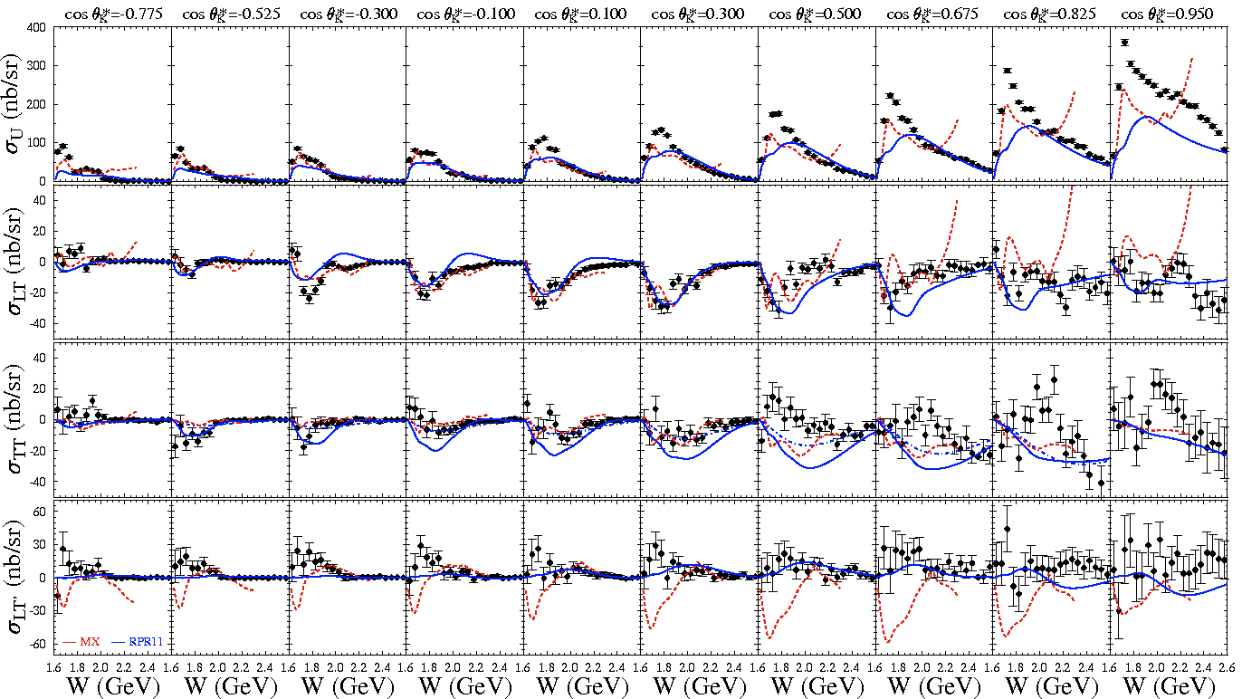
K⁺Λ Structure Functions
E = 5.5 GeV, W: thr – 2.6 GeV, Q² = 1.80, 2.60, 3.45 GeV²
[Carman et al., PRC 87, 025204 (2013)]

Slide 12
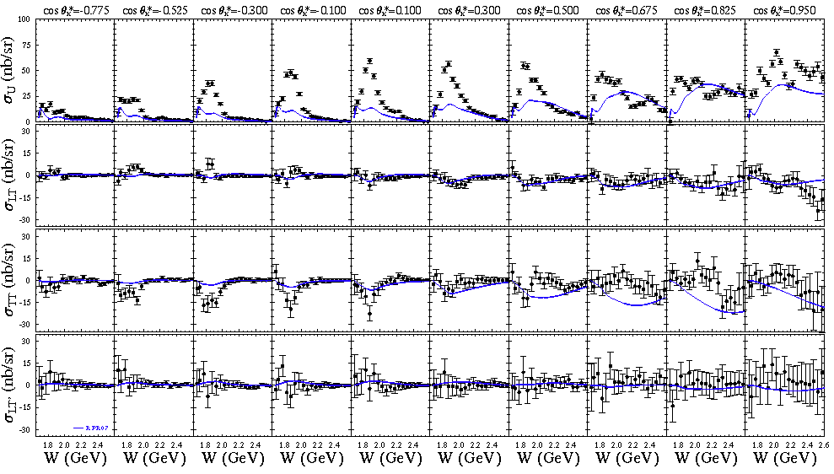
K⁺Σ⁰ Structure Functions
E = 5.5 GeV, W: thr – 2.6 GeV, Q² = 1.80, 2.60, 3.45 GeV²
[Carman et al., PRC 87, 025204 (2013)]

Slide 13
Access to the Dressed Quark Mass Function from the Data on the Transition
N→N* Form Factors
Δ(1232)3/2⁺
Jones-Scadron convention
N(1440)1/2⁺
Dirac F₁* and Pauli F₂*
N→N(1440)1/2⁺ transition form factors
J. Segovia et al., Few Body Syst. 55,1185 (2014).
J. Segovia et al., arXiv: 1504.04386[nucl-th]
Quark core
dominance
Quark core
dominance
Substantial
contributions
from meson-
baryon cloud
G_{M}*
Quark core
dominance
Substantial
contributions
from meson-
baryon cloud
Substantial
contributions
from meson-
baryon cloud
The quark core contributions to transition form factors computed in a common DSEQCD framework starting from the QCD Lagrangian:
Contact qq interaction,
frozen constituent quark mass.
Realistic qq interaction, running quark mass,
the same but multiplied by the common factor fit to the data at Q²>3.0 GeV² , which accounts for the product of the quark core fractions in ground and N(1440)1/2⁺ states
Realistic qq interaction,
running quark mass.
Good data description at Q²>2.0 GeV² achieved with the same dressed quark mass function for the ground and excited
nucleon states of distinctively different structure provides the strong evidence for:
the relevance of dressed quark predicted by DSEQCD
promising prospect to map out dressed quark mass function from combined analyses of the data on nucleon elastic and
transition form factors with available and future CLAS12 data at Q² < 12 GeV²

Slide 14
Quark Core and Meson-Baryon Cloud in the Structure of N(1440)1/2⁺ Resonance
Quark core from DSEQCD
The mechanisms of meson-baryon dressing :
Description of the N(1440)1/2⁺ A_{1/2} electrocoupling by the light
front quark models that incorporate the inner core and outer
meson-baryon (MB) cloud:
Nπ loops MB cloud; running quark mass.
I.G.Aznauryan, V.D.Burkert, Phys. Rev. C85, 055202 (2012).
Nσ loops for MB cloud; frozen constituent quark mass.
I.T. Obukhovsky, et al., Phys. Rev. D89, 014032 (2014).
MB cloud inferred from the CLAS data as the difference between the data fit and evaluated within DSEQCD quark core
Successful description of the N(1440)1/2⁺ quark core from the QCD Lagrangian has been achieved for the first time with the framework of DSEQCD!
The structure of N(1440)1/2⁺ resonance is determined by complex interplay between inner
core of three dressed quarks in the first radial excitation and external meson-baryon cloud.

Slide 15
Interplay Between Quark Core and Meson-Baryon Cloud in the Structure of Different Excited Nucleon States
N(1520)3/2⁻
N(1675)5/2⁻
Nπ CLAS
K.Park et al., PR C91,
045203 (2015).
Quark core
dominance
MB cloud
dominance
MB dressing abs. values
(Argonne-Osaka ).
E. Santopinto and M. M. Giannini,
PRC 86, 065202 (2012).
Almost direct access to:
quark core from the data on N(1520)3/2⁻: prospect to explore dressed quark mass function and qqG vertex;
meson-baryon cloud from the data on N(1675)5/2⁻: shed light on the transition from confined quarks in inner core to colorless mesons and baryons in N* exterior

Slide 16
First Interpretation of the Structure at W~1.7 GeV in π⁺π⁻p Electroproduction
The JM03 analysis of three of nine one-fold differential cross sections (M.Ripani et al., Phys. Rev. Lett. 91, 022002 (2003)).
conventional states only, consistent with PDG 02.
implementing 3/2⁺(1720) candidate or conventional
states only with different than in PDG 02 N(1720)3/2⁺
Nππ decays.
Two equally successful ways for the data description:
different than in PDG 02’ N(1720)3/2⁺ Nππ hadronic decay widths:
σ, μbn
 | Γ_{tot,} MeV | BF(πΔ) % | BF(ρp) %
N(1720)3/2⁺ decays fit to the CLAS Nππ data | 114±19 | 63±12 75±12 (BnGa12) | 19±9
N(1720)3/2⁺ PDG 02’ | 150-300 | <20 | 70-85
new 3/2⁺(1720) state and consistent with PDG 02’
Nππ hadronic decays of N(1720)3/2⁺:
 | Γ_{tot,} MeV | BF(πΔ) % | BF(ρp) %
3/2⁺(1720) candidate | 88±17 | 41±13 | 17±10.
N1720)3/2⁺ conventional | 161±31 | <20 | 60-100
W, GeV

Slide 17
Resonance Photocouplings from the Preliminary π⁺π⁻p Photoproduction Cross Sections
Resonance | A_{1/2}, GeV^{-1/2} *1000, JM15/RPP12 | A_{3/2}, GeV^{-1/2} *1000 JM15/RPP12
N(1650)1/2⁻ | 63±6 53±16
N(1680)5/2⁺ | -29±3 -15±6 | 133±14 133±12
N(1700)3/2⁻ | -5±4 -18±13 | 30±22 -2±24
N’(1720)3/2⁺ | 40±3 N/A | -43±8 N/A
N(1720)3/2⁺ | 89±16 97±3 (*) | -35±13 -39±3(*)
Δ(1600)3/2⁺ | -26±10 -23±20 | -19±9 -9±21
Δ(1620)1/2⁻ | 33±4 27±11
Δ(1700)3/2⁻ | 97±19 104±15 | 84±11 85±22
Δ(1905)5/2⁺ | 25±4 26±11 | -57±10 -45±20
Δ(1950)7/2⁺ | -68±16 -76±12 | -123±20 -97±10
Fit of the CLAS data within the framework of the JM15:
(*)M. Dugger et al., Phys. Rev. C76, 025211 (2007).
Consistent results on photocouplings of resonances with masses above 1.6 GeV from analyses of Nπ and π⁺π⁻p channels demonstrate reliable extraction of these fundamental quantities.

Slide 18
Further Evidence for the Existence of the New State N’(1720)3/2⁺ from Combined π⁺π⁻p Analyses in both Photo- and Electroproduction
Almost the same quality of the photoproduction data fit at
1.66 GeV <W<1.76 GeV and Q²=0, 0,65, 0.95, 1.30 GeV² was achieved with and without N’(1720)3/2⁺ new states
N* hadronic decays from the data fit that
incorporates the new N’(1720)3/2⁺ state
Resonance | BF(πΔ), % | BF(ρp), %
N’(1720)3/2⁺ electroproduction photoproduction | 47-64 46-62 | 3-10 4-13
N(1720)3/2⁺ electroproduction photoproduction | 39-55 38-53 | 23-49 31-46
Δ(1700)3/2⁻ electroproduction photoproduction | 77-95 78-93 | 3-5 3-6
N(1720)3/2⁺ hadronic decays from the CLAS data fit with
conventional resonances only
 | BF(πΔ), % | BF(ρp), %
electroproduction | 64-100 | <5
photoproduction | 14-60 | 19-69
Successful description of π⁺π⁻p photo- and
electroproduction data achieved by
implementing new N’(1720)3/2⁺ state with
Q²-independent hadronic decay widths of
all resonances contributing at W~1.7 GeV
provides strong evidence for the existence of
new N’(1720)3/2⁺ state.
The contradictory BF values for N(1720)3/2⁺ decays to the πΔ and ρp final states deduced from photo- and electroproduction data make it impossible to describe the data with conventional states only.

Slide 19
The Parameters of N’(1720)3/2⁺ New State from the CLAS Data Fit
The photo-/electrocouplings of N’(1720)3/2⁺ and conventional N(1720)3/2⁺ states:
N’(1720)3/2⁺
Resonance | Mass, GeV | Total width, MeV
N’(1720)3/2⁺ | 1.715-1.735 | 120±6
N (1720)3/2⁺ | 1.743-1.753 | 112±8
N(1720)3/2⁺
N’(1720)3/2⁺ is the only candidate state for which the results on Q²-evolution of transition
electrocouplings have become available offering the insight to the structure of the new
baryon state.

Slide 20

CLAS12 N* Program
E12-09-003
Nucleon Resonance Studies with CLAS12
Burkert, Mokeev, Stoler, Joo, Gothe, Cole
E12-06-108A
KY Electroproduction with CLAS12
Carman, Mokeev, Gothe
Measure exclusive electroproduction cross sections from an unpolarized proton target with polarized electron beam for Nπ, Nη, Nππ, KY:
  E_{b} = 11 GeV, Q² = 3 → 12 GeV², W → 3.0 GeV, cos θ_{m}* = [-1:1]
Key Motivations:
Study spectrum and structure of all prominent N* states vs. Q² up to 12 GeV².
A unique opportunity to explore the nature of confinement that is responsible for >98% of resonance masses and the emergence of N* states from QCD
KY data complement the Nππ data as independent information for high-mass states inaccessible with Nπ final states
Urgent need: Develop reaction models to extract electrocouplings that incorporate the transition from M-B to q-G degrees of freedom

Slide 21
Contact person:
Volker D. Burkert

Slide 22
Conclusions
High quality meson electroproduction data from CLAS allowed us to determine the
electrocouplings of most well-established resonances in mass range up to 1.8 GeV
from analyses of π⁺n, π⁰p, ηp and π⁺π⁻p electroproduction channels. Consistent electro-
coupling values for the transitions to N(1440)1/2⁺ and N(1520)3/2⁻ states obtained
independently from Nπ/Nππ exclusive channels demonstrated capabilities of the
developed reaction models for reliable extraction of N*-parameters.
To describe both the π⁺π⁻p photo- and electroproduction data demands including the new baryon state N’(1720)3/2⁺. Successful description of these data with Q²-independent hadronic decay widths to the πΔ and ρp final states of all contributing resonances provides strong evidence for the existence of N’(1720)3/2⁺ new baryon state.
Physics analyses of the CLAS results on resonance electrocouplings revealed the structure of N*-states at Q²<5.0 GeV² as complex interplay between meson-baryon and quark degrees of freedom. The studies of N*-states with different quantum numbers are essential in order to disentangle different components in the N* structure.
Successful description of elastic and transition form factors to different low-lying resonances achieved at Q²>2.5 GeV² within the framework of DSEQCD demonstrated promising opportunity to map out dressed quark mass function from the data on elastic and transition form factors.

Slide 23
Outlook
After 12 GeV Upgrade CLAS12 will be only available worldwide facility capable to obtained electrocouplings of all prominent N* states at still unexplored ranges of low photon virtualities down to 0.05 GeV² and highest photo virtialities ever achieved for exclusive reactions from 5.0 GeV² to 12 GeV² from the measurements of exclusive Nπ,π+π⁻p, and KY electroproduction.
The expected results will allow us:
a) search for hybrid-baryons;
b) explore the emergence of meson-baryon cloud from quark-gluon confinement;
c) access quark distribution amplitudes in N* states;
d) to map out the dressed quark mass function at the distance scales where the
transition from quark-gluon confinement to pQCD regime is expected, addressing
the most challenging problems of the Standard Model on the nature of >98% of
hadron mass and quark-gluon confinement.
Success of N* Program with the CLAS12 will be very beneficial for Jefferson Lab and hadron physics community worldwide.

Slide 24
Back up

Slide 25
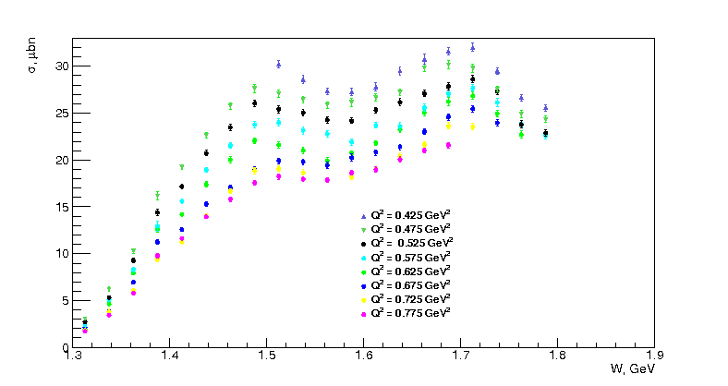
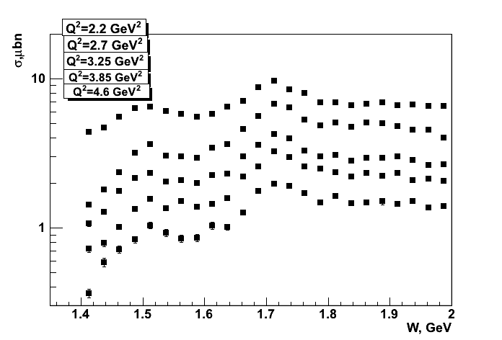
Extension of the CLAS π⁺π⁻p Electroproduction Data
Fully integrated π⁺π⁻p electroproduction cross
sections off protons
Nine 1-fold differential cross sections are
available In each bin of W and Q² shown in
the plots.
Resonance structures are clearly seen at
W ~1.5 GeV and ~1.7 GeV at 0.4< Q²< 5.0 GeV²
(red lines) .
R.W.Gothe,
G.V.Fedotov,
USC
Analysis objectives:
Extraction of γ_{v}NN* electrocouplings and πΔ ,
ρp decay widths for most N*s in mass range up
to 2.0 GeV and 0.4< Q²< 5.0 GeV² within the
framework of JM-model.
Exploration of the signals from 3/2⁺(1720)
candidate-state (M.Ripani et al., Phys. Rev. Lett
91, 022002 (2003)) with a goal to achieve decisive
conclusion on the state existence and structure.
First results on electrocouplings of high-lying
(M_{N*}>1.6 GeV) orbital nucleon excitations and
high-lying parity partners.
E.L. Isupov, K.Hicks
MSU/Univ. of Ohio

Slide 26
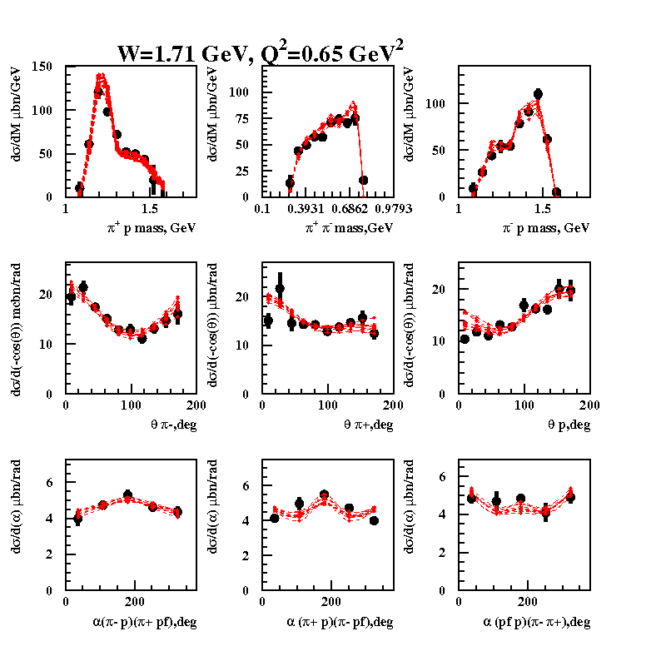
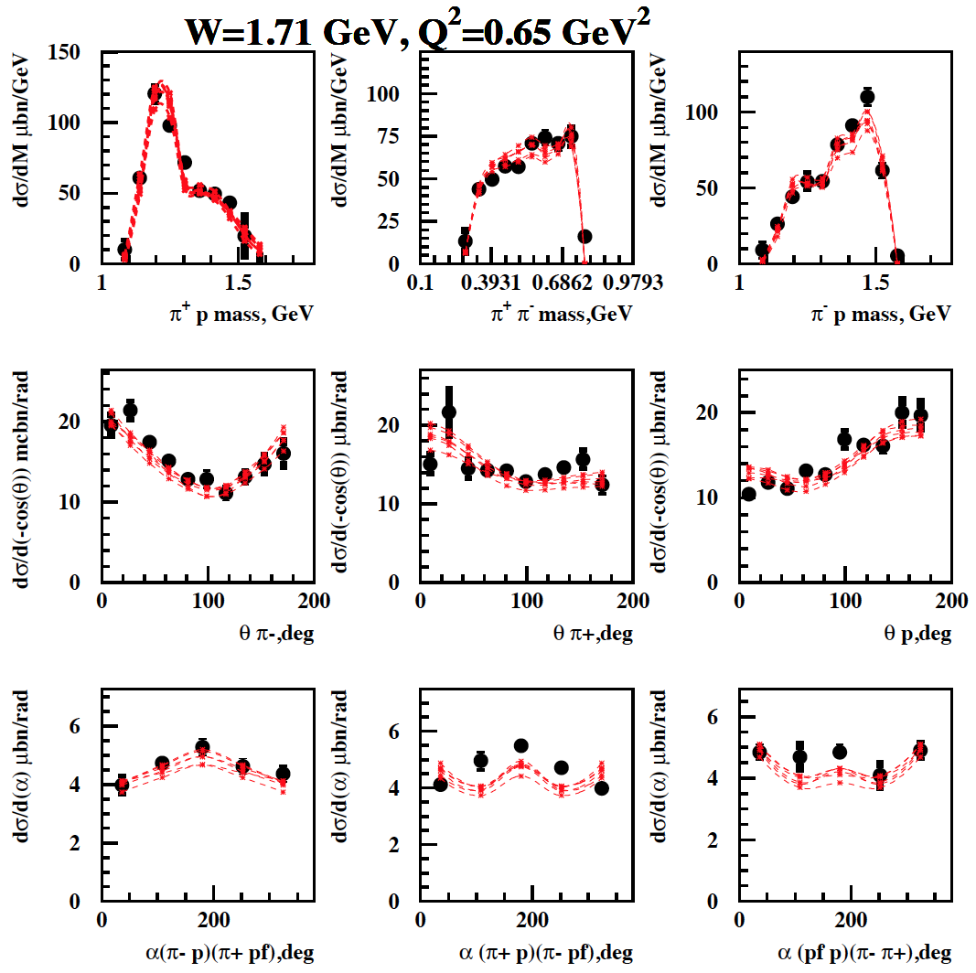
Analysis of the ep→ π⁺π⁻p CLAS data at W~1.7 GeV in the JM15 model
conventional N*-states with πΔ, ρp couplings fit to the data
3/2⁺(1720) candidate state is included to the fit
2.85<χ²/d.p.<3.03 (1.66 GeV<W<1.76 GeV)
2.56<χ²/d.p.<2.80 (1.66 GeV<W<1.76 GeV)
Fit of θ_{π−}, θ_{π+}, θ_{p} angular distributions requires essential contribution(s) from the resonance(s) of J^{π}=3/2⁺.
Single state of J^{π}=3/2⁺ should have major πΔ (>60%) and minor ρp (<5%) decays in order to reproduce
pronounced Δ−peaks in π⁺p and to avoid the ρ-peak formation in π⁺π⁻ mass distributions.

Slide 27
Signals from N* states in the CLAS KY electroproduction data
D.Carman, private communication
Q²=1.8 GeV²
Q²=2.6 GeV²
Q²=3.45 GeV²
3/2 ⁻ 5/2⁻
(1950)
KΛ
the structures in W-dependencies of C_{l} –moments at the same W-values in all Q²-bins are consistent with the contributions from resonances of spin-parities listed in the plots
1/2 ⁺3/2⁺
(1850)
1/2⁺3/2⁺
(2000)
KΣ
reaction model(s) are needed
for extraction of N* parameters
from KY electroproduction
KΣ
3/2⁻5/2⁻
(2050)
W GeV

Slide 28
Charting Meson-Baryon Mechanisms of the JM Model
Q²=0.95 GeV²
Q²=1.30 GeV²
Q²=0.65 GeV²
π⁺D₁₃(1520)
ρp
2π direct
π⁻Δ⁺⁺
π⁺Δ⁰
π⁺F₁₃(1680)
π⁻Δ⁺⁺ meson-baryon channel accounts for the major part of π⁺π⁻p electroproduction cross section. Relative resonant contribution to π⁻Δ⁺⁺ channel increases with Q².
2π direct production decreases substantially at W from 1.5 to 1.7 GeV offering an indication for sizable final hadronic interactions between the π⁺π⁻p final state and others open meson-baryon channels.
πΔ, ρp-amplitudes decomposed over PW’s of angular momenta J can be provided from the data fit.
The request for reaction theory: guidance for the development of analytical continuation of πΔ , ρp-amplitudes allowing us to extract resonance electrocouplings from residues at the resonance pole positions.

Slide 29
Resonant /Non-Resonant Contributions from the Fit of π⁺π⁻p Electroproduction Cross Sections within the JM Model
W=1.51 GeV, Q²=0.38 GeV²
W=1.51 GeV, Q²=0.43 GeV²
Reliable isolation of the resonant cross sections is achieved
full cross sections
within the JM model
resonant part
non-resonant part

Slide 30
Status and Prospects on Extraction of High-Lying N* Electrocouplings from CLAS Data
Preliminary
Δ(1620)3/2⁻
S_{1/2}
Δ(1700)3/2⁻
A_{1/2}
Preliminary
N(1720)3/2⁺
A_{3/2}
Independent fits in different W-intervals:
green: 1.46<W<1.56 GeV
magenta: 1.56<W<1.66 GeV
red: 1.61<W<1.71 GeV
blue: 1.66<W<1.76 GeV
black: 1.71<W<1.81 GeV
consistent electrocoupling values offer
sound evidence for their reliable extraction.
π⁺π⁻p electroproduction channel provided first preliminary results on Δ(1620)1/2⁻, N(1650)1/2⁻, N(1680)5/2⁺, Δ(1700)3/2⁻ , and N(1720)3/2⁺ electrocouplings with good accuracy.
Prospect: evaluation of high-mass N* electrocouplings
from independent analyses of KY channels.
Reaction models capable of extracting resonance
electrocouplings from the fit of unpolarized cross
sections and polarization asymmetries measured in
KY electroproduction are needed !
.

Slide 31
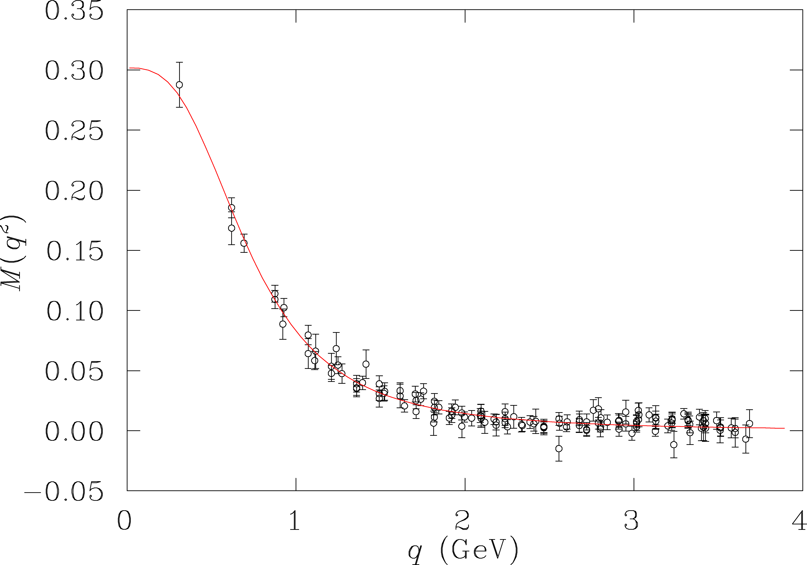
Resonance Transitions with the CLAS12
12 GeV experiment E12-09-003 will extend access to electrocouplings for all prominent N* states in the range up to Q²=12GeV².
Resonance electrocouplings in regime of quark core dominance can be related to the running quark masses and their dynamical structure.
P₁₁(1440) A_{1/2}
Light front quark model:
I.G.Aznauryan, V.D. Burkert,
PRC85, 055202 (2012).
accessible
at 6 GeV
LQCD
DSE
quark mass (GeV)
accessible
at 12 GeV
DSEQCD :
contact inte-
raction;
realistic QCD
interaction.
CLAS12 projected
Probe the transition from confinement to pQCD regimes, allowing us to explore how confinement in baryons emerge from QCD and how >98 % of baryon masses are generated non-perturbatively via dynamical chiral symmetry breaking.

Slide 32
Evidence for 3/2⁺(1720) Candidate-State in π⁺π⁻p Electroproduction
W=1.69 Gev Q²=0.65 GeV²
W=1.71 Gev Q²=0.95 GeV²
W=1.69 Gev Q²=1.30 GeV²
Conventional
states only:
Conventional
& 3/2⁺(1720)
candidate-
state:
Successful data description requires two nearly degenerated N*-states of J^{π}=3/2⁺. One of them (new) decays mostly (47-64%) to the πΔ with minor decays (<10%) to the ρp final states, the other (conventional N(1720)3/2⁺) has comparable decay probabilities to the πΔ (39−55%) and to the ρp (23-49%) final states.

