Slide 1
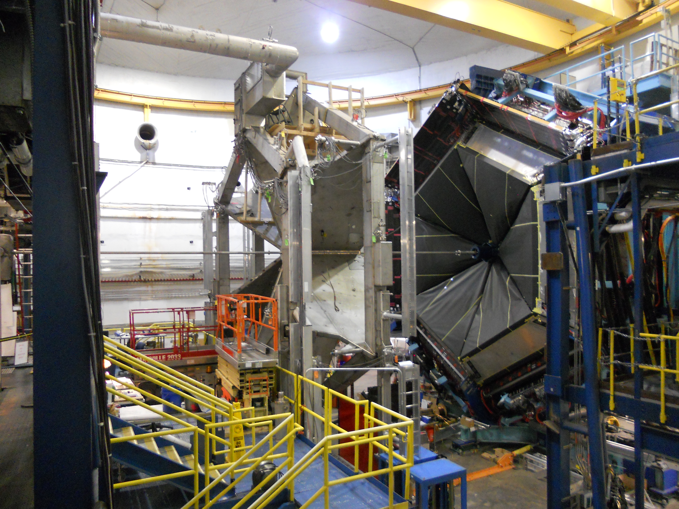
Daniel S. Carman
Jefferson Laboratory
CLAS N* Program
Nucleon Structure
Exclusive KY Data
New CLAS12 Experiment

Slide 2
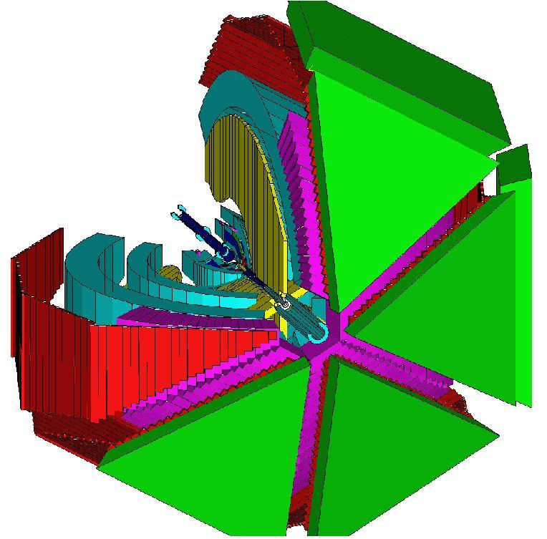
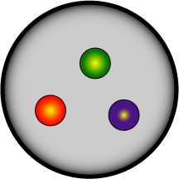
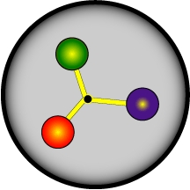
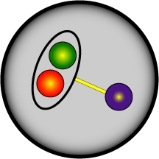
CLAS N* Program
The N* program is one of the key physics foundations of Hall B
CLAS was designed to measure γN and γ_{v}N cross sections and spin observables over a broad kinematic range for exclusive reaction channels
πN, ωN, φN, ηN, η’N, ππN
KY, K*Y, KY*
- Consistent interpretation of N* properties from different exclusive channels with different couplings and backgrounds offers model independent support for findings
The program goal is to probe the spectrum of states and their structure through studies of the Q² evolution of the γ_{v}NN* electrocouplings
- Probe the underlying degrees of freedom of the nucleon
- Study the non-perturbative strong interaction that generates N* of different quantum numbers from quark and gluons
?

Slide 3
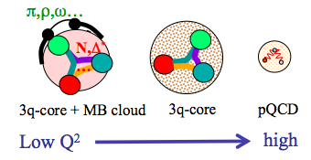
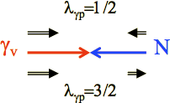
Nucleon Structure
Nucleon structure is more complex than what can be described accounting for quark degrees of freedom only
- Low Q²:
High Q²:
structure well described by adding an external MB cloud to inner quark core
quark core dominates; transition from confinement to pQCD regime
(Q² < 5 GeV²)
(Q² > 5 GeV²)
Electroproduction studies from low to high Q² probe the detailed structure of the N* states through the γ_{v}NN* electrocoupling amplitudes
- The electrocouplings probe the mass function and structure of the dressed quarks vs. distance scale
Comparison of theory predictions to data test our understanding of the strong interaction dynamics vs. distance scale
e’
K
γ_{v}
e
N*,△*
Q²
N
Y
A_{1/2}, A_{3/2}, S_{1/2}
helicity amplitudes
A_{1/2} , A_{3/2} – transverse
S_{1/2} - longitudinal

Slide 4
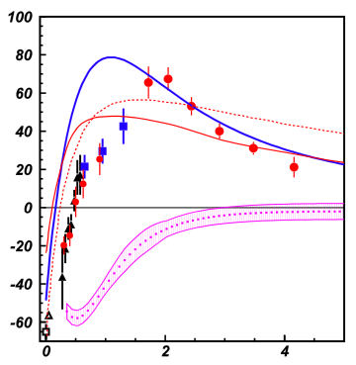
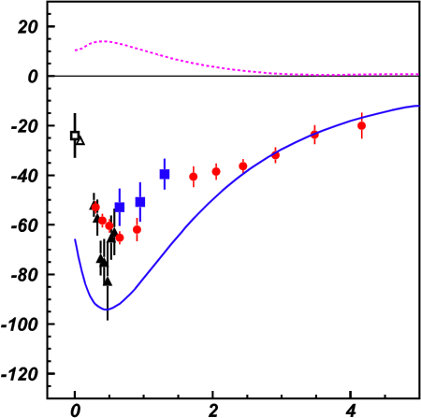
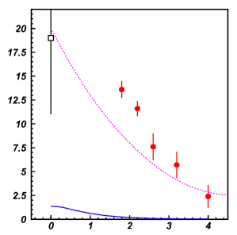
Lower-Lying N* States
A_{1/2}
A_{1/2}
A_{1/2}
P₁₁(1440)
D₁₃(1520)
D₁₅(1675)
Q² (GeV²)
Q² (GeV²)
Q² (GeV²)
Nπ
Nππ
Studies of γ_{v}NN* electrocouplings for different N* states at lower Q² reveals different interplay between quark core and MB cloud
- Important to study states of different quantum numbers vs. distance scale
MB cloud + quark core
MB cloud only
Quark core only
[Aznauryan et al., PRC 80, 055203 (2009)]
[Mokeev et al., PRC 86, 035203 (2012)]
[Park et al., PRC 91, 045203 (2015)]

Slide 5
Lower-Lying N* States
A_{1/2}
A_{1/2}
A_{1/2}
P₁₁(1440)
D₁₃(1520)
D₁₅(1675)
Q² (GeV²)
Q² (GeV²)
Q² (GeV²)
Good agreement of the extracted N* electrocouplings
from both the Nπ and Nππ exclusive channels:
Compelling evidence for the reliability of the results
Channels have very different mechanisms for the
non-resonant background
Structure studies of low-lying N* states (M < 1.7 GeV) have advanced due to agreement of results from independent analysis of the Nπ and Nππ final states
Nπ
Nππ
MB cloud + quark core
MB cloud only
Quark core only

Slide 6
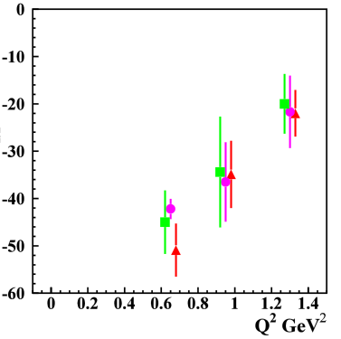
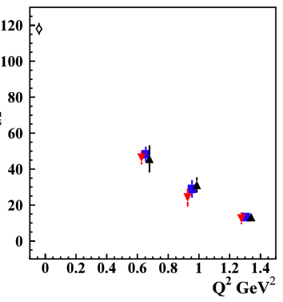
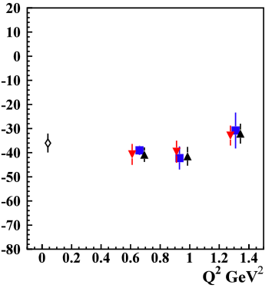
Higher-Lying N* States
Nππ channel provided the first results on higher-lying states up to 1.7 GeV:
S₃₁(1620), S₁₁(1650), F₁₅(1680), D₃₃(1700), P₃₃(1720)
S₃₁(1620)
D₃₃(1700)
P₁₃(1720)
1.61-1.71 GeV
1.66-1.76 GeV
1.71-1.81 GeV
1.46-1.56 GeV
1.56-1.66 GeV
1.61-1.71 GeV
S_{1/2}
A_{1/2}
A_{3/2}
[Mokeev, Aznauryan, Int. J. Mod. Phys. Conf. Ser. 26, 1460080 (2014)]
Many high-lying N* states (M > 1.6 GeV) decay mainly to Nππ with much smaller strength to Nπ
Data from the KY channels is critical to provide an independent
extraction of the electrocoupling amplitudes for the high-lying N* states

Slide 7
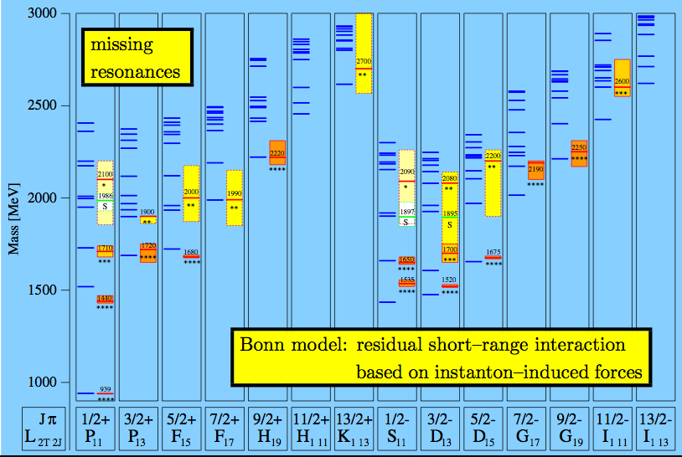
N* Spectrum
missing N* states
Nππ,
KY
sensitive to higher mass states
RCQM
[Löring, Metsch, Petry, Eur. Phys. J. A 10, 395 (2001)]

Slide 8
N*,Δ* → KY Landscape
Old
New
N* → KY |  |  |  | Δ* → KΣ
State | Rating | BR %(KΛ) | BR % (KΣ) | State | Rating | BR % (KΣ)
N*(1650) | **** | 3–11 | - | Δ*(1700) | **** | -
N*(1675) | **** | < 1 | - | Δ*(1750) | * | -
N*(1680) | **** | - | - | Δ*(1900) | ** | -
N*(1700) | *** | < 3 | - | Δ*(1905) | **** | -
N*(1710) | *** | 5–25 | - | Δ*(1910) | **** | 9
N*(1720) | *** | 1–15 | - | Δ*(1920) | *** | 2.1
N*(1875) | *** | - | - | Δ*(1930) | *** | -
N*(1900) | *** | 0-10 | 5 | Δ*(1940) | ** | -
N*(1990) | ** | - | - | Δ*(1950) | **** | -
N*(2000) | ** | - | - | Δ*(2000) | ** | -
N* → KY |  |  |  | Δ* → KΣ
State | Rating | BR % (KΛ) | BR %(KΣ) | State | Rating | BR % (KΣ)
N*(1650) | **** | 10±5 | - | Δ*(1620) | **** | -
N*(1675) | **** | - | - | Δ*(1700) | **** | -
N*(1680) | **** | - | - | Δ*(1750) | * | -
N*(1700) | *** | - | - | Δ*(1900) | ** | 5±3
N*(1710) | *** | 23±7 | - | Δ*(1905) | **** | -
N*(1720) | **** | - | - | Δ*(1910) | **** | 9±5
N*(1875) | *** | 4±2 | 15±8 | Δ*(1920) | *** | 4±2
N*(1880) | ** | 2±1 | 17±7 | Δ*(1930) | *** | -
N*(1895) | ** | 18±5 | 13±7 | Δ*(1940) | *** | -
N*(1900) | ** | 16±5 | 5±2 | Δ*(1950) | **** | 0.4±0.1
N*(1990) | ** | - | - | Δ*(2000) | ** | -
N*(2000) | ** | - | -
[Beringer et al. (PDG), PRD 86, 010001 (2012)]
[Anisovich et al., EPJ A 48, 15 (2012)]
Essentially nothing is known regarding N*,Δ* states for M > 2 GeV

Slide 9
CLAS12 N* Program
E12-09-003 | E12-06-108A
Nucleon Resonance Studies with CLAS12 | KY Electroproduction with CLAS12
Burkert, Mokeev, Stoler, Joo, Gothe, Cole | Carman, Mokeev, Gothe
Measure exclusive electroproduction cross sections from an unpolarized proton target with longitudinally polarized electron beam for Nπ, Nη, Nππ, KY:
E_{b} = 11 GeV, Q² = 5 → 12 GeV², W → 3.0 GeV, cos θ_{m}* = [-1:1]
Key Motivations:
Study spectrum and structure of all prominent N* states vs. Q² up to 12 GeV²
A unique opportunity to explore the nature of confinement that is responsible for >98% of resonance masses and the emergence of N* states from QCD
KY data complement the Nππ data as independent information for high-mass states inaccessible with Nπ final states
Urgent need: Develop reaction models to extract electrocouplings that incorporate the transition from M-B to q-G degrees of freedom

Slide 10
New Run Group Proposal
A new CLAS12 Run Group proposal has been submitted to PAC44 for review:
Hybrid Baryons | Search for new hybrid baryons (qqqg) focusing on 0.05 GeV² < Q² < 2.0 GeV² in mass range from 1.8 to 3 GeV
KY Electroproduction | Study N* structure for states that couple to KY through measurements of cross sections and polarization observables that will yield Q² evolution of electrocoupling amplitudes (Spokespersons: Carman, Gothe, Mokeev)
DVCS | Access GPDs H, E, H, E using DVCS process ep → epγ and the DVMP process ep → epπ⁰
~ ~
Run Group conditions:
E_{b} = 6.6 GeV, 50 days
E_{b} = 8.8 GeV, 50 days
Torus I = -3375 A (negatives outbending)
FT, MM, RICH (if available)
Highly polarized electrons, unpolarized lH₂ target
L = 1x10³⁵ cm⁻²s⁻¹
First run group proposal for less than 5-pass (11 GeV) beam

Slide 11
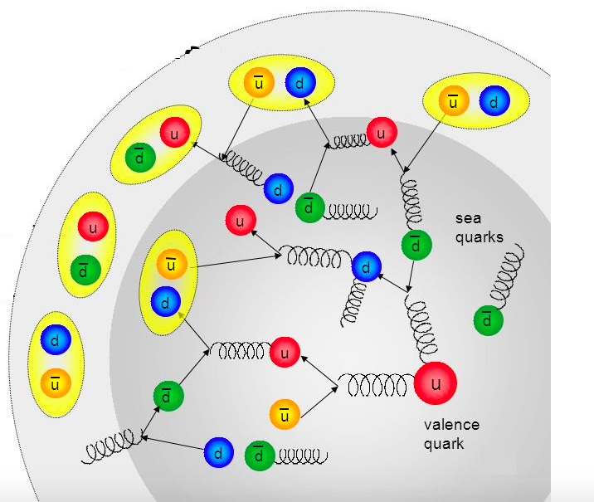
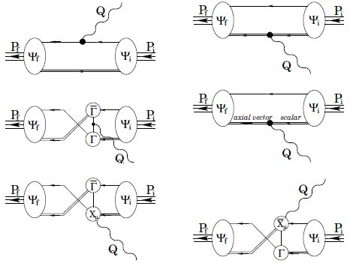
Physics Opportunities
This proposal is an extension of the approved proposal E12-06-108A that will take data during Run Group A at E_{b} = 11 GeV, yet it is not just “more of the same”, as there are unique opportunities at lower energies ⇒ lower Q².
Data in the range of Q² = 2 → 7 GeV² offer a unique opportunity:
to explore the emergence of the external MB cloud from the core of confined quarks and gluons
to check the theoretical expectations on the MB cloud generation from the confinement regime
Access di-quark correlations in N* structure:
important part of N* structure and γ_{v}NN* transition amplitudes
determined by dressed quark mass function through DCSB
dependent on N* quantum numbers
sizable for Q² < 5 GeV²; minimal contributions from MB cloud in range from Q² = 2 → 5 GeV²

Slide 12
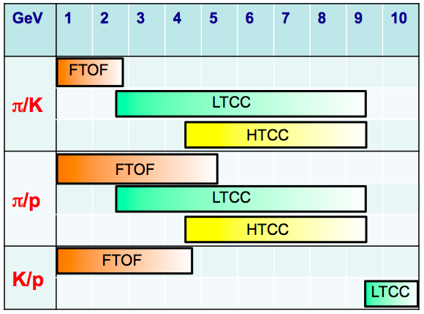
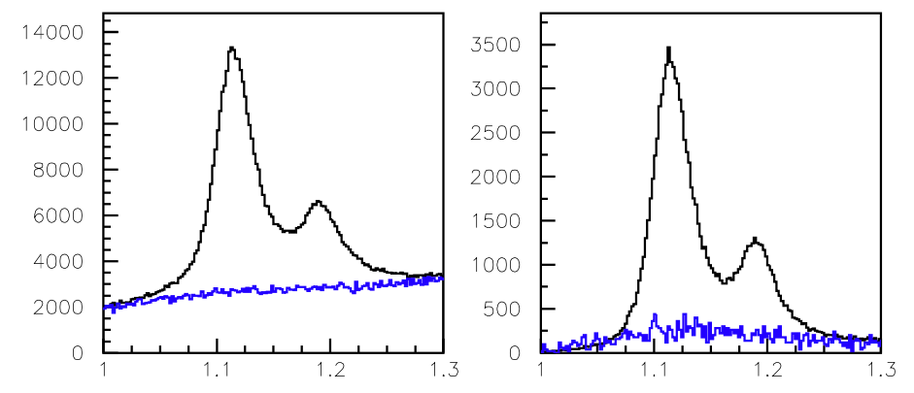
Experimental Details
CLAS12 K⁺ Identification Issues:
The finite time resolution of the FTOF system cannot distinguish π⁺ and K⁺ tracks when Δt_{πK} ~ dT_{counter}
π⁺ tracks from earlier or later beam buckets can fake K⁺ tracks regardless of timing resolution
Possible concern with increased accidental rates with CLAS12 operation
PID Mitigations:
FTOF system resolution is about a factor of 3 better than for CLAS TOF
HTCC, LTCC, RICH are 95-99% efficient for
p > 3 GeV
Exclusive event reconstruction from e’K⁺p final state can be used to reduce backgrounds
Tracking vertex resolution 10x better for CLAS12 vs. CLAS
e’K⁺
e’K⁺p
MM(e’K⁺) (GeV)

Slide 13
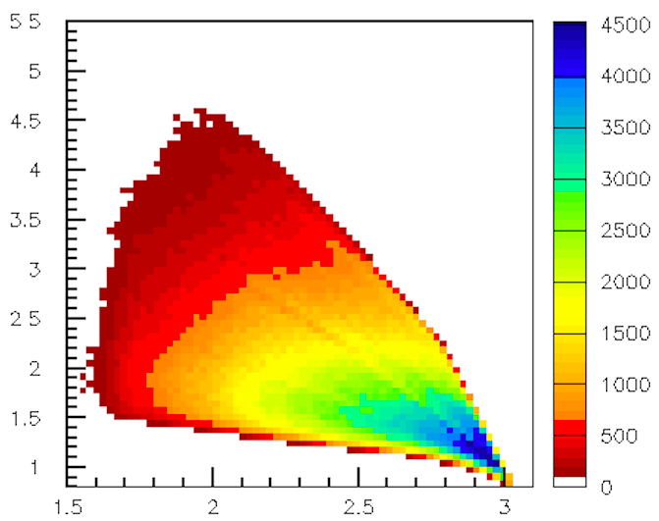
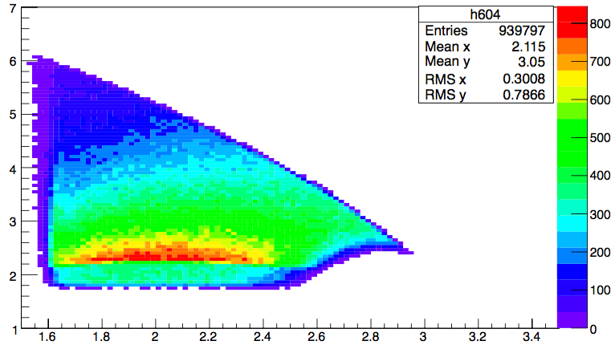
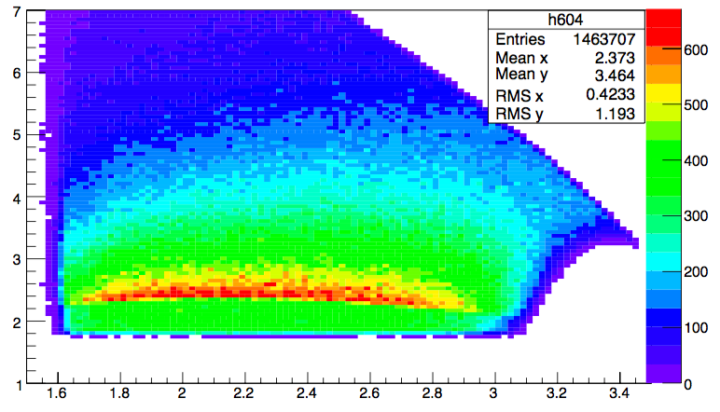
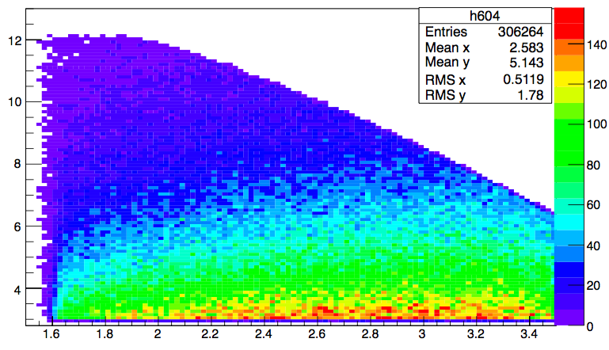
Kinematic Coverage
e1f @ 5.5 GeV, I = 2250 A
MC @ 6.6 GeV, I = -3375 A
E_{b}=6.6 GeV | F_{e1f}^{KY}
Q²=2 GeV² | x76
5 GeV² | x5
E_{b}=8.8 GeV
Q²=4 GeV² | x10
7 GeV² | x2
E_{b}=11 GeV
Q²=5 GeV² | x10
12 GeV² | x0.5
Q² (GeV²)
MC @ 8.8 GeV, I = -3375 A
MC @ 11 GeV, I = 3375 A
W (GeV)

Slide 14
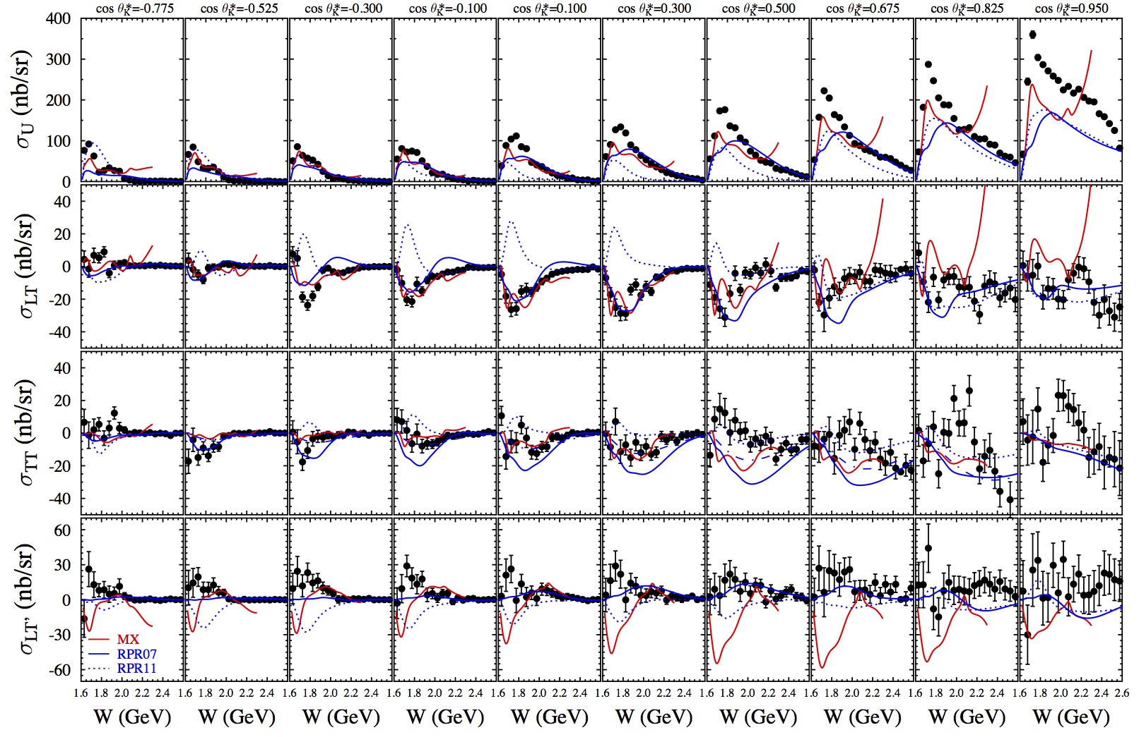
K⁺Λ Structure Functions
E = 5.5 GeV, W: thr – 2.6 GeV, Q² = 1.80, 2.60, 3.45 GeV²
[Carman et al., PRC 87, 025204 (2013)]

Slide 15
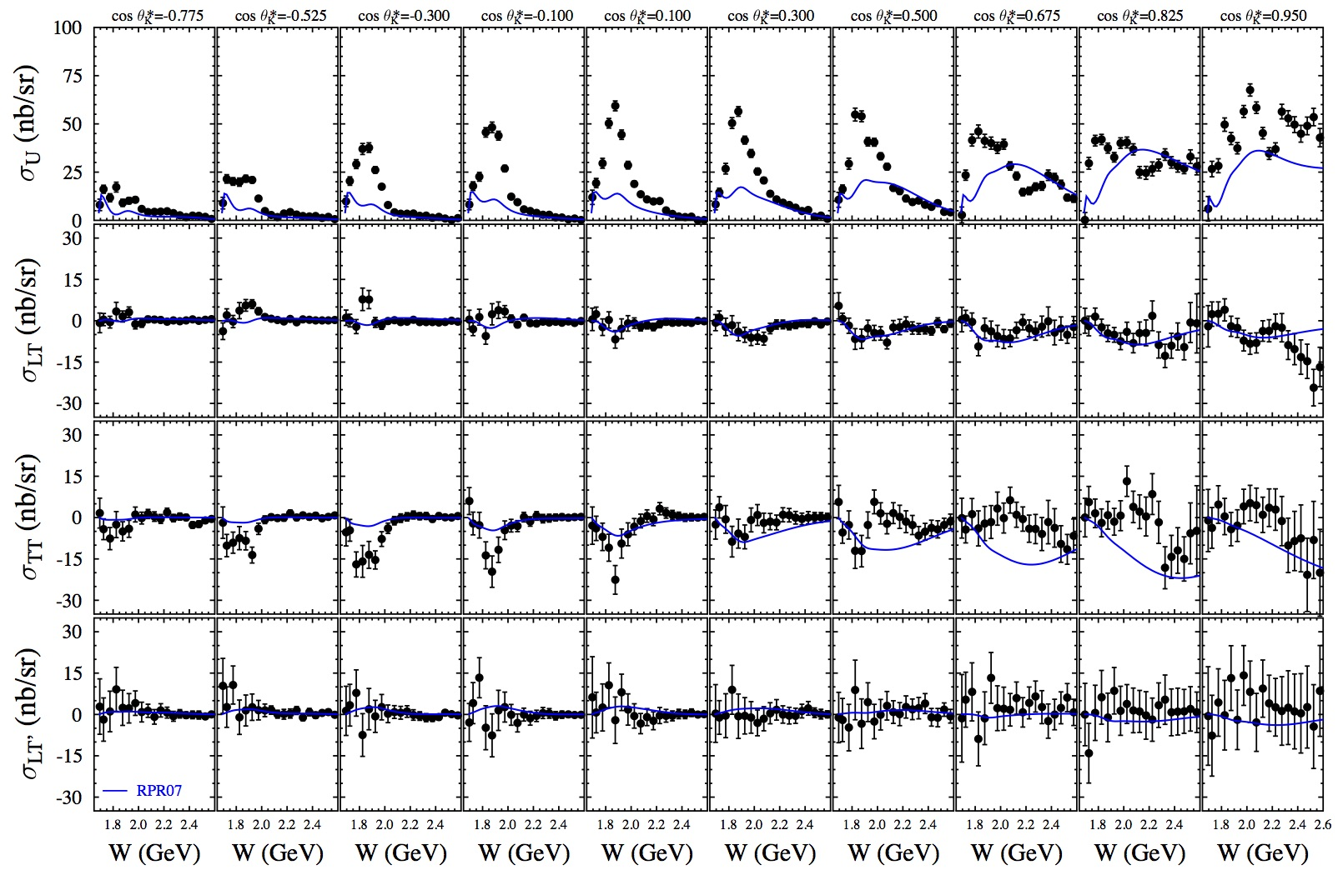
K⁺Σ⁰ Structure Functions
E = 5.5 GeV, W: thr – 2.6 GeV, Q² = 1.80, 2.60, 3.45 GeV²
[Carman et al., PRC 87, 025204 (2013)]

Slide 16
Concluding Remarks
The study of N* states is one of the key foundations of the Hall B physics program with CLAS:
CLAS has provided a dominant amount of precision data (cross sections and pol. observables) for the Nπ, Nη, KY, and Nππ channels Q² from 0 to 4.5 GeV²
Electrocouplings of most N* states < 1.7 GeV were extracted from these data for the first time for the non-strange MB final states
The CLAS12 N* program will extend these studies for 2 GeV² < Q² < 12 GeV²:
A new experimental proposal to study N* structure through KY final states at E_{b}=6.6 and 8.8 GeV has been submitted to PAC44
Along with the already approved N* experiments at E_{b}=11 GeV, these studies will allow for insight into the strong interaction dynamics of dressed quarks and their confinement in baryons over a broad Q² range
These data will address key questions of the Standard Model on the nature of hadron mass, q-g confinement, and the emergence of the N* states from QCD

