Slide 1
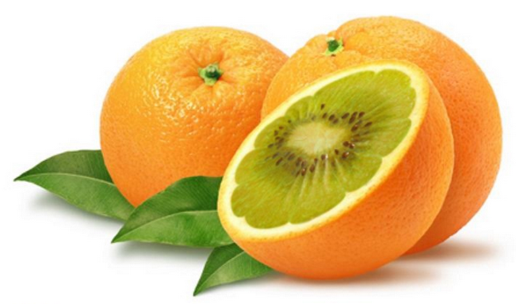
CLAS Collaboration Meeting
Thomas Jefferson National Accelerator Facility
June 16-18 2016
A Search for Hybrid Baryons in Hall B with CLAS12
Annalisa D’ANGELO
University of Rome “Tor Vergata” and INFN Rome Tor Vergata

Slide 2
Physics Motivation
What do we want to learn ?

Slide 3
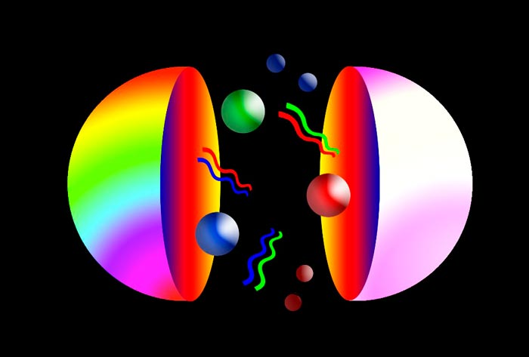
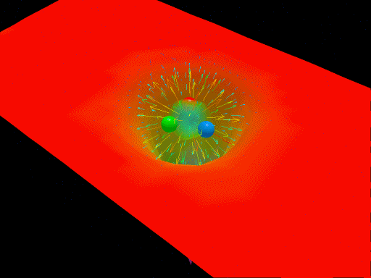
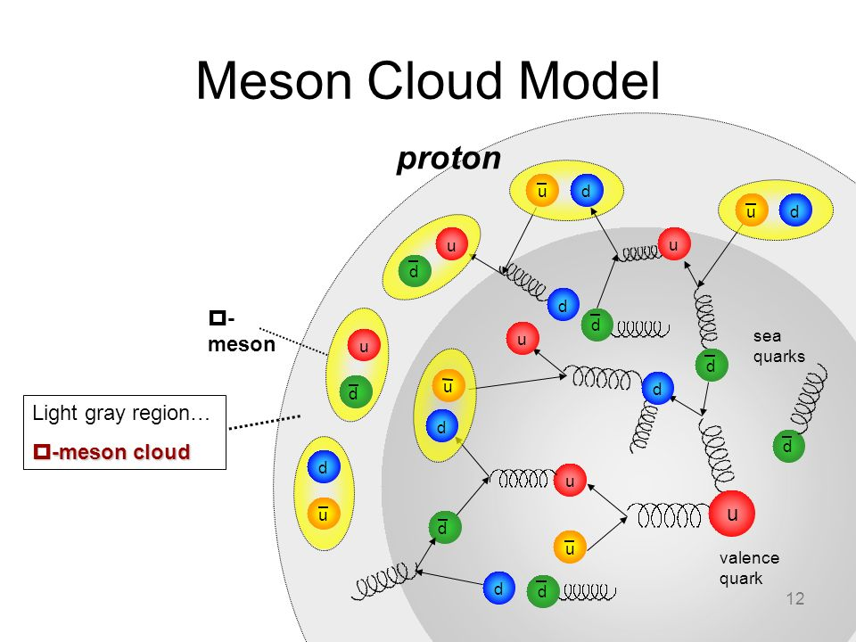
Hybrid Baryons: baryons with explicit gluonic degrees of freedom
CQM
CQM + flux tubes
Baryon-meson system
The N* spectrum reflects the underlying degrees of freedom and the effective forces between them.
Augmenting the quarks q by gluons g leads to additional states
|qqq>|_{color} ordinary 3-quark states color singlet
|qqqg>|_{color} 3-quark-core color octet ⊗ 8 color singlet
Hybrid baryons with dominant gluonic contributions are allowed by QCD
predicted by: MIT bag model and LQCD
Notes:
… One of the experimental tool we employ is the study of the N* spectrum as a reflection of the underlying degrees of freedom, some of which are shown by these cartoons representing constituent quarks in a bag, held together by gluon strings that my also get excited and generate hybrid baryons, quarks model with di-quark clustering, and states generated dynamically by meson-baryon interaction. These configuration result in variations of the excitation spectrum which we study with hadron or electromagnetic beams. The second line of research is to measure the strength of resonance excitations versus the space-time resolution of the probe to see how the strength of the effective degrees of freedom change with the distance scale. Beyond these mostly experimental aspects, there has been significant progress in the theory sector , e.g. predictions from LQCD of the spectrum, the Dyson-Schwinger equations of QCD, holographic QCD, and others.

Slide 4
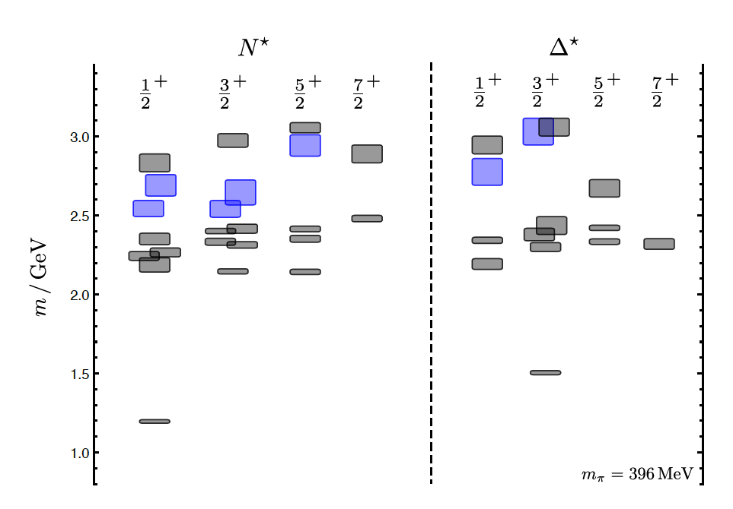
Hybrid Baryons in LQCD
J.J. Dudek and R.G. Edwards, PRD85 (2012) 054016
LQCD
clustered
in mass
regular states
hybrid states
Γ ∼ 0.2-0.3 GeV
1.3GeV
The nucleon mass is shifted ~300 MeV to higher masses
N
Hybrid states have same J^{P} values as Q³ baryons. How to identify them?
Overpopulation of N ½⁺ and N 3/2⁺ states compared to QM projections ?
A _{1/2} ( A _{3/2}) and S _{1/2} show different Q² evolution

Slide 5
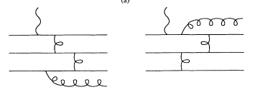
Separating q³g from q³ states?
Z.P. Li, V.Burkert, Zh. Li, PRD46 (1992)70; C.E. Carlson, N. Mukhopadhyay, PRL 67, 3745, 1991
Lowest mass hybrid baryon qqqg should be J^{P} =1/2⁺ (same as Roper) and next higher J^{P}=3/2⁺
The suppression of the longitudinal coupling S _{1/2}(Q²) = 0 appears to be a property
of the γqG
Question:
Could that be a universal feature of photoexcitation of hybrid baryons?
N(1440)1/2⁺
q³
q³
q³g
q³g
A_{1/2} dominant amplitude at high Q² indicates radial qqq excitation
Significant meson-baryon coupling at small Q²
For hybrid “Roper”, transverse amplitude A_{1/2}(Q²) drops off faster with Q², and S_{1/2}(Q²) ~ 0.

Slide 6
Hadronic couplings
Very little is known about hadronic couplings but it is reasonable to expect that hybrid baryons may decay in channel with high gluonic content such as:
B^{G} N η’
Alternatively one may expect decays with high content (due to G ) such as:
B^{G} K⁺Λ, KΣ
B^{G} N*(1535) π N η π
B^{G} N π π
B^{G} N φ
B^{G} K*Λ
The proposal focuses on:
e p e’ p π⁺ π⁻
e p e’ K⁺Λ, e’ K⁺Σ⁰
The study may be extended to other channels as:
ep e’ p η’ ep e’ p φ
ep e’ K*Λ ep e’ K⁺ Λ*

Slide 7
Hybrid Baryons Signature
Based on available knowledge, the signature for hybrid baryons may consist of :
• Extra resonances with J^{p}=1/2⁺ and J^{p}=3/2⁺ , with masses from 1.8 GeV to 2.5 GeV and decays to Nππ or KY final states
•A drop of the transverse helicity amplitudes A_{1/2}(Q²) and A_{3/2}(Q²) faster than for ordinary three quark states, because of extra glue-component in valence structure
•A suppressed longitudinal amplitude S_{1/2}(Q²) in comparison with transverse electro-excitation amplitude ( J^{P}=1/2⁺).

Slide 8
The Experimental Program
How do we proceed ?

Slide 9
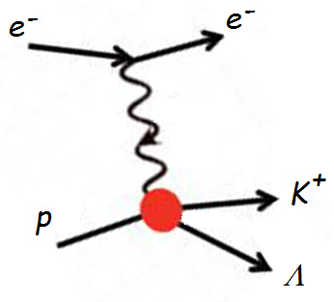
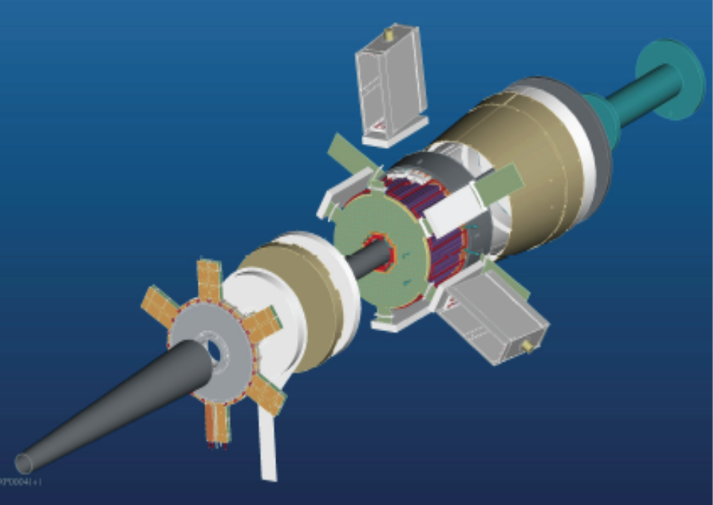
The experiment
FT
ϑ > 6°
ϑ > 6°
CLAS12
p
π⁺
π⁻
Scattered electrons will be detected:
in the Forward Tagger for angles from 2.5° to 4.5°
in the Forward Detector of CLAS12 for scattering angles greater than about 6°.
Charged hadrons will be measured in the full range from 6° to 130°.
FT allows to probe the crucial Q² range where hybrid baryons may be identified due to their fast dropping A_{1/2}(Q²) amplitude and the suppression of the scalar S_{1/2} (Q²) amplitude.
W < 3 GeV Q² range of interest: 0.05 - 2 GeV²

Slide 10
Beam energy? Inbending or outbending field?
Q² vs W
Ee =11 GeV
I = - 3375 A
Ee =11 GeV
I = - 3375 A
1. Need for lower beam energies to cover Q²< 0.2 GeV²
Ee =11 GeV
I = + 3375 A
Ee =11 GeV
I = + 3375 A
2. Need for outbending Torus field for electrons

Slide 11
Kinematical Coverage: full Q² range
Q² vs W
Ee =6.6 GeV
I = - 3375 A
Ee =6.6 GeV
I = - 3375 A
Q² ≥ 0.05 GeV²
3. Q² as low as 0.05 GeV² may be reached
Ee =8.8 GeV
I = - 3375 A
Ee =8.8 GeV
I = - 3375 A
4. Complementary Q² ranges using different E_{e}

Slide 12
Simulation and FASTMC reconstruction
e p e’ p π⁺ π⁻
e p e’ K⁺Y

Slide 13
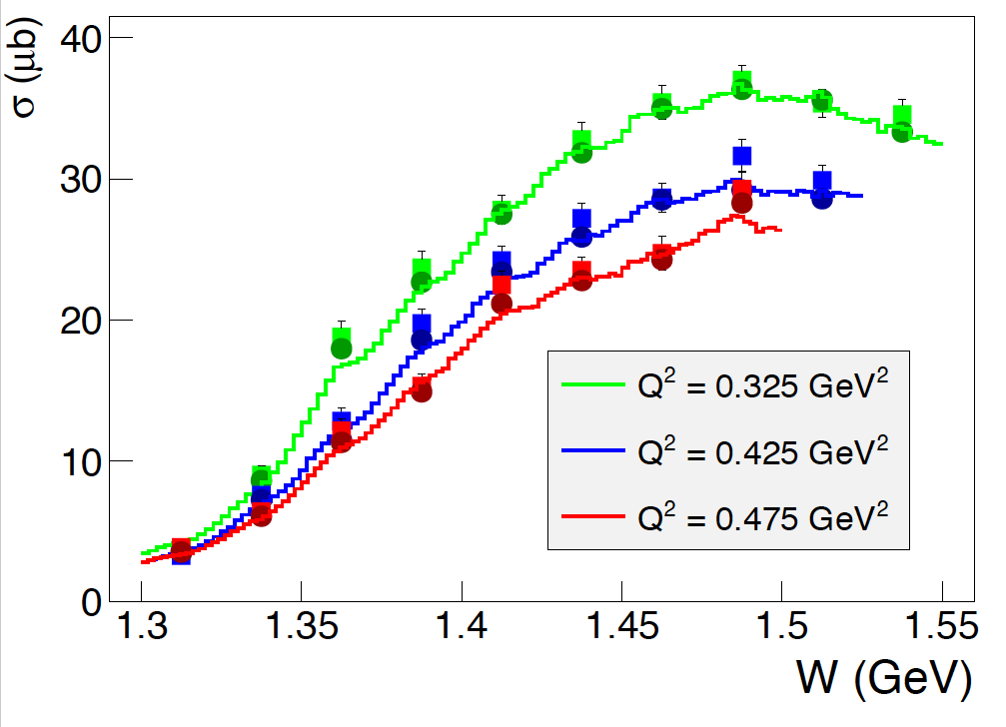
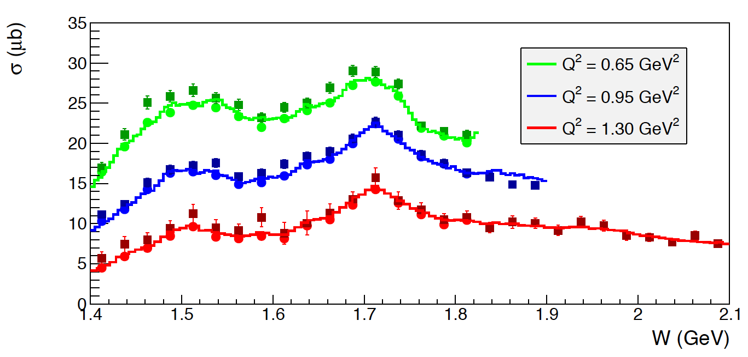
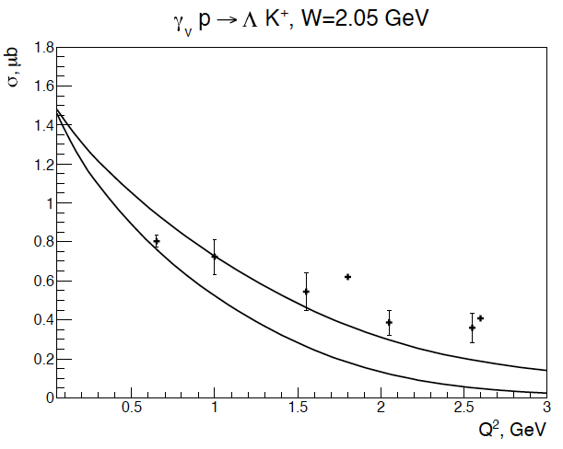
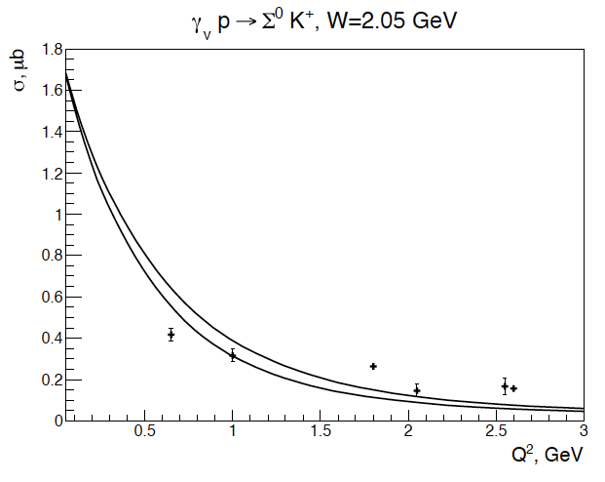
Simulation and FASTMC reconstruction of events in CLAS12
e p e’ p π⁺ π⁻
e p e’ K⁺Y
Develop realistic event generator
Simulation of quasi-data events including simplified experimental effects with FASTMC
Selection of trigger conditions:
scattered electron (FT or CLAS12) + at least 2 hadrons in CLAS12
Events reconstruction to determine final resolutions and efficiencies
JLab - Moscow (JM) model
Regge + Resonance (RPR) Gent model
http://rprmodel.ugent.be/calc/

Slide 14
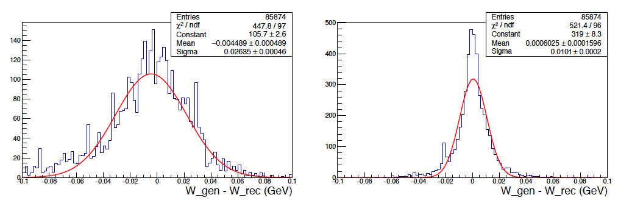
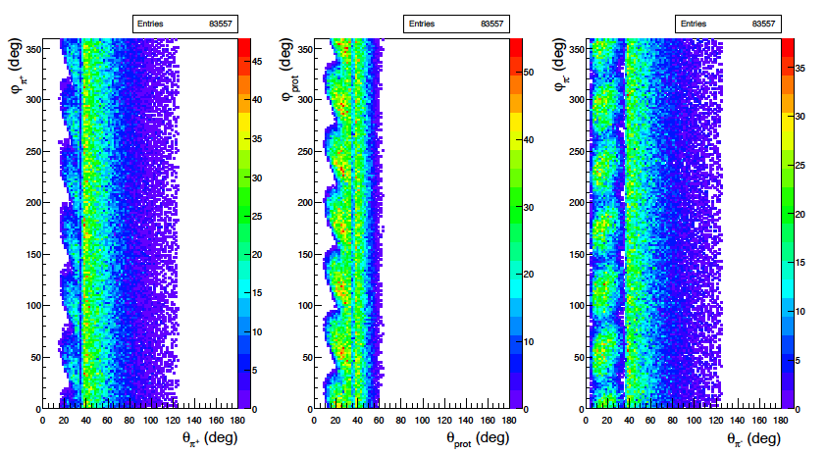
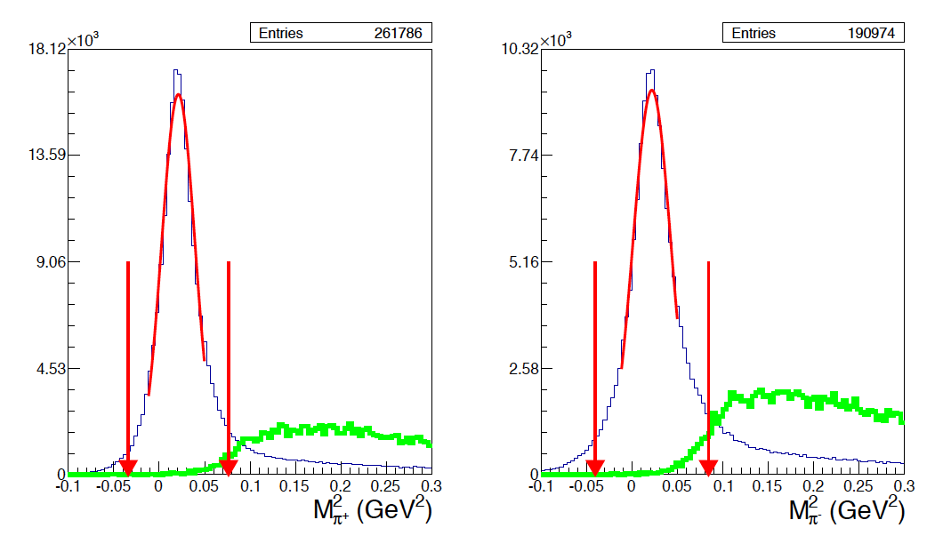
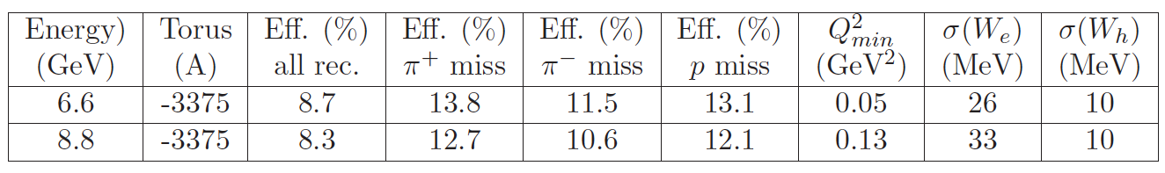
Simulation and FASTMC reconstruction of events in CLAS12
Results for e p e’ p π⁺ π⁻
Resolution
e scattering
hadrons
kinematics
φ vs θ angular acceptance for final hadrons
σ_{W}=26 MeV
σ_{W}=10 MeV
π⁺
p
π⁻
Exclusivity cuts
missing π⁺
missing π⁻
π⁺π⁻π⁰p
bkg
π⁺π⁻π⁰p
bkg

Slide 15
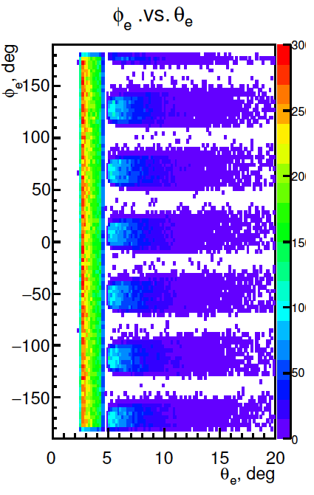
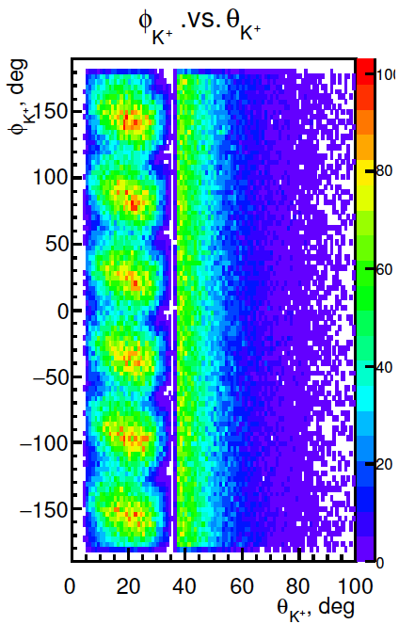
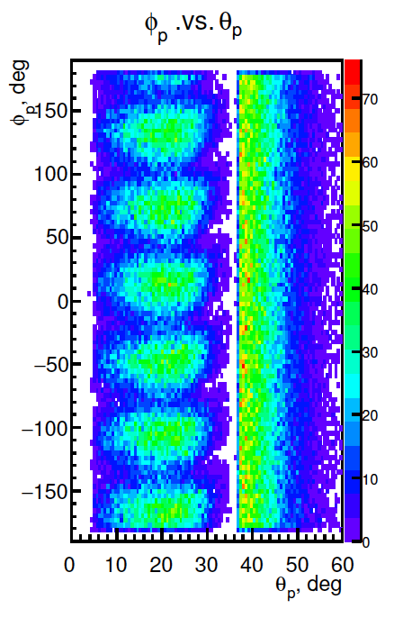
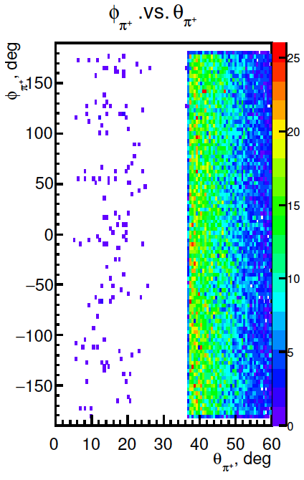
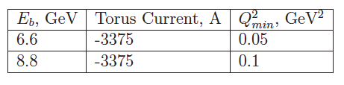
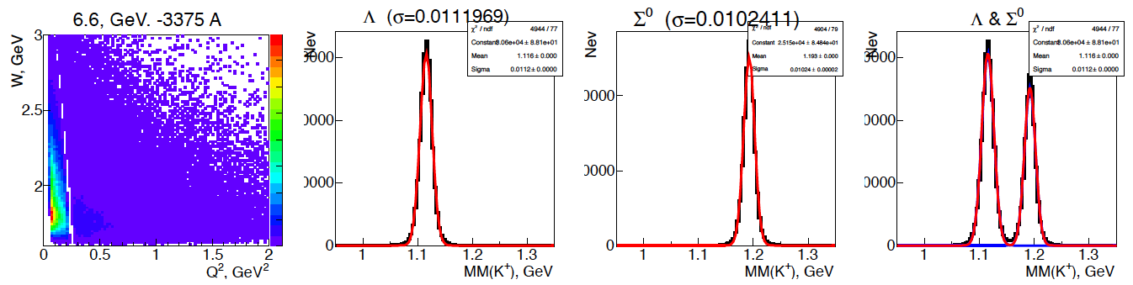
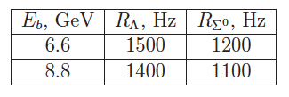
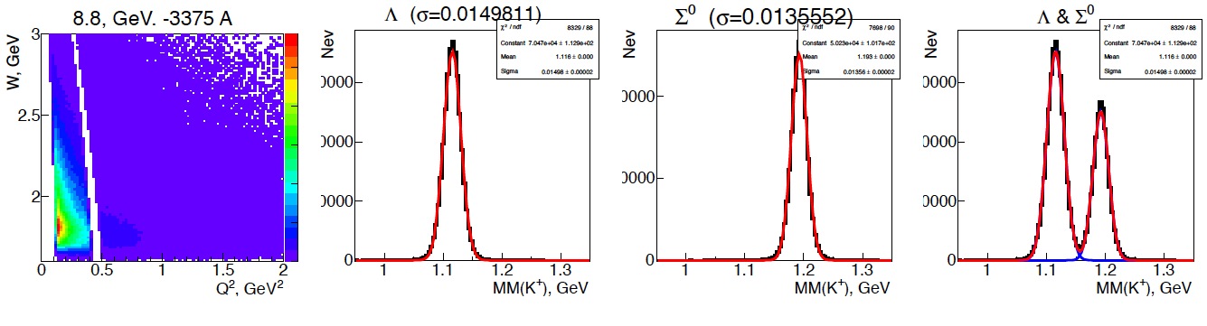
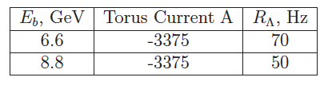
Simulation and FASTMC reconstruction of events in CLAS12
Results for e p e’ K⁺ Λ e’ K⁺ pπ⁻ and e p e’ K⁺ Σ⁰ e’ K⁺Λγ e’ K⁺pπ⁻γ
φ vs θ angular acceptance for final particles
Minimum measurable Q²
e⁻
K⁺
p
π⁻
Production rates
L=10³⁵cm⁻²s⁻¹
K⁺ missing mass resolution
W vs Q²
σ=11 MeV
σ=10 MeV
Ee = 6.6 GeV
Reconstructed events rates
L=10³⁵cm⁻²s⁻¹ (Λ pπ⁻ BR=64%)
W vs Q²
σ=15 MeV
σ=13 MeV
Ee = 8.8 GeV

Slide 16
Data Analysis and Quasi-data
Adding the Hybrid Baryons at the amplitude level
Statistical sensitivity to Hybrid Baryons electrocouplings: threshold values
Extraction of Legendre moments

Slide 17
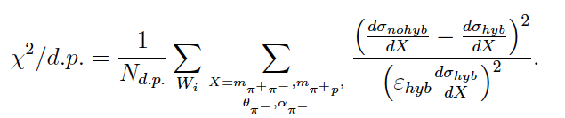
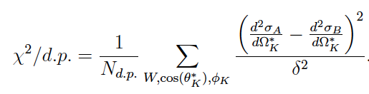
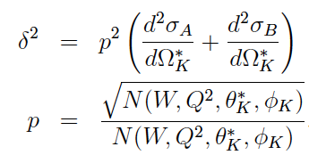


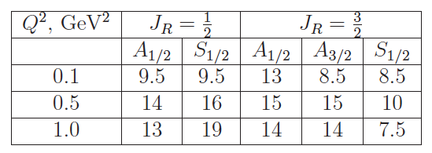
Simulation of model + hybrid contribution
e p e’ p π⁺ π⁻
e p e’ K⁺Y
JLab - Moskow (JM) model
Regge + Resonance (RPR-2011) Gent model
http://rprmodel.ugent.be/calc/
Sensitivity studies and statistical significance:
Threshold values for hybrid baryons electrocouplings
Fixing M_{res} =2.2 GeV, Γ_{res} =0.25 GeV and varying A_{1/2, 3/2}
p π ⁺π⁻ S_{1/2} = 0 x 10⁻³ GeV^{-1/2}
K⁺ Λ
10⁻³ GeV^{-1/2}
lower or comparable with values for other N*

Slide 18
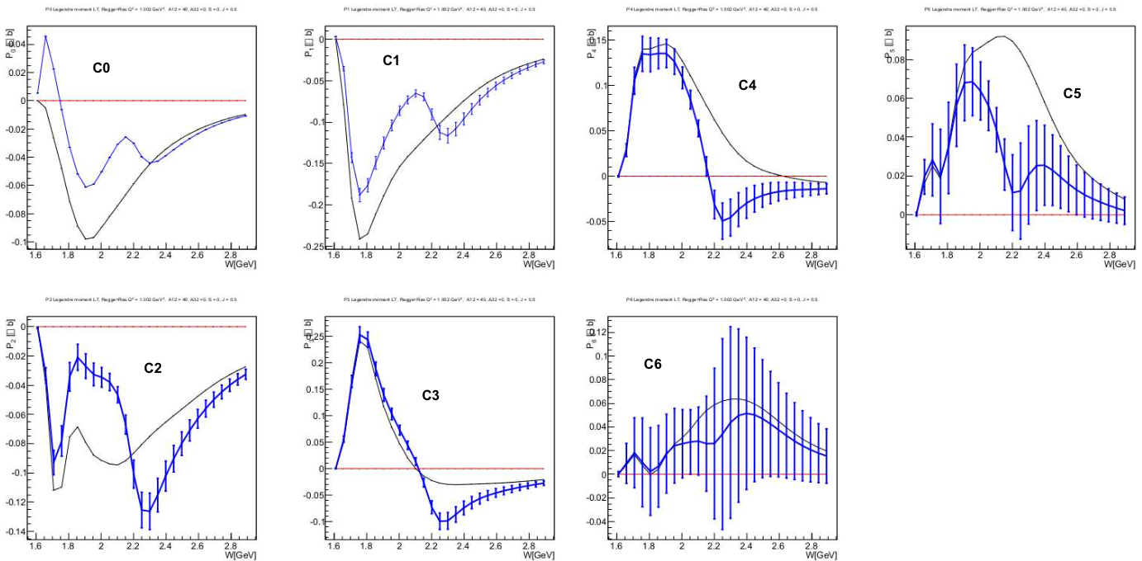
Simulation of model + hybrid contribution
Sensitivity studies and
statistical significance:
Legendre moments: LT
e p e’ K⁺Λ
Regge + Resonance (RPR-2011) Gent model
http://rprmodel.ugent.be/calc/
J = ½
Regge + Res.
Q² = 1 GeV²
M_{res} = 2.2 GeV
A_{1/2} = 0.04 GeV^{-1/2}
S_{1/2} = 0
2
Significant structures appear in most of the Legendre moments at the value of
W = 2.2 GeV, corresponding to the mass of the added hybrid baryon

Slide 19
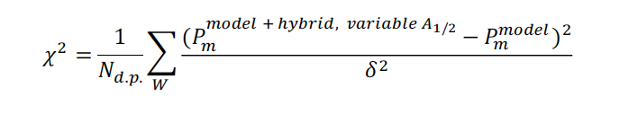
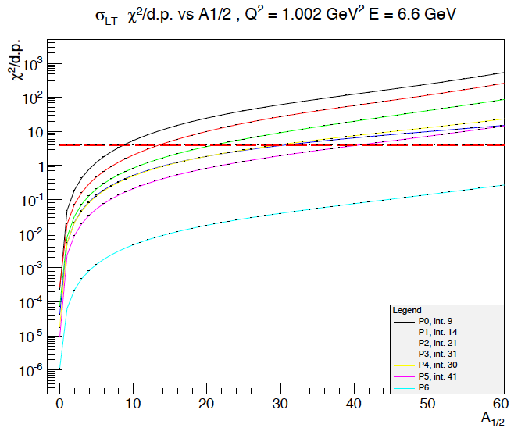
Simulation of model + hybrid contribution
Legendre moments: LT
χ² dependence upon A_{1/2}x 10⁻³ GeV^{-1/2}
e p e’ K⁺Λ
Regge + Resonance (RPR-2011) Gent model
http://rprmodel.ugent.be/calc/
J^{P} = ½⁺
Regge + Res.
Q² = 1 GeV²
M_{res} = 2.2 GeV
Γ_{res} = 0.25 GeV
S_{1/2} = 0
χ² > 4
Threshold values for A_{1/2} are comparable with those obtained from cross sections values.

Slide 20
Resonance extraction – blind analysis
Inclusion of a hybrid baryon with fixed known parameters
Capability of determining resonance parameters from χ²
Blind Extraction of unknown resonance parameters

Slide 21
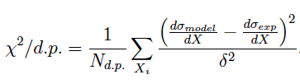
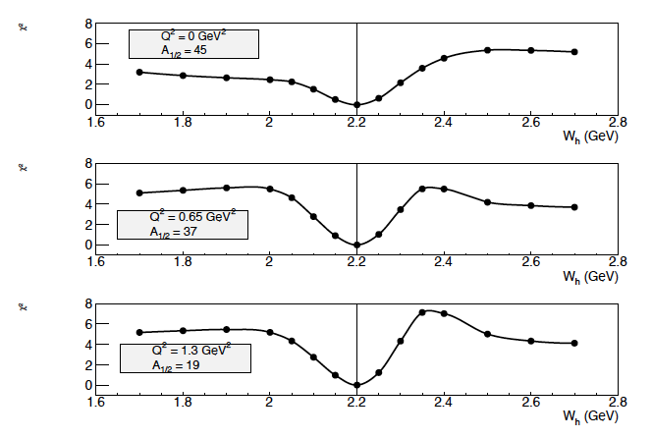
Known Resonance Parameters Extraction: J^{P}=1/2⁺
We inserted an hybrid baryon resonance with fixed known parameters and tried to scan
over the mass value to find the minimum value for the following χ² :
ep e’p π⁺π⁻
pπ⁺π⁻
J⁺ = ½⁺
M_{res} = 2.2 GeV
(to be varied)
Γ_{res} = 0.25 GeV
S_{1/2} = 0 x 10⁻³ GeV^{1-/2}
Q² = 0.0 GeV²
Q² = 0.65 GeV²
A_{1/2} = statistical threshold value
Q² = 1.0 GeV²

Slide 22
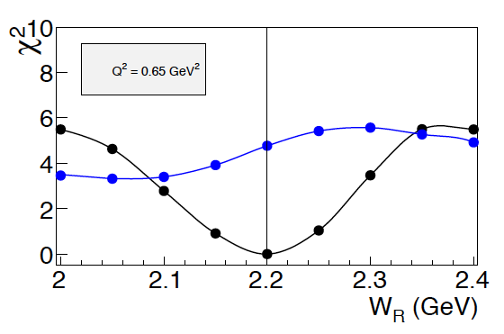
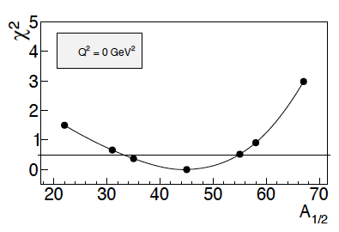
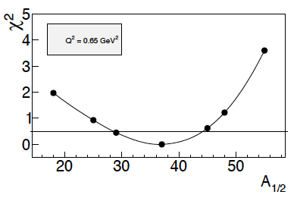
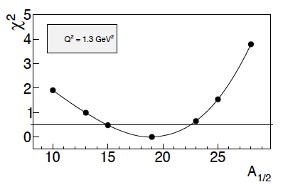
Known Resonance Parameters Extraction: J^{P}=1/2⁺
We checked the sensitivity to the correct type of electrocoupling:
e p e’ p π⁺π⁻
Quasi-data for
J^{P} = 1/2⁺
M_{res} = 2.2 GeV
(to be varied)
Γ_{res} = 0.25 GeV
A_{1/2} = 20 x 10⁻³ GeV^{-1/2}
S_{1/2} = 0 x 10⁻³ GeV^{1-/2}
Q² = 0.65 GeV²
Model assumptions:
A_{1/2} = 0 x 10⁻³ GeV^{-1/2}
S_{1/2} = 20 x 10⁻³ GeV^{1-/2}
A_{1/2} = 20 x 10⁻³ GeV^{-1/2}
S_{1/2} = 0 x 10⁻³ GeV^{1-/2}
S_{1/2}
A_{1/2}
We checked the sensitivity to the electrocoupling stength: the model has the same parameters of the quasi-data except for the A _{1/2} value, which is varied.

Slide 23
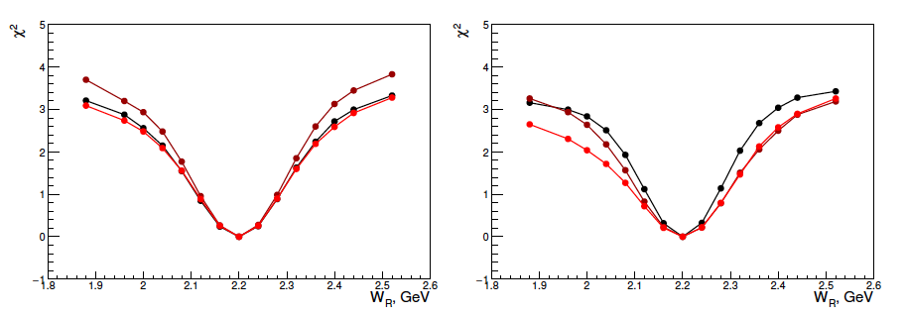
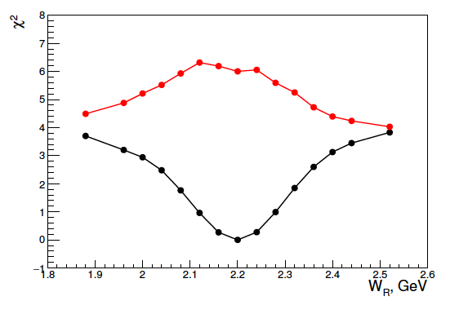
Known Resonance Parameters Extraction: J^{P}=1/2⁺ or J^{P}=3/2⁺
e p e’ pK⁺Λ
We inserted one hybrid baryon resonance with fixed J^{p} = ½⁺ or 3/2^{+ ,} generated quasi-data and model with the same known parameters and tried to vary the mass value to find the minimum χ² value.
Known:
A_{1/2} = A _{3/2} = 20 x 10⁻³ GeV^{-1/2}
M_{res} = 2.2 GeV (to be varied)
Γ_{res} = 0.25 GeV
S_{1/2} = 0 x 10⁻³ GeV^{-1/2}
Q² = 0.1 GeV²
Q² = 0.5 GeV²
Q² = 1.0 GeV²
J^{P} = ½⁺
J^{P} = 3/2⁺
We checked the sensitivity to the spin J^{p} = ½⁺ or 3/2^{+ :}
Model assumptions:
J^{P} = 3/2⁺
A_{1/2} = 20 x 10⁻³ GeV^{-1/2}
A _{3/2} = 0 x 10⁻³ GeV^{-1/2}
J^{P} = 1/2⁺
A_{1/2} = 20 x 10⁻³ GeV^{-1/2}
Known:
M_{res} = 2.2 GeV
(to be varied)
Γ_{res} = 0.25 GeV
S_{1/2} = 0 x 10⁻³ GeV^{-1/2}
Q² = 0.5 GeV²
Quasi-data for
J^{P} = 1/2⁺
A_{1/2} = 20 x 10⁻³ GeV^{-1/2}
J^{P} = 3/2⁺
J^{P} = 1/2⁺

Slide 24
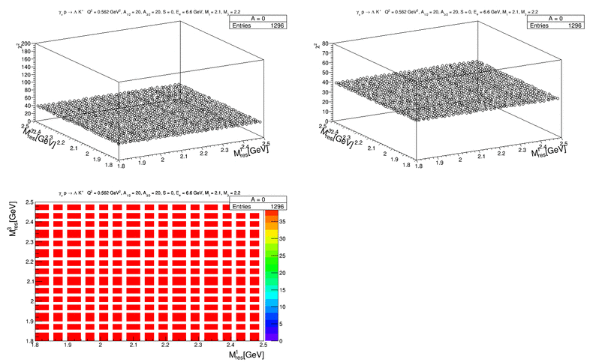
Known Resonance Parameters Extraction: J^{P}=1/2⁺ + J^{P}=3/2⁺
We inserted two hybrid baryon resonances with J^{p} = ½⁺ J^{p} = 3/2⁺ and varied masses and strength
http://rprmodel.ugent.be/calc/
J = ½
Regge + Res.
Q² = 1 GeV²
M_{res} = 2.2 GeV
S_{1/2} = 0
e p e’ K⁺ Λ
A_{3/2} = 20 x 10⁻³ GeV^{-1/2}
M_{res} = 2.2 GeV
A_{1/2} = 0 x 10⁻³ GeV^{-1/2}
S_{1/2} = 0 x 10⁻³ GeV^{-1/2}
Q² = 0.5 GeV²
Γ_{res} = 0.25 GeV
J^{P} = 3/2⁺
Threshold values for A_{1/2} are comparable with those obtained from cross sections values.
To be determined:
A_{1/2} = 20 x 10⁻³ GeV^{-1/2}
M_{res} = 2.1 GeV
Known:
S_{1/2} = 0 x 10⁻³ GeV^{-1/2}
Q² = 0.5 GeV²
Γ_{res} = 0.25 GeV
J^{P} = ½⁺

Slide 25
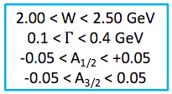
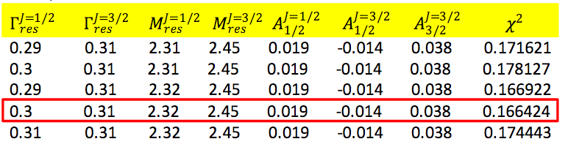
Blind analysis: J^{P}=1/2⁺ + J^{P}=3/2⁺
A blind analysis has been attempted inserting two resonances: J^{P}=1/2⁺ + J^{P}=3/2⁺
7 unknown parameters: M_{res}¹ Γ_{res}¹ A_{1/2}¹
M_{res}² Γ_{res}² A_{1/2}² A_{3/2}²
Looking for the minimum χ² value in the search range:
Iterative procedure:
The algorithm calculates the χ² value over a 7-dim parameters coarse grid, covering the full range
The combination of parameters corresponding to the minimum χ² value is found
χ² value is calculated over a finer 7-dim parameters grid, around the minimum
The procedure is repeated three times. Final step results:
χ²< 0.18
Absolute minimum
To be compared with:
Γ^{1/2}=0.3 GeV Γ^{3/2}=0.35 GeV M^{1/2}=2.30 GeV M^{3/2}=2.45 GeV A^{1/2} _{1/2}=0.020 A ^{3/2}_{1/2}=-0.015 A^{3/2} _{1/2}=0.04

Slide 26
Conclusions
Extensive program to study the excitation of nucleon resonances in meson electroproduction using E= 6.6 GeV and E=8.8 GeV in the kinematical range Q² > 0.05 GeV², W< 3 GeV with a focus on gluonic light hybrid baryon
Main investigated channels: pπ⁺π⁻ , K⁺Λ and KΣ electroproduction; acceptance, resolution and events rates for 100 days runs have been determined.
State-of-the-art partial wave analysis will be necessary to establish the existence of new resonances in the 2.0 < M < 2.5 GeV mass region.
We will have sensitivity to find hybrid baryons, if they exist, in the mass range from 1.8 to 3.0 GeV.
Data quality would then allow to determine their properties (spin, parity, mass, width, branching fraction, electrocoupling amplitudes)
I would like to thank Evgeny Golovach, Gleb Fetodov, Iuliia Skorodumina, Lucilla Lanza, Victor Mokeev, Ralf Gothe, Volker Burkert, Daniel Carman and all the Hybrid Baryons group for letting me present their work results.

Slide 27
Backup slides

Slide 28
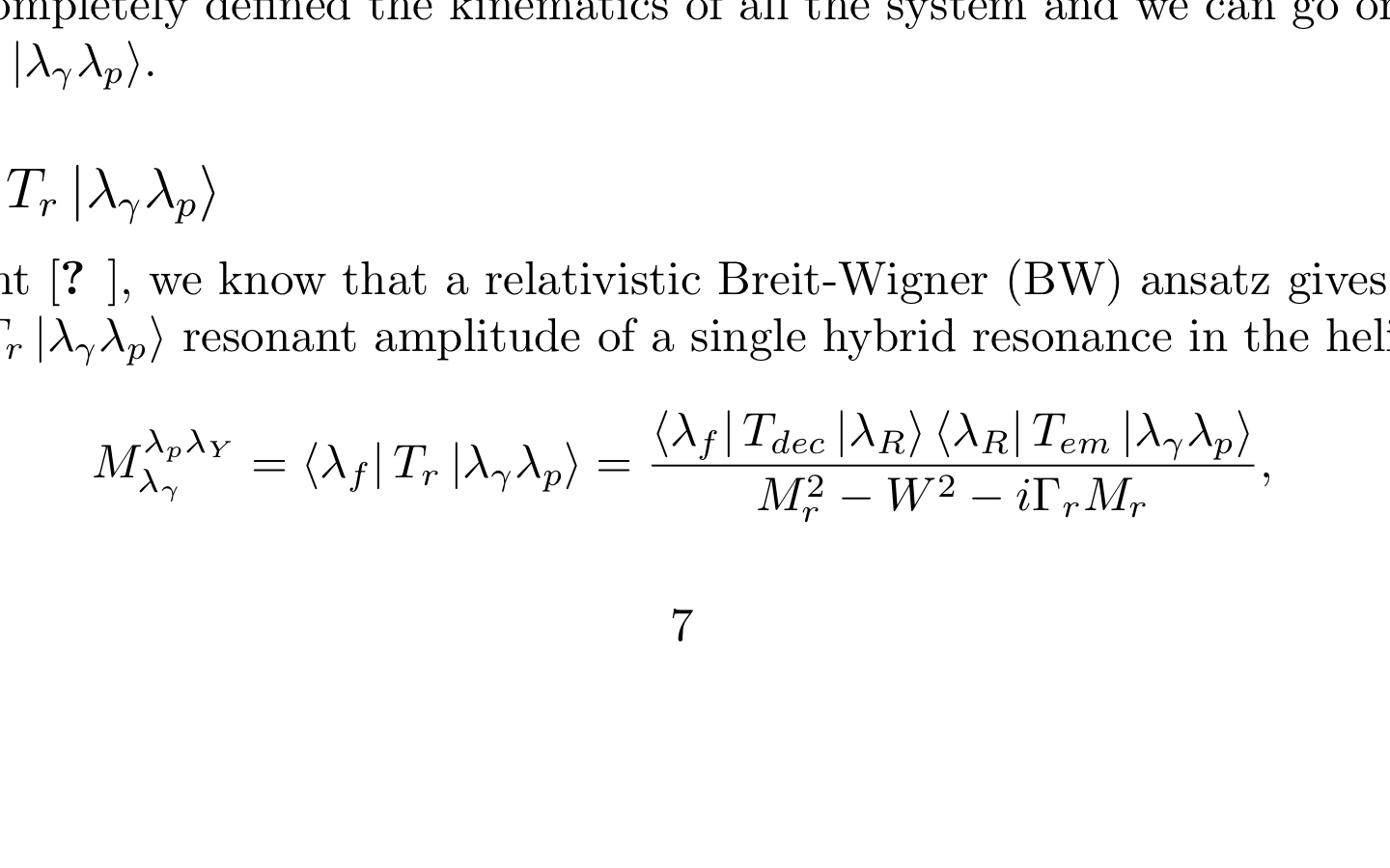
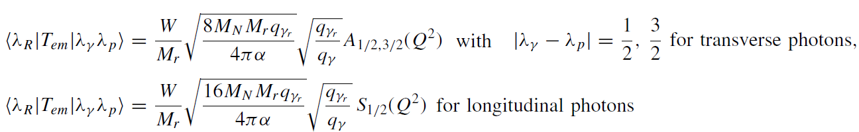
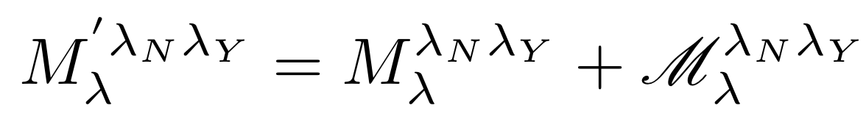
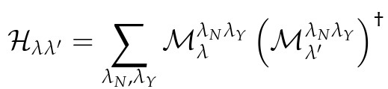
Simulation of model + hybrid contribution
e p e’ p π π
e p e’ KY
JLab - Moskow (JM) model
Regge + Resonance (RPR-2011) Gent model
http://rprmodel.ugent.be/calc/
Both reaction models are available at the Amplitude level.
Breit-Wigner ansatz for the hybrid amplitude:
The electromagnetic transition amplitudes are connected to the γ∗ΝΝ∗ electrocouplings A_{1/2, 3/2} and S_{1/2}
Add the hybrid baryon contribution to the JM/RPR-2001 model at the amplitude level:
Mr ~ 2.1-2.3 GeV
Γr ~ 0.2-0.3 GeV
J^{p} = 1/2 ⁺, 3/2⁺
λγ, λ_{N}, λ_{Y} = photon, nucleon and hyperon helicities
hadronic tensor
observables

Slide 29
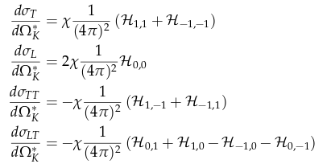
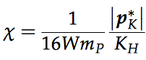

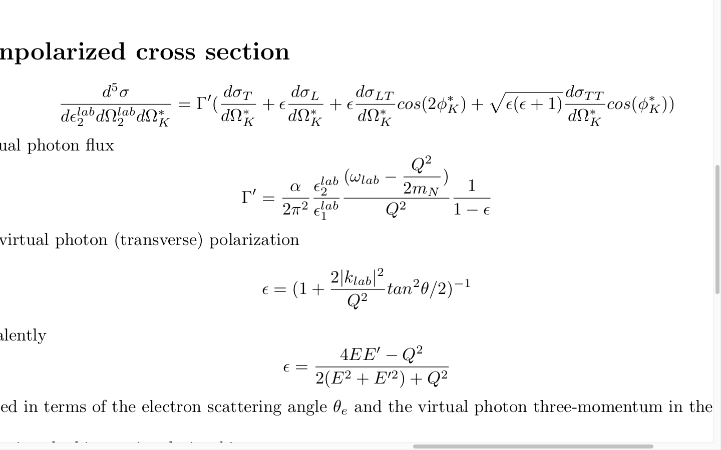


Simulation of model + hybrid contribution
e p e’ p π π
e p e’ KY
JLab - Moskow (JM) model
Regge + Resonance (RPR-2011) Gent model
http://rprmodel.ugent.be/calc/
hadronic tensor
cross section:
black points: model (A)
blue points: model + hybrid (B)

Slide 30



Simulation of model + hybrid contribution
Sensitivity Studies and
statistical significance:
Legendre moments
e p e’ KY
Regge + Resonance (RPR-2011) Gent model
http://rprmodel.ugent.be/calc/
2
The appearance of a structure in a single Legendre moment at the same value of W for each Q2 point is likely a signal from a resonance contribution

