Slide 1
Continuum-QCD & ab initio predictions

Slide 2
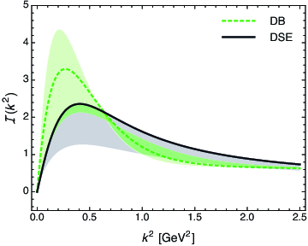
Top down & Bottom up
Bridging a gap between continuum-QCD
& ab initio predictions of hadron observables
D. Binosi (Italy), L. Chang (Australia), J. Papavassiliou (Spain),
C. D. Roberts (US), arXiv:1412.4782 [nucl-th] , Phys. Lett. B 742 (2015) 183
Modern kernels and interaction, developed at ANL and Peking U.
One parameter, fitted to ground-state properties without reference to gauge-sector studies.
Modern top-down and bottom-up results agree within 3% !
Bottom-up scheme – infer interaction by fitting data within a well-defined truncation of the matter sector DSEs that are relevant to bound-state properties.
Top-down approach – ab initio computation of the interaction via direct analysis of the gauge-sector gap equations
Serendipitous collaboration, conceived at one-week ECT* Workshop on DSEs in Mathematics and Physics, has united these two approaches
Top-down result = gauge-sector prediction
– Interaction predicted by modern analyses of QCD's gauge sector coincides with that required to describe ground-state observables using the sophisticated matter-sector ANL-PKU DSE truncation

Slide 3
Top down & Bottom up
Bridging a gap between continuum-QCD
& ab initio predictions of hadron observables
D. Binosi (Italy), L. Chang (Australia), J. Papavassiliou (Spain),
C. D. Roberts (US), arXiv:1412.4782 [nucl-th] , Phys. Lett. B 742 (2015) 183
Modern kernels and interaction, developed at ANL and Peking U.
One parameter, fitted to ground-state properties without reference to gauge-sector studies.
Modern top-down and bottom-up results agree within 3% !
Bottom-up scheme – infer interaction by fitting data within a well-defined truncation of the matter sector DSEs that are relevant to bound-state properties.
Top-down approach – ab initio computation of the interaction via direct analysis of the gauge-sector gap equations
Serendipitous collaboration, conceived at one-week ECT* Workshop on DSEs in Mathematics and Physics, has united these two approaches
Significant steps toward
parameter-free prediction of hadron properties
Top-down result = gauge-sector prediction
– Interaction predicted by modern analyses of QCD's gauge sector coincides with that required to describe ground-state observables using the sophisticated matter-sector ANL-PKU DSE truncation

Slide 4
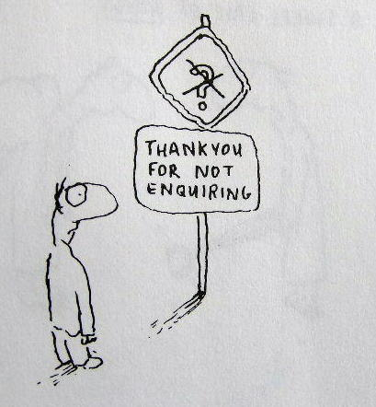
Enigma of Mass

Slide 5
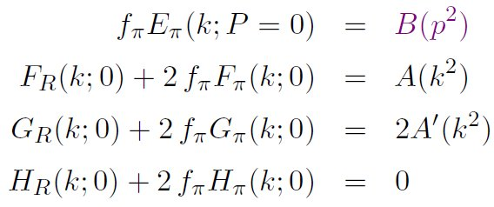
Pion’s Goldberger -Treiman relation
Maris, Roberts and Tandy
nucl-th/9707003, Phys.Lett. B420 (1998) 267-273
Pion’s Bethe-Salpeter amplitude
Solution of the Bethe-Salpeter equation
Dressed-quark propagator
Axial-vector Ward-Takahashi identity entails
B(k²)
Owing to DCSB
& Exact in
Chiral QCD
Miracle: two body problem solved, almost completely, once solution of one body problem is known

Slide 6
The most fundamental expression of Goldstone’s Theorem and DCSB
Rudimentary version of this relation is apparent in Nambu’s Nobel Prize work
Model independent
Gauge independent
Scheme independent
f_{π} E_{π}(p²) = B(p²)

Slide 7
Pion exists if, and only if, mass is dynamically generated
Rudimentary version of this relation is apparent in Nambu’s Nobel Prize work
Model independent
Gauge independent
Scheme independent
f_{π} E_{π}(p²)⇔ B(p²)

Slide 8
This is why m_{π}=0 in the absence of a Higgs mechanism
Rudimentary version of this relation is apparent in Nambu’s Nobel Prize work
Model independent
Gauge independent
Scheme independent
f_{π} E_{π}(p²)⇔ B(p²)

Slide 9
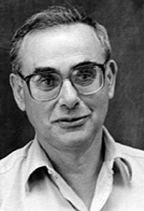
Enigma of mass
f_{π} E_{π}(p²) = B(p²)
This algebraic identity is why QCD’s pion is massless in the chiral limit
The quark level Goldberger-Treiman relation shows that DCSB has a very deep and far reaching impact on physics within the strong interaction sector of the Standard Model; viz.,
Goldstone's theorem is fundamentally an expression of equivalence between the one-body problem and the two-body problem in the pseudoscalar channel.
This emphasises that Goldstone's theorem has a pointwise expression in QCD
Hence, pion properties are an almost direct measure of
the dressed-quark mass function.
Thus, enigmatically, the properties of the massless pion
are the cleanest expression of the mechanism that is
responsible for almost all the visible mass in the universe.

Slide 10
Observing M(p²)

Slide 11
Observing the mass function
Importance ⇒ Is the dressed-quark mass function observable?
Goldberger-Treiman relations entail that on m≃0, dressed-quark mass function (almost) completely determines χ_{π} (wave function)
⇒ Thus, like a wave function in any field of physics, the dressed-quark mass function is not strictly observable
On the other hand, no one can reasonably doubt the enormous value of possessing (nearly) complete knowledge of a bound-state's wave function
Moreover, χ_{π} can be projected onto the light-front
Object thus obtained is strictly a probability amplitude and the moments of a probability measure are truly observable.
Consequently, there is a mathematically strict sense in which moments of the dressed-quark mass function are observable.
One should note in addition that generalised parton distributions can rigorously be defined as an overlap of light-front wave functions

Slide 12
Observing the mass function
Moreover, χ_{π} can be projected onto the light-front
Object thus obtained is strictly a probability amplitude.
Consequently, there is a mathematically strict sense in which moments of the dressed-quark mass function are observable.
One should note in addition that generalised parton distributions can rigorously be defined as an overlap of light-front wave functions
Practically, the dressed-quark mass function can be “measured” because it influences and determines a vast array of experimental observables, and there is at least one tractable framework, the DSEs, through which to relate those observables to QCD
In this sense, M(p²) is as readily observable as, e.g. parton distribution amplitudes and functions
JLab 12 will provide data on nucleon elastic and transition form factors, on meson form factors, on distribution functions and amplitudes, etc., all of which have been unified via M(p²)
Agreement will be a clear validation of the fundamental character of M(p²) and its crucial role in determining hadron observables

