Slide 1
Hall B - Run Group K
Color Confinement and Strong QCD
Physics Overview
PR12-16-010 A Search for Hybrid Baryons in Hall B with CLAS12
Annalisa D’Angelo
PR12-16-010A Nucleon Resonance Structure Studies Via Exclusive KY Electroproduction at 6.6 GeV and 8.8 GeV
Daniel Carman
PR12-16-010B Deeply Virtual Compton Scattering with CLAS12 at 6.6 GeV and 8.8 GeV Latifa Elouadrhiri

Slide 2
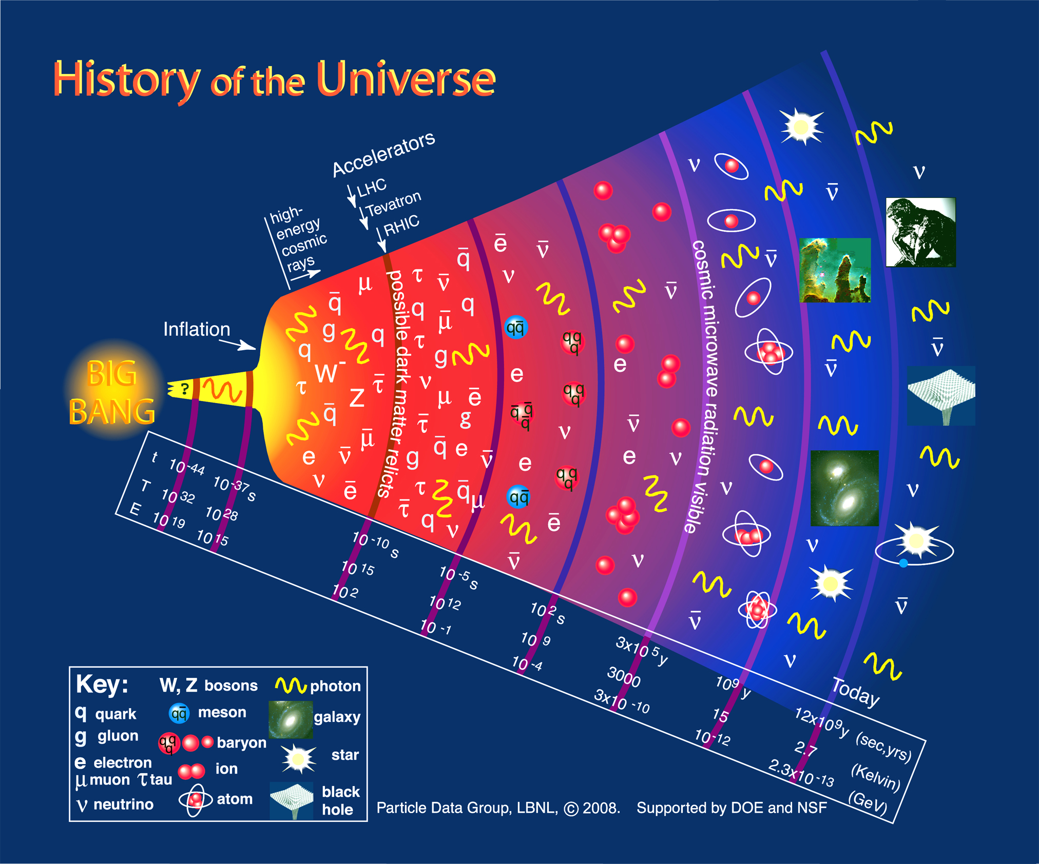
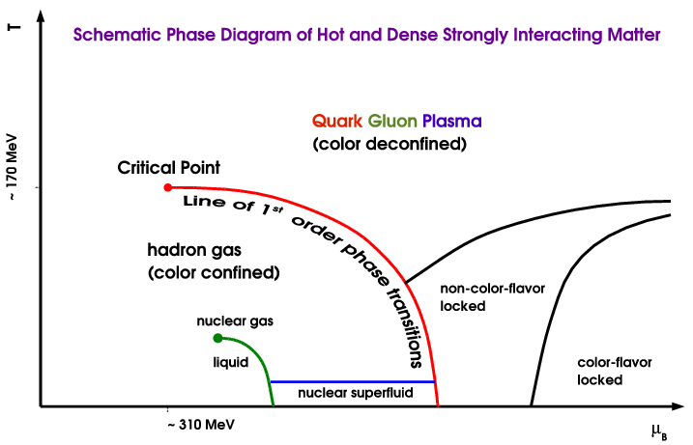
“Confinement and Strong QCD” in the Evolution of the Early Universe
CEBAF
Quark Gluon Plasma
(color deconfined)
N*
Hadron Gas
(color confined)
N*
Dramatic events occur in the microsecond old Universe.
The transition from the QGP to the baryon phase is dominated by excited baryons.
A quantitative description requires more states than found to date => missing baryons.
During the transition the quarks acquire dynamical mass and the confinement of color occurs.

Slide 3
Main Questions to Address
The N* spectrum: what is the role of glue?
Search for new baryon states
PR12-16-010
How do massless quarks acquire mass?
Measure the Q² dependence of electrocoupling amplitudes
PR12-16-010A
How is color confinement realized in the force and pressure distributions in stable nucleons?
Study GPDs and their moments from DVCS
PR12-16-010B

Slide 4
New Run Group Proposal (RG K)
“Color Confinement and Strong QCD”
Hybrid Baryons PR12-16-010 | Search for hybrid baryons (qqqg) focusing on 0.05 GeV² < Q² < 2.0 GeV² in mass range from 1.8 to 3 GeV in KΛ, Nππ, Nπ (A. D’Angelo)
KY Electroproduction PR12-16-010A | Study N* structure for states that couple to KY through measurements of cross sections and polarization observables that will yield Q² evolution of electrocoupling amplitudes (D.S. Carman)
DVCS PR12-16-010B | Access GPDs H, E, H, E using DVCS process ep → epγ and the DVMP process ep → epπ⁰ (L.Elouadrhiri)
~ ~
Run Group conditions 100 days:
E_{b} = 6.6 GeV, 50 days
E_{b} = 8.8 GeV, 50 days
Torus I = -3375 A (negatives outbending)
FT, MM, RICH
Polarized electrons, unpolarized LH₂ target
L = 1x10³⁵ cm⁻²s⁻¹

Slide 5
Evidence for New N* in KY Final State
State N(mass)J^{P} | PDG pre 2010 | PDG 2016 | KΛ | KΣ | Nγ
N(1710)1/2⁺ | *** | **** | **** | ** | ****
N(1880)1/2⁺ |  | ** | ** |  | **
N(1895)1/2⁻ |  | ** | ** | * | **
N(1900)3/2⁺ | ** | *** | *** | ** | ***
N(1875)3/2⁻ |  | *** | *** | ** | ***
N(2150)3/2⁻ |  | ** | ** |  | **
N(2000)5/2⁺ | * | ** | ** | * | **
N(2060)5/2⁻ |  | ** |  | ** | **
Study these states in electroproduction and extend to higher masses
Notes:
This slides shows a summary of the results in this analysis. The green column shows the rating by the PDG. The two columns show the importance of the strangeness channel in this results.

Slide 6
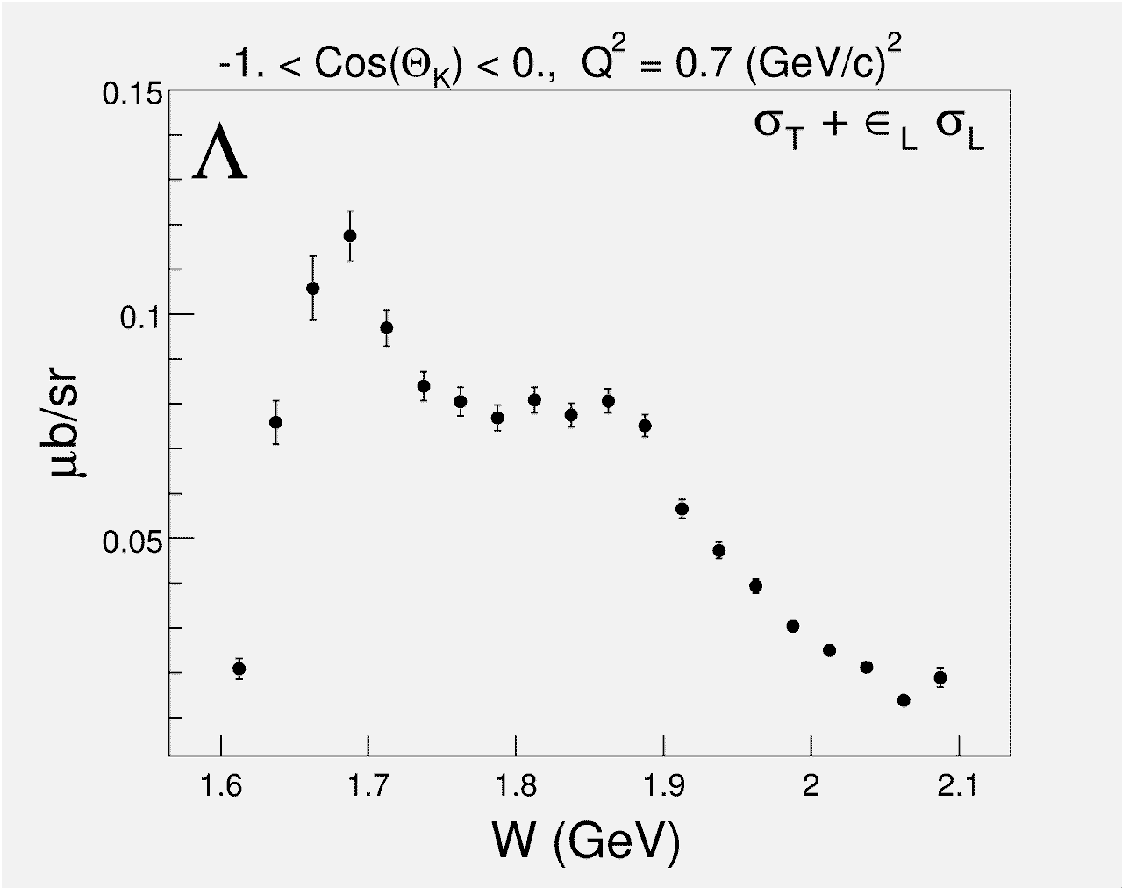
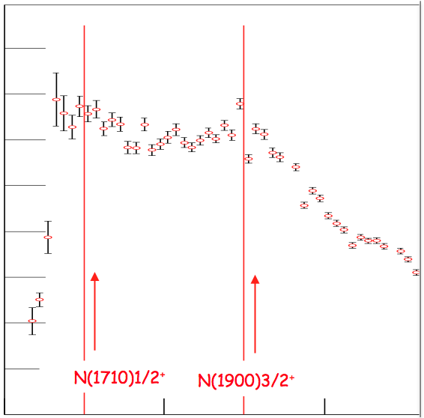
Studying Baryons in γ*p → KΛ/Σ ?
Photoproduction
Electroproduction
1.6
1.4
1.2
1.0
0.8
0.6
0.4
0.2
N(1710)1/2⁺
N(1900)3/2⁺
N(1710)1/2⁺
N(1900)3/2⁺
1.6
1.8
2.0
W (GeV)
Strangeness electroproduction is a fertile ground in studying S=0 baryon states with masses above 1.6 GeV.

Slide 7
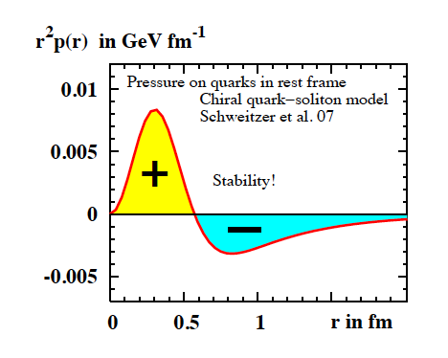
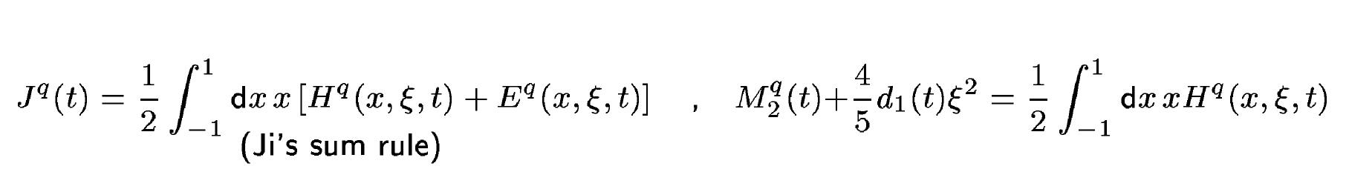
Accessing the Forces & Pressure on Quarks
Nucleon matrix element of EMT contains:
M₂(t) : Mass distribution inside the nucleon
J (t) : Angular momentum distribution
d₁(t) : Shear forces and pressure distribution
Separate M₂(t) and d₁(t) through measurements at small/large ξ.
Measuring these form factors, we may learn about confinement forces.
Notes:
The nucleon matrix element of the energy-momentum tensor is known to contain 3 form factors. They describe ….. and can only be measured directly in elastic graviton-nucleon scattering. However, these form factors appear as moments of the unpolarized GPDs as shown here. The quark angular momentum in the nucleon is given by the 2nd moment of the sum of GPD H and E. The mass and pressure distribution of the quarks are given by the 2nd moment of H where the pressure is probed by parameter xi.

Slide 8
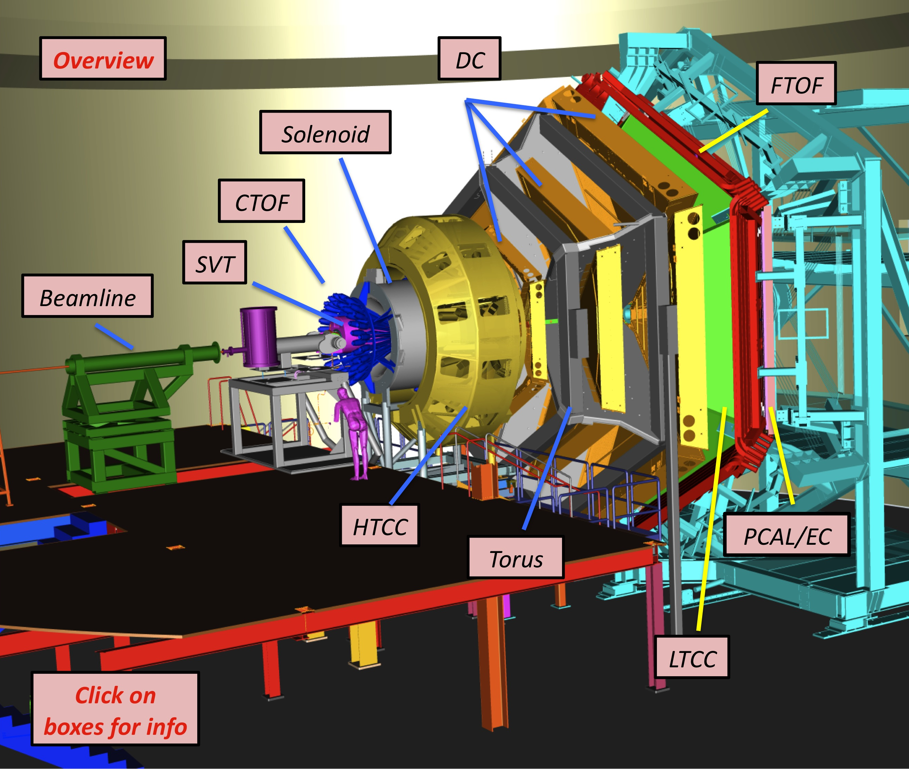
Equipment
CLAS12
Hall B
Forward Detector (FD)
  - TORUS magnet
  HT Cherenkov Counter
  Drift chamber system
  LT Cherenkov Counter
  Forward TOF System
  Pre-shower calorimeter
  E.M. calorimeter
Central Detector (CD)
  SOLENOID magnet
  Silicon Vertex Tracker
  Central Time-of-Flight
Beamline
  Cryo Target
  Moller polarimeter
  - Shielding
  Photon Tagger
Upgrade to the baseline
- Central Neutron Detector
  MicroMegas
  Forward Tagger
  RICH detector
  Polarized target
MM
CND
FT
RICH

Slide 9
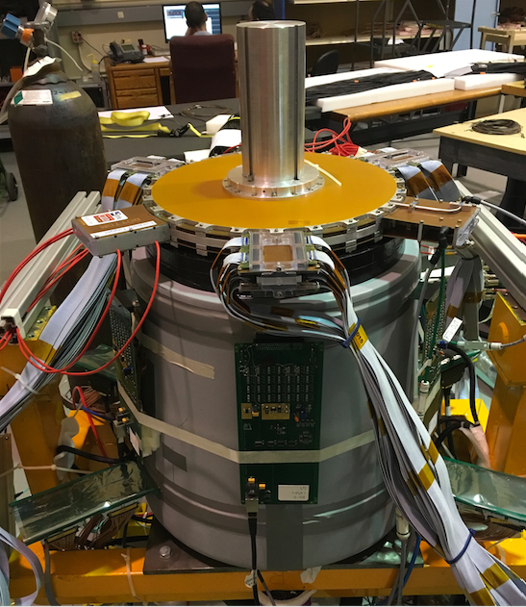
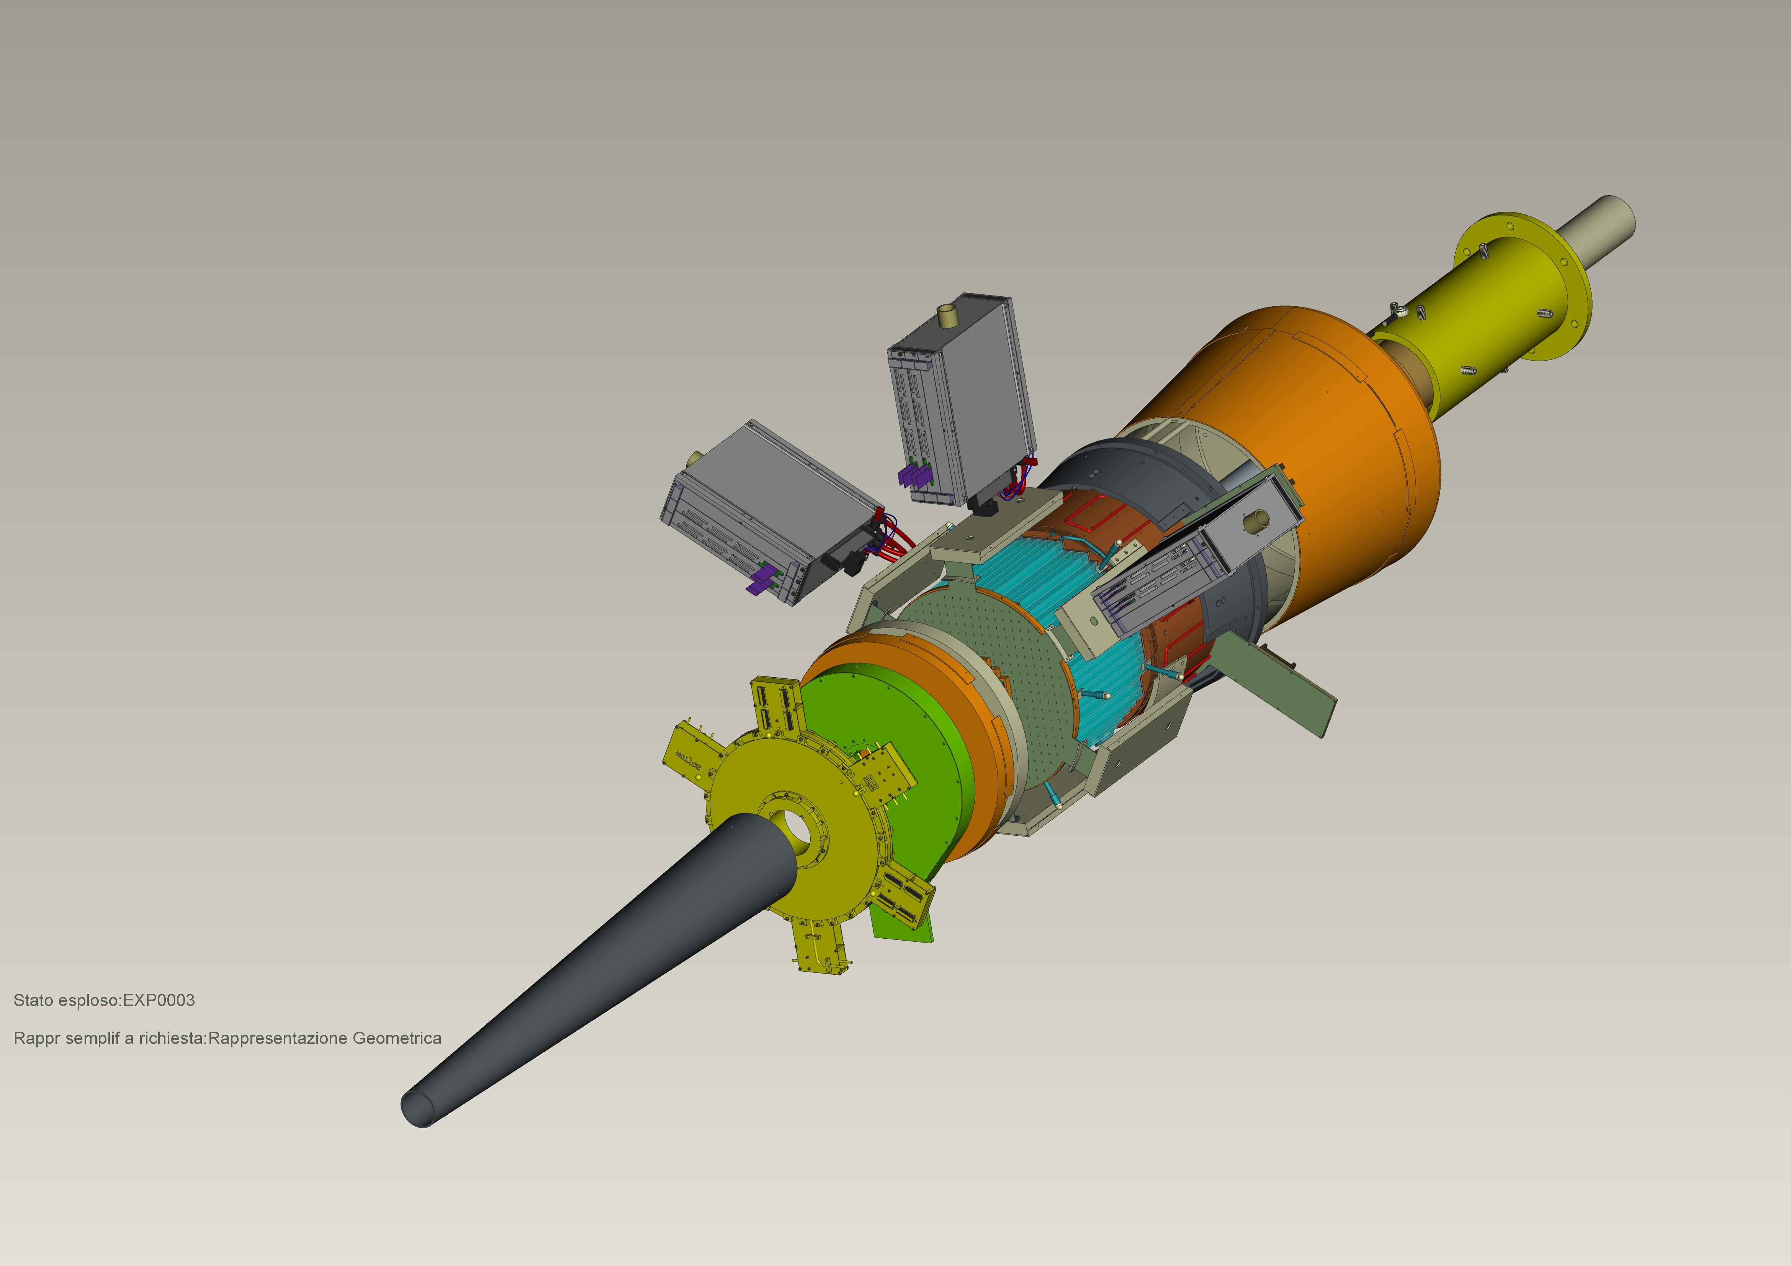
Forward Tagger
CLAS12
Hall B
FT designed to detect electrons and photons at small angles
FT-Cal: calorimeter to measure electron energy/momentum
  FT-Hodo: scintillation hodoscope to veto photons & backsplash
FT-Trk: micro-mega detector to measure electron angles, polarization plane
calorimeter
tracker
hodoscope

Slide 10

NSAC 2015 Long Range Plan
Recommendation #1
1) With the imminent completion of the CEBAF 12-GeV Upgrade, its forefront program of using electrons to unfold the quark and gluon structure of hadrons and nuclei and to probe the Standard Model must be realized.
Run Group K “Confinement & Strong QCD” will address major parts of this recommendation

Slide 11
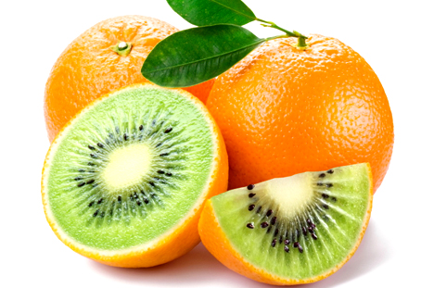
PAC 44 PR12-16-010
A Search for Hybrid Baryons in Hall B with CLAS12
Spokespersons:
Annalisa D’ANGELO
University of Rome “Tor Vergata” and INFN Rome Tor Vergata
Volker BURKERT, Daniel S. CARMAN, Victor MOKEEV
Thomas Jefferson National Accelerator Facility
Evgeny GOLOVACH
Skobeltsyn Institute of Nuclear Physics and Lomonosov Moscow State University
Ralf GOTHE
University of South Carolina
for the CLAS Collaboration

Slide 12
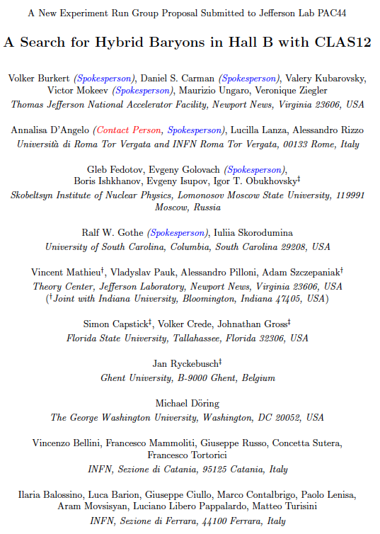
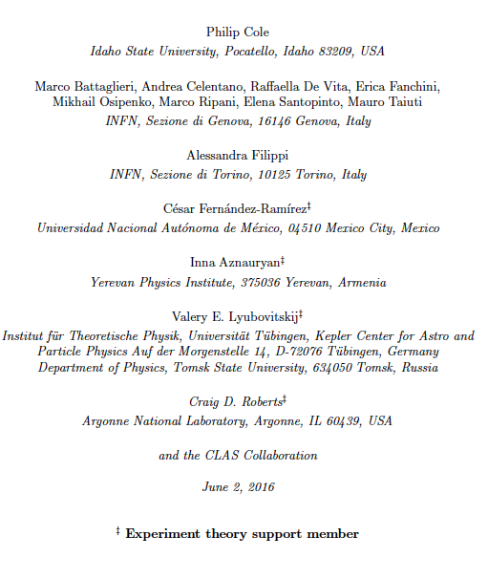

Slide 13
Hybrid Baryons: Baryons with Explicit Gluonic Degrees of Freedom
Hybrid hadrons with dominant gluonic contributions are predicted to exist by QCD.
Experimentally:
Hybrid mesons |qqg> states may have exotic quantum numbers J^{PC} not available to pure |qq> states GlueX, MesonEx, COMPASS, PANDA ….
Hybrid baryons |qqqg> have the same quantum numbers J^{P} as |qqq> electroproduction with CLAS12 (Hall B).
Theoretical predictions:
        MIT bag model - T. Barnes and F. Close, Phys. Lett. 123B, 89 (1983).
        QCD Sum Rule - L. Kisslinger and Z. Li, Phys. Rev. D 51, R5986 (1995).
        Flux Tube model - S. Capstick and P. R. Page, Phys. Rev. C 66, 065204 (2002).
        LQCD - J.J. Dudek and R.G. Edwards, PRD85, 054016 (2012).
Notes:
… One of the experimental tool we employ is the study of the N* spectrum as a reflection of the underlying degrees of freedom, some of which are shown by these cartoons representing constituent quarks in a bag, held together by gluon strings that my also get excited and generate hybrid baryons, quarks model with di-quark clustering, and states generated dynamically by meson-baryon interaction. These configuration result in variations of the excitation spectrum which we study with hadron or electromagnetic beams. The second line of research is to measure the strength of resonance excitations versus the space-time resolution of the probe to see how the strength of the effective degrees of freedom change with the distance scale. Beyond these mostly experimental aspects, there has been significant progress in the theory sector , e.g. predictions from LQCD of the spectrum, the Dyson-Schwinger equations of QCD, holographic QCD, and others.

Slide 14
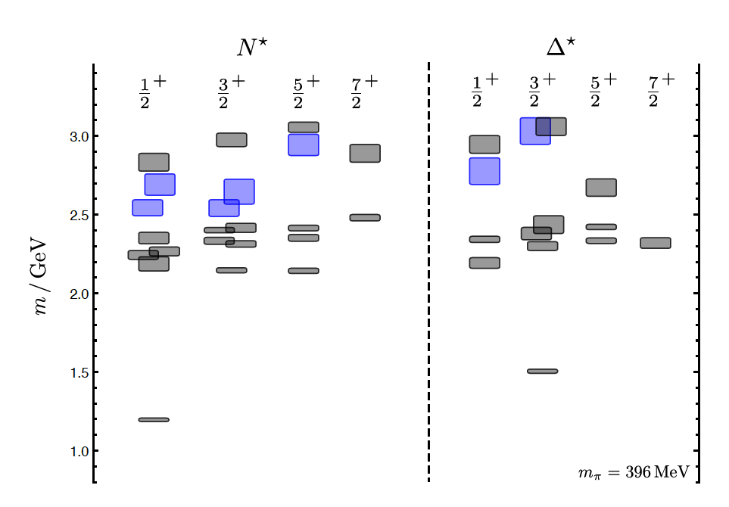
Hybrid Baryons in LQCD
J.J. Dudek and R.G. Edwards, PRD85, 054016 (2012)
LQCD
clustered
in mass
regular states
hybrid states
1.3GeV
The nucleon mass is shifted ~300 MeV to higher masses
N
Hybrid states have same J^{P} values as qqq baryons. How to identify them?
Overpopulation of N 1/2⁺ and N 3/2⁺ states compared to QM projections. ?
A_{1/2} (A_{3/2}) and S_{1/2} show different Q² evolution. Can we do it?

Slide 15
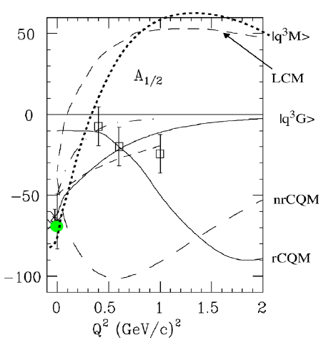
Separating q³g from q³ States?
Lowest mass hybrid baryon should be J^{P} =1/2⁺ (same as Roper)
In 2002 Roper amplitude A_{1/2} measurements were more consistent with hybrid state
but data were limited with large uncertainties.

Slide 16
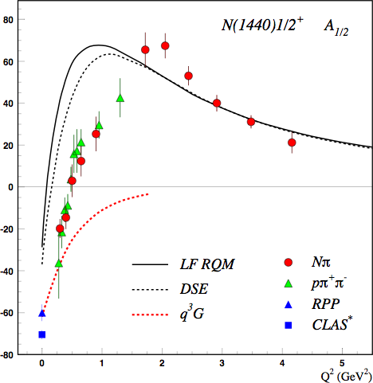
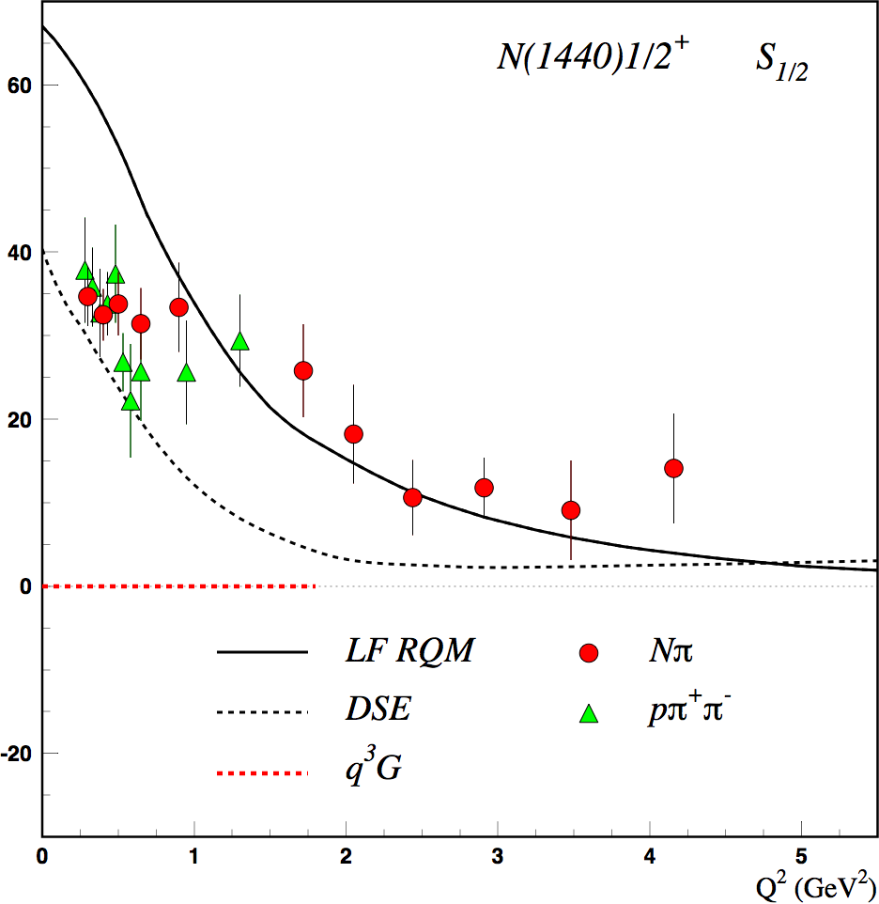
Separating q³g from q³ States?
CLAS results on electrocouplings clarified nature of the Roper
q³
q³
q³g
q³g
q³
A_{1/2} and S_{1/2} amplitudes at high Q² indicate 1st radial q³ excitation
Significant meson-baryon coupling at small Q²
For hybrid “Roper”, A_{1/2}(Q²) drops off faster with Q² and S_{1/2}(Q²) ~ 0.

Slide 17
Hybrid Baryon Signatures
Based on available knowledge, the signatures for hybrid baryons consist of:
• Extra resonances with J^{p}=1/2⁺ and J^{p}=3/2⁺, with masses > 1.8 GeV and decays into Nππ or KY final states.
•A drop of the transverse helicity amplitudes A_{1/2}(Q²) and A_{3/2}(Q²) faster than for ordinary three quark states, because of extra glue-component in valence structure.
•A suppressed longitudinal amplitude S_{1/2}(Q²) in comparison with transverse electro-excitation amplitude (J^{P}=1/2⁺).
The proposal focuses on:
e p e p π⁺ π⁻
e p e K⁺Λ, e K⁺Σ⁰
The study will include other single meson channels.

Slide 18
Analysis Tools for Excited Baryons
Single Meson Analysis
Unitary Isobar Model & Fixed-t Dispersion Relations approaches
Regge-and Resonance Model (Gent Group)
Double Meson Analysis
J-M Reaction Model
Multi-channel Analysis
Bonn-Gatchina multi-channel PWA
Argonne-Osaka dynamically coupled-channel model
JPAC Analysis Tools for high mass states using Regge & Veneziano Approach

Slide 19
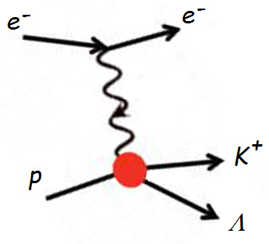
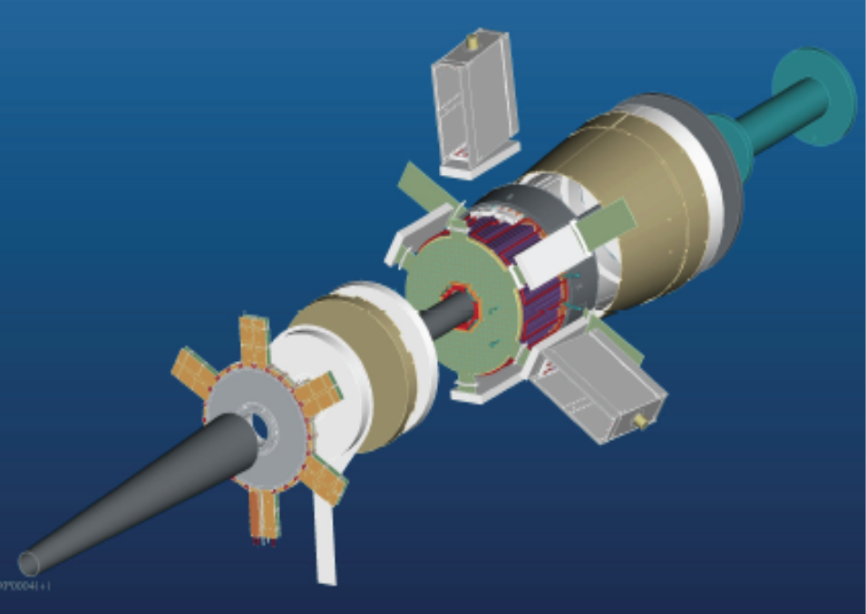
The Experiment
FT
ϑ > 6°
ϑ > 6°
CLAS12
p
π⁺
π⁻
Scattered electrons will be detected:
in the Forward Tagger for angles from 2.5° to 4.5°
in the Forward Detector of CLAS12 for scattering angles greater than about 6°
Charged hadrons will be measured in the full range from 6° to 130°
FT allows to probe the crucial Q² range where hybrid baryons may be identified due to their fast dropping A_{1/2}(Q²) amplitude and the suppression of the scalar S_{1/2}(Q²) amplitude.
W < 3 GeV Q² range of interest: 0.05 - 2 GeV²

Slide 20
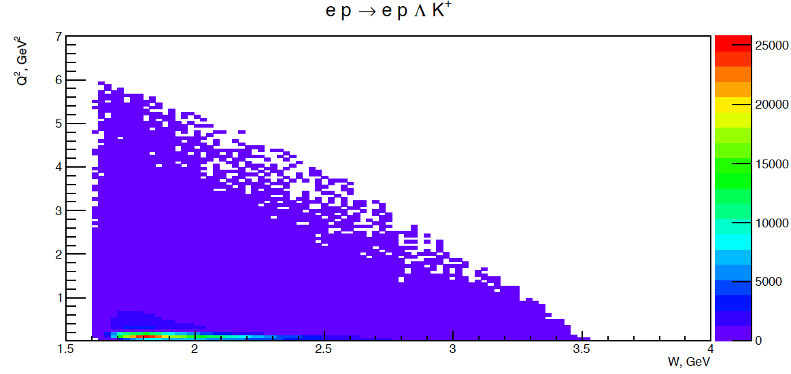
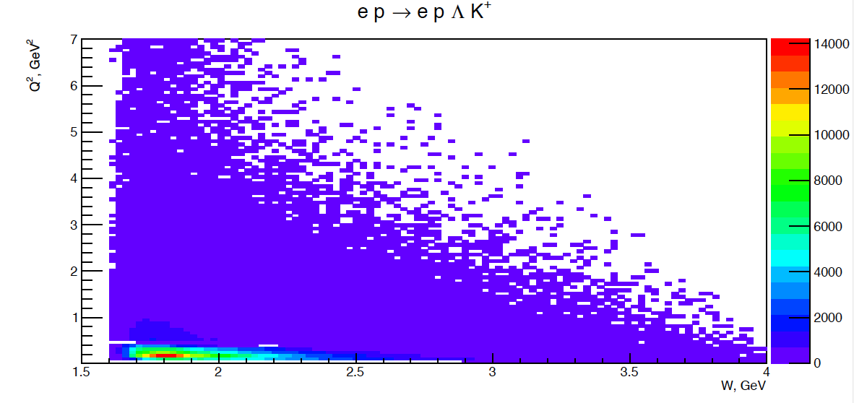
Kinematical Coverage: Full Q² Range
Q² vs W
e p e K⁺Λ
ep e K⁺Λ
Ee =6.6 GeV
I = - 3375 A
Ee =6.6 GeV
I = - 3375 A
Ee =6.6 GeV
I = - 3375 A
Q² ≥ 0.05 GeV²
Q² as low as 0.05 GeV² may be reached
ep e K⁺Λ
e p e K⁺Λ
Ee =8.8 GeV
I = - 3375 A
Ee =8.8 GeV
I = - 3375 A
Ee =8.8 GeV
I = - 3375 A
Ee = 8.8 GeV provides enough statistics for 2.5 < W < 3 GeV
Complementary Q² ranges using different E_{e}

Slide 21
Event Simulation
e p e p π⁺ π⁻
e p e K⁺Y

Slide 22
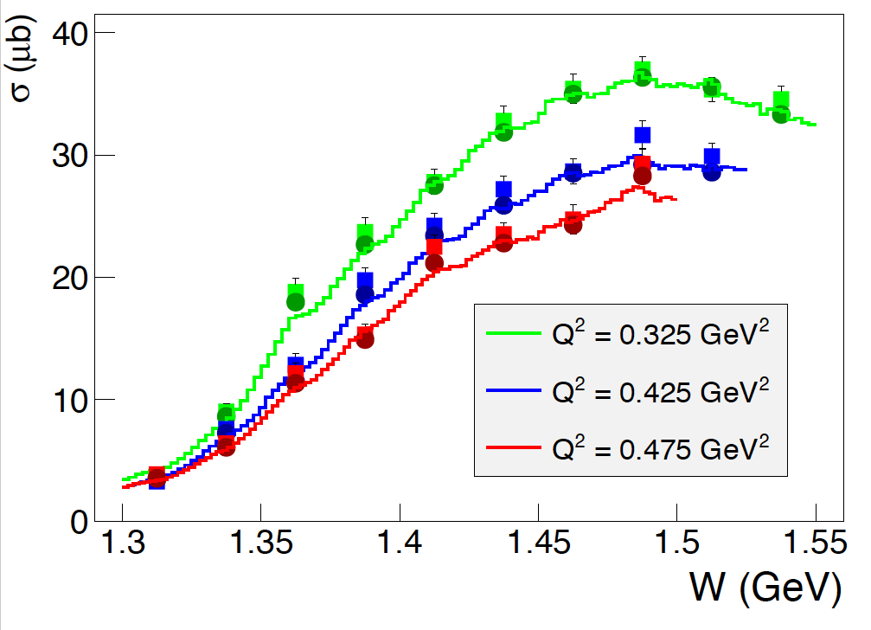
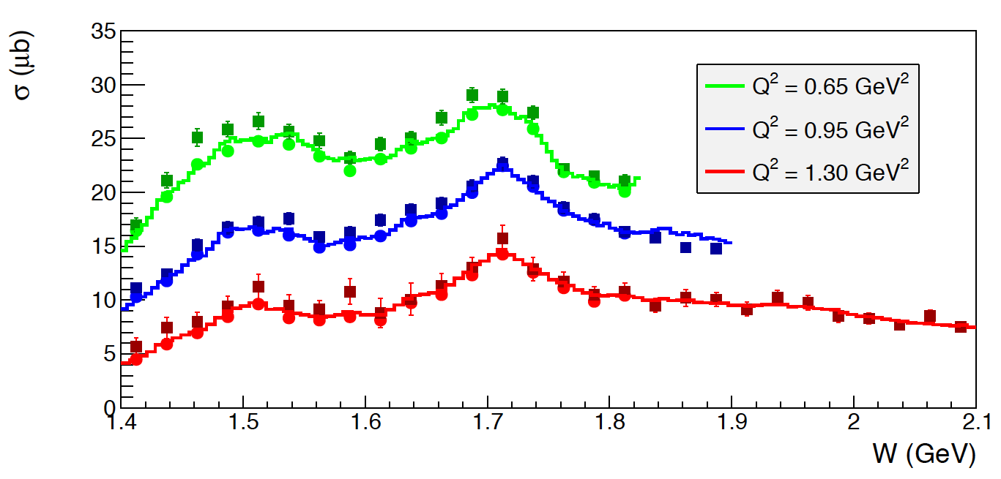
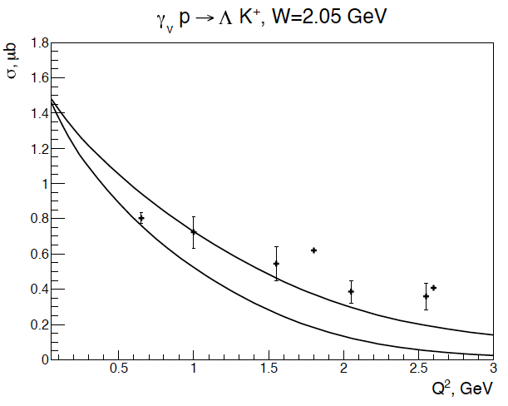
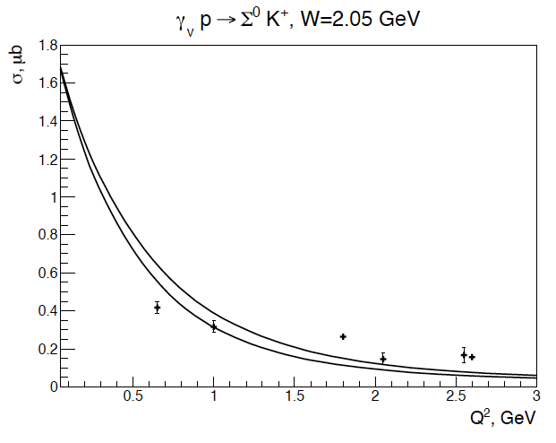
Event Simulation in CLAS12
e p e p π⁺ π⁻
e p e K⁺Y
JLab - Moscow (JM) model
Regge + Resonance (RPR) Gent model
Development of a realistic event generator using the best presently available models.
Simulation of quasi-data events.
Selection of trigger conditions:
scattered electron (FT or CLAS12) + at least 1 hadron in CLAS12.
Events reconstruction to determine final resolutions and efficiencies.

Slide 23
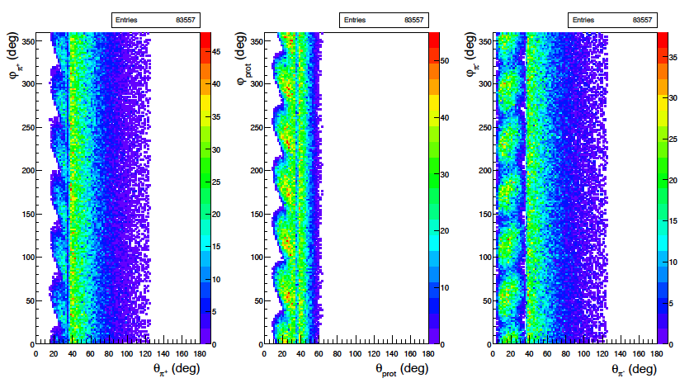
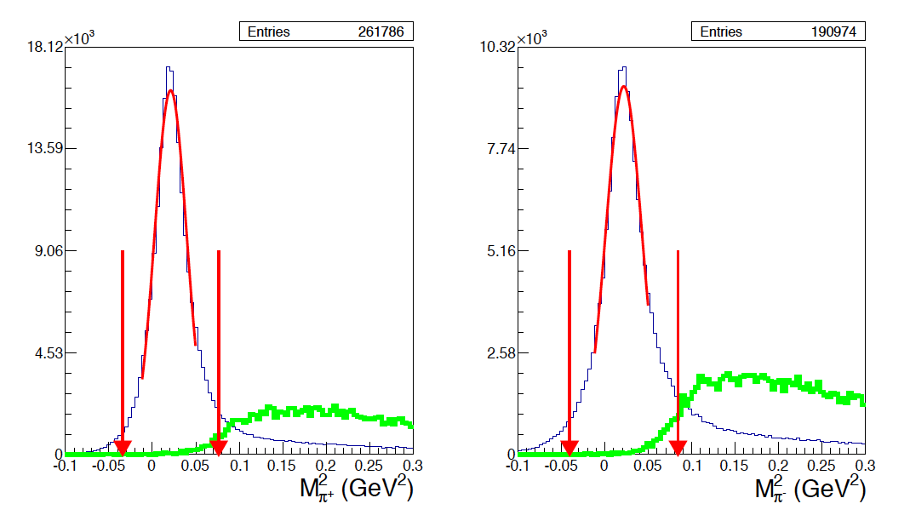
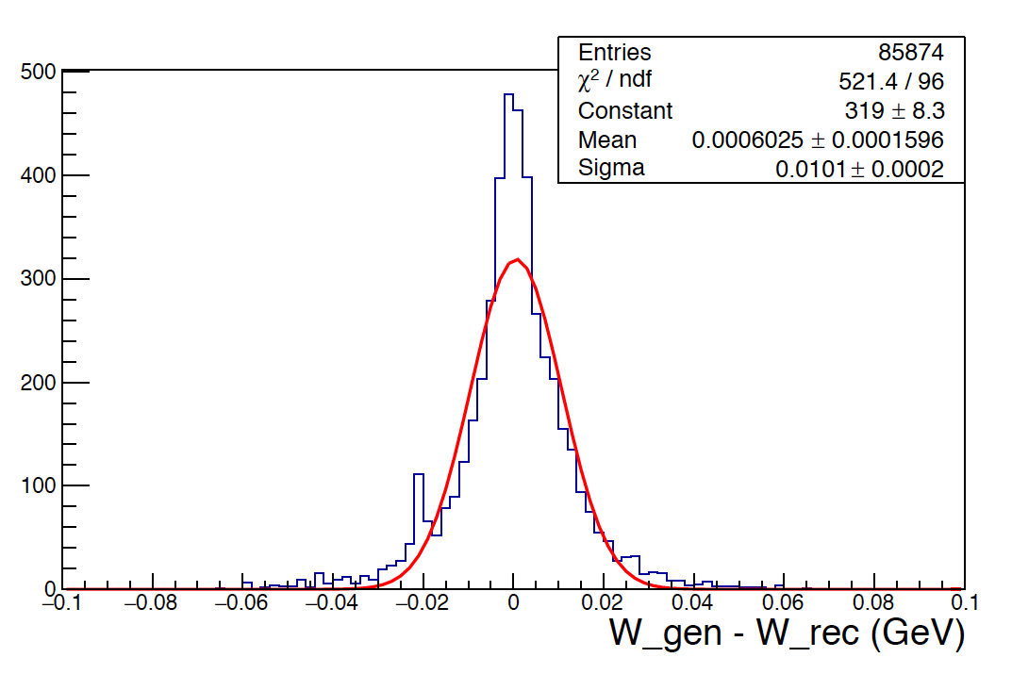
Event Simulation in CLAS12
Results for e p e p π⁺ π⁻
φ vs. θ angular acceptance for final hadrons
Exclusivity cuts
missing π⁺
missing π⁻
π⁺π⁻π⁰p
bkg
π⁺
p
π⁻
π⁺π⁻π⁰p
bkg
Resolution
Acceptance
Final hadrons
kinematics
Ee | pπ⁺π⁻ detected | one missing hadron
Ee = 6.6 GeV | 8.7 % | 13%
Ee = 8.8 GeV | 8.3 % | 13 %
σ_{W}=10 MeV

Slide 24
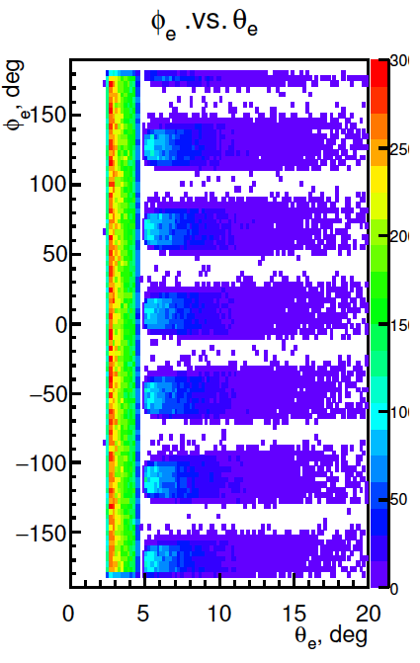
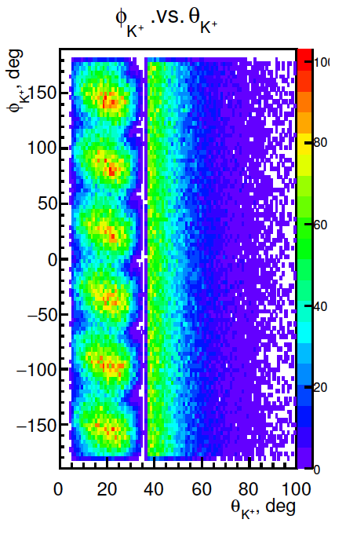
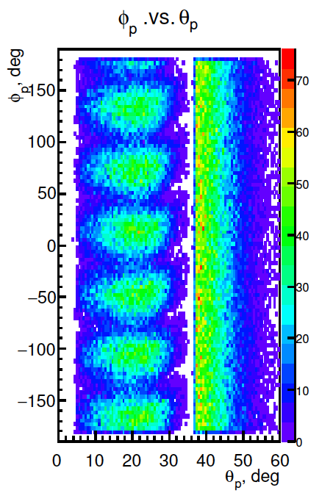
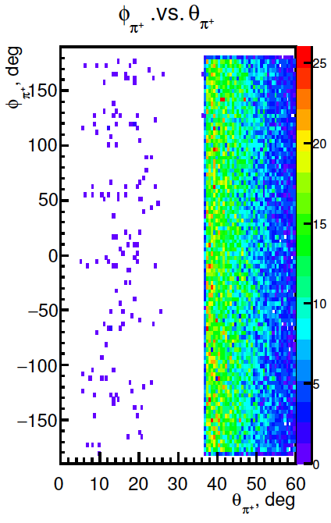
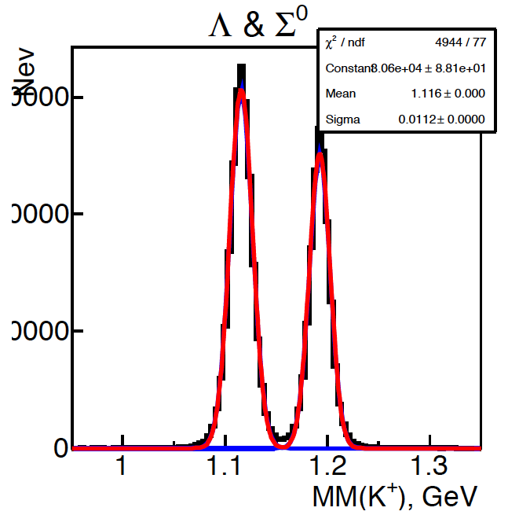
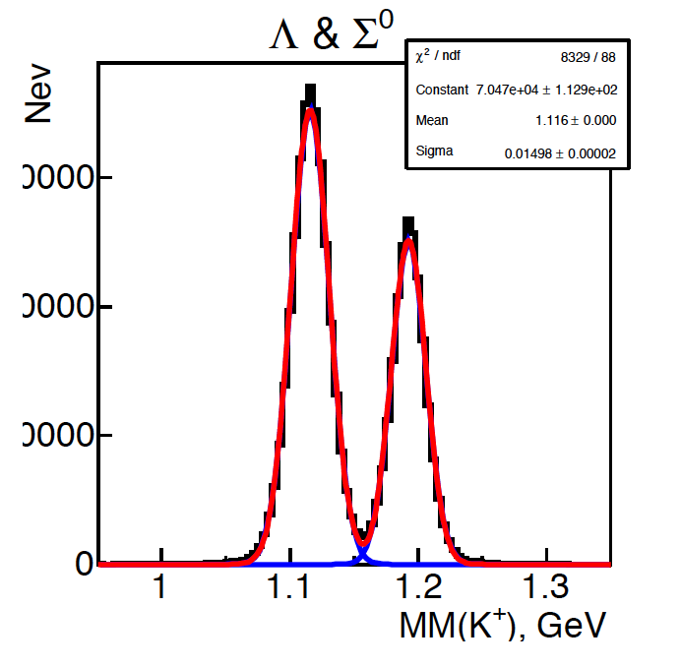
Event Simulation in CLAS12
Results for e p e K⁺ Y
φ vs θ angular acceptance for final particles
Minimum measurable Q²
e⁻
p
π⁻
Ee = 6.6 GeV | 0.05 GeV²
Ee = 8.8 GeV | 0.1 GeV²
Ee = 6.6 GeV | 0.05 GeV²
Ee = 8.8 GeV | 0.1 GeV²
Ee = 6.6 GeV | 0.05 GeV²
Ee = 8.8 GeV | 0.1 GeV²
Ee = 6.6 GeV | 0.05 GeV²
Ee = 8.8 GeV | 0.1 GeV²
Ee = 6.6 GeV | 0.05 GeV²
Ee = 8.8 GeV | 0.1 GeV²
Ee = 6.6 GeV | 0.05 GeV²
Ee = 8.8 GeV | 0.1 GeV²
K⁺
Ee = 6.6 GeV | 0.05 GeV²
Ee = 8.8 GeV | 0.1 GeV²
K⁺ missing mass resolution
Ee = 6.6 GeV
Ee = 8.8 GeV
Acceptance
30000
W vs Q²
30000
Ee = 6.6 GV
Ee | one missing hadron
Ee = 6.6 GeV | 10 %
Ee = 8.8 GeV | 8 %
20000
20000
10000
σ=11 MeV
σ=15 MeV
σ=13 MeV
W vs Q²
σ=10 MeV
10000
Ee = 8.8 GeV

Slide 25
Quasi – Data Analysis
A hypothetical hybrid baryon contribution added at the amplitude level to the best presently available models: M_{R} = 2.2 GeV Γ_{R}=0.25 GeV J^{P} = 1/2 ⁺ (J^{P} = 3/2 ⁺)
The reaction cross section has been calculated with and without the baryon resonance contribution to determine:
Minimum beam time needed to obtain statistical uncertainty for cross sections comparable with CLAS photoproduction data.
      100 days of beam time (50 days at 6.6 GeV & 50 days at 8.8 GeV)
The Legendre moments of the unseparated and polarization interference components of the cross section.
    Search for distinctive structures to the added resonance.
The statistical sensitivity to hybrid baryons electrocouplings. Minimum electrocoupling values with 100 days of beam time.
The capability of extracting the added resonance parameters from expected data.
      Blind analysis of quasi-data.

Slide 26
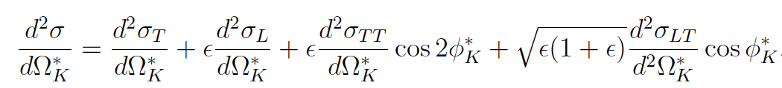
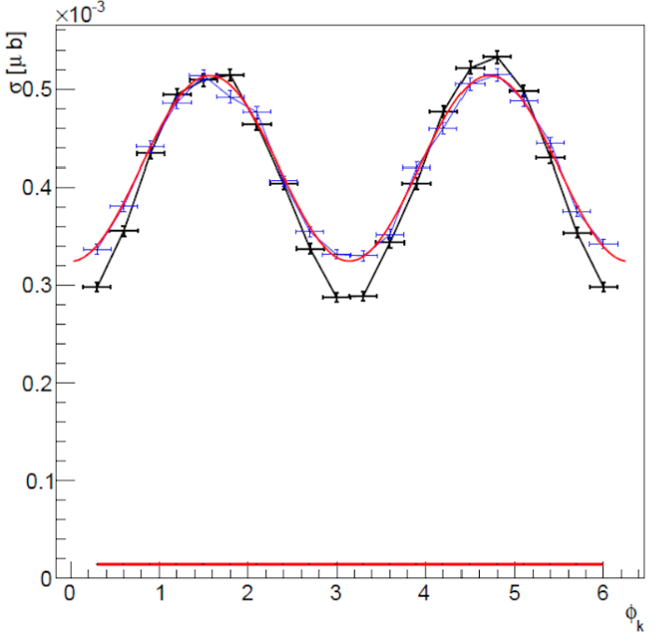
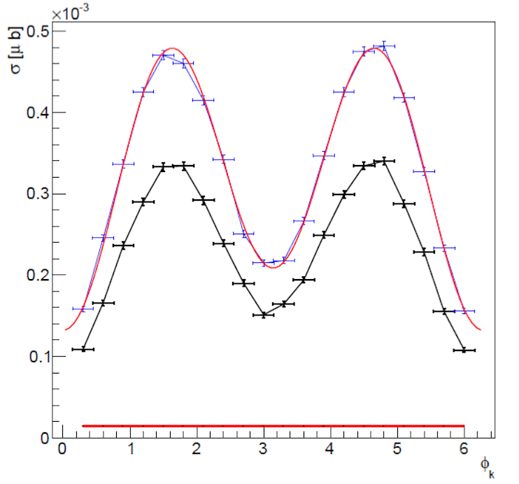
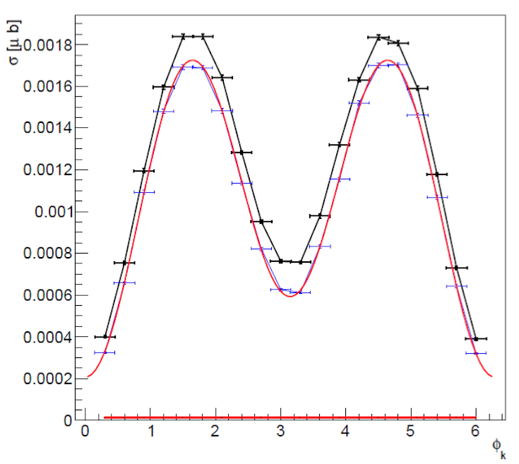
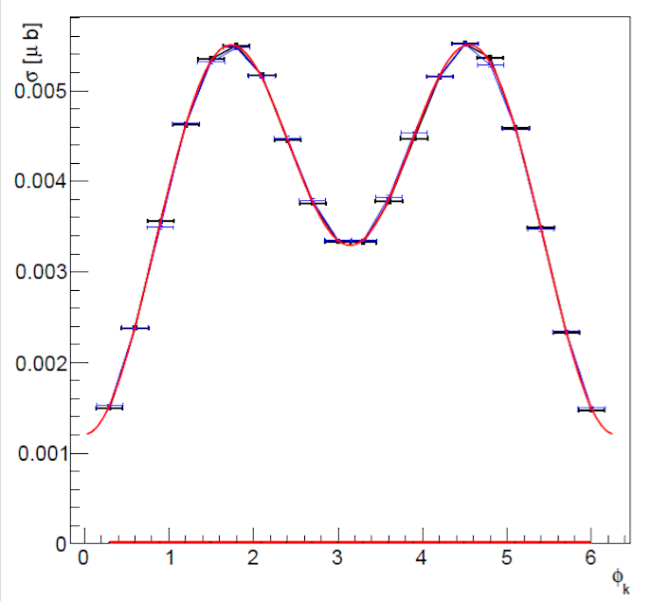
Simulation of Model + Hybrid Contributions
e p e K⁺Y
σ_{U} = σ_{T} + εσ_{L}
Black points RPR 2011 model Blue points RPR 2011 + hybrid resonance
Q² = 0.1 GeV² W=2.2 GeV E_{e} = 6.6 GeV (M_{R} = 2.2 GeV Γ_{R}=0.25 GeV A_{1/2} = 15 10⁻³ GeV^{-1/2})
cos θ_{K}= - 0.7
cos θ_{K}= - 0.2
cos θ_{K}= 0.3
cos θ_{K}= 0.8
The extraction of the unseparated cross section dσ_{U} and the interference cross sections dσ_{TT} and dσ_{LT} rely on a fit of the azimuthal dependence of the differential cross section at fixed bins of: W, Q² , cos θ*.

Slide 27
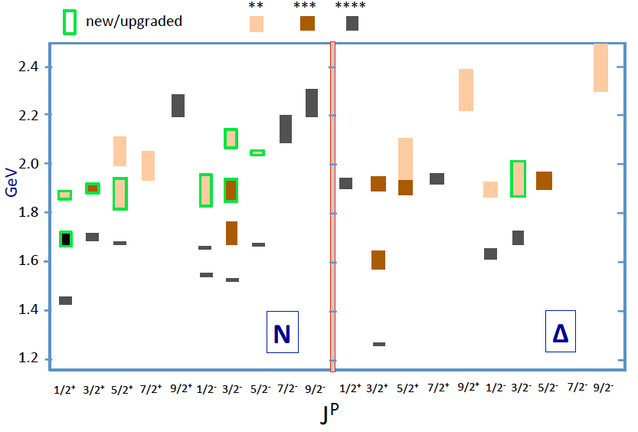
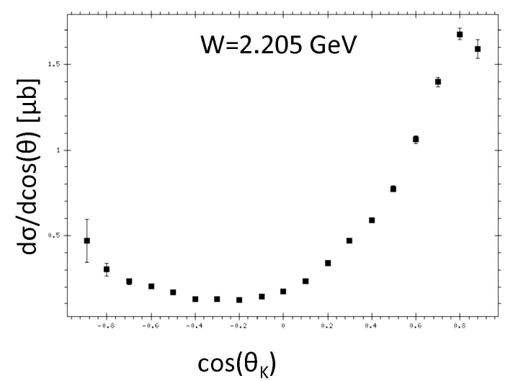
Statistics and Binning Requirements
Samples of γp -> K⁺Λ cross section used in BnGa analysis that discovered new baryon states in the W range 1.85 – 2.2 GeV mass region.
Statistical precision ranges from 2% - 7%.
ΔW=10 MeV, Δcos θ* = 0.1
Similar statistics needed to:
Separate structure functions in φ
Find new excited baryon states
Map Q² dependence of amplitudes
 | Range | Bin | #bins
W (GeV) | 1.8-3.0 | 0.01 | 120
cos θ* | -1 to +1 | 0.1 | 20
φ [º] | 0 - 360 | 18 | 20
Q²(GeV²) | 0.05 - 2 | 0.02/0.1 | 5/15
Total KΛ data in 50+50 days: 518.4x10⁶ events
Number of bins: 960x10³
<N> = 540 evts/bin
σ_{N}/N = 4.3%

Slide 28
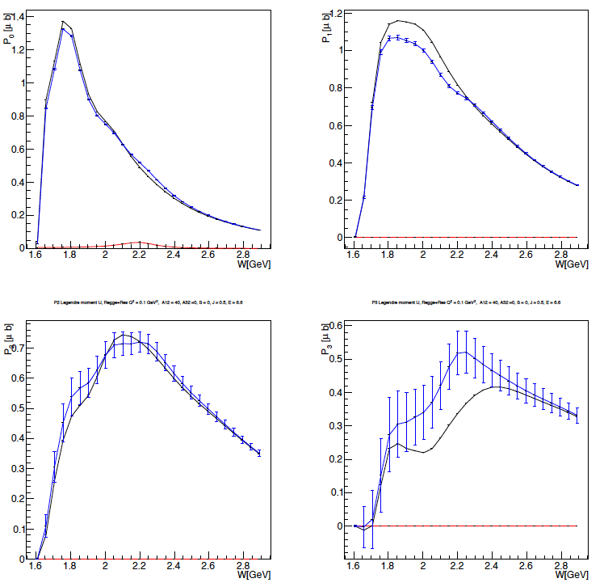
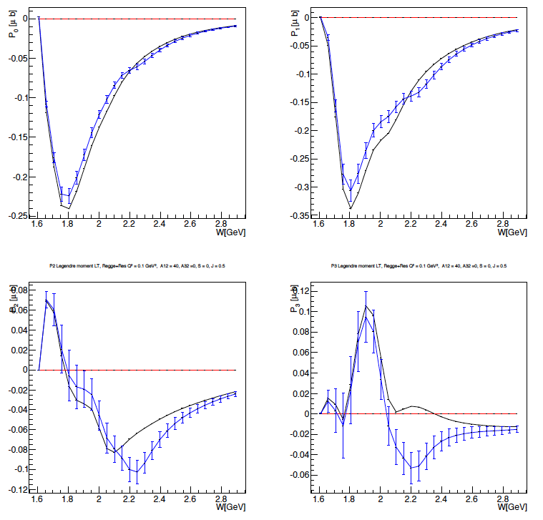
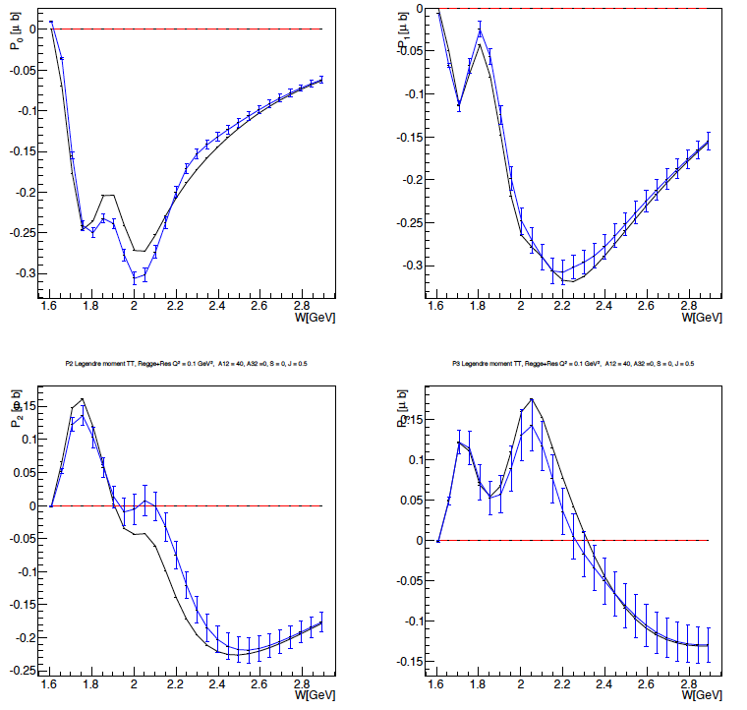
Extraction of Legendre Moments
e p e K⁺Λ
First Legendre Moments
Black curves RPR 2011 model
Blue points RPR 2011 + Resonance
σ_{U}
σ_{LT}
σ_{TT}
P0
P1
P0
P1
P0
P1
P2
P2
P3
P2
P3
P3
J = ½ Regge + Res.
Q² = 1 GeV² M_{res} = 2.2 GeV A_{1/2} = 0.04 GeV^{-1/2} S_{1/2} = 0
Significant structures appear in most of the Legendre moments at the value of
W = 2.2 GeV, corresponding to the mass of the added hybrid baryon

Slide 29
Statistical Sensitivity of Resonance Electrocouplings
e p e p π⁺ π⁻
e p e K⁺Y
JLab - Moskow (JM) model
Regge + Resonance (RPR-2011) Gent model
Fixing the resonance parameters: M_{res} = 2.2 GeV, Γ_{res} = 0.25 GeV, S_{1/2} = 0
and varying A_{1/2, 3/2} Minimum values for hybrid baryons electrocouplings
pπ ⁺π ⁻
K⁺Λ
Q² (GeV²) | 0. | 0.65 | 1.3
A_{1/3} x 10⁻³(GeV^{-1/2}) | 22 | 20 | 11
Q² (GeV²) | J_{R} = 1/2 |  | J_{R} = 3/2
X 10⁻³ (GeV^{-1/2}) | A_{1/2} | S_{1/2} | A_{1/2} | A_{3/2} | S_{1/2}
0.1 | 9.5 | 9.5 | 13 | 8.5 | 8.5
0.5 | 14 | 16 | 15 | 15 | 10
1.0 | 13 | 19 | 14 | 14 | 7.5
To be compared with N(1440)1/2⁺
Q² (GeV²) | 0. | 0.65 | 1.3
A_{1/3} x 10⁻³(GeV^{-1/2}) | -70 | 10 | 30

Slide 30
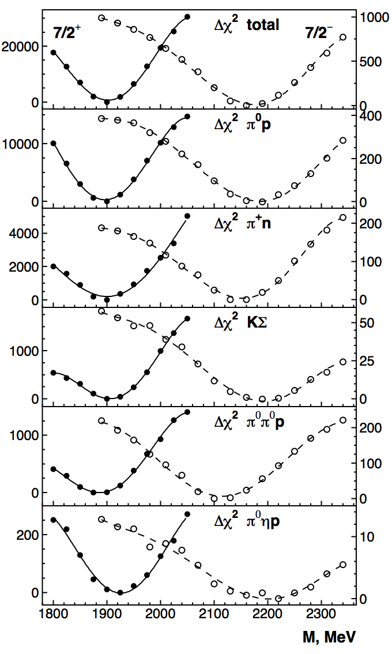
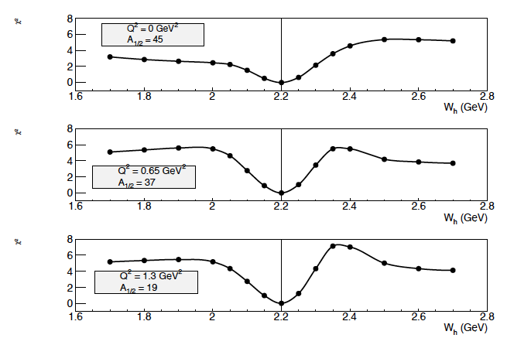
Bonn-Gatchina Analysis Example
Resonance Parameters Extraction: Resonance Mass
ep e p π⁺π⁻
Δ(1950)7/2⁺
Δ(2200)7/2⁻
dσ_{q.d.} = JM model + “hybrid resonance”
dσ_{th} = JM model + variable mass resonance
J⁺ = ½⁺ M_{res} = 2.2 GeV Γ_{res} = 0.25 GeV
S_{1/2} = 0, A_{1/2} = statistical threshold value
Q² = 0.0 GeV²
pπ⁺π⁻
Q² = 0.65 GeV²
Q² = 1.0 GeV²
χ² scan over the resonance mass
Notes:
Example of a 2-resonance analysis in
the γp -> Nπ, KΣ, pπ⁰π⁰, pπ⁰η channels that involves all available cross section and polarization observables.
The Figure shows the χ² difference Δχ² when a new state Δ(M_{R})7/2⁺ (full line) or Δ(M_{R})7/2⁻ (dashed line) are added, and the resonance mass M_{R} is scanned in a large range. The fit includes the full known spectrum of resonances except the one in question. The existence of the state near 1900 MeV (a well known state) is confirmed and a new (missing) state near 2200 MeV is evident.
(The Δχ² is normalized to 0 at the minimum for better comparison, and two different y scales are used for the two resonance scans.)

Slide 31
Blind Extraction: J^{P}=1/2⁺ + J^{P}=3/2⁺
Two hybrid baryon resonances with J^{p} = 1/2⁺ and J^{p} = 3/2⁺ were inserted in the ep e K⁺Λ Gent RPR2011 reaction amplitude and quasi-data were generated dσ_{q.d.}
A blind analysis has been then attempted trying to extract
7 unknown parameters: M_{res}¹ Γ_{res}¹ A_{1/2}¹
M_{res}² Γ_{res}² A_{1/2}² A_{3/2}²
Searching the minimum of the quantity:
dσ_{th} were calculated using the Gent RPR2011 amplitudes including two resonances
J^{p} = 1/2⁺ and J^{p} = 3/2⁺, whose parameters values were scanned in the range:
2.0 < W < 2.5 GeV
0.1 < Γ < 0.4 GeV
-0.05 < A_{1/2}< +0.05 GeV^{-1/2}
-0.05 < A_{3/2} < +0.05 GeV^{-1/2}
at a fixed Q² = 0.5 GeV²
S_{1/2} = 0

Slide 32
Blind Extraction: J^{P}=1/2⁺ + J^{P}=3/2⁺
Two hybrid baryon resonances with J^{p} = 1/2⁺ and J^{p} = 3/2⁺ were inserted in the ep e K⁺Λ Gent RPR2011 reaction amplitude and quasi-data were generated dσ_{q.d.}
A blind analysis has been then attempted trying to extract
7 unknown parameters: M_{res}¹ Γ_{res}¹ A_{1/2}¹
M_{res}² Γ_{res}² A_{1/2}² A_{3/2}²
Iterative procedure:
The algorithm calculates the χ² value over a 7-dim parameters coarse grid, covering the full range
The combination of parameters corresponding to the minimum χ² value is found
χ² value is calculated over a finer 7-dim parameters grid, around the minimum
The procedure is repeated three times.

Slide 33
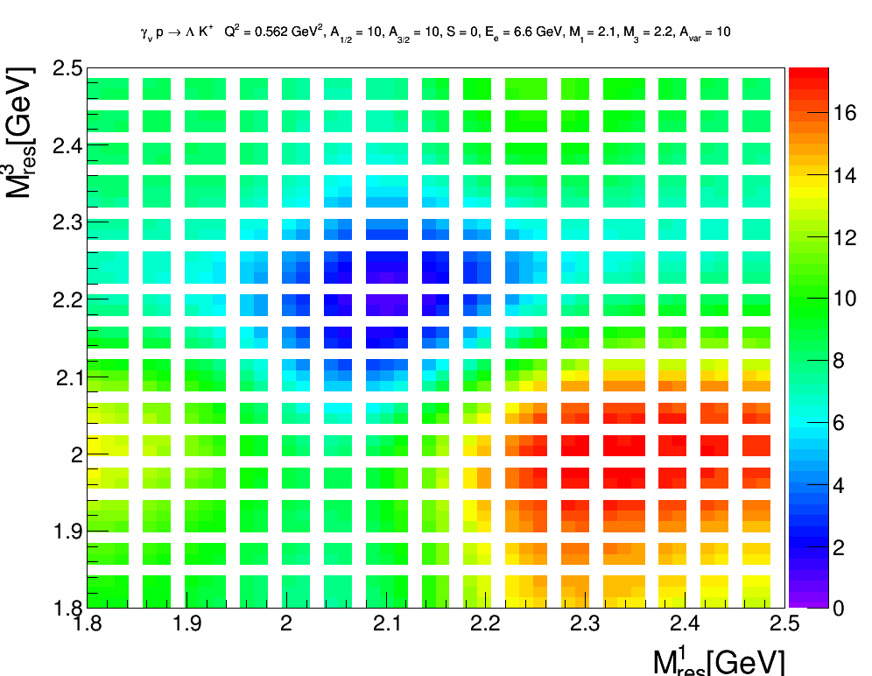
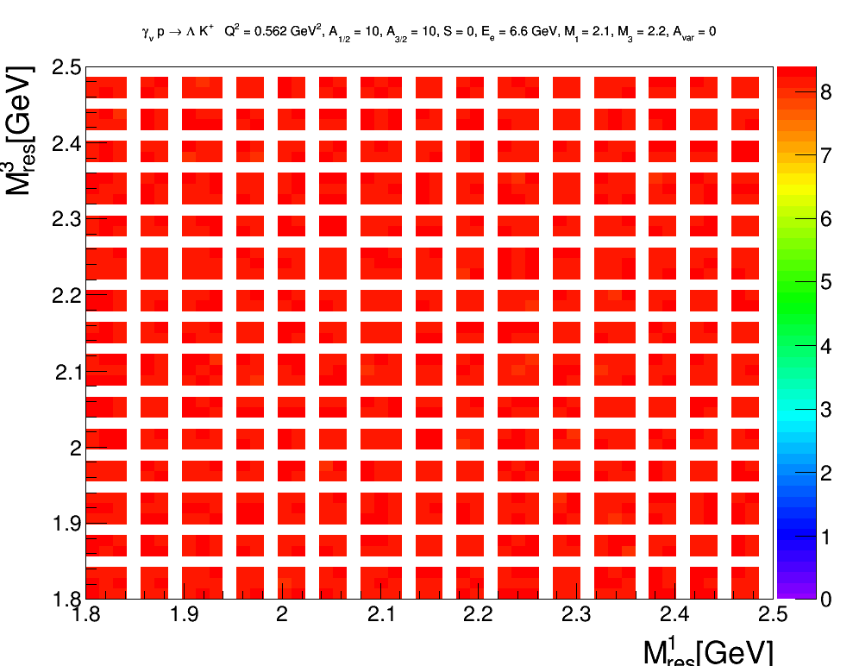
Blind Extraction: J^{P}=1/2⁺ + J^{P}=3/2⁺
Two hybrid baryon resonances with J^{p} = 1/2⁺ and J^{p} = 3/2⁺ were inserted in the ep e K⁺Λ Gent RPR2011 reaction amplitude and quasi-data were generated dσ_{q.d.}
Typical 3-dim map of χ² as a function of the two resonance masses, evolving in time for increasing A_{1/2} (A_{3/2}) strength.
χ ² minimum

Slide 34
Blind Extraction: J^{P}=1/2⁺ + J^{P}=3/2⁺
Two hybrid baryon resonances with J^{p} = 1/2⁺ and J^{p} = 3/2⁺ were inserted in the ep e K⁺Λ Gent RPR2011 reaction amplitude and quasi-data were generated dσ_{q.d.}
A blind analysis has been then attempted trying to extract
7 unknown parameters: M_{res}¹ Γ_{res}¹ A_{1/2}¹
M_{res}² Γ_{res}² A_{1/2}² A_{3/2}²
Blind Resonance Parameters | Extracted Resonance Parameters
M_{res}^{1/2} = 2.30 GeV | M_{res}^{1/2} = 2.32 GeV
Γ_{res} ^{1/2} = 0.30 GeV | Γ_{res} ^{1/2} = 0.30 GeV
Α_{1/2} ¹ = 0.020 GeV^{-1/2} | Α_{1/2} ¹ = 0.019 GeV^{-1/2}
M_{res}^{1/2} = 2.45 GeV | M_{res}^{1/2} = 2.45 GeV
Γ_{res} ^{1/2} = 0.35 GeV | Γ_{res} ^{1/2} = 0.31 GeV
Α_{1/2} ¹ = - 0.015 GeV^{-1/2} | Α_{1/2} ¹ = - 0.014 GeV^{-1/2}
Α_{3/2} ¹ = 0.04 GeV^{-1/2} | Α_{3/2} ¹ = 0.038 GeV^{-1/2}
Very small differences between initial blind parameters and extracted values.

Slide 35
Summary
We presented a program to search for new states of baryonic matter: hybrid baryons.
Complementing the international program to search for hybrid mesons.
Identification of hybrid baryons will verify fundamental expectations of strong QCD on the role of glue.
Search for these states in exclusive channels will cover the kinematical range Q² > 0.05 GeV², W< 3 GeV.
We have demonstrated for two major electroproduction channels pπ⁺π⁻ and K⁺Y that, with 100 days beam time with CLAS12, we have the statistical sensitivity to find new excited states and identify their nature.
Amplitude analysis will be developed with the theoretical support groups to establish the existence and properties of new resonances in the 1.8 GeV < M < 3.0 GeV mass region.

