Slide 1
Hall B – Hybrid Baryons
PR12-16-010
A Search for Hybrid Baryons in Hall B with CLAS12
Spokespersons:
Annalisa D’ANGELO
University of Rome “Tor Vergata” and INFN Rome Tor Vergata
Volker BURKERT, Daniel S. CARMAN, Victor MOKEEV
Thomas Jefferson National Accelerator Facility
Evgeny GOLOVACH
Skobeltsyn Institute of Nuclear Physics and Lomonosov Moscow State University
Ralf GOTHE
University of South Carolina

Slide 2
University of Rome “Tor Vergata”
and
INFN Rome Tor Vergata
Manpower: Prof. Annalisa D’ANGELO
Post. Doc. Lucilla LANZA
Efforts: Calibration: Forward Tagger cluster energy correction
Software: Full CLAS12 simulation and event reconstruction

Slide 3
Skobeltsyn Institute of Nuclear Physics and Lomonosov Moscow State University
Manpower: Prof. Boris S Ishkhanov
Staff Evgeny Golovach
Staff Gleb Fetodov
Staff Evgeny Isupov
Grad. Student V. Klimenko
Efforts: Software: π⁺π⁻p, π⁺n,π⁰p, KΛ , KΣ Event generators
at 5.<Q²<12 GeV²
Software: Full CLAS12 simulation and event reconstruction
for exclusive electroproduction π+π-p,
π⁺n,π⁰p, KΛ , KΣ at 0.05<Q²<12 GeV²

Slide 4
University of South Carolina
Manpower: Prof. Ralph Gothe
PhD Student Julia Skorodumia
Efforts: Software: ππp Event generator
Software: CLAS12 simulation and event reconstruction

Slide 5
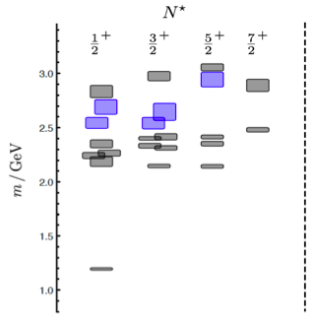
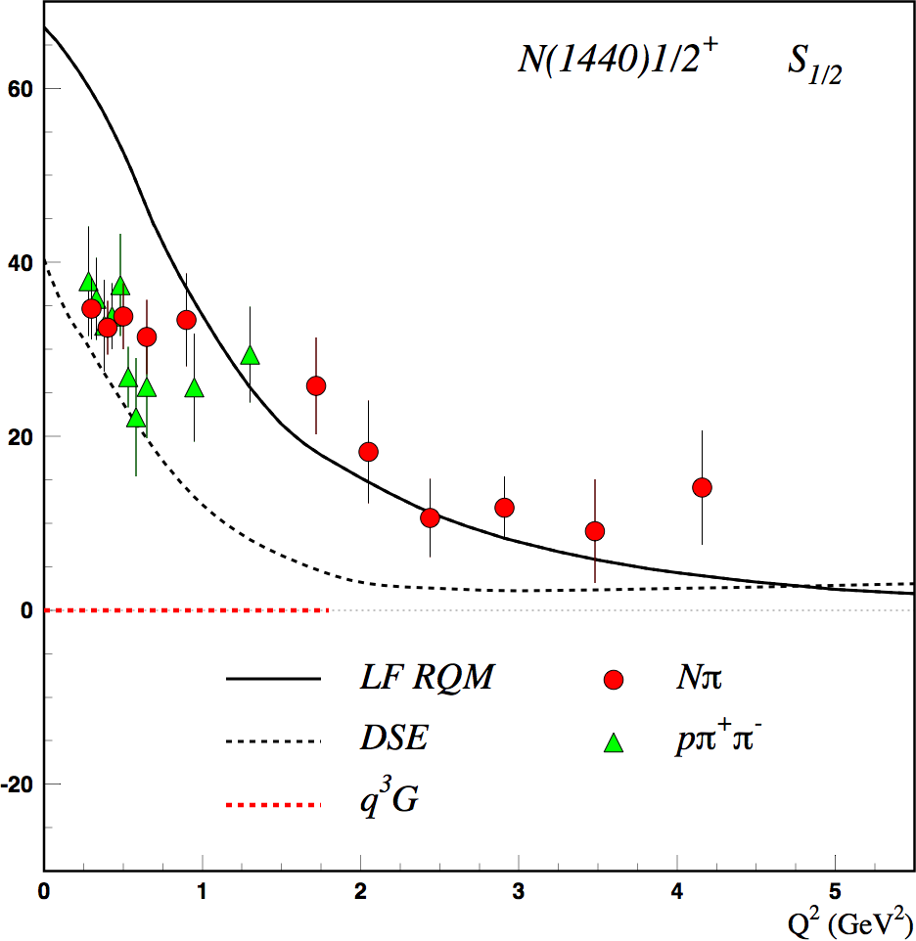
Motivation: Search for Glue in Baryons
N* spectrum from Lattice QCD predicts the existence of hybrid baryons.
The hybrid nature of baryons appears in the Q² evolution of the electroexcitation amplitudes.
(JLab LQCD group results)
N(1440)1/2⁺ S_{1/2}
Black curves: predictions for qqq state
GeV^{-1/2} *1000
q³
CLAS
Electroexcitation Amplitude
q³g
1.3GeV
regular states
N
hybrid states
Red curve: prediction for q³g hybrid
Q² (GeV²)
CLAS12 is the unique laboratory where hybrid baryons may be identified by measuring electrocouplings of excited states with masses greater than 2 GeV.

