Slide 1
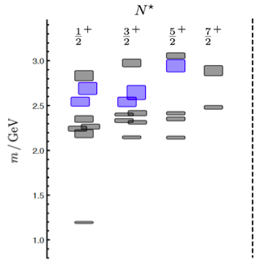
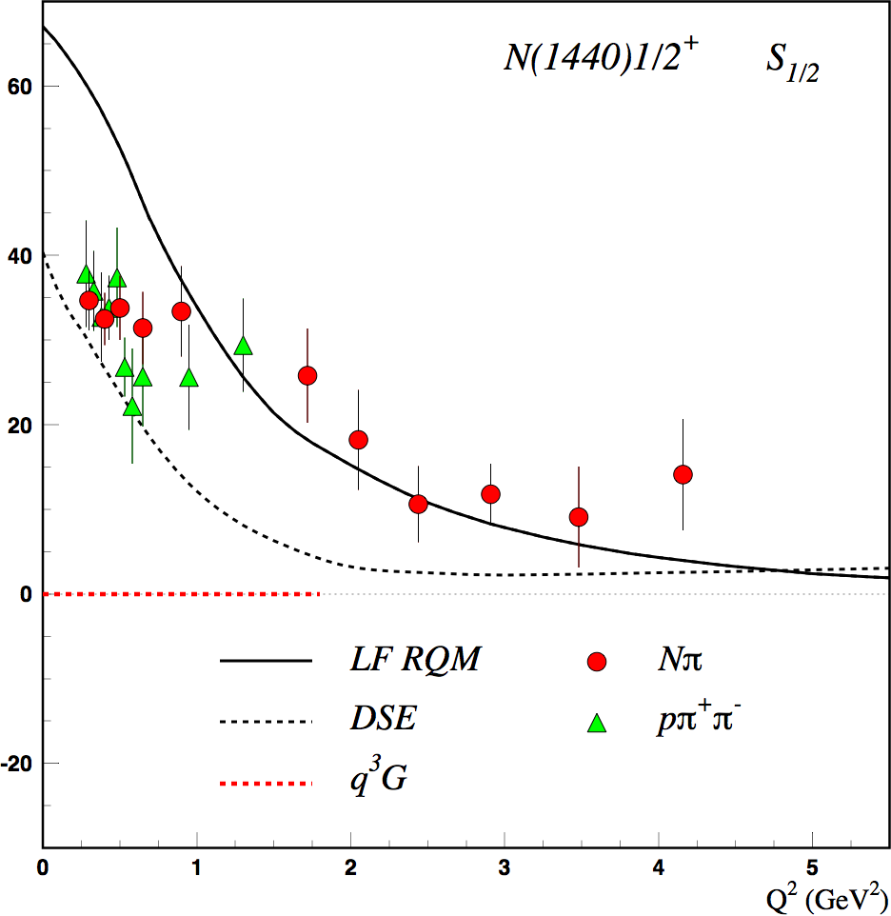
Motivation: Search for Glue in Baryons
N* spectrum from Lattice QCD predicts the existence of hybrid baryons.
The hybrid nature of baryons appears in the Q² evolution of the electroexcitation amplitudes.
(JLab LQCD group results)
N(1440)1/2⁺ S_{1/2}
Black curves: predictions for qqq state
GeV^{-1/2} *1000
q³
CLAS
Electroexcitation Amplitude
q³g
1.3GeV
regular states
N
hybrid states
Red curve: prediction for q³g hybrid
Q² (GeV²)
CLAS12 is the unique laboratory where hybrid baryons may be identified by measuring electrocouplings of excited states with masses greater than 2 GeV.
1

Slide 2
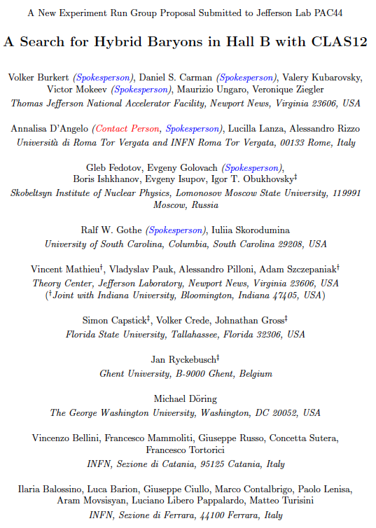
Search for Hybrid Baryons with CLAS12
E12-16-010
Spokespersons: A. D’ Angelo, V. Burkert, D.S. Carman,
R. Gothe, E. Golovach, V. Mokeev
Experiment Details:
Measure K⁺Λ, K⁺Σ⁰ and π⁺π⁻ electroproduction from an unpolarized proton target with longitudinally polarized electron beam at low Q²
Measure differential cross sections, separated structure functions, induced and recoil hyperon polarization for
W [1.6 - 3.0 GeV], Q² [0.02 - 3 GeV²], cosθ_{K}^{cm} [-1.0:1.0]
Beam Energy considerations:
Lowest Q² values (0.02 – 3 GeV²) are obtainable at 6.3 GeV (3 pass)
Complementary low Q² acceptance (0.2 – 3 GeV²) is obtained also at 10.6 GeV (5 pass)
E = 6.3 GeV
electron efficiency
Experiment Goals:
Measure γ_{v}NN* electrocoupling amplitudes for N*, Δ* states that couple to KY or Nππ final state, in kinematical regions complementary to E12-06-108A and E12-09-003 proposals.
Search for evidence of hybrid baryon contributions through low Q² evolution of γ_{v}NN* electro-couplings.
E = 10.6 GeV

Slide 3
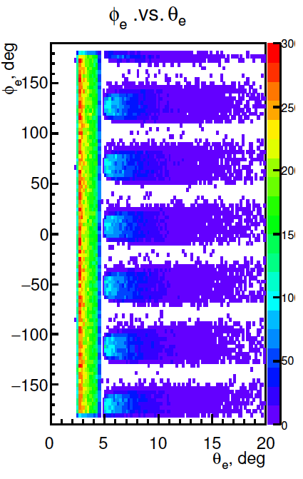
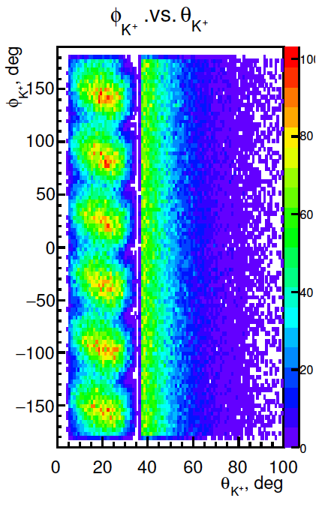
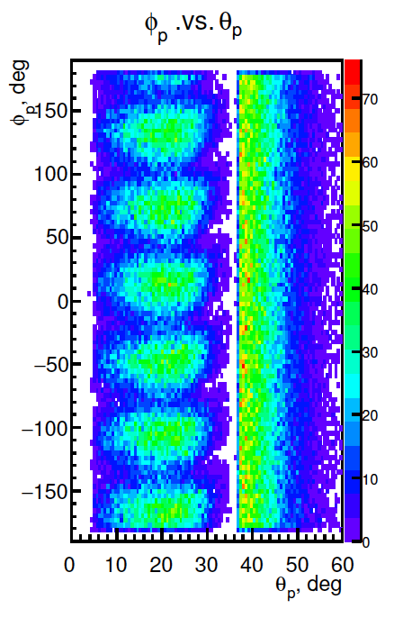
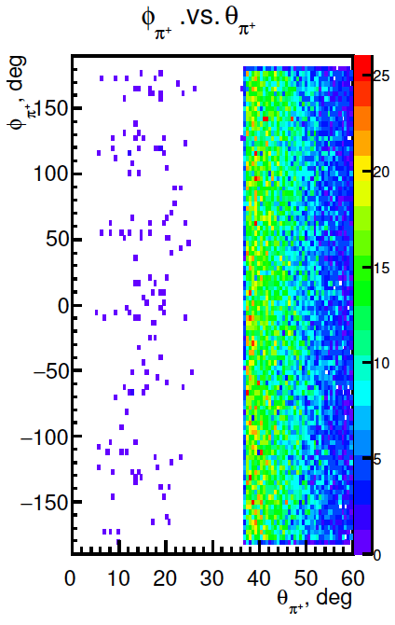
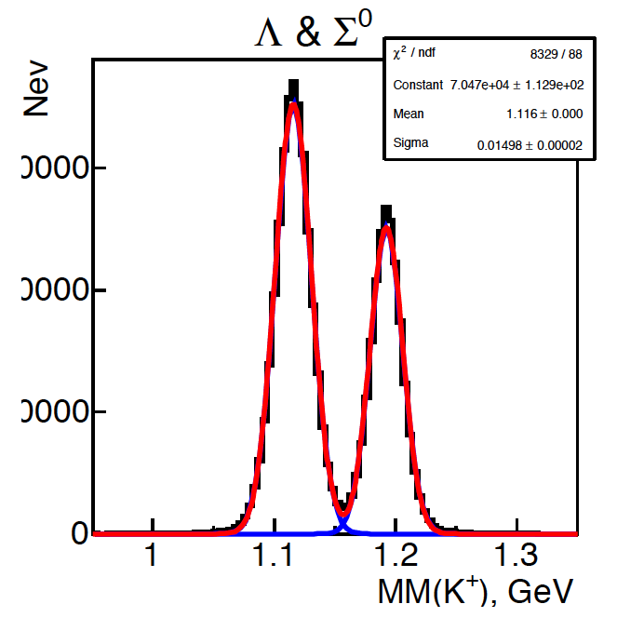
e p e K⁺ Y Event Simulation in CLAS12
φ vs θ angular acceptance for final particles
Torus polarity:
negative
outbending
e⁻
π⁻
K⁺
p
K⁺ missing mass resolution
Minimum measurable Q²
Trigger Conditions:
One electron in CLAS12
          or
          If the acquisition rate allows for it:
          1 electron in the FT + at least one charged particle in CLAS12
          Otherwise:1 electron in the FT + at least two charged particle in CLAS12
Ee = 10.6 GeV | 0.5 GeV²
Ee = 8.8 GeV
30000
20000
10000
Acceptance
σ=15 MeV
σ=13 MeV
Ee | one missing hadron
10.6 GeV | 33%

Slide 4
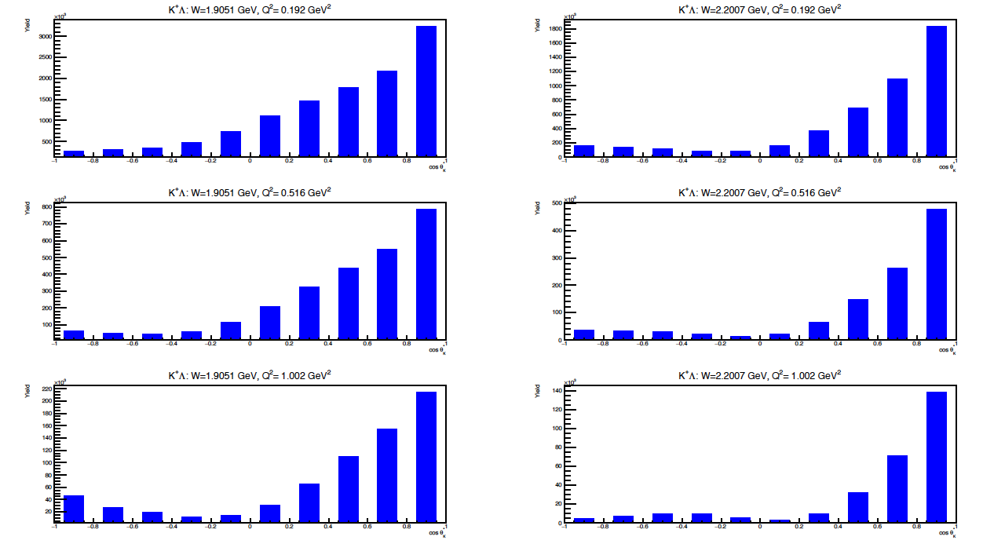
e p e K⁺ Y Rates and Yields in 2018 Spring Run
Total Rate in 1.6 GeV <W<3 GeV 0.2 GeV² <Q²< 3 GeV²
Ghent RPR 2017
L = 10³⁵ cm⁻²s⁻¹ ε=0.32
R = σ_{e’KΛ} (μb) x10⁻³⁰ (cm²/μb) x L x ε = 283.3 Hz x ε = 90 Hz
Expected yields from 20 PAC days in spring RG-A run
Yield
3x10⁶
2x10⁶
1x10⁶
W=1.9 GeV
1.8x10⁶
1.2x10⁶
0.6x10⁶
W=2.2 GeV
Q²=0.2 GeV²
Q²=0.2 GeV²
E=10.6 GeV
8x10⁵
6x10⁵
4x10⁵
2x10⁵
W=1.9 GeV
5x10⁵
3x10⁵
1x10⁵
W=2.2 GeV
Q²=0.5 GeV²
Q²=0.5 GeV²
22x10⁴
16x10⁴
10x10⁴
4x10⁴
14x10⁴
10x10⁴
6x10⁴
2x10⁴
W=1.9 GeV
W=2.2 GeV
Q²=1.0 GeV²
Q²=1.0 GeV²
4

Slide 5
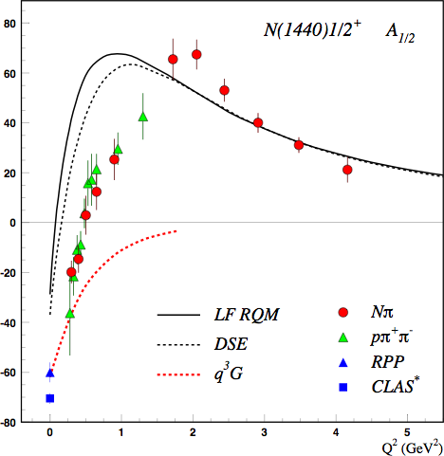
First Publication
The first publication related to low Q² KY will exploit the high yield obtained in 20 PAC days to:
determine precision measurements of hyperon polarization observables at Q²< 3GeV²
Subsequent accurate extraction of cross sections and separated structure functions will allow for
attempt the extraction of high mass resonance
contribution to the reaction cross and sections
polarization observables
determine the low Q² evolution of resonance
electrocouplings to investigate the relevant
degrees of freedom and the nature of the
resonances.
q³
q³g
q³
5

