Slide 1
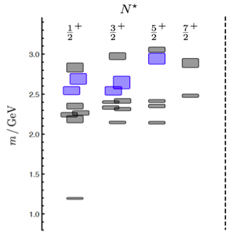
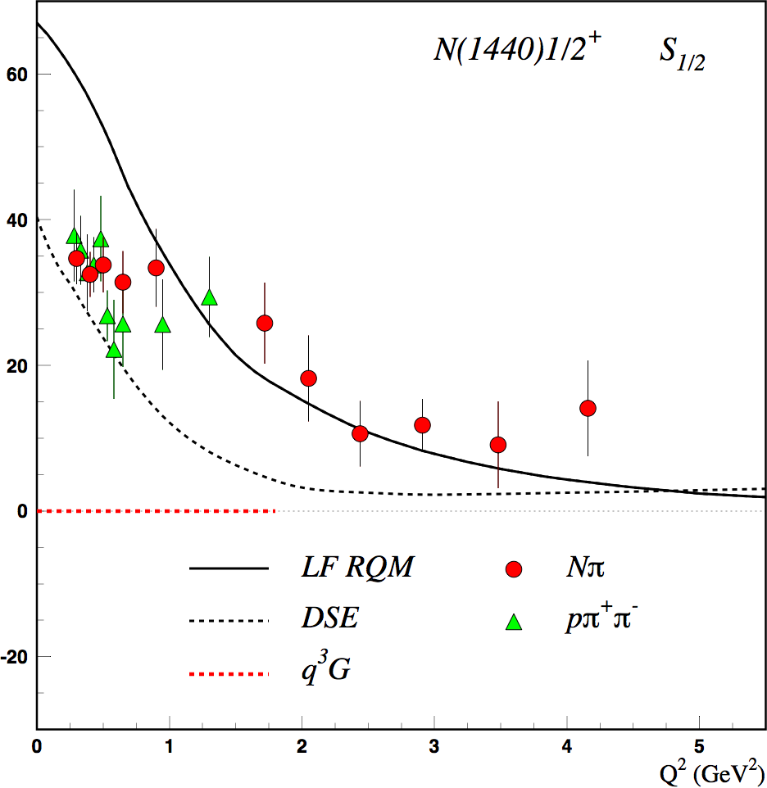
Motivation: Search for Glue in Baryons
N* spectrum from Lattice QCD predicts the existence of hybrid baryons.
The hybrid nature of baryons appears in the Q² evolution of the electroexcitation amplitudes.
(JLab LQCD group results)
N(1440)1/2⁺ S_{1/2}
Black curves: predictions for qqq state
GeV^{-1/2} *1000
q³
CLAS
Electroexcitation Amplitude
q³g
1.3GeV
regular states
N
hybrid states
Red curve: prediction for q³g hybrid
Q² (GeV²)
CLAS12 is the unique laboratory where hybrid baryons may be identified by measuring electrocouplings of excited states with masses greater than 2 GeV.
1

Slide 2
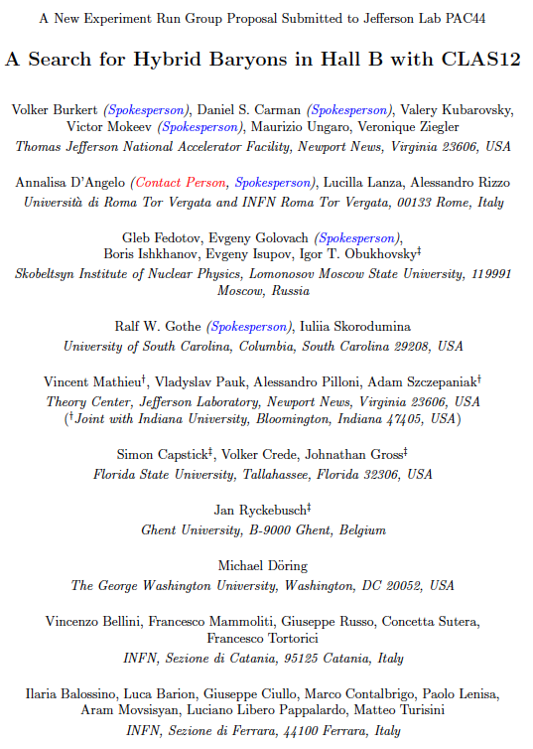
Search for Hybrid Baryons with CLAS12
E12-16-010
Spokespersons: A. D’ Angelo, V. Burkert, D.S. Carman,
R. Gothe, E. Golovach, V. Mokeev
Experiment Details:
Measure K⁺Λ, K⁺Σ⁰ and π⁺π⁻ electroproduction from an unpolarized proton target with longitudinally polarized electron beam at low Q²
Measure differential cross sections, separated structure functions, induced and recoil hyperon polarization for
W [1.6 - 3.0 GeV], Q² [0.02 - 3 GeV²], cosθ_{K}^{cm} [-1.0:1.0]
Beam Energy considerations:
Lowest Q² values (0.02 – 3 GeV²) are obtainable at 6.3 GeV (3 pass)
Complementary low Q² acceptance (0.2 – 3 GeV²) is obtained at 10.6 GeV (5 pass)
E = 6.3 GeV
electron efficiency
Experiment Goals:
Measure γ_{v}NN* electrocoupling amplitudes for N*, Δ* states that couple to KY or Nππ final state, in kinematical regions complementary to E12-06-108A and E12-09-003 proposals.
Search for evidence of hybrid baryon contributions through low Q² evolution of γ_{v}NN* electro-couplings.
E = 10.6 GeV

Slide 3
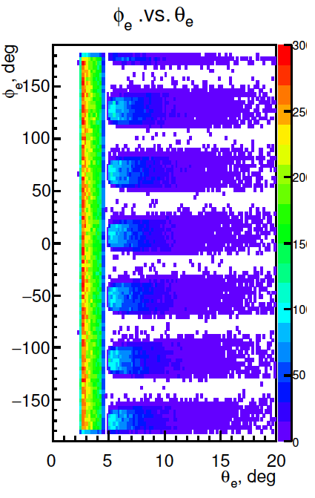
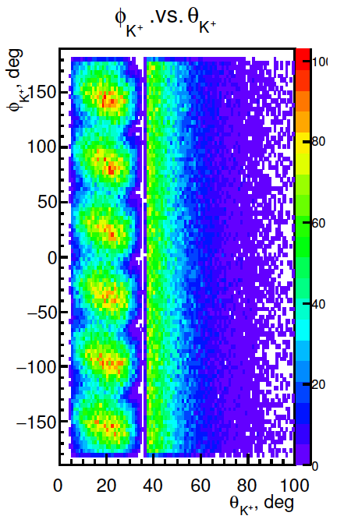
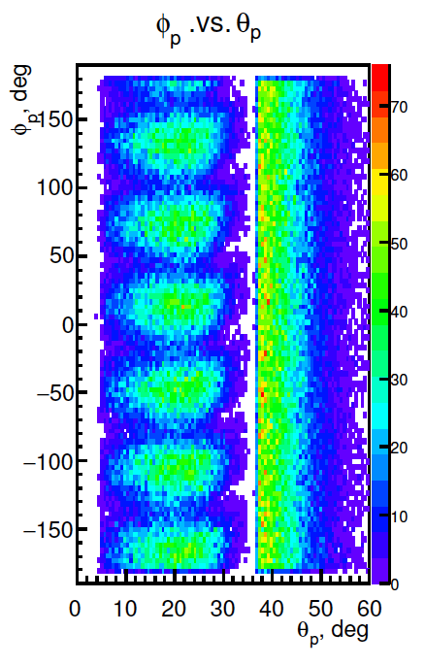
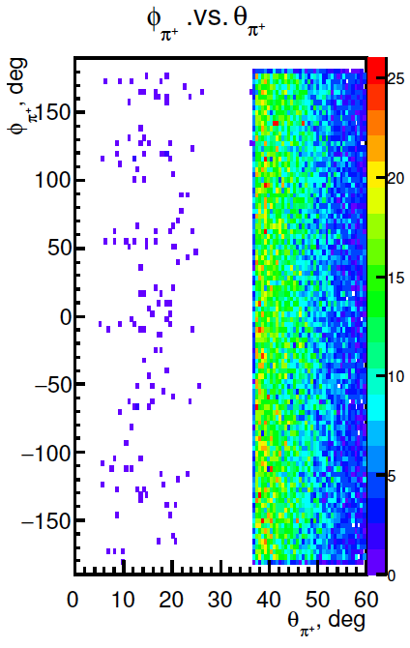
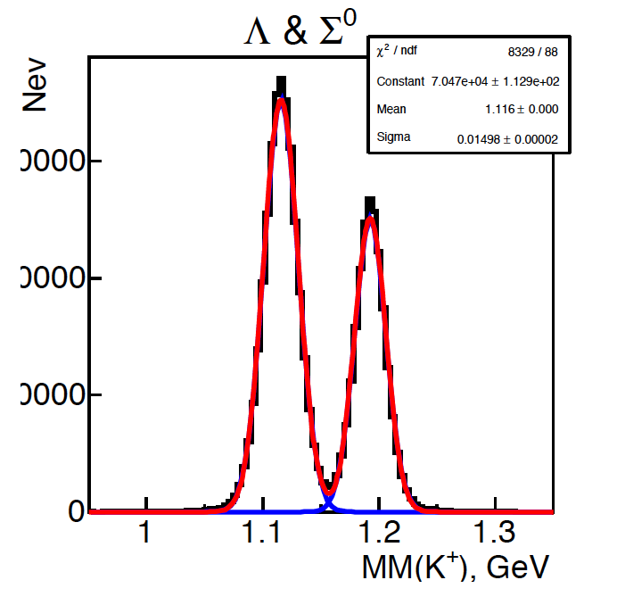
e p e K⁺ Y Event Simulation in CLAS12
φ vs θ angular acceptance for final particles
Torus polarity:
negative
outbending
e⁻
π⁻
K⁺
p
K⁺ missing mass resolution
Minimum measurable Q²
Trigger Conditions:
One electron in CLAS12
          or
          If the acquisition rate allows for it:
          1 electron in the FT + at least one charged particle in CLAS12
          Otherwise:1 electron in the FT + at least two charged particle in CLAS12
Ee = 10.6 GeV | 0.2 GeV²
Ee = 8.8 GeV
30000
20000
10000
Acceptance
σ=15 MeV
σ=13 MeV
Ee | one missing hadron
10.6 GeV | 33%

Slide 4
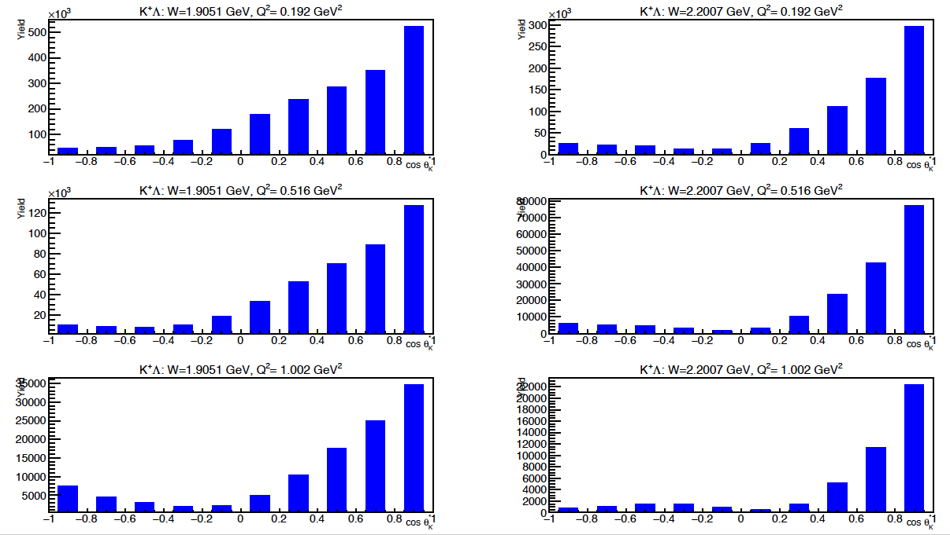
e p e K⁺ Y Rates and Yields in 2018 Spring Run
Total Rate in 1.6 GeV <W<3 GeV 0.2 GeV² <Q²< 3 GeV²
Ghent RPR 2017
L = 10³⁵ cm⁻²s⁻¹ ε=0.32
R = σ_{e’KΛ} (μb) x10⁻³⁰ (cm²/μb) x L x ε = 283.3 Hz x ε = 90 Hz
Expected yields from 20 PAC days in spring RG-A run
Yield
W=1.9 GeV
W=2.2 GeV
Q²=0.2 GeV²
Q²=0.2 GeV²
E=10.6 GeV
x10³
W=1.9 GeV
80
50
30
0
W=2.2 GeV
Q²=0.5 GeV²
Q²=0.5 GeV²
x10³
x10³
35
25
15
5
22
14
6
0
W=1.9 GeV
W=2.2 GeV
Q²=1.0 GeV²
Q²=1.0 GeV²
4

Slide 5
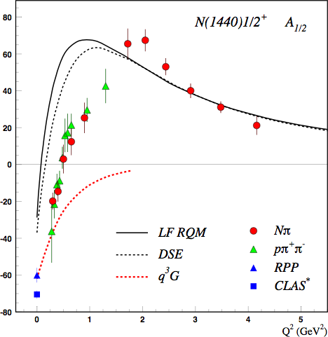
First Publication
The first publication related to low Q² KY will exploit the high yield obtained in 20 PAC days to:
determine precision measurements of hyperon polarization observables at Q²< 3GeV²
Subsequent accurate extraction of cross sections and separated structure functions will allow to:
attempt the extraction of high mass resonance
contribution to the reaction cross sections and
polarization observables.
determine the low Q² evolution of resonance
electrocouplings to investigate the relevant
degrees of freedom and the nature of the
resonances.
q³
q³g
q³
5

