Slide 1
Hall B - Run Group K
Color Confinement and Strong QCD
Status Update
E12-16-010 A Search for Hybrid Baryons in Hall B with CLAS12
Annalisa D’Angelo
E12-16-010A Nucleon Resonance Structure Studies Via Exclusive KY Electroproduction at 6.6 GeV and 8.8 GeV
Daniel Carman
E12-16-010B Deeply Virtual Compton Scattering with CLAS12 at 6.6 GeV and 8.8 GeV Latifa Elouadrhiri
Approved:
50 PAC days at 8.8 GeV
50 PAC days at 6.6 GeV
Assigned:
10.5 PAC days at 7.5 GeV
3.5 PAC days at 6.5 GeV

Slide 2
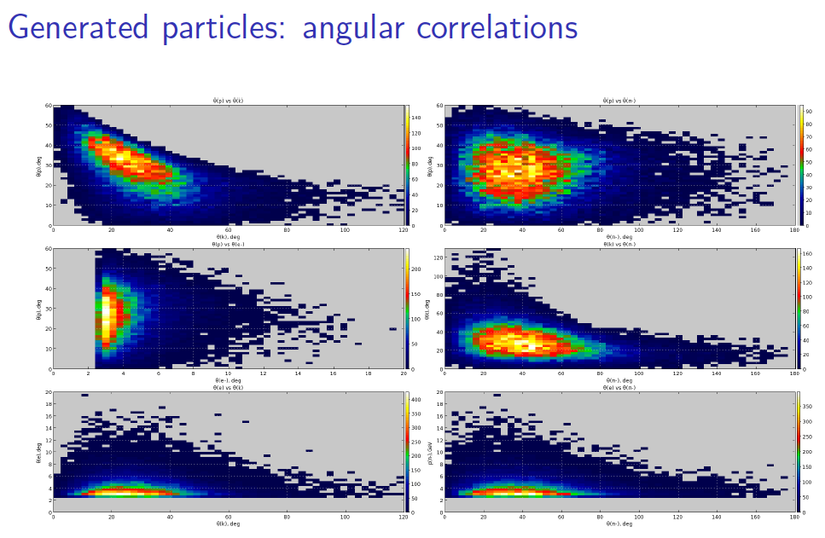
two forward hadrons
1 central and 1 forward hadron
two central hadrons
θp vs θπ⁻
θp vs θk
Two forward hadrons may
only correspond to a p – K⁺
couple
Acceptance ~ 0.5%
A forward and a central hadron trigger covers most but not all the phase space: the fine tuning of the trigger configuration requires further studies
(FT x FTOF x PCAL x CTOF x CND)
θp vs θe
θk vs θπ⁻
θe vs θk
θe vs θπ⁻
Trigger: FT + | Acceptance
1 forward + 1 central hadron | 5 %
1 forward hadron | 20 %

Slide 3
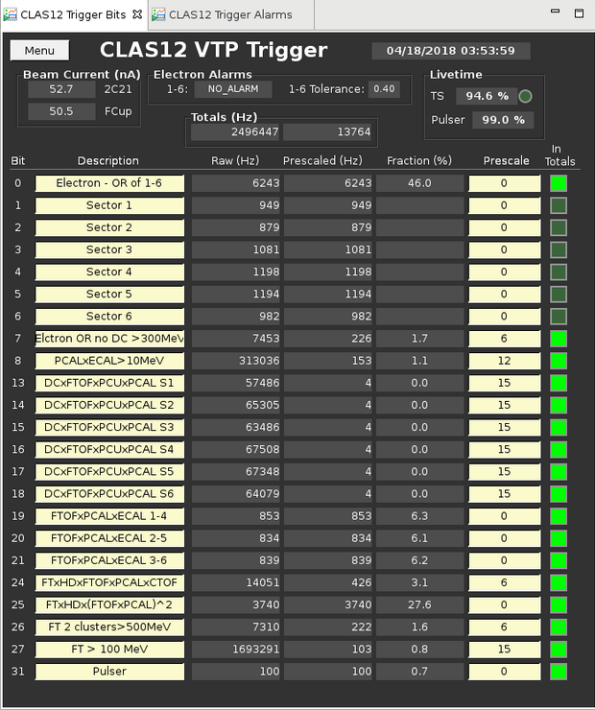
Trigger
Run Group A - 50 nA
Accept 13 kHz events @ 91% live time
trigger improvements:
road finder and geometry match
45 % reduction
full luminosity 75 nA
x 1.5 increase
Electron trigger
6 kHz
Service trigger
<1 kHz
“Muon” trigger
2.4 kHz
FT trigger
4.3 kHz
0.5 <E<4 (GeV)
To be redefined
0.5 <E ft< 4 (GeV)

Slide 4
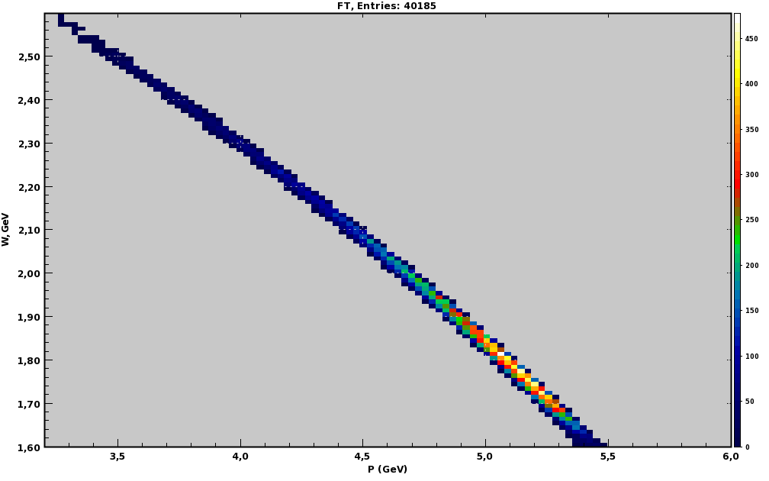
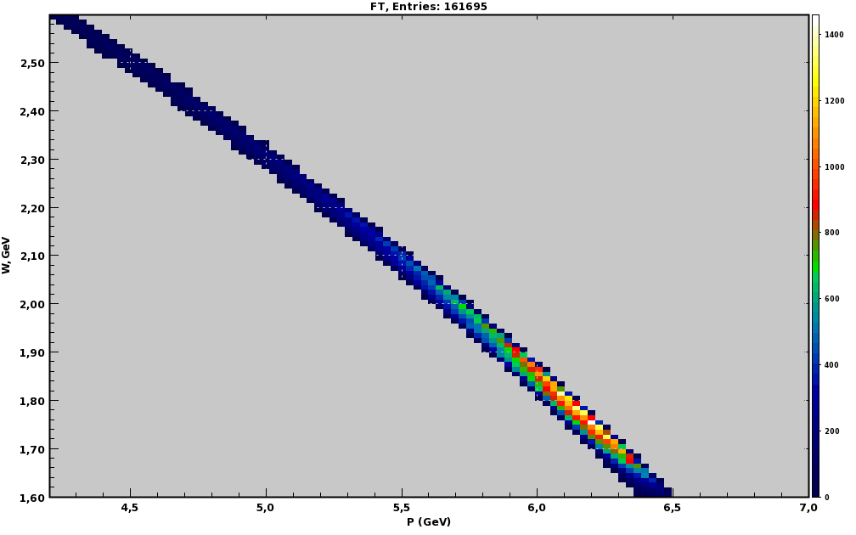
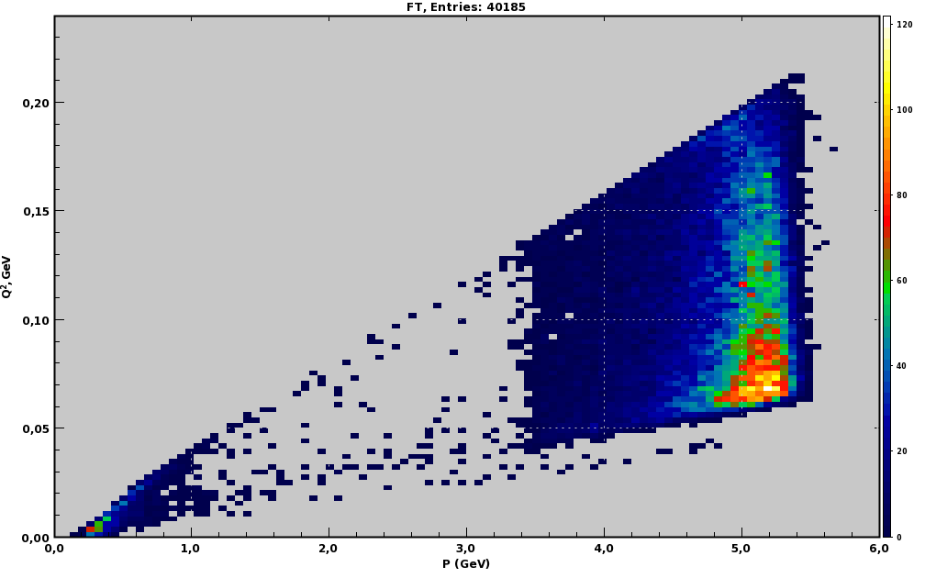
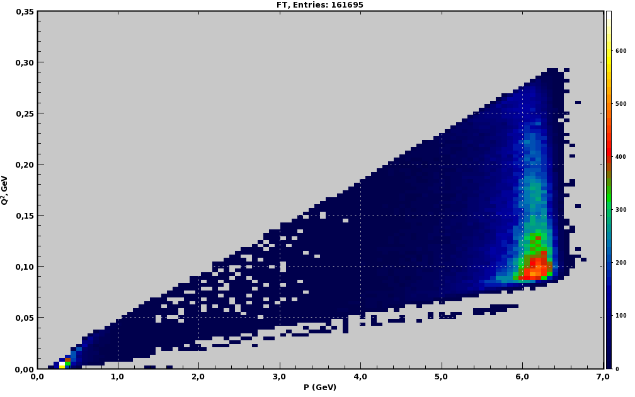
Trigger – FTcal energy window
2.6
W (GeV)
2.5
2 < E Ft < 5.5 (GeV)
2.6
3 < E Ft < 6.5 (GeV)
2.4
W (GeV)
2.5
2.3
2.4
Ee = 7.5 GeV
2.2
Ee = 6.5 GeV
2.3
2.1
2.2
2.0
1.6 < W < 3 (GeV)
2.1
1.6 < W < 3 (GeV)
1.9
2.0
1.8
1.9
1.7
1.8
1.6
1.7
3.5
4.0
4.5
5.0
5.5
6.0
1.6
E FTCAL (GeV)
4.5
5.0
5.5
6.0
6.5
7.0
0.35
E FTCAL (GeV)
Q² (GeV²)
Ee = 6.5 GeV
Ee = 7.5 GeV
0.20
0.30
Q² (GeV²)
0.15
0.25
0.20
0.10
0.15
0.05
0.10
0.05
0.00
0.00
0.0
1.0
2.0
3.0
4.0
5.0
6.0
0.0
1.0
2.0
3.0
4.0
5.0
6.0
7.0
E FTCAL (GeV)
E FTCAL (GeV)

Slide 5
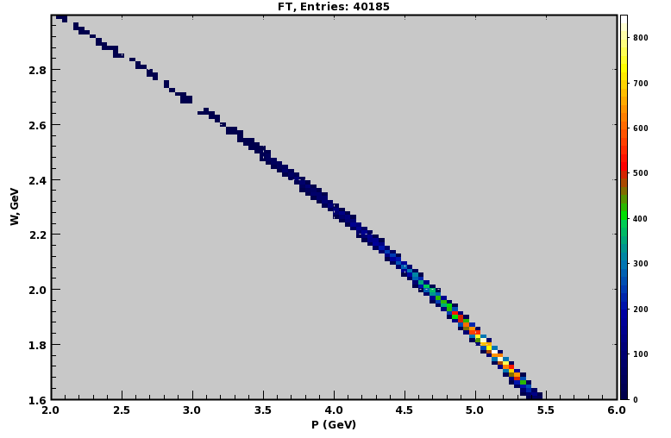
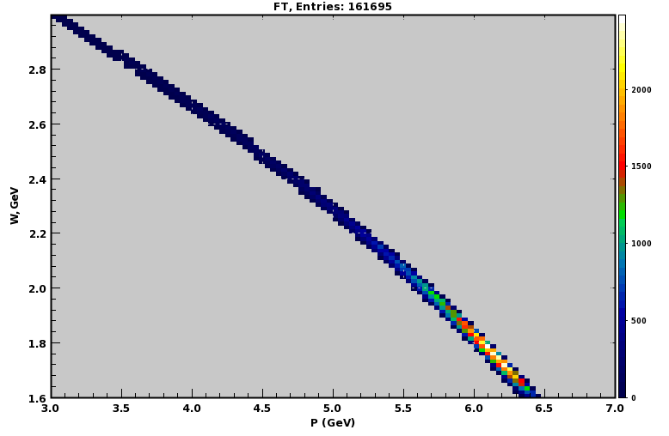
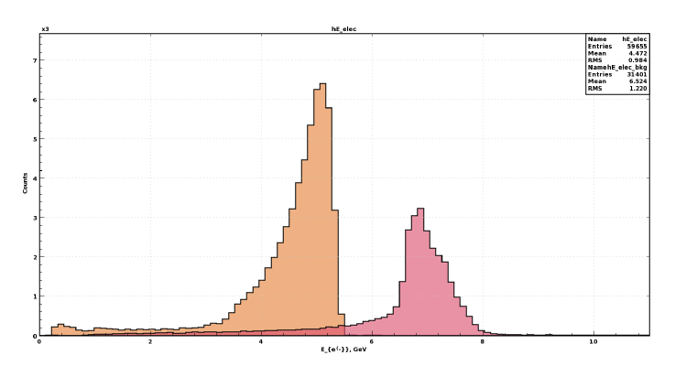
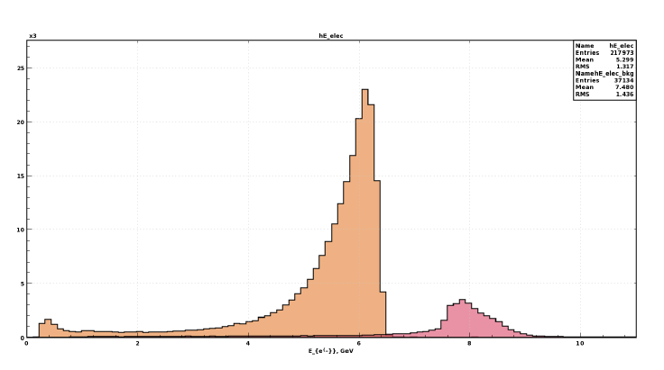
Trigger – FTcal energy window
W (GeV)
2.8
2 < E Ft < 5.5 (GeV)
W (GeV)
2.8
3 < E Ft < 6.5 (GeV)
2.6
2.6
Ee = 7.5 GeV
2.4
Ee = 6.5 GeV
2.4
2.2
1.6 < W < 3 (GeV)
2.2
1.6 < W < 3 (GeV)
2.0
2.0
1.8
1.8
1.6
2.0
2.5
3.0
3.5
4.0
4.5
5.0
5.5
6.0
1.6
E FTCAL (GeV)
3.0
3.5
4.0
4.5
5.0
5.5
6.0
6.5
7.0
E FTCAL (GeV)
2 < E Ft < 5.8 (GeV)
3 < E Ft < 6.8 (GeV)
trigger window
trigger window
Ee = 6.5 GeV
Ee = 7.5 GeV
elastic peak X 10³
elastic peak X 10³
KY
KY
0.0
2.0
4.0
6.0
8.0
10.0
0.0
2.0
4.0
6.0
8.0
10.0
E FTCAL (GeV)
E FTCAL (GeV)

Slide 6
Trigger
Run Group K - 75 nA
Accept 13 kHz events @ 91% live time
Bit | Description | Pre-scale | Raw rate Hz | Pre-scaled rate Hz
0 | Electron OR of 1-6 | 0 | 6300 | 6300
1 | Sector 1 | 0 | 1050 | 1050
2 | Sector 2 | 0 | 1050 | 1050
3 | Sector 3 | 0 | 1050 | 1050
4 | Sector 4 | 0 | 1050 | 1050
5 | Sector 5 | 0 | 1050 | 1050
6 | Sector 6 | 0 | 1050 | 1050
24 | FT xHDxFTOFxPCAL(xCTOFxCND) | 0 | 6000 | 6000
27 | FT > 100MeV | 15 | 1700000 | 103
31 | Pulser | 0 | 100 | 100
7 | Electron OR no DC>300 MeV | 6 | 7500 | 226
8 | PCAL x ECAL>10 MeV | 12 | 313000 | 153
13-18 | DC x FTOF x PCU x PCAL S 1-6 | 15 | 400000 | 26
26 | FT 2 Cluster > 500 MeV | 6 | 7300 | 222
 | Total |  |  | 13 K
trigger improvements:
road finder and geometry match
45 % reduction
full luminosity 75 nA
50 % increase
Electron trigger
6 kHz
FT trigger
4.3 kHz
Service trigger
<1 kHz

Slide 7
Expected Data Volume and Events
Inputs: I_{e} = 75 nA (L = 10³⁵ cm⁻²s⁻¹)
Trigger rate = 12 kHz
 | Event | Beam-second | Week | Full period
Row EVIO | 50 kB | 600 MB | 180 TB | 720 TB
Decoded Hipo | 13 kB | 195 MB | 59 TB | 240 TB
DST Hipo | 2.2 kB | 33 MB | 10 TB | 40 TB
Assuming data compression achieved -> x 0.7 event size reduction
 | Event | Beam-second | Week | Full period
Row EVIO | 35 kB | 420 MB | 125 TB | 500 TB
K Λ expected events at full luminosity
 | efficiency | event rate Hz | Week | Full period
KΛ events prod | 1 | 70 | 21 M | 85 M
KΛ events trigg | 0.13 | 9 | 2.7 M | 11 M

Slide 8
Manpower
Run group K experiments would benefit of the collaboration with similar experiment of Run group A running at 10 GeV :
E12-06-108A Exclusive N* -> KY Studies with CLAS12 - D.S. Carman
E12-06-119 (a) Deeply Virtual Compton Scattering - Sabatie
Same working group of Run Group A will be involved.

Slide 9
Conclusions
Run group K has agreed to take the opportunity of an early run at energies
6.5 GeV and 7.5 GeV. -> GEMC + CLARA full simulation performed
Complementary Q² ranges are still available with lower statistics expected for
2.5 <W < 3 GeV
Run conditions are similar to run Group A, but limited to negative outbending torus field.
Trigger conditions include: 1 electron in CLAS + 1 electron in the FT (higher energy window respect to MesonX trigger) in coincidence with 1 Forward and 1 Central hadron
Same manpower of run group A is foreseen to contribute.
500 TB raw EVIO data, 40 TB reconstructed DST and 11 M KY events are expected.

Slide 10
To do list
Decide Exact Trigger configuration:
electron in CLAS: PCAL &EC threshold? -> expected rates vs W range
FT + hadron(s): FTCAL energy window + 2 hadrons -> exact central configuration
FT x Ftof x HTCC x PCAL x CTOF (X CND?) - thresholds? Rates? 1cntr & 1 Fwd
FT x (Ftof x HTCC x PCAL)² - thresholds? Rates? 2Fwd
FT x ( CTOF X CND)² 2cntr
Dedicated 6 GeV runs: 38
Double check Magnetic Filed Intensity:
100% Torus + 100% Solenoid -> pions with energies lower than 350 MeV lost
50% Torus + 50% Solenoid -> higher expected acceptance + lower resolution
Acceptance vs Resolution
May kinematical fitting of three detected particles recover the resolution?

Slide 11
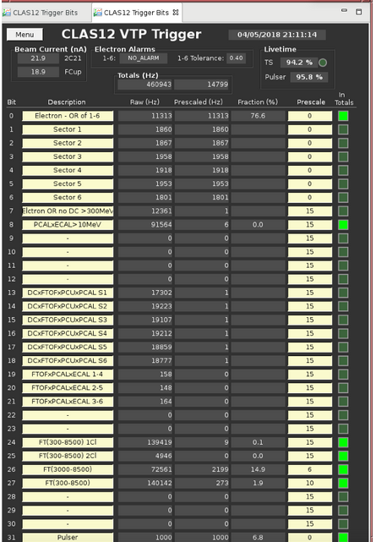
Run 3853
6 GeV
with FT triggers
Needs to be calibrated and cooked
at least for a few files

