Slide 1
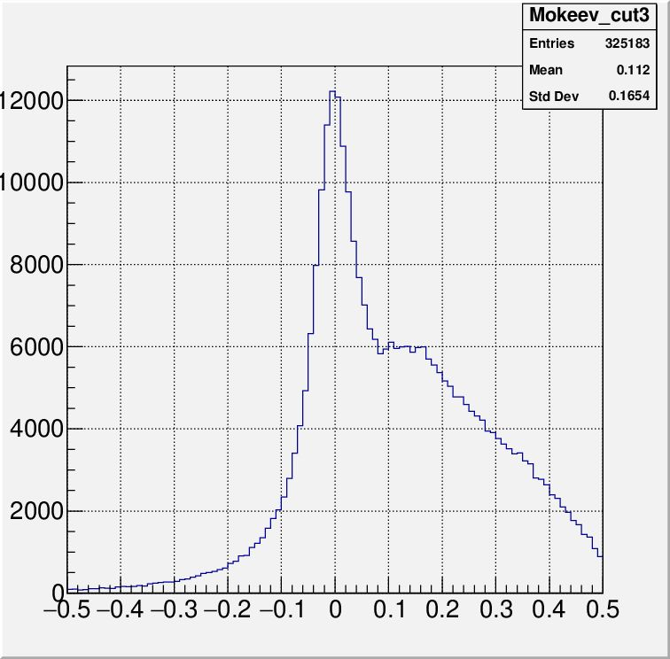
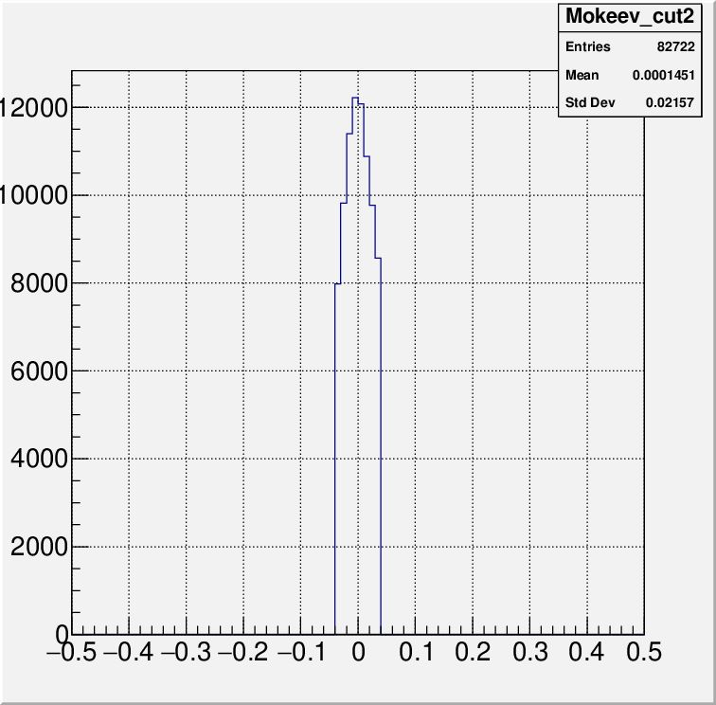
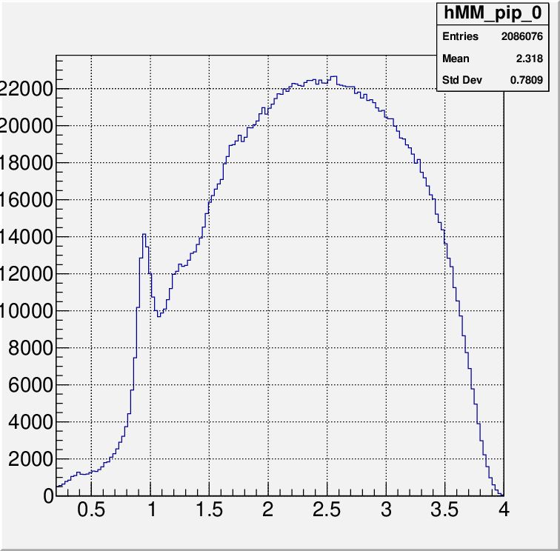
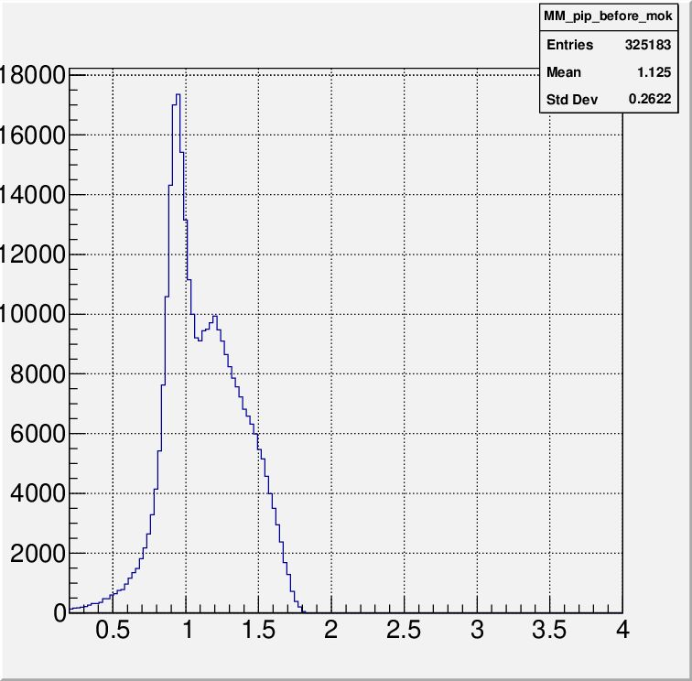
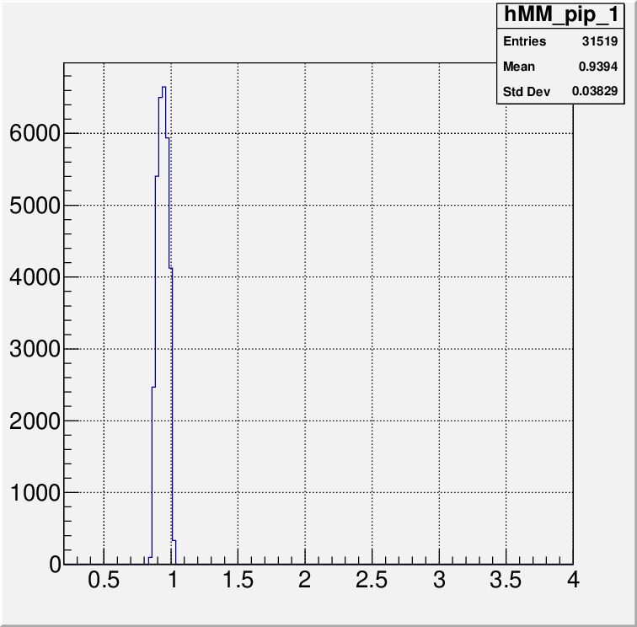
π⁺n Exclusive Events from the CLAS12
Selection criteria :
Exactly one π⁺
Track quality check
π⁺ momentum > 0.2 GeV
π⁺ should be detected by FD
No other charged hadrons except π⁺
W<2 GeV
Measured π⁺ energy in CM E_{mes} should coincide with the computed E_{π}+ from W-values (1) determined from the scattered e⁻ momentum
Matching cut for CM pion energy:
(1)
After cuts # 1-6:
Cut # 7:
Missing mass MM(n): ep→e’π⁺X
E _{mes}- E_{π+}
E _{mes}- E_{π+}
GeV
No cuts on π⁺:
+ Cuts # 1-6
+ Cut # 7
MM(n)
MM(n)
MM(n)
GeV
GeV
GeV
Good isolation of ep→e’p’π⁺n events

Slide 2
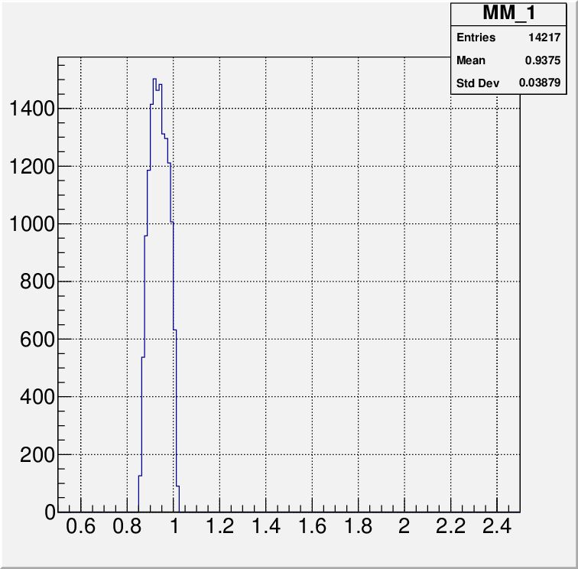
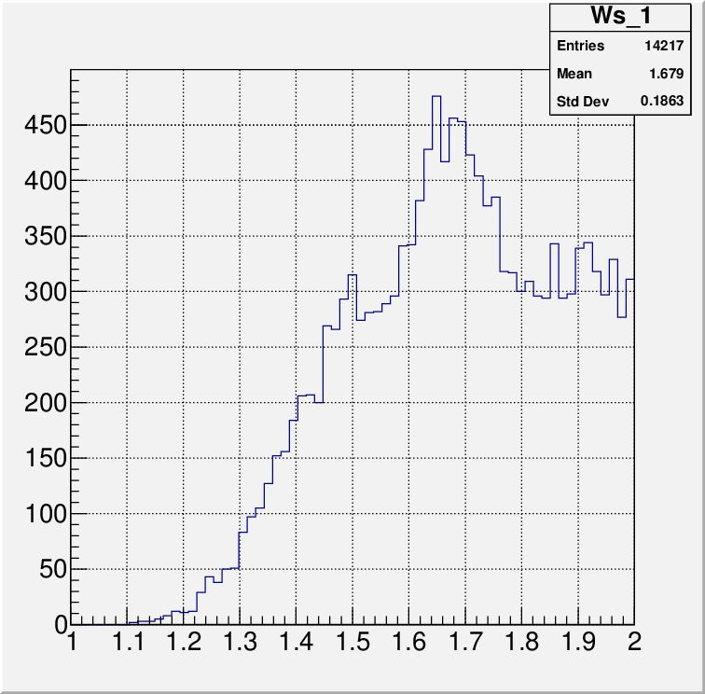
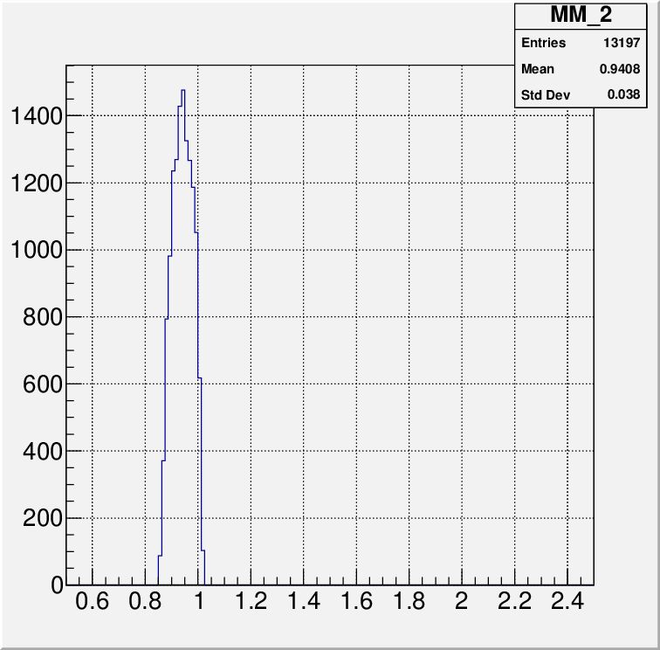
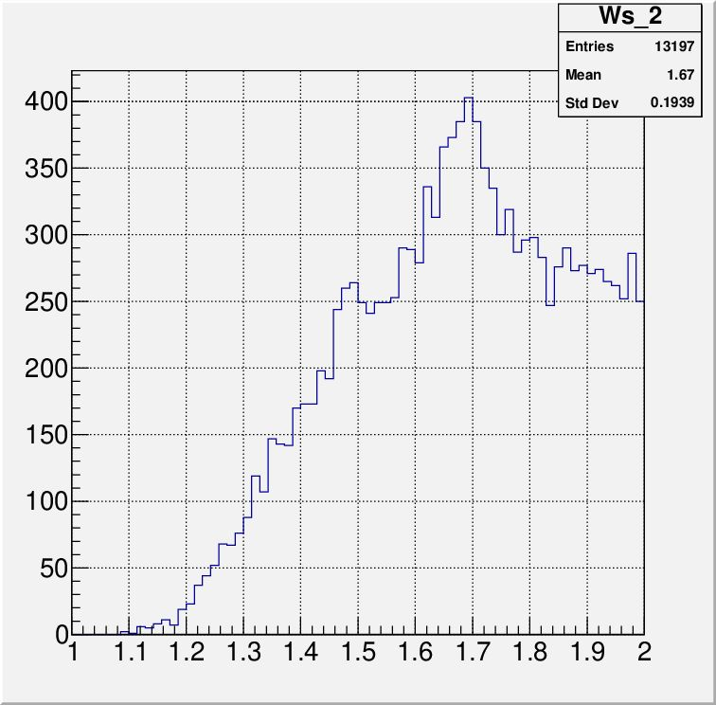
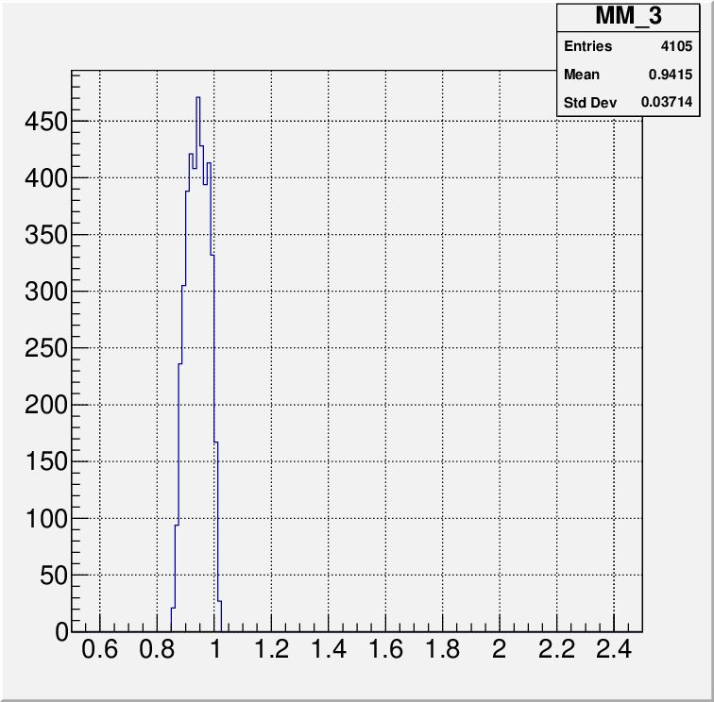
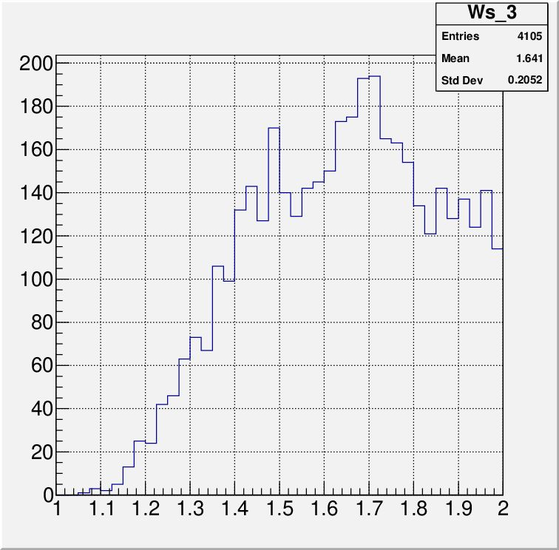
W-distributions of the Selected π⁺n Exclusive Events in Different Q²-intervals
Q²<2 GeV²
W, GeV
MM(n), GeV
W-distributions demonstrate
the structures corresponded to the second and third resonance regions. The structure become more pronounced as Q² increases
2<Q²<3.5 GeV²
W, GeV
MM(n), GeV
Q²>3.5 GeV²
W, GeV
MM(n), GeV

