Slide 1
Overview of CLAS12 Run Group K Experiments
Joshua Artem Tan
on behalf of CLAS Collaboration Run Group K
JLAB User’s Group Meeting
July 11, 2019
Notes:
.

Slide 2
Outline
Introduction to CLAS12 Run Group K
$N^{∗}$ Studies via $KY$ Electroproduction
$π^{+}n$ Exclusive Events from CLAS12
Hunting for Glue in Excited Baryons
Deeply Virtual Compton Scattering
Future Run Group K Experiments

Slide 3
Introduction to CLAS12 Run Group K
Forward Detector
Central Detector
Inclusive Spectrum:
$$Q^{2}=−q^{2}$$
$$W=\sqrt{{\left(q+p\right)}^{2}}$$
Particle ID
Run Group K:
Run at 6.5 GeV and 7.5 GeV in Dec. 2018
Acquired 7% of approved beam time
Longitudinally polarized electrons on unpolarized H₂ target

Slide 4
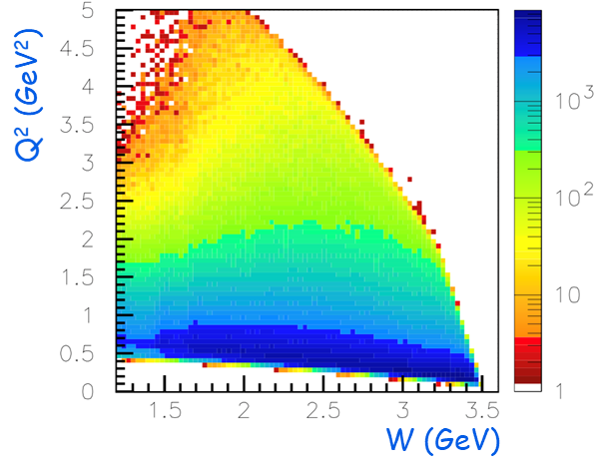
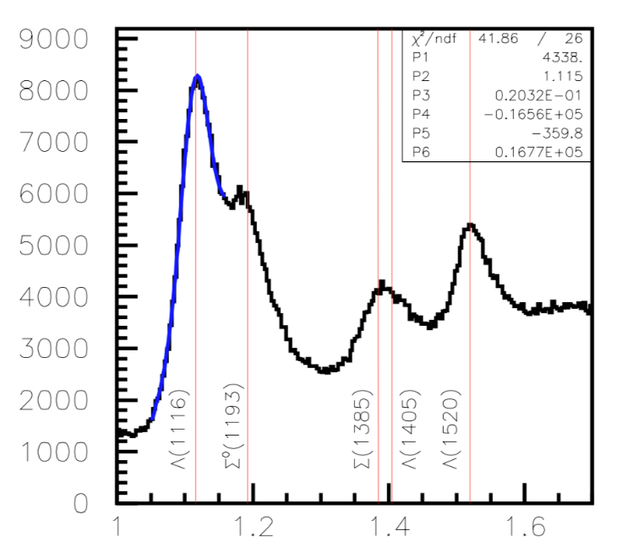
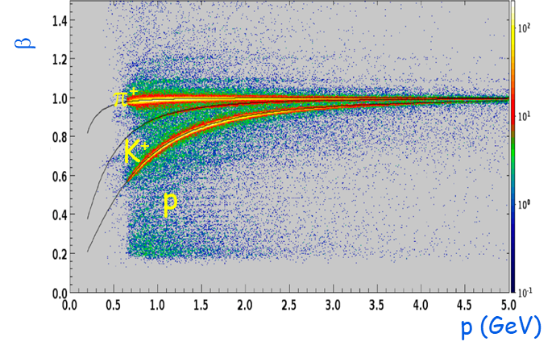
$N^{∗}$ Studies via $KY$ Electroproduction
Kinematic Coverage
$$MM\left(e^{′}K^{+}\right)$$
Particle ID
Run Group K:
Extraction of $γ_{v}pN^{∗}$electrocouplings from $KY$ electroproduction off protons.
Comparison with the results from $Nπ$, $π^{+}π^{−}p$electroproduction off protons.
Explore the interplay between meson-baryon and quark degrees of freedom in the $N^{∗}$ structure.
Shed light on dynamics of dressed quark mass generation and di-quark correlations in different excited nucleon states.
A unique experimental input on many facets of strong QCD in generation of the excited nucleon states of different structural features.

Slide 5
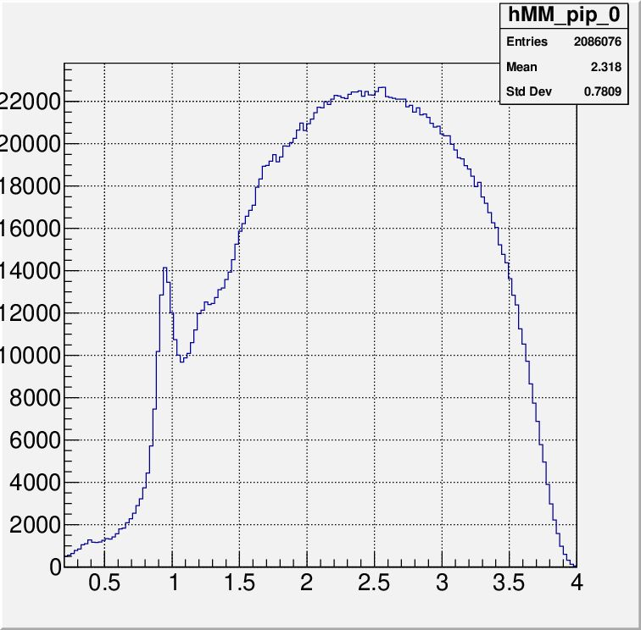
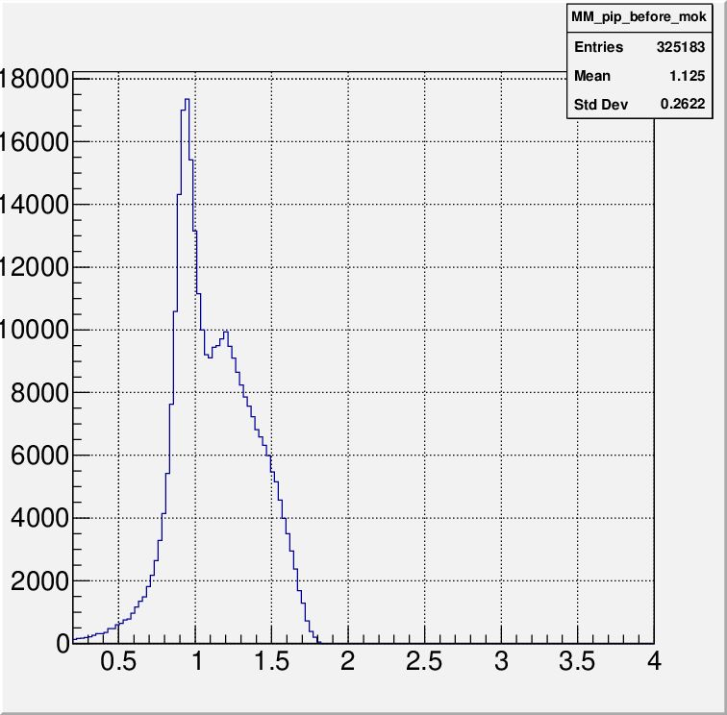
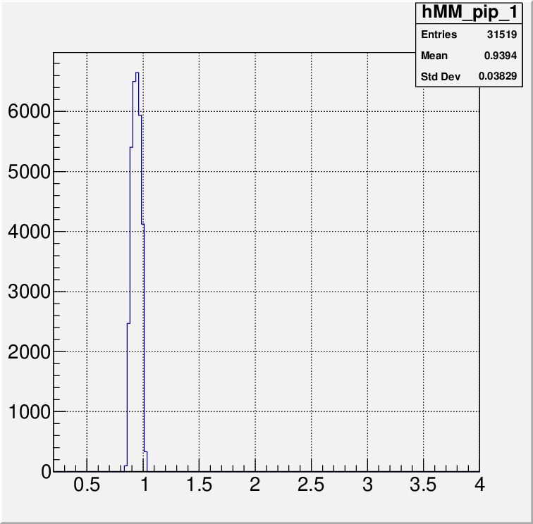
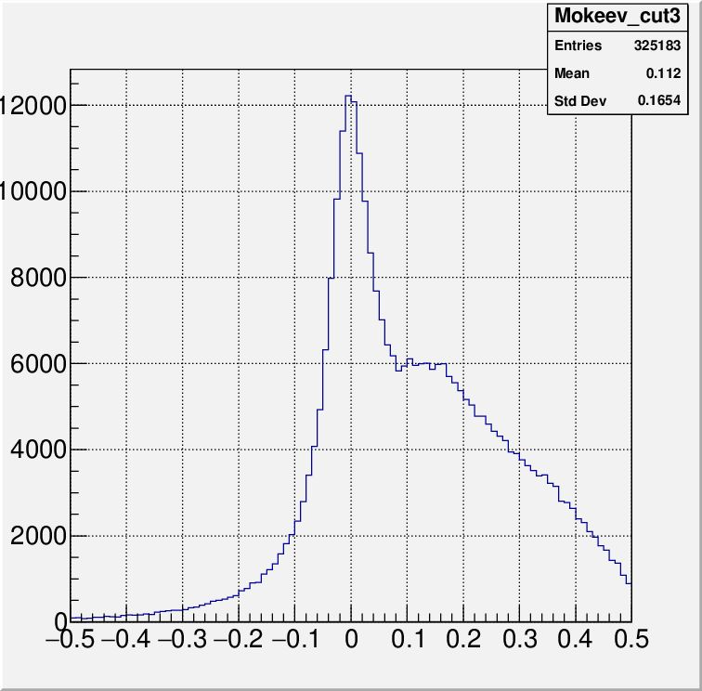
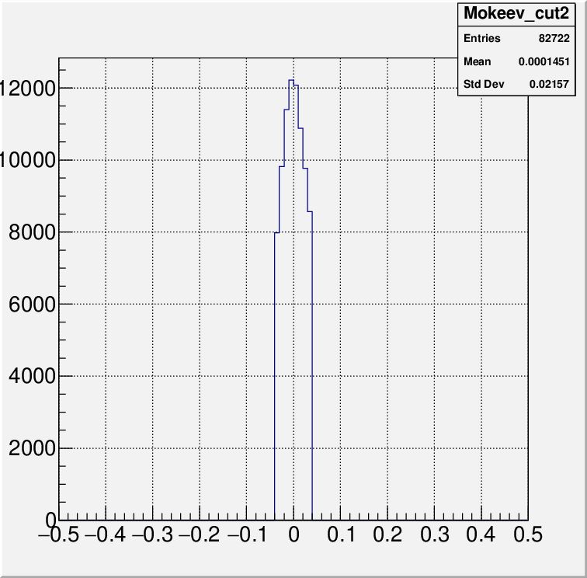
$π^{+}n$ Exclusive Events from CLAS12
No Cuts on $π^{+}$
+ Cuts # 1-6
+ Cuts # 7
Missing Mass $MM\left(n\right)$: $ep→e^{′}π^{+}X$
After Cuts # 1-6
After Cuts # 7
$$E_{mes}−E_{π^{+}}$$
Events are selected based on these criteria: (1) exactly one $π^{+}$; (2) track quality check; (3) $π^{+}$ momentum > 0.2 GeV; (4) $π^{+}$ should be detected by forward detector (FD); (5) no other charged hadrons except $π^{+}$; (6) $W$ < 2 GeV; and, (7) measured $π^{+}$ energy in CM $E_{mes}$ should coincide with the computed $E_{π^{+}}$ from $W$-values determined from the scattered $e^{−}$ momentum:
$E_{π^{+}}=\frac{W^{2}+{M_{π^{+}}}^{2}+{M_{n}}^{2}}{2W}$.

Slide 6
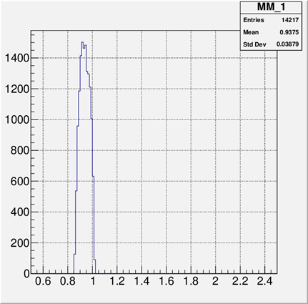
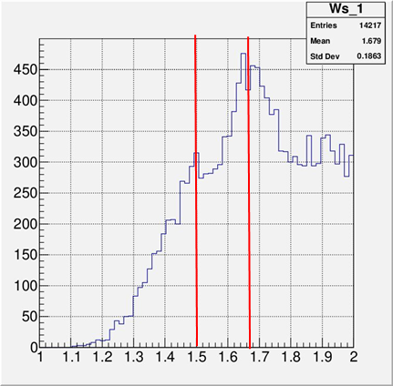
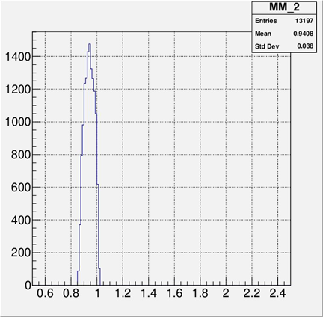
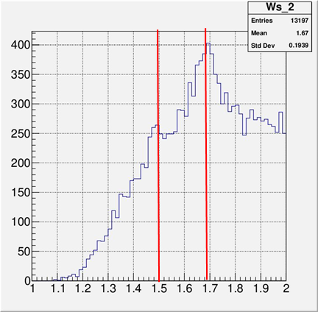
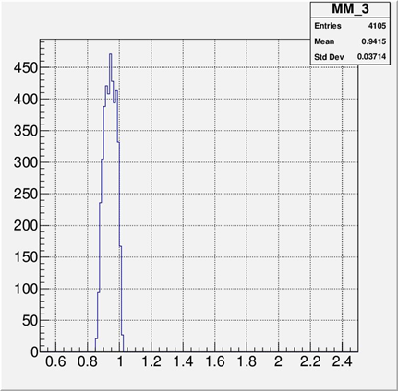
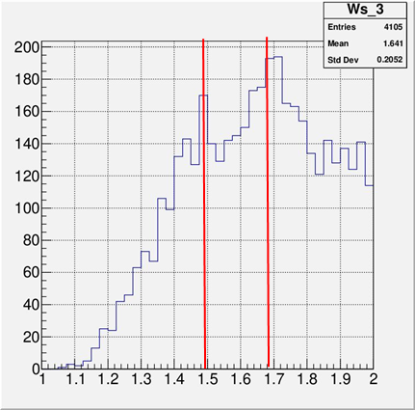
$W$ of Selected $π^{+}n$ Exclusive Events
$Q^{2}$ < 2 GeV²
2 < $Q^{2}$ < 2 GeV²
$MM\left(n\right)$ [GeV]
$W$ [GeV]
$MM\left(n\right)$ [GeV]
$W$ [GeV]
$Q^{2}$ > 3.5 GeV²
$MM\left(n\right)$ [GeV]
$W$ [GeV]
$MM(n)$ and $W$ distributions of the Selected $π^{+}n$ Exclusive Events in Different $Q^{2}$ Intervals
$W$ distributions demonstrate the structures corresponding to the second and third resonance regions. The structure become more pronounced as $Q^{2}$ increases

Slide 7
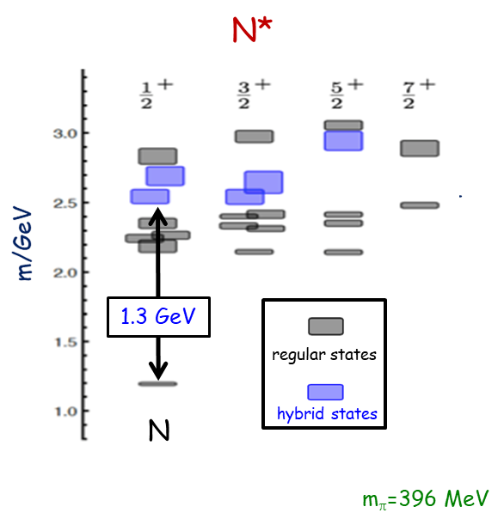
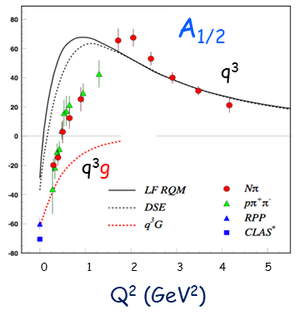
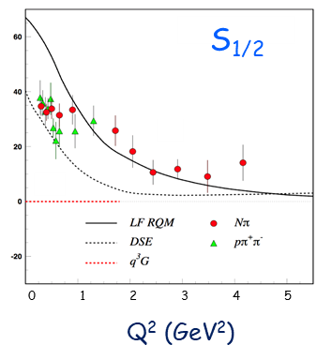
Hunting for Glue in Excited Baryons
Results and Predictions for $N\left(1440\right){1/2}^{+}$
JLAB LQCD Group Results
Possibility of glue as a structural component of excited baryon states:
$N^{∗}$ spectrum from Lattice QCD predicts the existence of hybrid baryons.
The hybrid nature of baryons appears in the $Q^{2}$ evolution of their transition amplitudes.
CLAS12 is the ideal laboratory to perform the search.

Slide 8
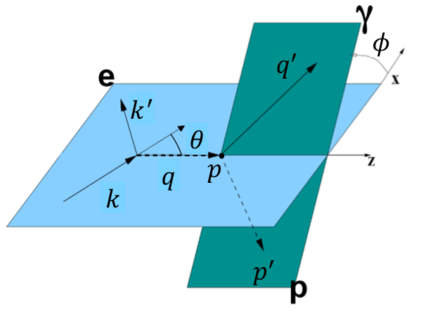
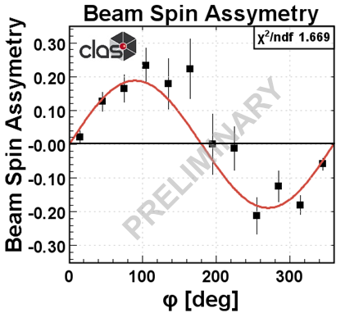
Deeply Virtual Compton Scattering
DVCS Kinematics:
$$A_{LU}\left(φ\right)∝s_{1,unp}^{ℐ}\sin\left(φ\right)$$
$$A_{LU}\left(φ\right)=\frac{1}{ε}\frac{N^{↑}\left(φ\right)−N^{↓}\left(φ\right)}{N^{↑}\left(φ\right)+N^{↓}\left(φ\right)}$$
Kinematic Coverage
Beam Spin Asymmetry
Deeply virtual Compton scattering (DVCS) at 6.5 and 7.5 GeV polarized electron beam:
Measure beam spin asymmetry describing DVCS and Bethe-Heitler (BH) interference term for unpolarized target
Access chiral-even GPDs: $H^{q}$, ${\tilde{H}}^{q}$, and $E^{q}$

Slide 9
Future Run Group K Experiments

Slide 10
Thank You!!!

