Slide 1
RG-K DVCS Analysis:
Beam Spin Asymmetry Measurements at 6.5 GeV and 7.5 GeV
Joshua Artem Tan
23 June 2025

Slide 2
Contents
Introduction
Experiment
Fiducial Cuts
Kinematic Corrections
Event Selection
Raw Beam Spin Asymmetry
DV$π^{0}$P Contamination Subtraction
Systematic Errors
Fully Corrected BSA
Summary

Slide 3
Introduction

Slide 4
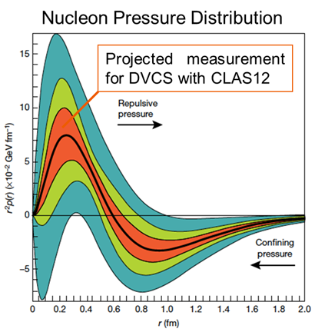
Towards GPDs to GFFs
$H$GPD to
$d_{1}\left(t\right)$GFF
Deeply Virtual Compton Scattering (DVCS) provides cleanest access to GPDs. Beam Spin Asymmetry is particularly sensitive to $H$GPD from which the GFF $d_{1}\left(t\right)$ can be extracted.

Slide 5
$ep→e^{′}p^{′}γ$ Reaction
$${\left|𝒯\right|}^{2}={\left|𝒯_{DVCS}\right|}^{2}+{\left|𝒯_{BH}\right|}^{2}+ℐ$$
$$A_{LU}\left(φ\right)=\frac{dσ^{↑}\left(φ\right)−dσ^{↓}\left(φ\right)}{dσ^{↑}\left(φ\right)+dσ^{↓}\left(φ\right)}⟹A_{LU}\left(φ\right)≈\frac{x_{B}{\left(1+ε^{2}\right)}^{2}}{y}\frac{s_{1,unp}^{ℐ}\sin\left(φ\right)}{c_{0,unp}^{BH}+c_{1,unp}^{BH}\cos\left(φ\right)}$$
$$α≡\frac{x_{B}{\left(1+ε^{2}\right)}^{2}s_{1,unp}^{ℐ}}{yc_{0,unp}^{BH}},β≡\frac{c_{1,unp}^{BH}}{yc_{0,unp}^{BH}}⟹A_{LU}\left(φ\right)≈\frac{α\sin\left(φ\right)}{1+β\cos\left(φ\right)}$$
$$α∝ℑ𝔪\left[F_{1}ℋ+\frac{x_{B}}{2−x_{B}}\left(F_{1}+F_{2}\right)\tilde{ℋ}−\frac{∆^{2}}{4M^{2}}F_{2}ℰ\right]$$
BSA is an observable measured from the DVCS-BH interference term of $ep→e^{′}p^{′}γ$ reaction’s scattering amplitude.

Slide 6
Beam Spin Asymmetry
$$A_{LU} =\frac{1}{P}\frac{N^{+}−N^{−}}{N^{+}+N^{−}}$$
BSA shows the relative cross-section difference of positive and negative beam helicity events as function of the separation angle between the lepton and the reaction planes.

Slide 7
Experiment

Slide 8
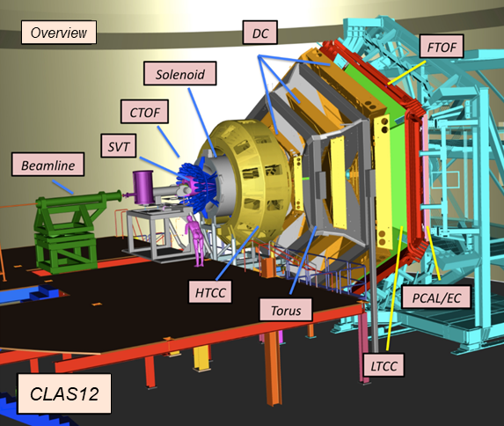
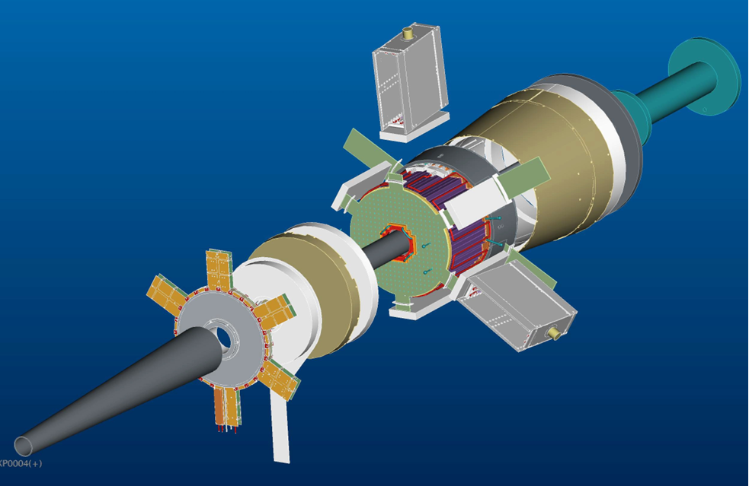
CLAS12 Configuration
FT
6.5 GeV experiment was performed with the Forward Tager (FT) off, and 7.5 GeV experiment was run with FT on.

Slide 9
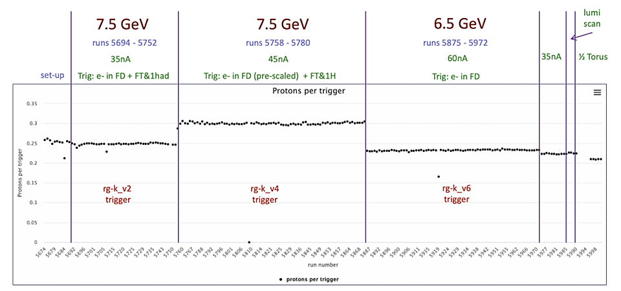
Run Conditions
6.5 GeV beam was measured with 85.17±1.49% polarization and 7.5 GeV beam had 86.17±1.49% polarization.

Slide 10
Fiducial Cuts

Slide 11
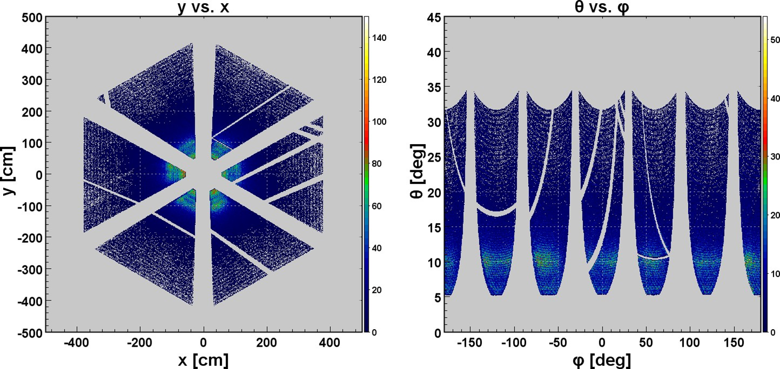
ECal Fiducial Cuts
ECal fiducial was defined by cutting off the “rough” edges and regions corresponding to faulty channels on the hit map.

Slide 12
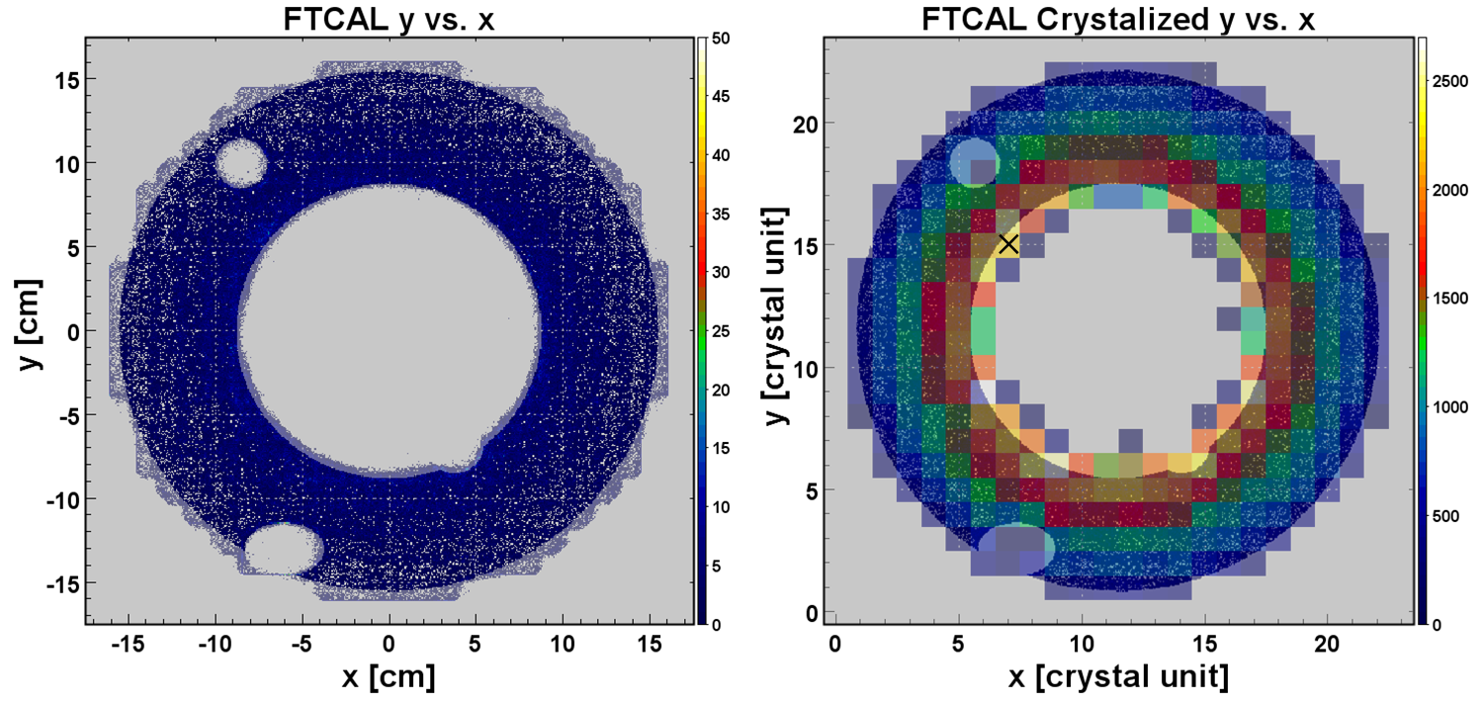
FTCal Fiducial Cuts
FTCal fiducial was trimmed to exclude both “rough” edges and pixels corresponding to faulty channels on the hit map.

Slide 13
Kinematic Corrections

Slide 14
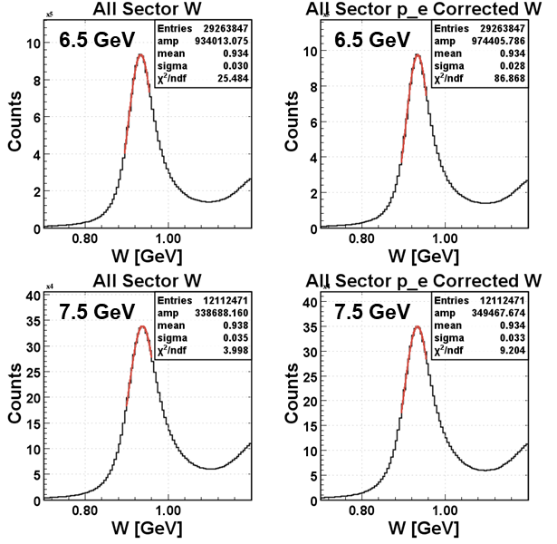
Electron Momentum Correction
These elastic-channel-based corrections were implemented by parameterizing $δW$ in lab-frame $θ$ and $φ$ of the scattered $e$.

Slide 15
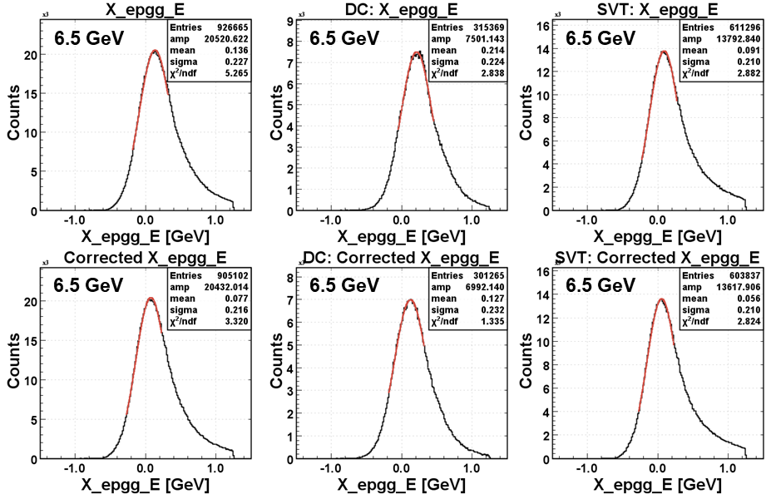
Proton Momentum Correction
These corrections were implemented by parameterizing $δE_{X}$ in lab-frame $θ$ and $φ$ of $p^{′}$ from exclusive $ep→e^{′}p^{′}{\left(γγ\right)}_{π^{0}}$.

Slide 16
Event Selection

Slide 17
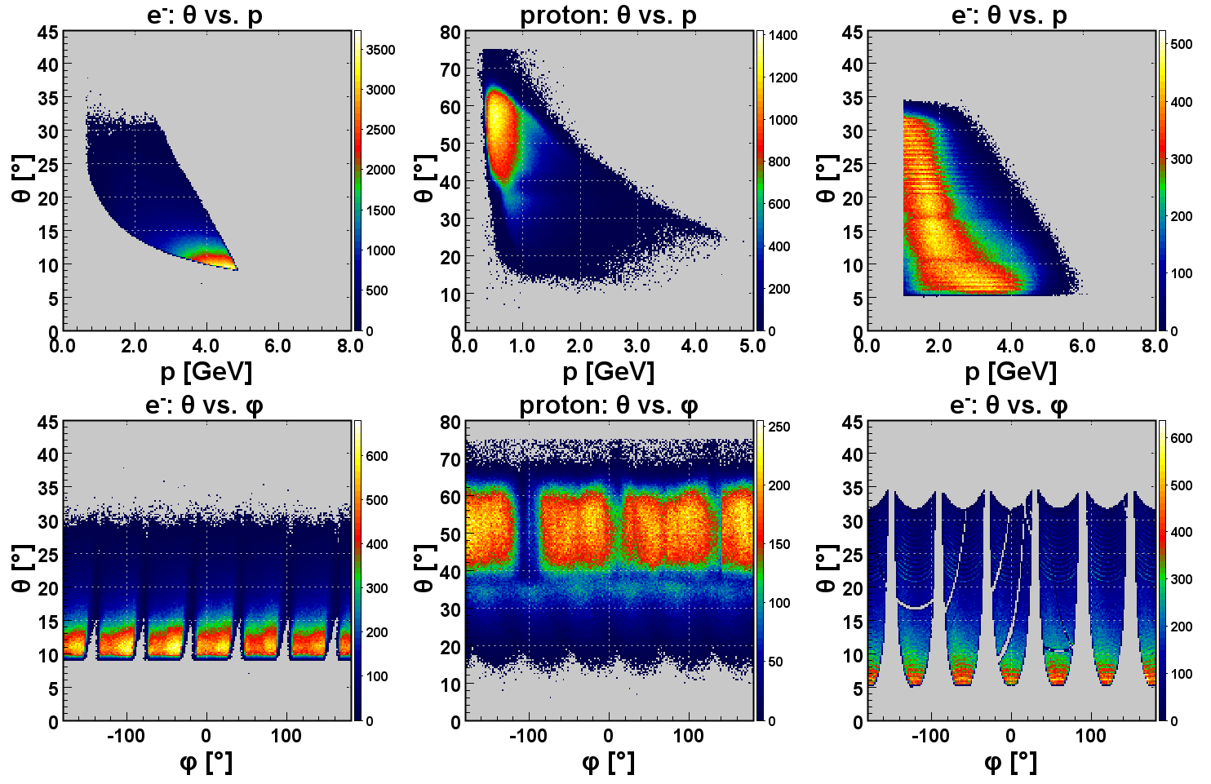
6.5 GeV Acceptance

Slide 18
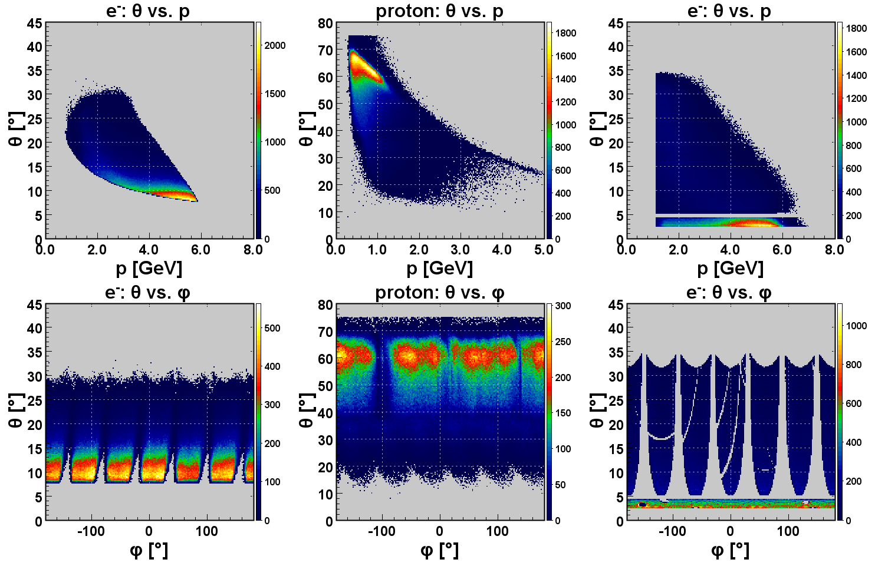
7.5 GeV Acceptance

Slide 19
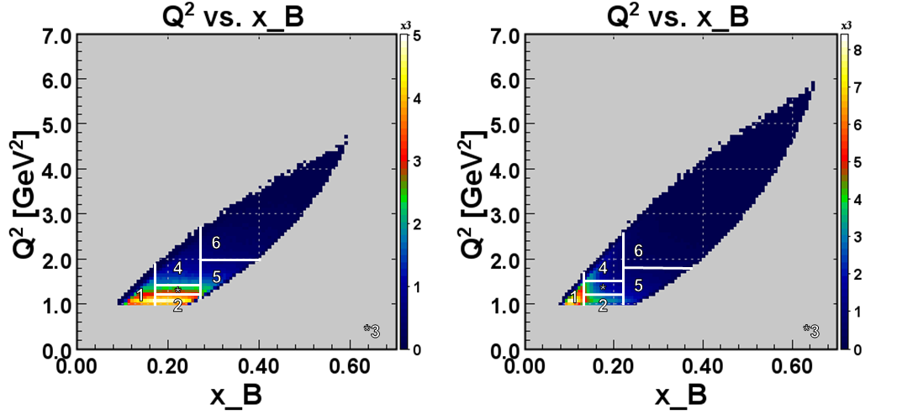
$Q^{2}$-$x_{B}$ Bins
6.5 GeV
7.5 GeV
Bins were chosen to contain the same magnitude of the number of events.

Slide 20
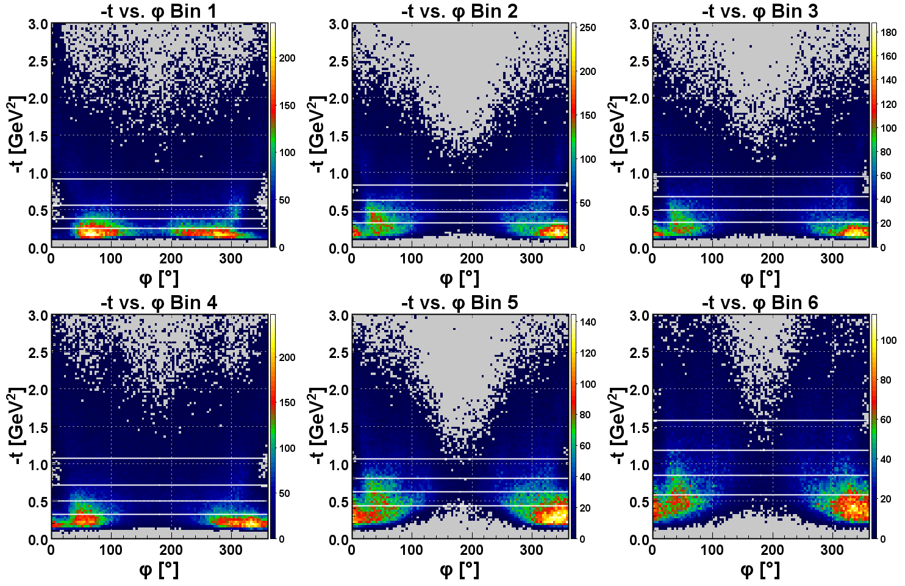
6.5 GeV $−t$ Bins

Slide 21
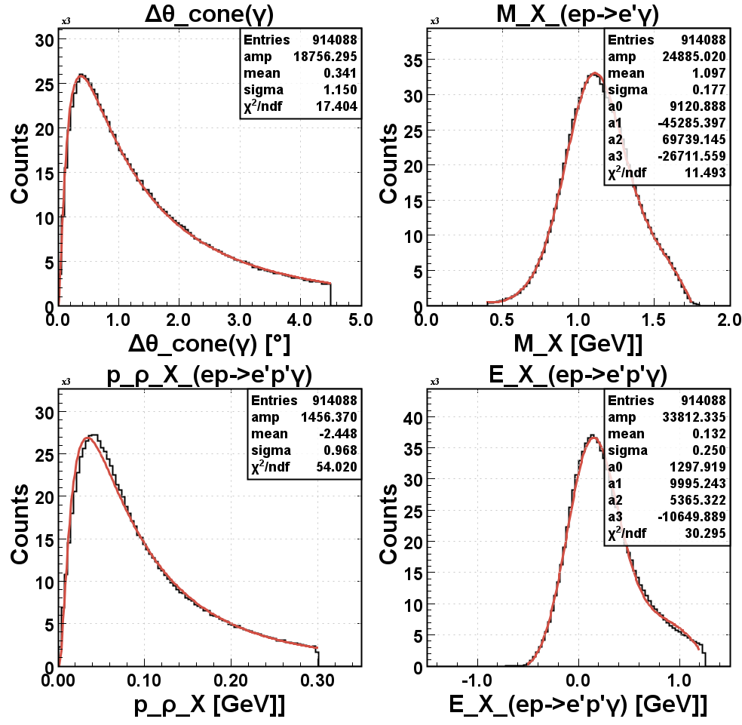
6.5 GeV Exclusivity Cuts
$$∆θ=\cos^{−1}{\frac{\vec{q^{′}}{\vec{q^{′}}}_{miss}}{\left|\vec{q}\right|\left|{\vec{q^{′}}}_{miss}\right|}}$$
$$M_{p_{miss}^{′}}=\sqrt{p_{miss}^{′}{∙p}_{miss}^{′}}$$
$$X_{miss⊥}$$
$$E_{X_{miss}}$$
Four kinematic cuts based on the exclusivity of the $ep→e^{′}p^{′}γX$ reaction, with $X$ as the missing particle, were implemented.

Slide 22
6.5 GeV $∆θ$and $M_{p_{miss}^{′}}$ Cuts
For each $\left(Q^{2},x_{B},−t\right)$ bin, $<e^{μ+σ}$ cut was implemented for $∆θ$ and $μ±2σ$ for $M_{p_{miss}^{′}}$.

Slide 23
6.5 GeV $X_{miss⊥}$ and $E_{X_{miss}}$ Cuts
$\left(Q^{2},x_{B},−t\right)$-bin-dependent cuts of $<e^{μ+σ}$ for $X_{miss⊥}$ and $μ±2σ$ for $E_{X_{miss}}$ were implemented.

Slide 24
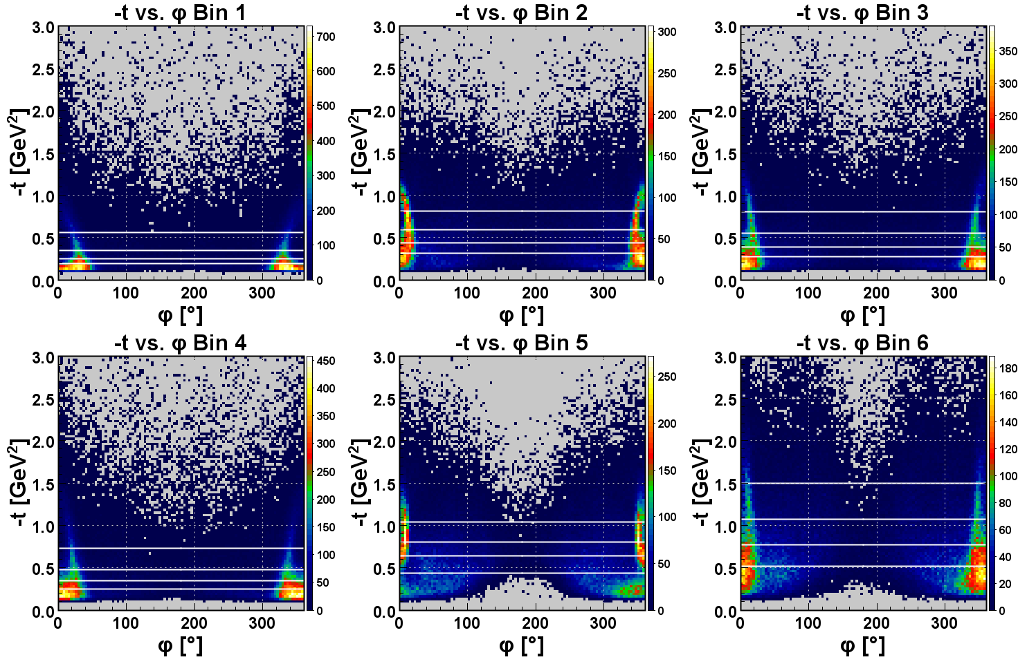
7.5 $−t$ Bins

Slide 25
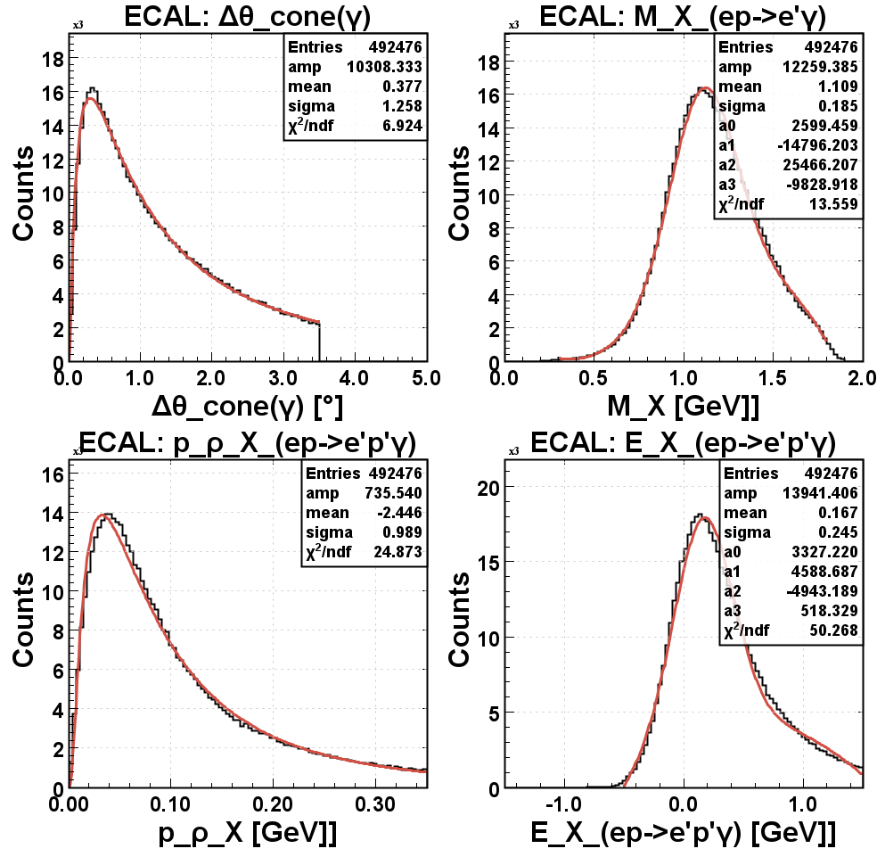
7.5 GeV ECal Exclusivity Cuts
$$∆θ=\cos^{−1}{\frac{\vec{q^{′}}{\vec{q^{′}}}_{miss}}{\left|\vec{q}\right|\left|{\vec{q^{′}}}_{miss}\right|}}$$
$$M_{p_{miss}^{′}}=\sqrt{p_{miss}^{′}{∙p}_{miss}^{′}}$$
$$X_{miss⊥}$$
$$E_{X_{miss}}$$
Kinematic cuts based on $ep→e^{′}p^{′}γX$ reaction, with $X$ as the missing particle and $γ$ in ECal, were implemented.

Slide 26
7.5 GeV ECal $∆θ$and $M_{p_{miss}^{′}}$ Cuts
For each $\left(Q^{2},x_{B},−t\right)$ bin with $γ$ in ECal, $<e^{μ+σ}$ cut was implemented for $∆θ$ and $μ±2σ$ for $M_{p_{miss}^{′}}$.

Slide 27
7.5 GeV ECal $X_{miss⊥}$ and $E_{X_{miss}}$ Cuts
$\left(Q^{2},x_{B},−t\right)$-bin-dependent cuts of $<e^{μ+σ}$ for $X_{miss⊥}$ and $μ±2σ$ for $E_{X_{miss}}$ were implemented to events with $γ$ in ECal.

Slide 28
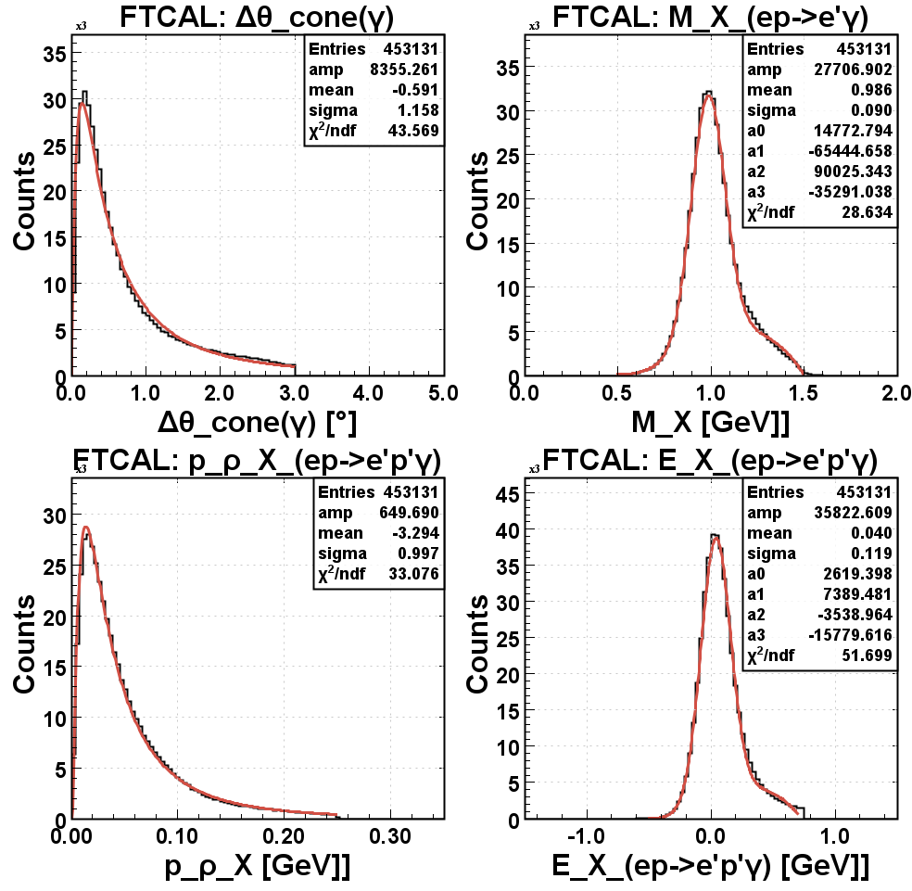
7.5 GeV FTCal Exclusivity Cuts
$$∆θ=\cos^{−1}{\frac{\vec{q^{′}}{\vec{q^{′}}}_{miss}}{\left|\vec{q}\right|\left|{\vec{q^{′}}}_{miss}\right|}}$$
$$M_{p_{miss}^{′}}=\sqrt{p_{miss}^{′}{∙p}_{miss}^{′}}$$
$$X_{miss⊥}$$
$$E_{X_{miss}}$$
Same cuts based on $ep→e^{′}p^{′}γX$ reaction, with $X$ as the missing particle but with $γ$ in FTCal, were implemented.

Slide 29
7.5 GeV FTCal $∆θ$and $M_{p_{miss}^{′}}$ Cuts
For each $\left(Q^{2},x_{B},−t\right)$ bin with $γ$ in FTCal, $<e^{μ+σ}$ cut was implemented for $∆θ$ and $μ±2σ$ for $M_{p_{miss}^{′}}$.

Slide 30
7.5 GeV FTCal $X_{miss⊥}$ and $E_{X_{miss}}$ Cuts
$\left(Q^{2},x_{B},−t\right)$-bin-dependent cuts of $<e^{μ+σ}$ for $X_{miss⊥}$ and $μ±2σ$ for $E_{X_{miss}}$ were implemented to events with $γ$ in FTCal.

Slide 31
Raw
Beam Spin Asymmetry

Slide 32
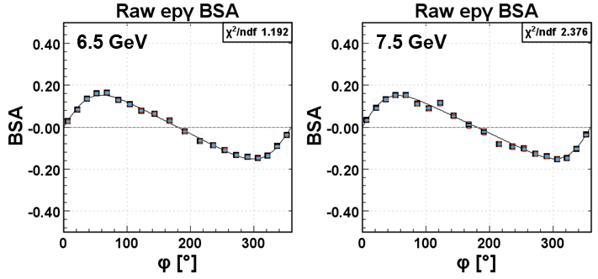
Integrated Raw BSA
$$A=\frac{α\sin{φ}}{1+β\cos{φ}}$$
$$A=\frac{α\sin{φ}}{1+β\cos{φ}}$$
$α$ 0.132±0.002
$β$ -0.496±0.021
$\frac{χ^{2}}{ndf}$ 1.192
$α$ 0.126±0.003
$β$ -0.548±0.020
$\frac{χ^{2}}{ndf}$ 2.376
Statistical
Systematic
Quadrature
Raw BSA includes BSA contribution from DV$π^{0}$P events detected with only one $γ$.

Slide 33
6.5 GeV Raw BSA $α$
$x_{B}$ < 0.17
0.17 ≤ $x_{B}$ < 0.27 :
$Q^{2}$ < 1.2 GeV²
1.2 GeV² ≤ $Q^{2}$ < 1.4 GeV²
1.4 GeV² ≤ $Q^{2}$
0.27 ≤ $x_{B}$ :
$Q^{2}$ < 2.0 GeV²
2.0 GeV² ≤ $Q^{2}$
Raw BSA $α$also includes contribution from DV$π^{0}$P events detected with only one $γ$.

Slide 34
7.5 GeV Raw BSA $α$
B
A
$x_{B}$ < 0.13
0.13 ≤ $x_{B}$ < 0.22 :
$Q^{2}$ < 1.2 GeV²
1.2 GeV² ≤ $Q^{2}$ < 1.5 GeV²
1.5 GeV² ≤ $Q^{2}$
0.22 ≤ $x_{B}$ :
$Q^{2}$ < 1.8 GeV²
1.8 GeV² ≤ $Q^{2}$
“Out-of-trend” measurements can be distinguished even at the early stage of BSA $α$(A and B) extraction.

Slide 35
DV$π^{0}$P Contamination Subtraction

Slide 36
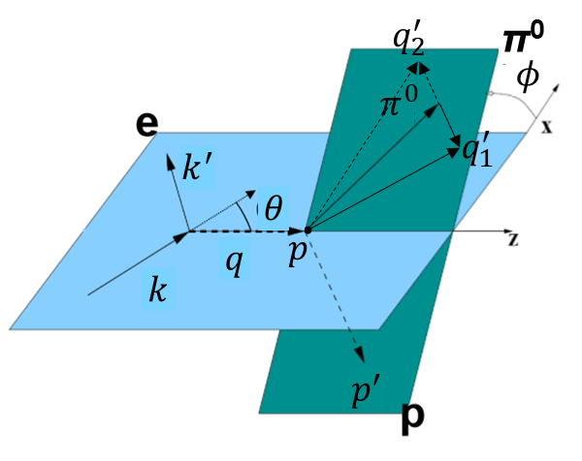
$ep→e^{′}p^{′}{\left(γγ_{miss}\right)}_{π^{0}}$ Contaminants
$$r={\left.\frac{N_{π^{0}\left(γ\right)}}{N_{π^{0}\left(γγ\right)}}\right|}_{dat}={\left.\frac{N_{π^{0}\left(γ\right)}}{N_{π^{0}\left(γγ\right)}}\right|}_{sim}$$
$$f=r\frac{N_{π^{0}\left(γγ\right)}}{N_{epγ}}$$
$$A=\frac{1}{1−f}\left(A_{epγ}−fA_{π^{0}\left(γγ\right)}\right)$$
Exclusive DV$π^{0}$P event is misidentified as DVCS when one of its final-state photons ($γ_{miss}$) has sufficiently low energy and lands outside the detector’s acceptance.

Slide 37
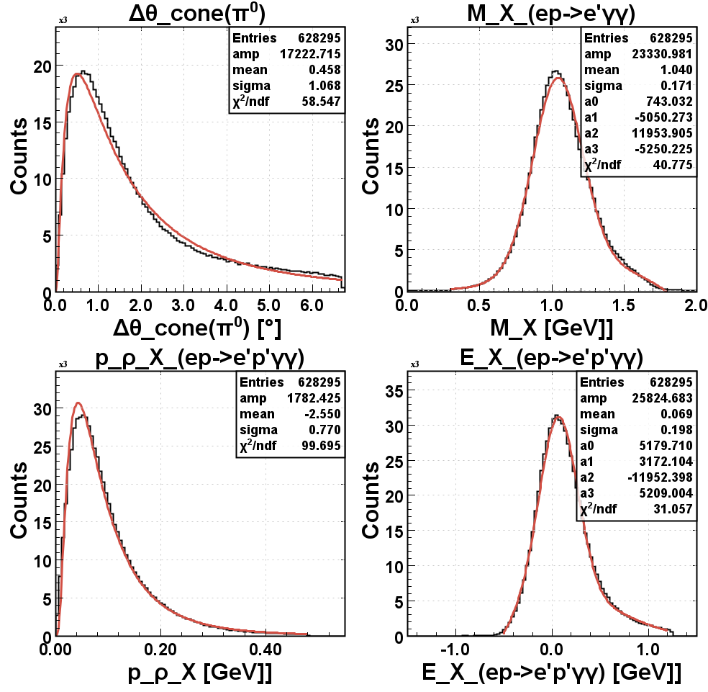
6.5 GeV DV$π^{0}$P Cuts
$$∆θ=\cos^{−1}{\frac{\vec{π^{0}}{\vec{π^{0}}}_{miss}}{\left|\vec{π^{0}}\right|\left|{\vec{π^{0}}}_{miss}\right|}}$$
$$M_{p_{miss}^{′}}=\sqrt{p_{miss}^{′}{∙p}_{miss}^{′}}$$
$$X_{miss⊥}$$
$$E_{X_{miss}}$$
The kinematic cuts were adopted based on the exclusivity of the $ep→e^{′}p^{′}{\left(γγ\right)}_{π^{0}}X$ reaction.

Slide 38
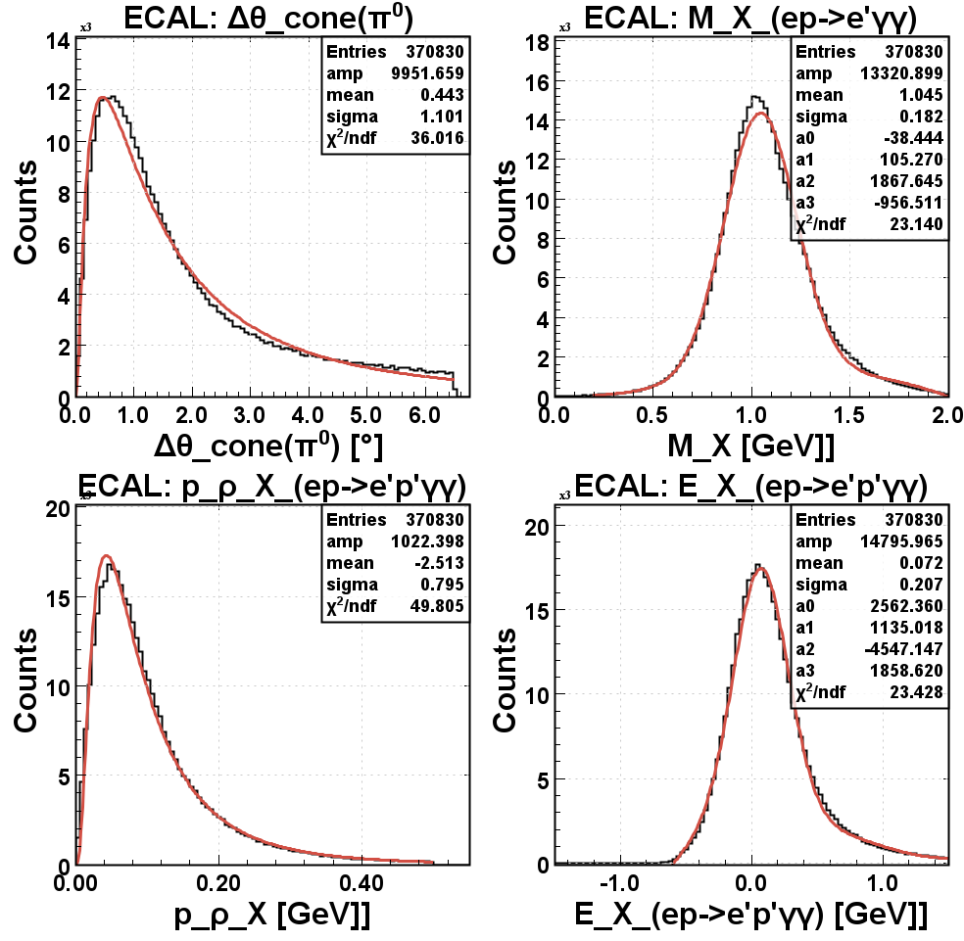
7.5 GeV ECal-ECal Cuts
$$∆θ=\cos^{−1}{\frac{\vec{π^{0}}{\vec{π^{0}}}_{miss}}{\left|\vec{π^{0}}\right|\left|{\vec{π^{0}}}_{miss}\right|}}$$
$$M_{p_{miss}^{′}}=\sqrt{p_{miss}^{′}{∙p}_{miss}^{′}}$$
$$X_{miss⊥}$$
$$E_{X_{miss}}$$
One set of cuts for $ep→e^{′}p^{′}{\left(γγ\right)}_{π^{0}}X$ requires both final-state photons to hit ECal.

Slide 39
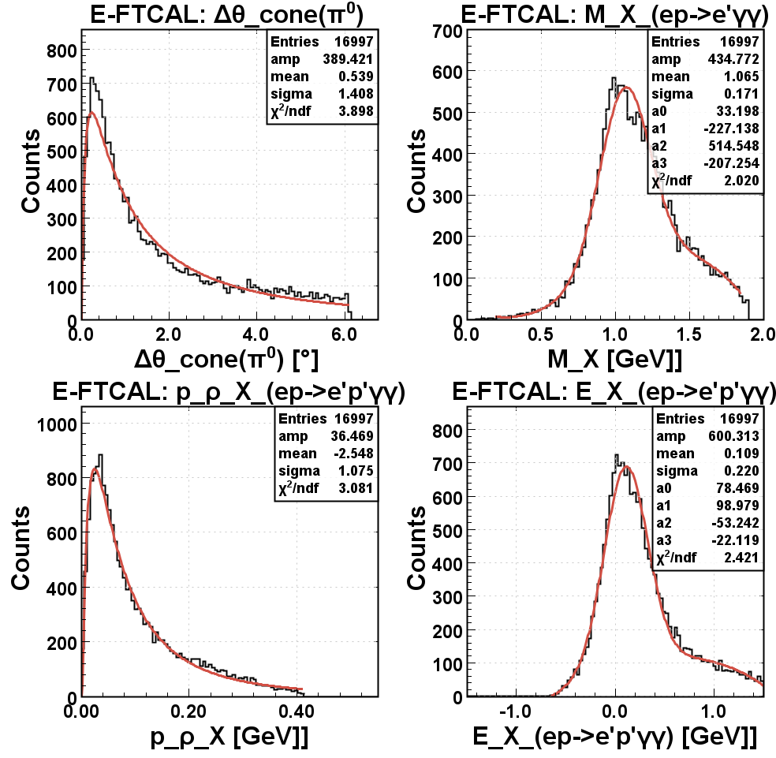
7.5 GeV ECal-FTCal Cuts
$$∆θ=\cos^{−1}{\frac{\vec{π^{0}}{\vec{π^{0}}}_{miss}}{\left|\vec{π^{0}}\right|\left|{\vec{π^{0}}}_{miss}\right|}}$$
$$M_{p_{miss}^{′}}=\sqrt{p_{miss}^{′}{∙p}_{miss}^{′}}$$
$$X_{miss⊥}$$
$$E_{X_{miss}}$$
In $ep→e^{′}p^{′}{\left(γγ\right)}_{π^{0}}X$ reaction, one photon can hit ECal while the other lands on FTCal.

Slide 40
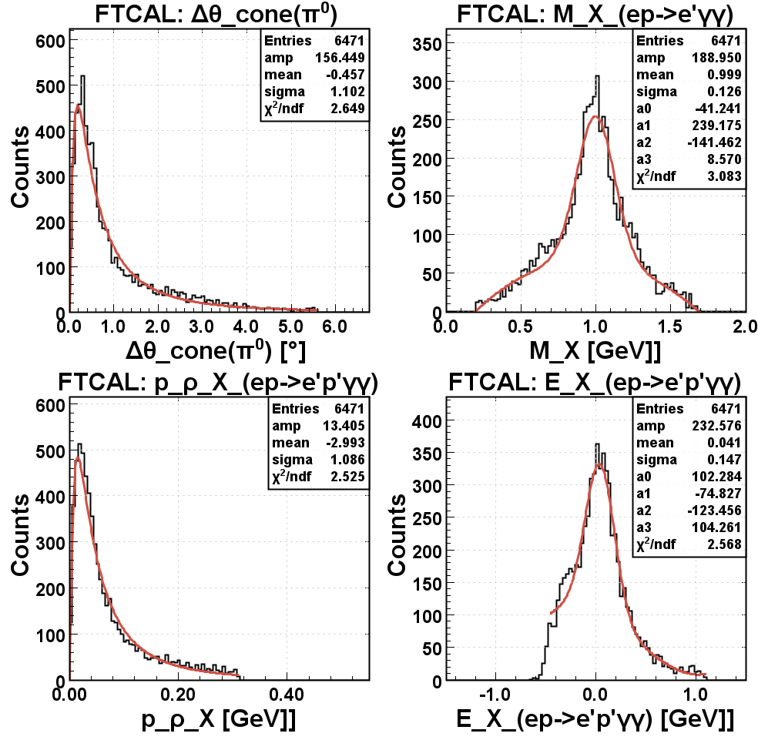
7.5 GeV FTCal-FTCal Cuts
$$∆θ=\cos^{−1}{\frac{\vec{π^{0}}{\vec{π^{0}}}_{miss}}{\left|\vec{π^{0}}\right|\left|{\vec{π^{0}}}_{miss}\right|}}$$
$$M_{p_{miss}^{′}}=\sqrt{p_{miss}^{′}{∙p}_{miss}^{′}}$$
$$X_{miss⊥}$$
$$E_{X_{miss}}$$
The third possible set of cuts for $ep→e^{′}p^{′}{\left(γγ\right)}_{π^{0}}X$ requires both final-state photons to hit FTCal.

Slide 41
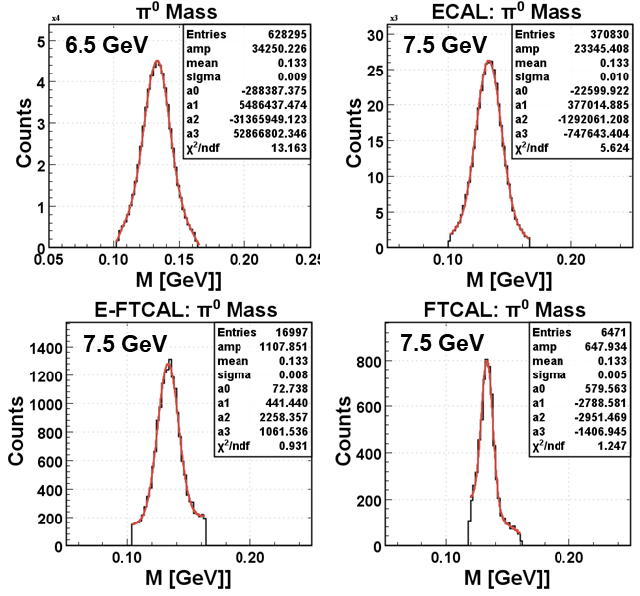
$π^{0}$Mass Cuts
$π^{0}$mass distributions rely mainly on the calorimeter resolutions.

Slide 42
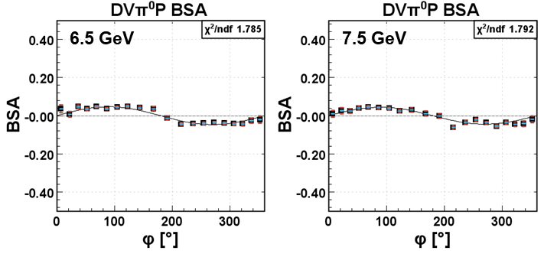
Integrated DV$π^{0}$P BSA
$A$=$α\sin{φ}$
$A$=$α\sin{φ}$
$α$ 0.047±0.002
$\frac{χ^{2}}{ndf}$ 1.785
$α$ 0.044±0.003
$\frac{χ^{2}}{ndf}$ 1.792
In the leading order DV$π^{0}$P BSA only includes the $\sin{φ}$ term.

Slide 43
6.5 GeV DV$π^{0}$P BSA $α$
$x_{B}$ < 0.17
0.17 ≤ $x_{B}$ < 0.27 :
$Q^{2}$ < 1.2 GeV²
1.2 GeV² ≤ $Q^{2}$ < 1.4 GeV²
1.4 GeV² ≤ $Q^{2}$
0.27 ≤ $x_{B}$ :
$Q^{2}$ < 2.0 GeV²
2.0 GeV² ≤ $Q^{2}$
The same $\left(Q^{2},x_{B},−t\right)$ bins were adopted for DV$π^{0}$P BSA analysis section.

Slide 44
7.5 GeV DV$π^{0}$P BSA $α$
$x_{B}$ < 0.13
0.13 ≤ $x_{B}$ < 0.22 :
$Q^{2}$ < 1.2 GeV²
1.2 GeV² ≤ $Q^{2}$ < 1.5 GeV²
1.5 GeV² ≤ $Q^{2}$
0.22 ≤ $x_{B}$ :
$Q^{2}$ < 1.8 GeV²
1.8 GeV² ≤ $Q^{2}$
Since the binning was optimized for DVCS, $\left(Q^{2},x_{B},−t\right)$ bins of disproportionately high uncertainties can be observed.

Slide 45
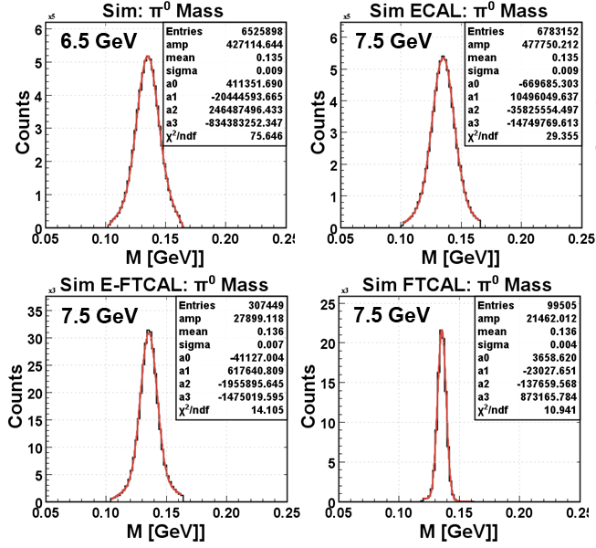
DV$π^{0}$P GEMC Simulations
Detector:
rgk_fall2018_FTOff
Magnetic field:
tor+1.00_sol-100
Background:
60nA_6535MeV
Detector:
rgk_fall2018_FTOn
Magnetic field:
tor+1.00_sol-100
Background:
36.4% at
35nA_7546MeV
63.6% at
45nA_7546MeV
Detector:
rgk_fall2018_FTOn
Magnetic field:
tor+1.00_sol-100
Background:
36.4% at
35nA_7546MeV
63.6% at
45nA_7546MeV
Detector:
rgk_fall2018_FTOn
Magnetic field:
tor+1.00_sol-100
Background:
36.4% at
35nA_7546MeV
63.6% at
45nA_7546MeV
$π^{0}$invariant mass distributions from the simulations are in good agreement with the ones from the data.

Slide 46
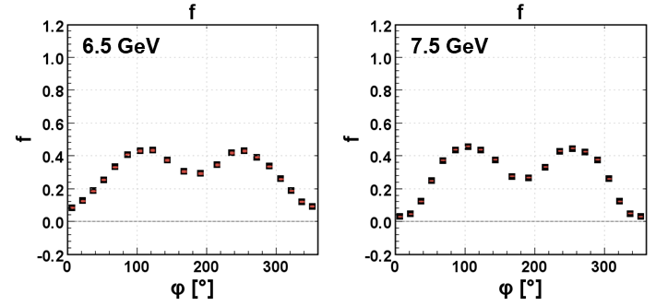
Integrated Fractional Contamination
The fractional contamination $f$ quantifies the contribution of DV$π^{0}$P BSA to $epγ$ BSA. $f$ can also be estimated using fast MC.

Slide 47
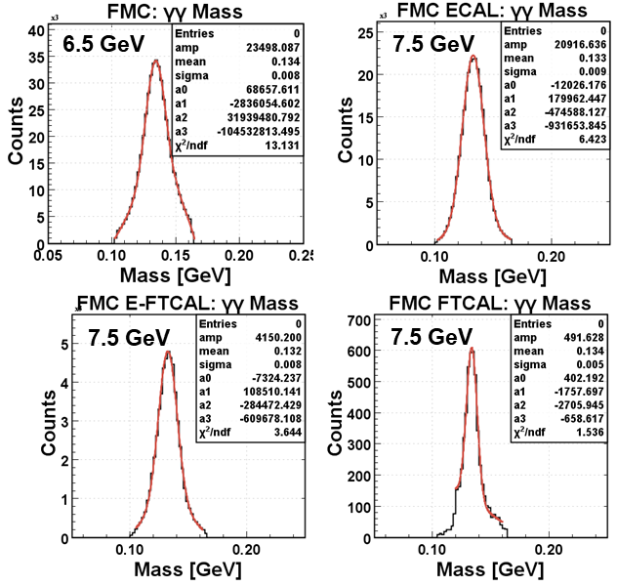
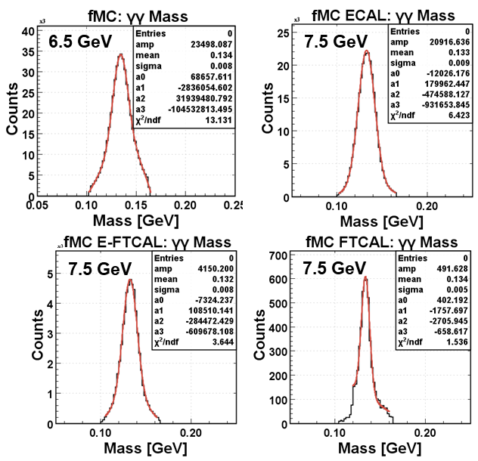
$π^{0}$ Events from Fast MC
Photon resolution smearing produced consistent fMC $π^{0}$ invariant mass distributions.

Slide 48
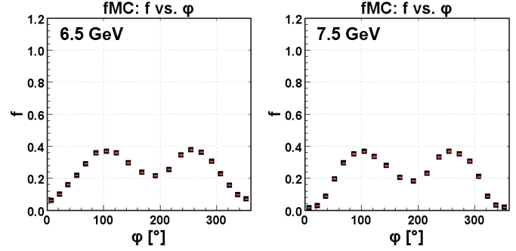
Integrated $f$ from fMC
$f$ estimates from fast MC were in good level of agreement with the estimates from GEMC simulations.

Slide 49
Systematic Errors

Slide 50
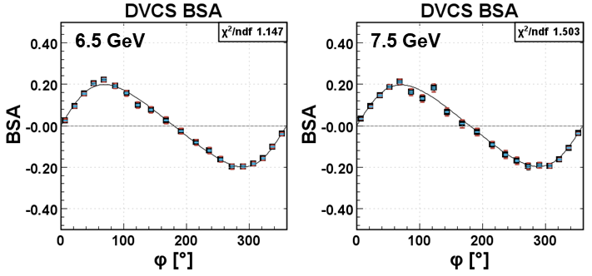
Polarization Uncertainty
$$A=\frac{α\sin{φ}}{1+β\cos{φ}}$$
$$A=\frac{α\sin{φ}}{1+β\cos{φ}}$$
$α$ 0.186±0.004
$β$ -0.349±0.027
$\frac{χ^{2}}{ndf}$ 1.147
$α$ 0.186±0.006
$β$ -0.327±0.030
$\frac{χ^{2}}{ndf}$ 1.503
$E_{beam}$ [GeV] | Fit | Parameters | $$σ_{syst}$$
$$\text{6.535}$$ | $$\frac{α\sin{φ}}{1+β\cos{φ}}$$ | $$α=0.186±0.00412$$ | $$\text{0.000806}$$
 |  | $$β=−0.349±0.0269$$ | $$\text{0.00}\text{156}$$
$$7.546$$ | $$\frac{α\sin{φ}}{1+β\cos{φ}}$$ | $$α=0.186±0.00550$$ | $$\text{0.000}\text{278}$$
 |  | $$β=−0.327±0.0301$$ | $$\text{0.000}\text{182}$$
Systematic variations were calculated in reference to the values obtained without any systematic uncertainty.

Slide 51
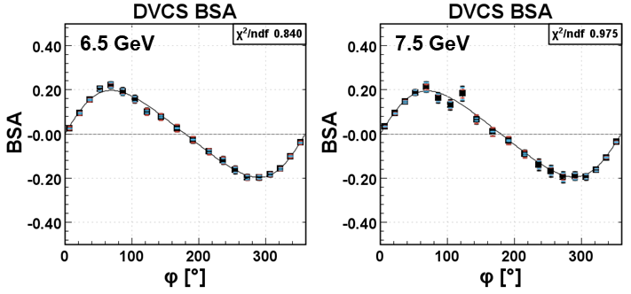
$π^{0}$ Contamination Uncertainty
$$A=\frac{α\sin{φ}}{1+β\cos{φ}}$$
$$A=\frac{α\sin{φ}}{1+β\cos{φ}}$$
$α$ 0.186±0.004
$β$ -0.349±0.027
$\frac{χ^{2}}{ndf}$ 0.840
$α$ 0.186±0.006
$β$ -0.327±0.030
$\frac{χ^{2}}{ndf}$ 0.975
$E_{beam}$ [GeV] | Fit | Parameters | $$σ_{syst}$$
$$\text{6.535}$$ | $$\frac{α\sin{φ}}{1+β\cos{φ}}$$ | $$α=0.185±0.00503$$ | $$\text{0.00}\text{235}$$
 |  | $$β=−0.348±0.0306$$ | $$\text{0.00}\text{0135}$$
$$7.546$$ | $$\frac{α\sin{φ}}{1+β\cos{φ}}$$ | $$α=0.184±0.00748$$ | $$\text{0.00}\text{284}$$
 |  | $$β=−0.336±0.0369$$ | $\text{0.00}$939
Uncertainty in $f$ ($∆f$) collectively includes the convoluted effects of fiducial and exclusivity cut systematics.

Slide 52
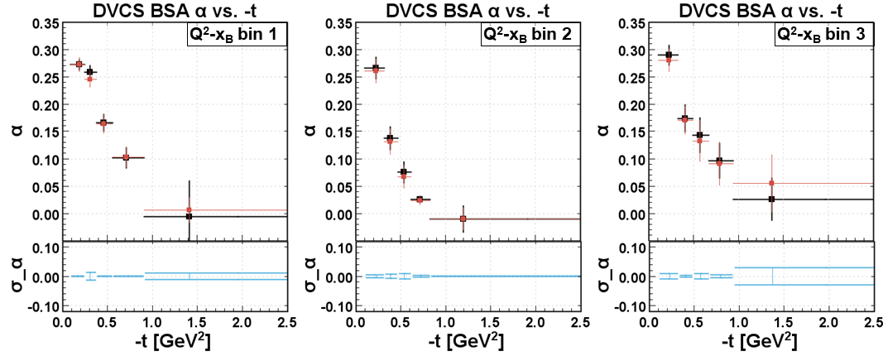
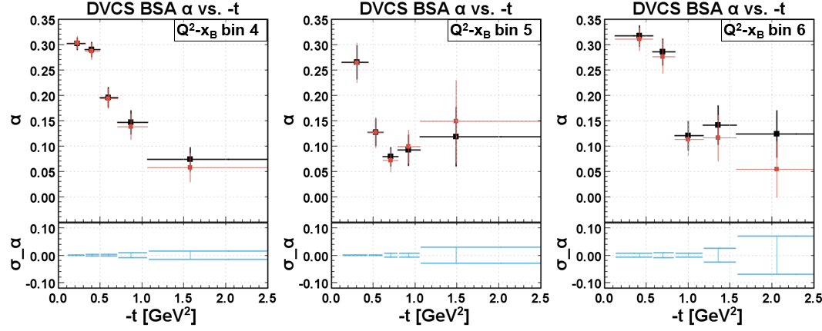
6.5 GeV: $∆f$ Effects in $α$
Values of $α$ were extracted with (red) and without (black) the inclusion of $∆f$.

Slide 53
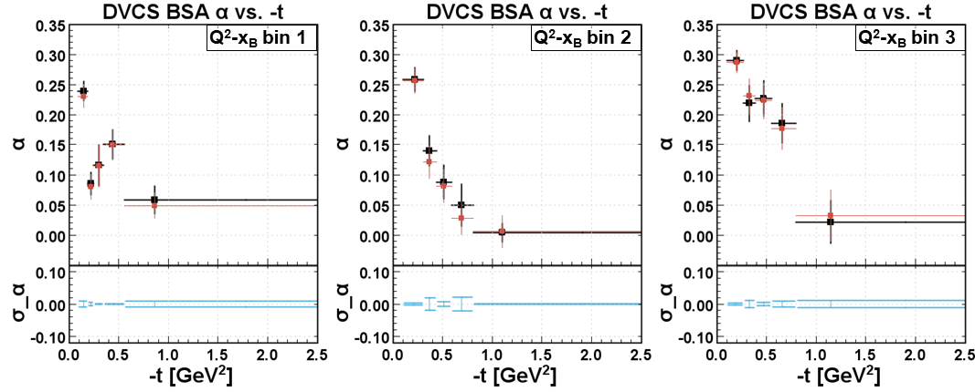
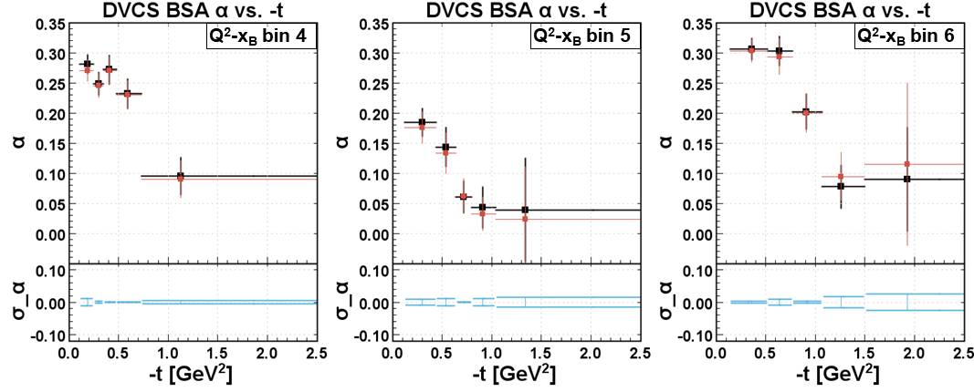
7.5 GeV: $∆f$ Effects in $α$
In general, the systematic variation in $α$ due to $∆f$ is smaller than the error due to statistical uncertainties.

Slide 54
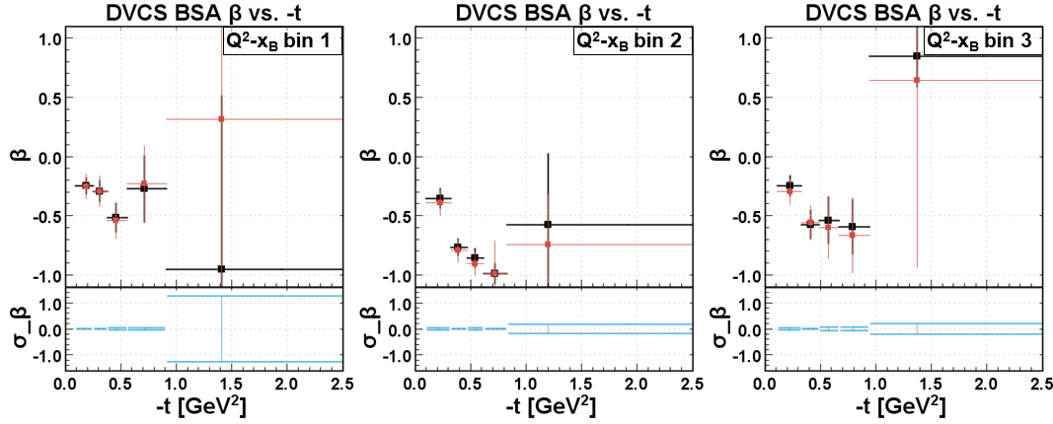
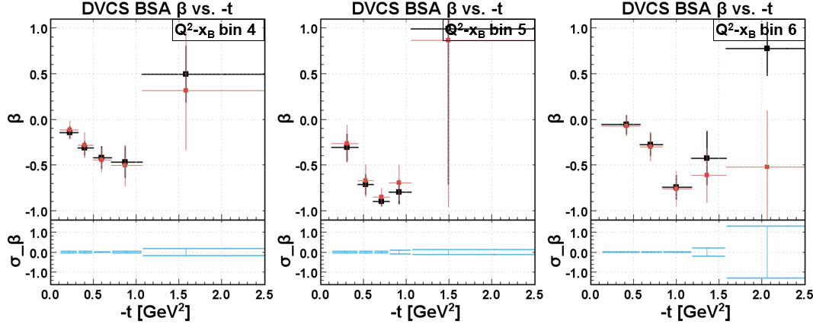
6.5 GeV: $∆f$ Effects in $β$
Systematic variation in $β$ has tendency to increase in high $−t$ regions.

Slide 55
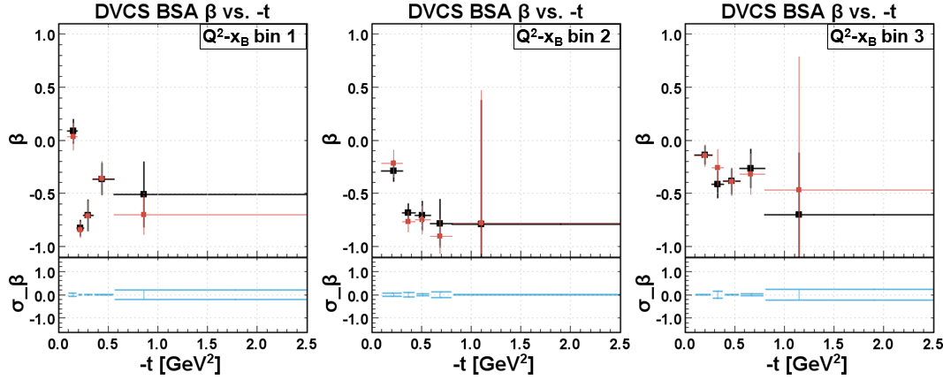
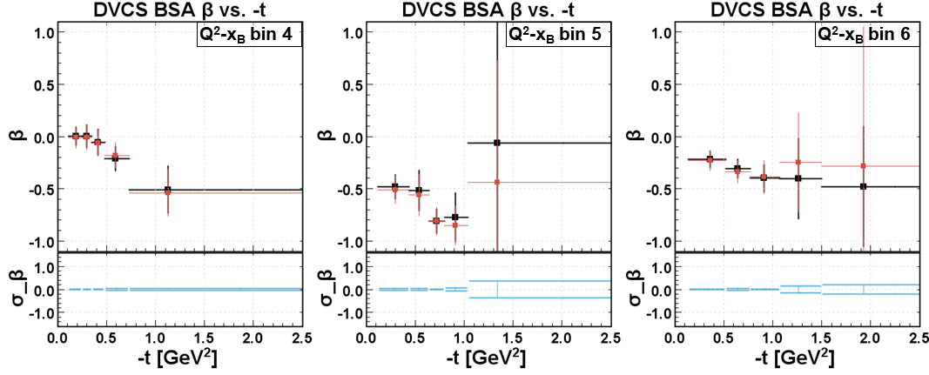
7.5 GeV: $∆f$ Effects in $β$
The systematic variation in $β$ due to $∆f$ is generally less than the error due to statistical uncertainties.

Slide 56
Fully Corrected BSA

Slide 57
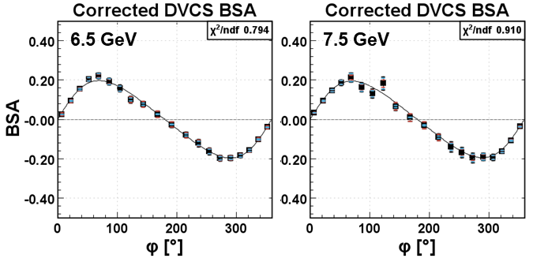
Corrected DVCS BSA (Integrated)
$$A=\frac{α\sin{φ}}{1+β\cos{φ}}$$
$$A=\frac{α\sin{φ}}{1+β\cos{φ}}$$
$α$ 0.184±0.005
$β$ -0.349±0.032
$\frac{χ^{2}}{ndf}$ 0.794
$α$ 0.184±0.008
$β$ -0.336±0.038
$\frac{χ^{2}}{ndf}$ 0.910
Fully corrected DVCS BSA was measured after $π^{0}$ contamination subtraction and includes all statistical and systematic uncertainties.

Slide 58
6.5 GeV Corrected DVCS BSA $α$
$x_{B}$ < 0.17
0.17 ≤ $x_{B}$ < 0.27 :
$Q^{2}$ < 1.2 GeV²
1.2 GeV² ≤ $Q^{2}$ < 1.4 GeV²
1.4 GeV² ≤ $Q^{2}$
0.27 ≤ $x_{B}$ :
$Q^{2}$ < 2.0 GeV²
2.0 GeV² ≤ $Q^{2}$
Comparison with raw BSA measurements shows higher sensitivity of the uncertainties to $π^{0}$ contamination subtraction in high $Q^{2}$, high $x_{B}$, and high $−t$ regions.

Slide 59
7.5 GeV Corrected DVCS BSA $α$
B
A
$x_{B}$ < 0.13
0.13 ≤ $x_{B}$ < 0.22 :
$Q^{2}$ < 1.2 GeV²
1.2 GeV² ≤ $Q^{2}$ < 1.5 GeV²
1.5 GeV² ≤ $Q^{2}$
0.22 ≤ $x_{B}$ :
$Q^{2}$ < 1.8 GeV²
1.8 GeV² ≤ $Q^{2}$
The same “out-of-trend” measurements (A and B) can be observed after $π^{0}$ contamination subtraction.

Slide 60
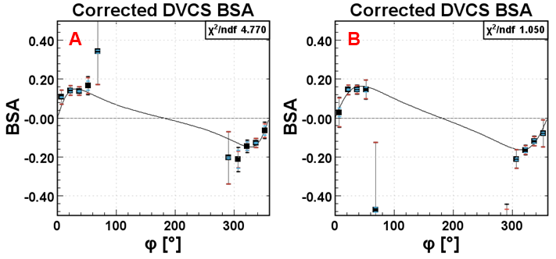
7.5 GeV Low Statistics Bins
$$A=\frac{α\sin{φ}}{1+β\cos{φ}}$$
$$A=\frac{α\sin{φ}}{1+β\cos{φ}}$$
$α$ 0.080±0.021
$β$ -0.845±0.075
$\frac{χ^{2}}{ndf}$ 4.770
$α$ 0.115±0.035
$β$ -0.714±0.144
$\frac{χ^{2}}{ndf}$ 1.050
Closer look to the “out-of-trend” $α$ measurements shows that their corresponding $\left(Q^{2},x_{B},−t\right)$ bins lacked statistics in $φ$.

Slide 61
6.5 GeV Corrected DVCS BSA $β$
$x_{B}$ < 0.17
0.17 ≤ $x_{B}$ < 0.27 :
$Q^{2}$ < 1.2 GeV²
1.2 GeV² ≤ $Q^{2}$ < 1.4 GeV²
1.4 GeV² ≤ $Q^{2}$
0.27 ≤ $x_{B}$ :
$Q^{2}$ < 2.0 GeV²
2.0 GeV² ≤ $Q^{2}$
Like measurements in $α$, the errors in $β$ increases in high $Q^{2}$, high $x_{B}$, and high $−t$ regions.

Slide 62
7.5 GeV Corrected DVCS BSA $β$
B
A
$x_{B}$ < 0.13
0.13 ≤ $x_{B}$ < 0.22 :
$Q^{2}$ < 1.2 GeV²
1.2 GeV² ≤ $Q^{2}$ < 1.5 GeV²
1.5 GeV² ≤ $Q^{2}$
0.22 ≤ $x_{B}$ :
$Q^{2}$ < 1.8 GeV²
1.8 GeV² ≤ $Q^{2}$
Although the errors of “out-of-trend” measurements (A and B) are small in $β$, individual inspections of their bins conclusively suggest the unreliable results from these bins.

Slide 63
Summary

Slide 64
In this analysis:
DVCS BSA was measured at 6.5 GeV and 7.5 GeV beam energies.
$\left(Q^{2},x_{b},−t\right)$-dependence of BSA measurements was mapped.
$π^{0}$ contaminants were estimated, and their asymmetry contributions were excluded.
Systematic uncertainties were contained within the range of statistical errors.
The $H$-GPD-sensitive observable $α$ was extracted with values comparable to earlier measurements.

Slide 65
Following this analysis:
The corresponding DVCS cross-section will be measured from the same data set.
The BSA measurements acquired will be used as constraints in $H$ GPD extraction.
Investigation of the nature and behavior of the detected $epγ$ events at high $−t$ can be conducted.

Slide 66
Thank You!!!

