Slide 1
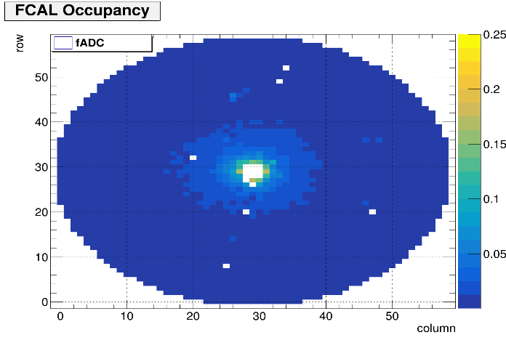
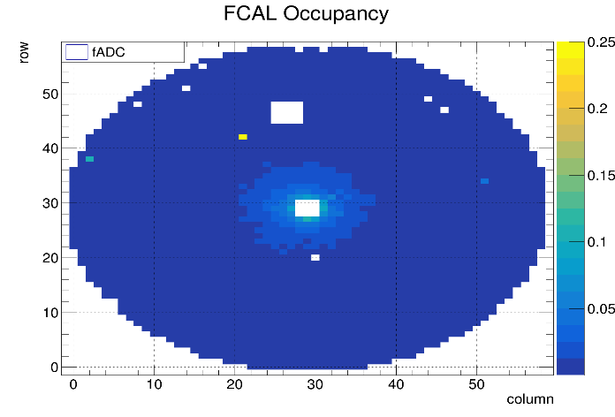
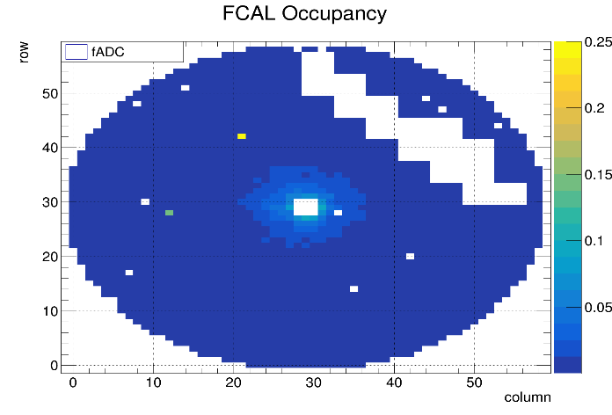
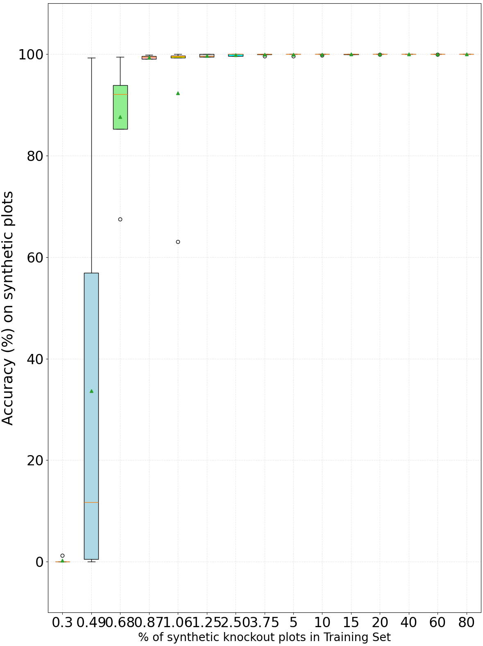
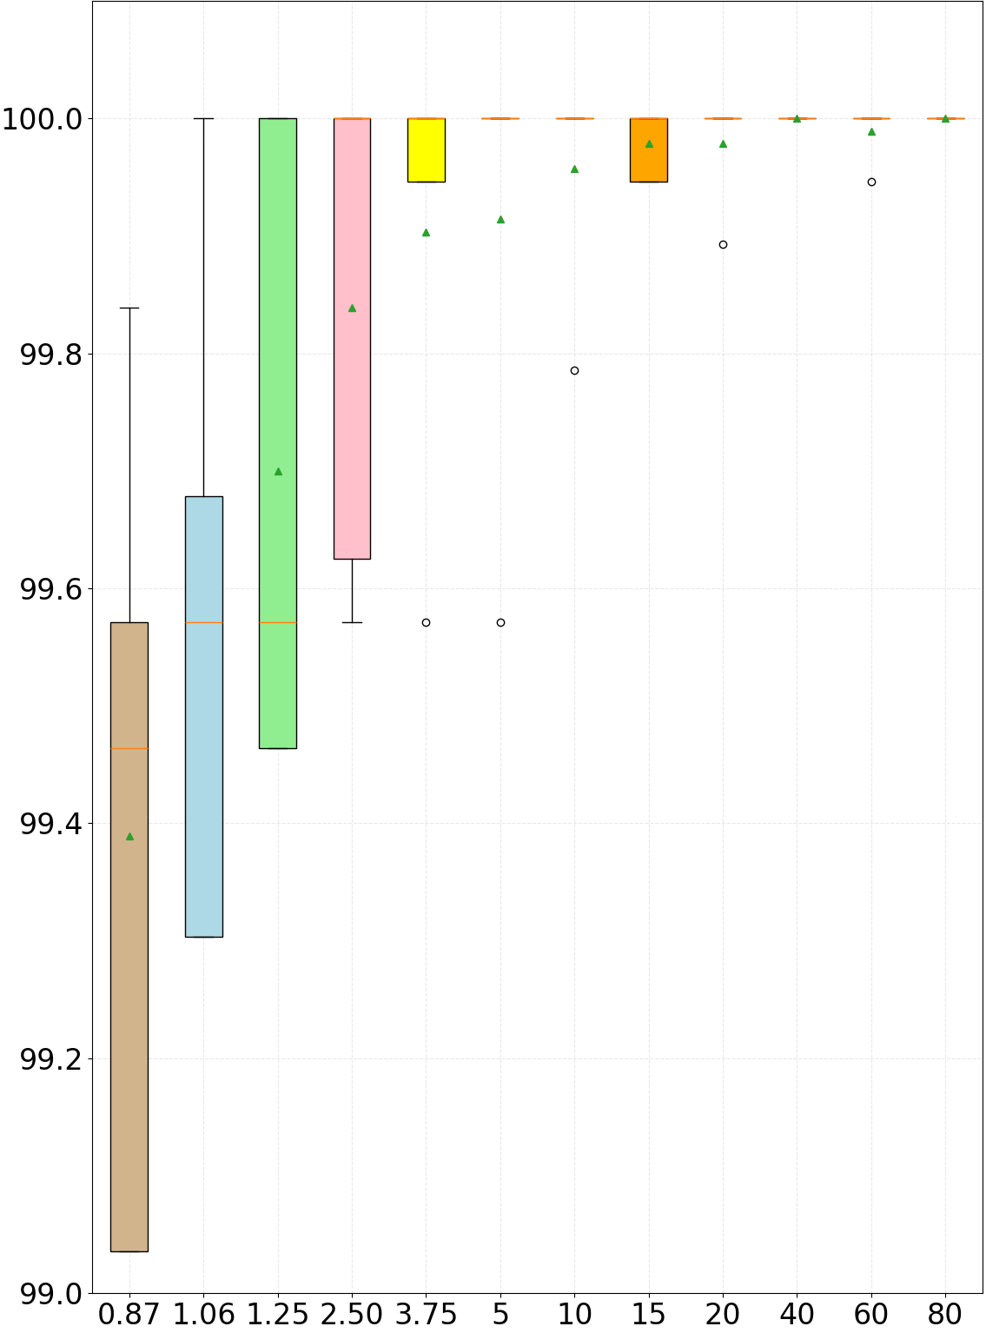
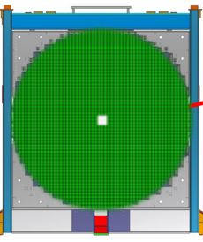
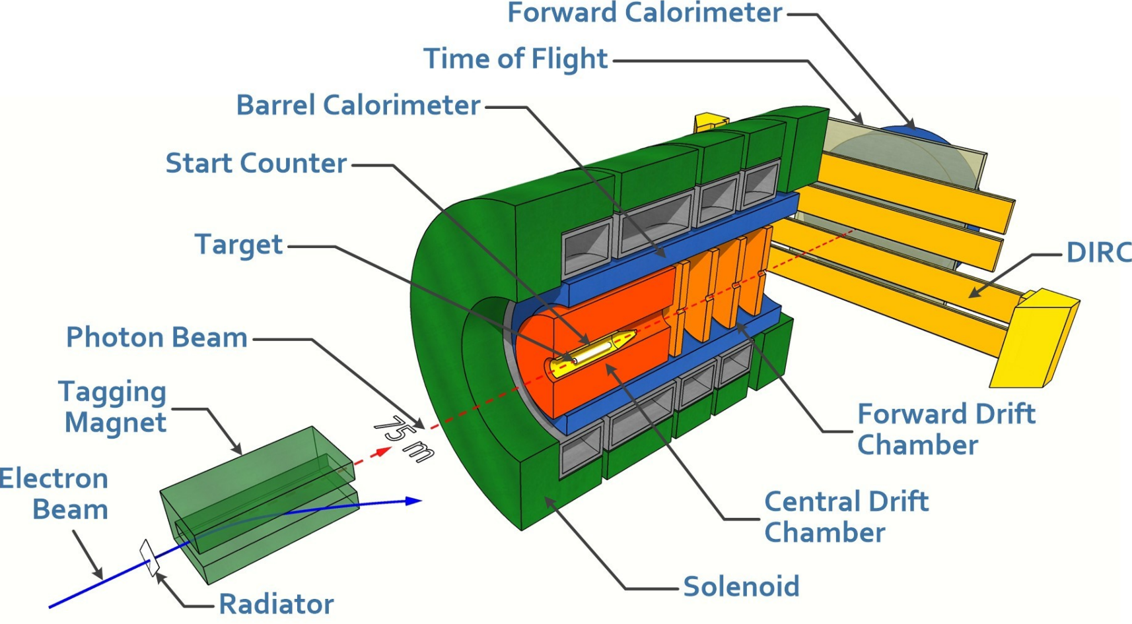
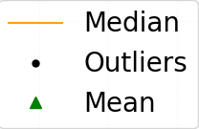
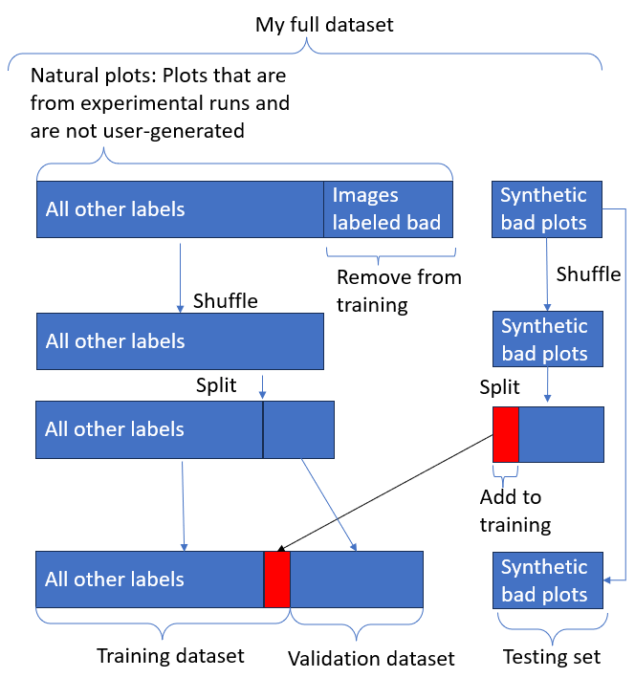
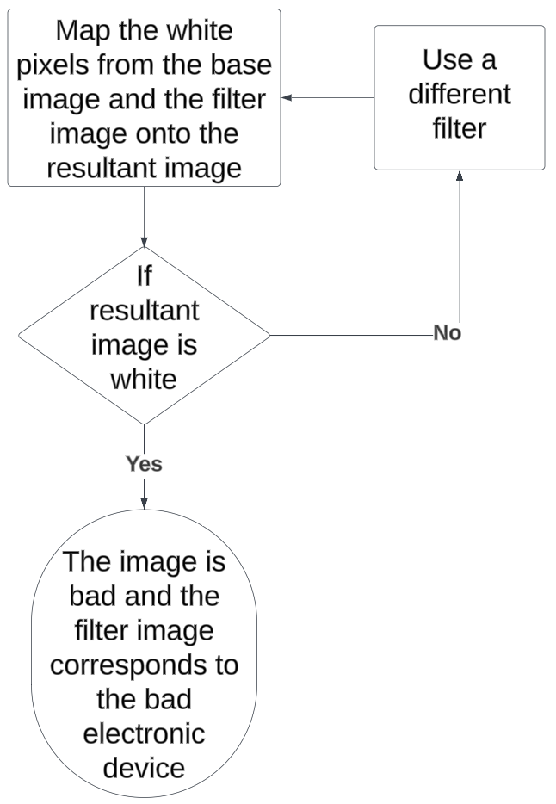
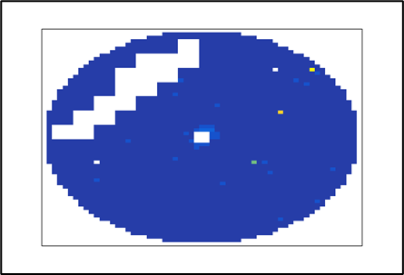

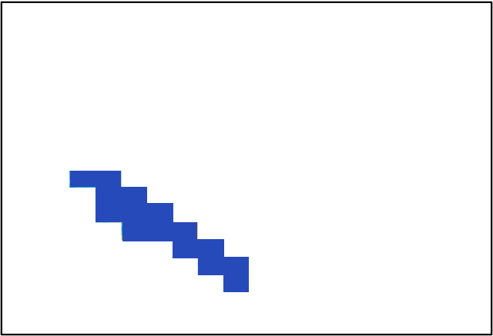
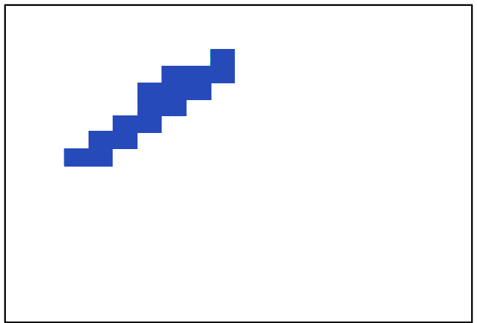




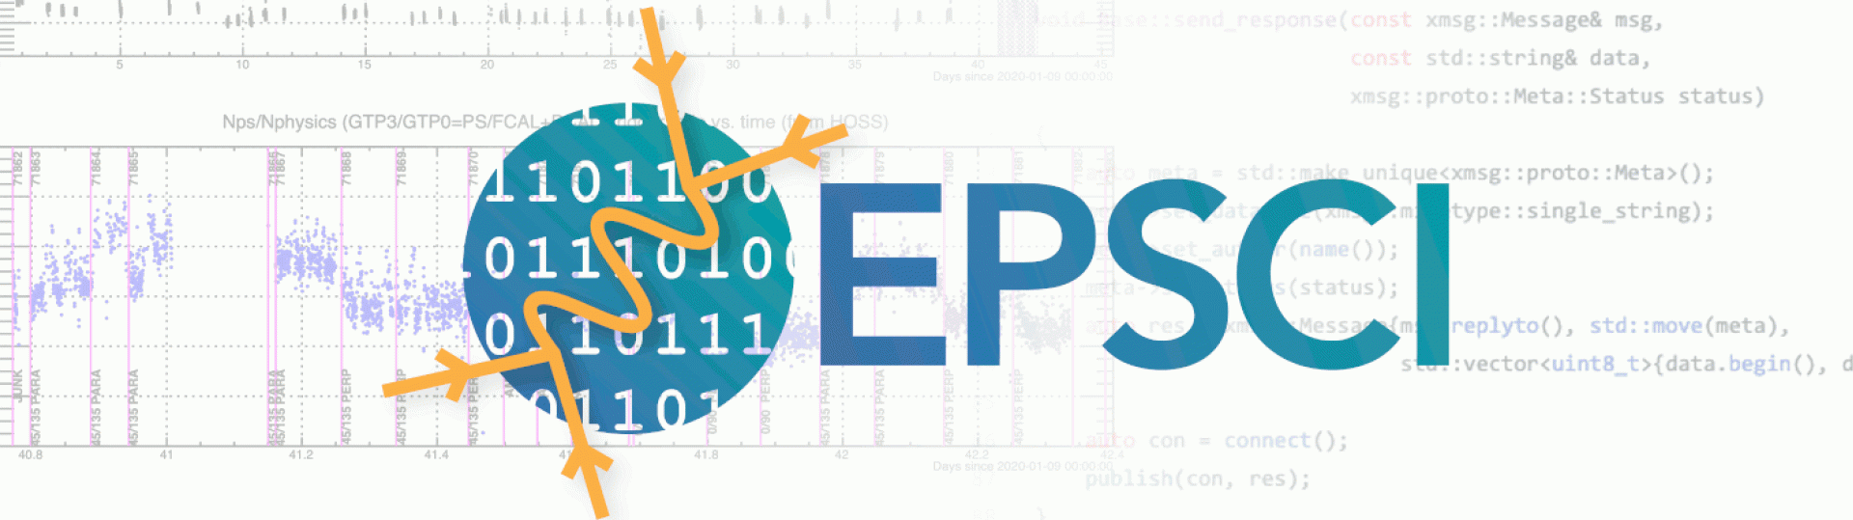



Improving the Hydra Classifier for Data Acquisition at GlueX
${\text{Manav} \text{Bilakhi}a}^{1}$ (Student), ${\text{Colin} \text{Gleason}}^{1} (Advisor)$, ${ Matthew Anderson}^{1}$ $(Advisor)$, ${Thomas Britton}^{2} \left(Advisor\right),{Torri Jeske(Advisor)}^{2}$
$I^{1}$Union College, Schenectady, $I^{2}$Thomas Jefferson National Accelerator Facility
  Examples of Good and Bad Plots
  Experiment 1 Results
  GlueX and Hydra
Algorithm Good
Algorithm Bad
GlueX studies QCD by searching for exotic mesons[1]
Hydra is an extensible framework for training, managing, and evaluating AI
Hydra aims to aid and support shift crew with identifying data anomalies
Approximately 5 TB in 3 hours
Figure 2(a): Good Figure 2(b): BAD fADC12_13 Figure 2(c): Bad Crate_17
  Research Questions
  Can our model recognize these plots that have broken electronics as bad? (Experiment 1)
  Can we develop a non-machine learning algorithm that can be used to identify what subcategory of bad the image falls under? (Experiment 2)
  Problem: Imbalanced Dataset, Solution: The Knockout Plugin
The Knockout plugin uses old runs to emulate a missing electronic component
Can Hydra learn that this is a bad image? (Exp 1)
Figure 1: the GlueX detector (Left). The FCAL Sub-Detector (Right)
Figure 3: Plot classifications
Electronics in the FCAL:
  2,800 channels
  Up to 16 channels in a fADC
  Up to 18 fADCs in a DAQ Crate
  A total of 12 DAQ crates in the detector
FCAL’s Hydra model has five different labels, two of which are ‘Good’ and ‘Bad’[4]
Extend the “Bad” category for the FCAL such that Hydra can tell which fADC or DAQ crate is broken
Failure modes are easily visible in the occupancy plot
  Experiment 1
  Experiment 2
  Experiment 2 Results
 | Algorithm Good | Algorithm Bad
Good | 11030 | 0
Bad | 1275 → Effectively 0 | 5646
Base Image
  Perform K-fold Cross-Validation (Experiment 1)
  Add more filters to experiment 2
  Add >1% of synthetic bad plots in Hydra’s training set
  When Hydra flags a plot as bad, run it as the base image in Exp 2
(a) Filter 1 (b) Filter 2
(a) Resultant 1 (b) Resultant 2
Notes:
Each $γP→η^{′}π^{0}P$ which essentially is a combination of 4${\text{π}}^{0}$, ${\text{π}}^{+}$and ${\text{π}}^{−}$.

