Slide 1

Photoproduction of
⁶⁷Cu and ¹⁷⁷Lu in Ga and Ta
Pavel Degtiarenko, George Kharashvili, JLab RadCon
8/7/15

Slide 2
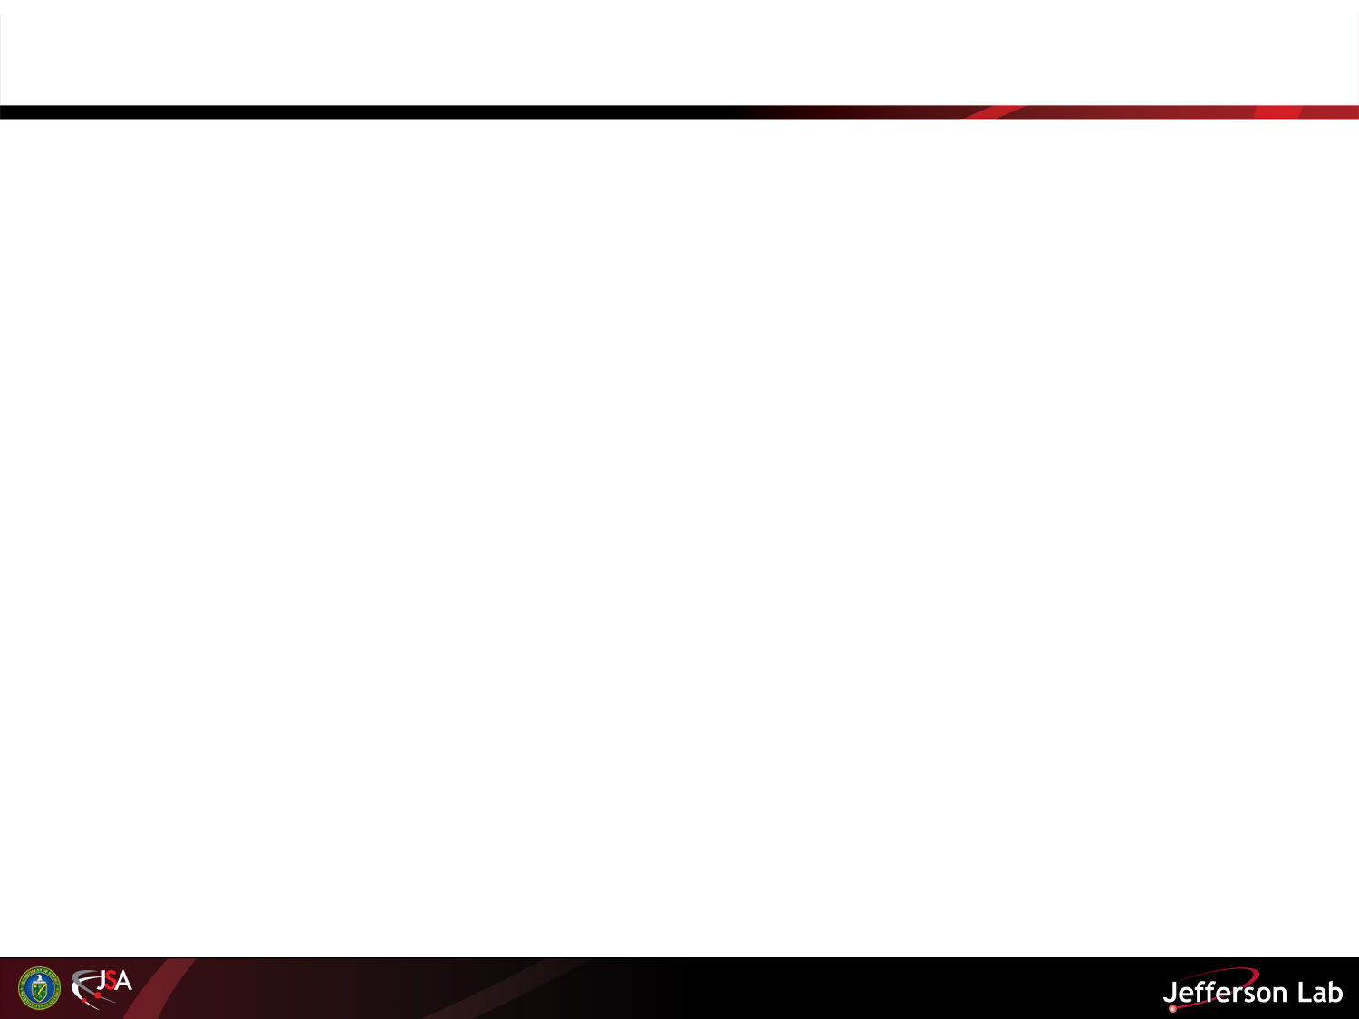
Motivation
Near-threshold cross-sections are poorly known
  Missing experimental data
  Models often fail
Radiological concerns
  Evaluation of activation at low energies
Medical isotope production
  ”Clean" process at lowest practical energies

Slide 3
⁶⁷Cu
One of the most promising radioisotopes for cancer therapy
Promising in diagnostics as well
T_{1/2} = 2.87 d
  β⁻ decay to stable ⁶⁷Zn
  Produces 184.58 keV photon (Y = 48.7%)
  ⁶⁸Zn(γ,p)⁶⁷Cu considered for photoproduction
We propose investigating ⁷¹Ga(γ,α)⁶⁷Cu

Slide 4
  Photon induced reaction in Ga
  Natural Gallium: ⁶⁹Ga – 60%, ⁷¹Ga – 40%
Reaction | Threshold (MeV) | Product T_{1/2}
⁷¹Ga(γ,α)⁶⁷Cu | 5.25 | 61.83 h
⁷¹Ga(γ,n)⁷⁰Cu | 9.3 | 21.1 min
⁶⁹Ga(γ,n)⁶⁸Ga | 10.3 | 67.6 min
⁶⁹Ga(γ,α)⁶⁵Cu | 4.48 | Stable

Slide 5
¹⁷⁷Lu
¹⁷⁷Lu
  T_{1/2} = 6.73 d
  β⁻ decay to ¹⁷⁷Yb (T_{1/2}=1.9h)
  Produces 208.4 keV photon (Y = 11%)
Possible production channel
  ¹⁸¹Ta(γ,α)¹⁷⁷Lu
  E_{th} = 0

Slide 6
Cross-sections

Slide 7
Average photon fluence in a 0.5”x0.5”x0.5” Ga sample 1cm downstream from a 6mm Cu radiator

Slide 8

Expected Activation Rates
Folding the calculated spectra with the TENDL-2014 cross-sections would result in the following activation rates:
Beam Kinetic Energy (MeV) | Activity of ⁶⁷Cu (Bq/h/10μA)
9.5 | 1.25
10 | 4
Expected dose rates - below detection limits of survey meters after several hour long irradiation. Standard procedure for removal of potentially activated items in place

Slide 9
Gamma Spectroscopy
RadCon Radioanalytical Lab (ARC ground floor) operates a state of the art gamma spectroscopy system
  2 shielded HPGe detectors + 1 portable unit
  Several NIST traceable multinuclide standards
  1 of the shielded detectors and the portable unit are characterized for use with ISOCS/LabSOCS calibration software
Our activation analysis experience at JLab
  Foil activation study at g²_{p} beam dump in Hall A
  C100 activation monitoring

Slide 10
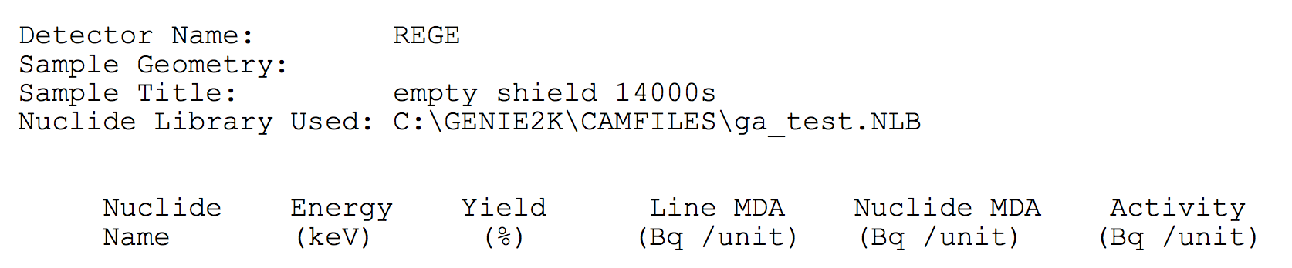
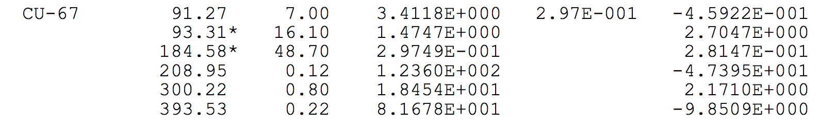
Detection Limits
⁶⁷Cu detection limits evaluated using ~4h count of empty shield and by applying detection efficiencies calculated with LabSOCS for a 0.5”x0.5”x0.5” Ga sample

