Slide 1
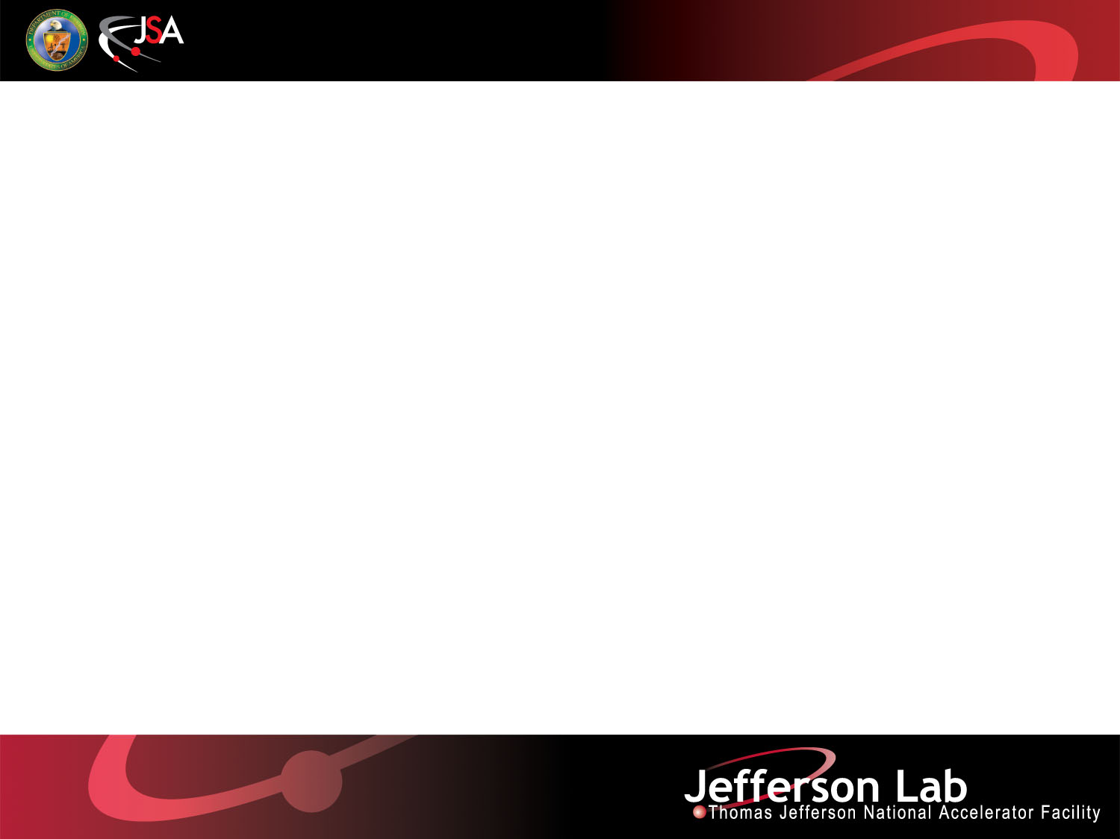
Low Power Gallium Target for the ⁶⁷Cu Isotope Production Test
Pavel Degtiarenko, George Kharashvili
Radiation Physics Group at RadCon
August, 2015

Slide 2
Overview
Natural Gallium: ⁶⁹Ga (60%) and ⁷¹Ga(40%)
Soft metal, corrosive to light metals
Melts at about 30°C, expands 3% upon the liquid-to-solid transition
Reaction of interest: ⁷¹Ga(γ,α)⁶⁷Cu, E_{γ} above 7-8 MeV
Irradiation in gamma field produced by 6 mm Cu radiator
Electron beam on radiator: E_{e}= 8-10 MeV, 10 μA
Practical target size (1/2 inch)³, placed 1 cm from the radiator
Beam power at 10 MeV, 10 μA: 85 W in Cu, 0.7 W in Ga
Radiological problems: minimal to none expected
Target design to minimize possible heat related chemical contamination problems: Gallium target wrapped in Kapton tape
Kapton: inert and stable up to 260°C; in multilayer configuration should be strong and flexible enough to withstand multiple 3% expansions and contractions

Slide 3
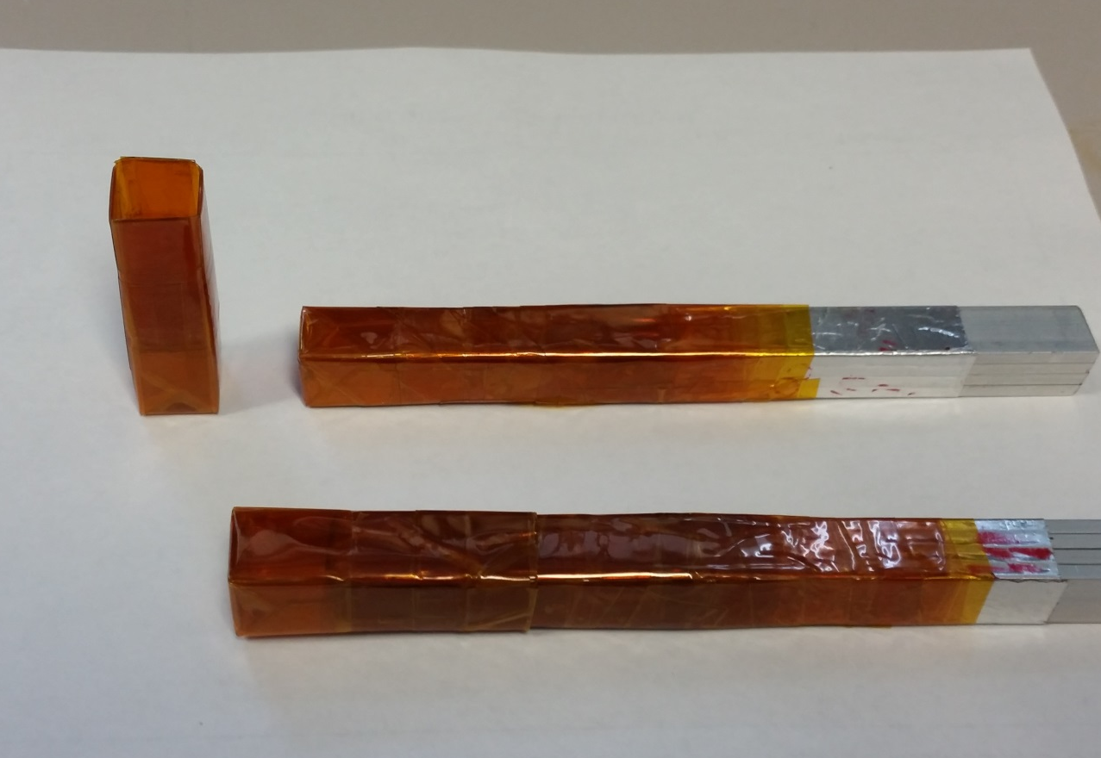
Low Power Gallium Target
  Kapton jar, rectangular, built using adhesive tape
  Windows: 6-8 layers, 0.4-0.5 mm (two faces)
  Sides and the bottom: 12-16 layers
  Three layers at vertices
  Aluminum bar wrapped in multiple Kapton layers serves as the plug-in cork
  Target: (1/2 in)³ of Gallium poured in, solidified, plug inserted, and then the jar taped over with Kapton
  The sets for the two targets available

Slide 4
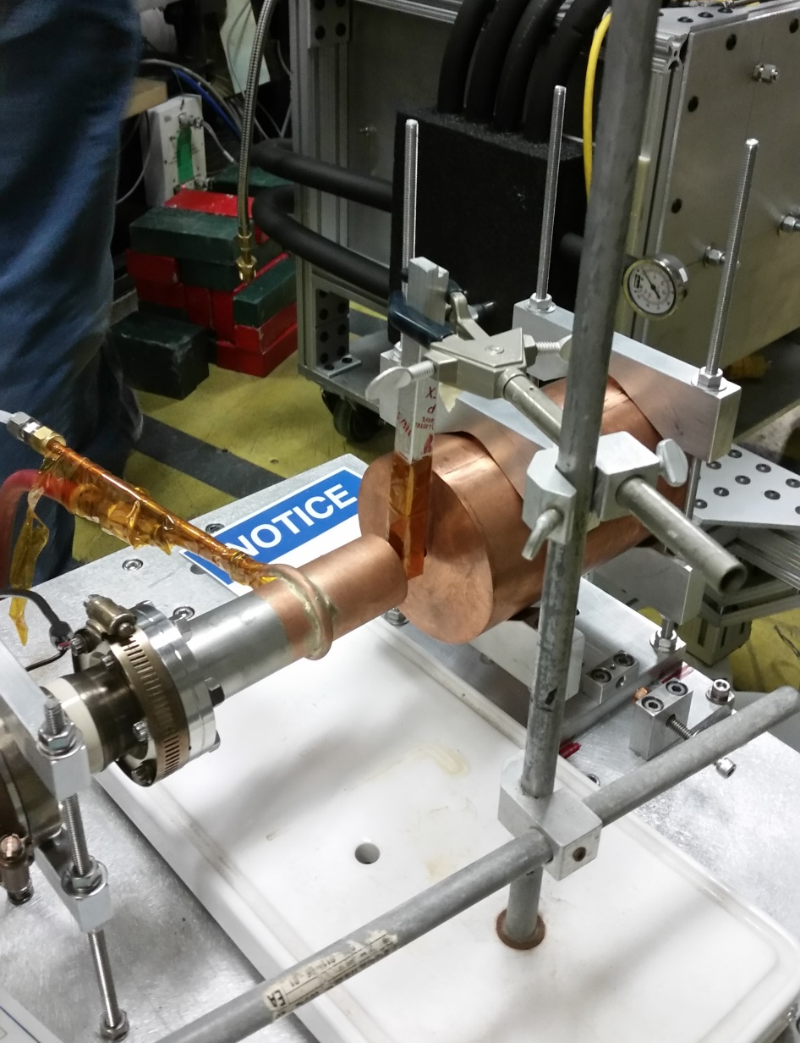
Target on the Beam, Thermal Calculations
    Vertical placement using clamps
    Thermal parameters (conservative)
    Two faces, 1.27x2.54 cm² in all, need 130°C to dissipate 0.7 W using convection and radiation
    0.4-0.5 mm of Kapton + Silicon adhesive: Gallium temperature inside will be 137°C
    Max operating temperature for Kapton is 260°C, the beam current can be increased up to 25 μA
    Extra safety measures: glass bowl under the target, Kapton curtains for the nearby copper parts

Slide 5
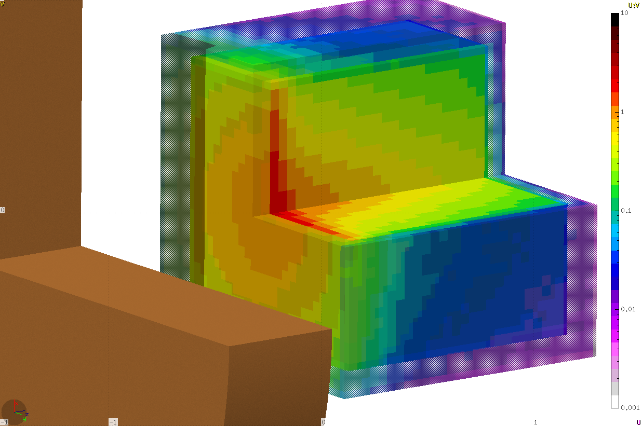
Absorbed power in target
10
1
0.1
0.01
0.001
Absorbed power (W/cm³ per 10μA of 10 MeV beam)

Slide 6
Absorbed power in 1mm Kapton per 10μA of 10 MeV beam

Slide 7
Proposed run plan
Ga
  10 MeV Kinetic Energy
    9.5 MeV if 10 is not available
  25 µA current
    10 µA minimum
  15 min initial run to verify beam position using film dosimeter
  4 hours at 10 MeV
  Replace sample
  4 hours at 9.5 MeV
Ta
  7.5 MeV, 25 µA
  4 hours

