Slide 1
Isotope Production at LERF
Pavel Degtiarenko
Radiation Physics Group at RadCon
September 18, 2015

Slide 2
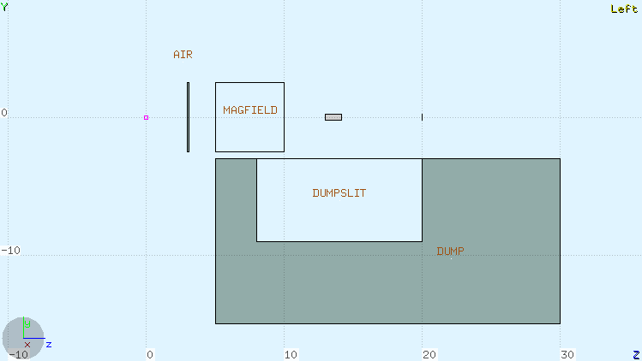
FLUKA toy model geometry
Air volume, Tungsten radiator and dump, ²²⁶Ra target
Magnetic field volume 5x5x5 cm³
Target
Radiator

Slide 3
Selected Results
Beam 150 kW, ²²⁶Ra target - 1 Ci (=1 g)
Production of ²²⁵Ac after 1h irradiation & 18d decay
150 MeV beam, 1 mm W radiator, 5 T x 5 cm magnetic field, 10 cm between radiator and target, 4 mm diameter target. Results: 13 mCi ²²⁵Ac produced, 3.7 kW in radiator, 620 W in the target
50 MeV beam , 5 mm W radiator, no magnetic field, 2.5 cm between radiator and target, 6 mm diameter target. Results: 35 mCi ²²⁵Ac produced, 67 kW in radiator, 1.1 kW in the target

Slide 4
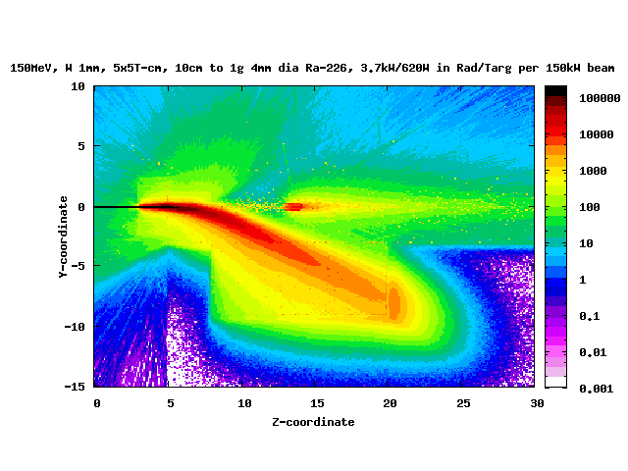
High energy, thin radiator run
Colors represent dose rates in arbitrary units

Slide 5
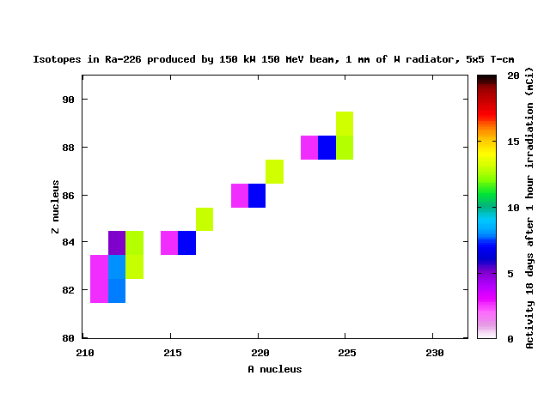
High energy, thin radiator run
Colors represent activities in mCi

Slide 6
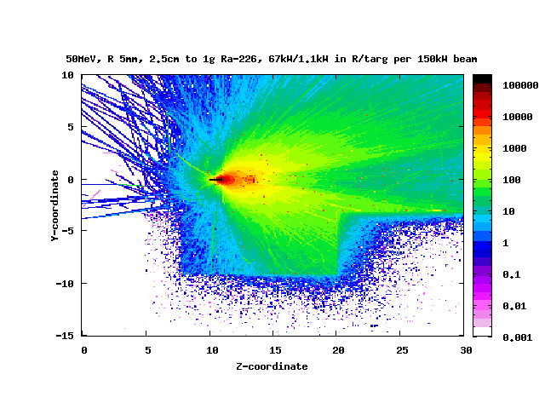
Medium energy, medium radiator run
Colors represent dose rates in arbitrary units

Slide 7
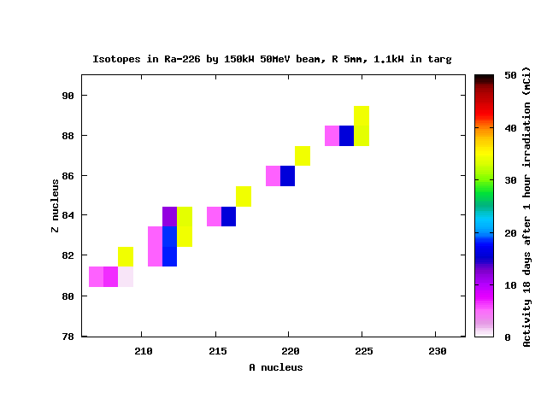
Medium energy, medium radiator run
Colors represent activities in mCi

Slide 8
Subsystems’ Critical Parameters
LERF accelerator beam current limit
Machine limits, function of energy
Vacuum Window: Beam current limit
Design limits
Radiator: Power density and Power deposition limit
Design limits
Target: Absorbed power limit
Design limits
Isotope production limits
Dump: Total beam power limit
Should be no big problem

Slide 9
Extras

Slide 10
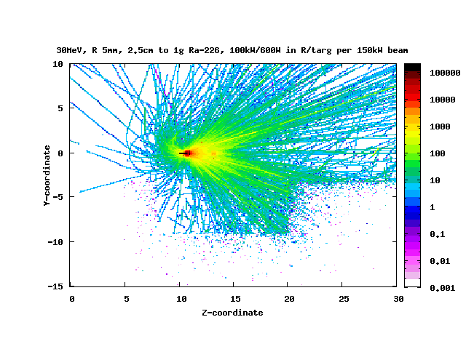
Low energy, medium radiator run
Colors represent dose rates in arbitrary units

Slide 11
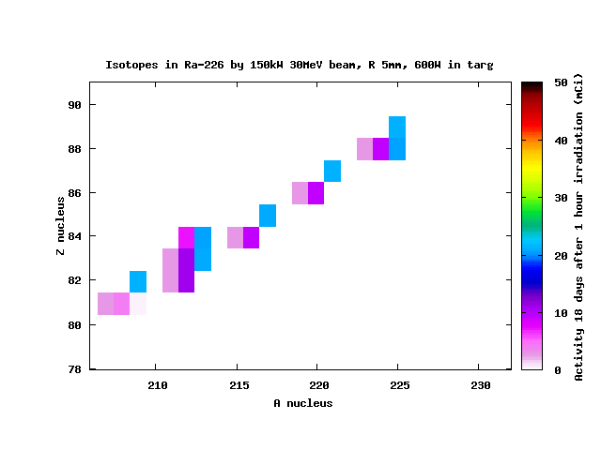
Low energy, medium radiator run
Colors represent activities in mCi

