Slide 1
Isotope Production at LERF
Pavel Degtiarenko
Radiation Physics Group at RadCon
October 2, 2015

Slide 2
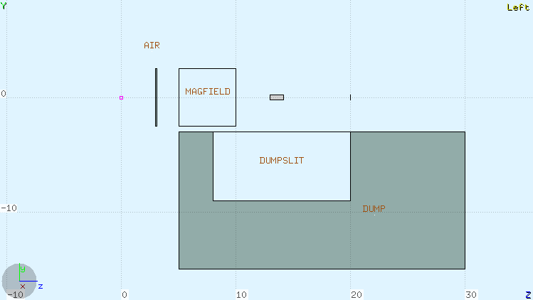
FLUKA toy model geometry
Air volume, Tungsten radiator and dump, ²²⁶Ra target
Magnetic field volume 5x5x5 cm³
Target
Radiator

Slide 3
Selected Results on ²²⁶Ra target
Beam 150 kW, ²²⁶Ra target - 1 Ci (=1 g)
Production of ²²⁵Ac after 1h irradiation & 18d decay
150 MeV beam, 1 mm W radiator, 5 T x 5 cm magnetic field, 10 cm between radiator and target, 4 mm diameter target. Results: 13 mCi ²²⁵Ac produced, 3.7 kW in radiator, 620 W in the target
50 MeV beam , 5 mm W radiator, no magnetic field, 2.5 cm between radiator and target, 6 mm diameter target. Results: 35 mCi ²²⁵Ac produced, 67 kW in radiator, 1.1 kW in the target

Slide 4
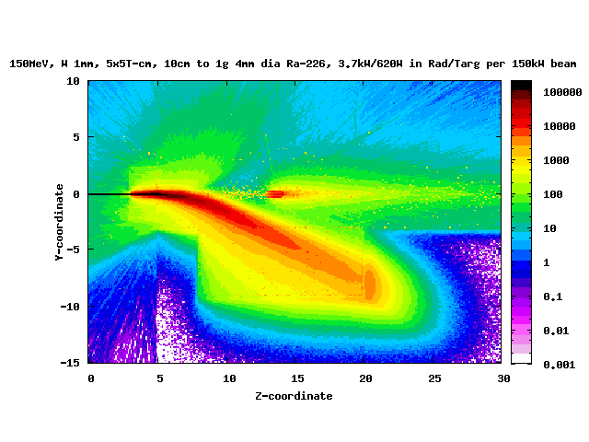
High energy, thin radiator run
Colors represent dose rates in arbitrary units

Slide 5
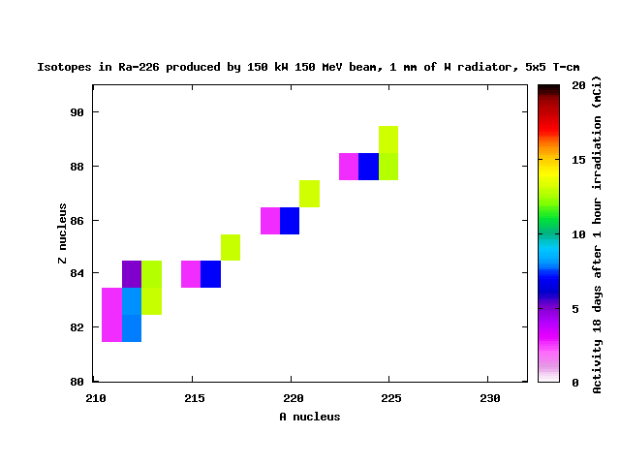
High energy, thin radiator run
Colors represent activities in mCi
²²⁵Ac
(9.9d)
²²⁶Ra (1600y) parent
²¹³Po (164μs)
²⁰⁹Pb (3.2h)
²²⁵Ra (14.9d)
²²¹Fr (4.9m)
²¹⁷At (1.5s)
²¹³Bi (46m)

Slide 6
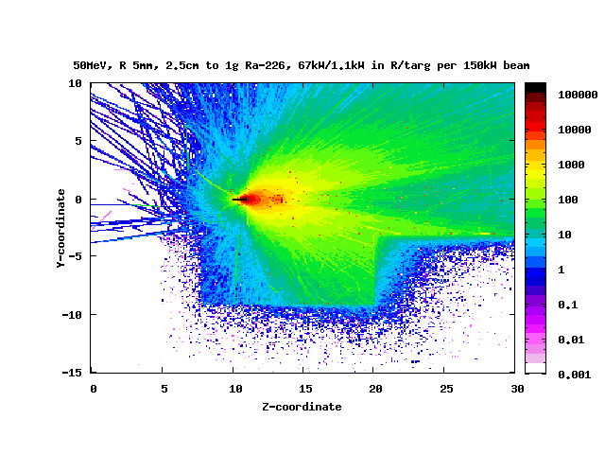
Medium energy, medium radiator run
Colors represent dose rates in arbitrary units

Slide 7
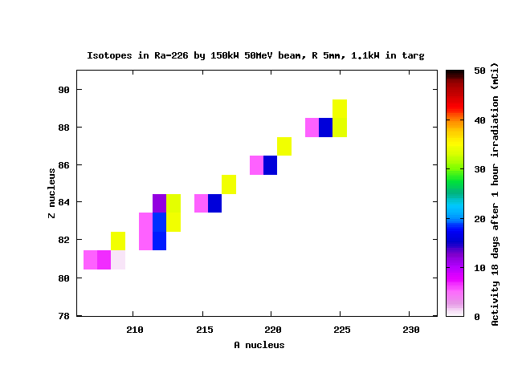
Medium energy, medium radiator run
Colors represent activities in mCi
for 1 hour
²²⁵Ac
(9.9d)
²⁰⁹Bi
(stable)
²¹³Po (164μs)
²²⁶Ra (1600y) parent
²⁰⁹Pb (3.2h)
²²⁵Ra (14.9d)
²²¹Fr
(4.9m)
²¹⁷At (1.5s)
²¹³Bi (46m)

Slide 8
²²⁵Ac from ²³²Th target
Natural Thorium-232 (100% nat) is readily available at (~5 $/g)
Processes leading to ²²⁵Ac production:
Immediate (hours of irradiation to ~mCi production of ²²⁵Ac )
²³²Th (γ,6n+p) ²²⁵Ac (9.9d) - direct
²³²Th (γ,7n) ²²⁵Th (8.7m) → ²²⁵Ac (9.9d)
²³²Th (γ,5n+2p) ²²⁵Ra (14.9d) → ²²⁵Ac (9.9d)
Delayed (~1000 hours of irradiation to ~mCi production of ²²⁹Th, to be used to produce ~mCi of ²²⁵Ac every ~20 days “forever”)
²³²Th (γ,3n) ²²⁹Th (7880Y) → ²²⁵Ra (14.9d) → ²²⁵Ac (9.9d)

Slide 9
High Energy, thick Thorium target

Slide 10
High Energy, thick Thorium target run
for 1 hour
mCi
²³²Th (1.4 10¹⁰y) parent nucleus

Slide 11
High Energy, thick Thorium target run
for 1 hour
mCi
²²⁵Th (8.8m)
²²⁵Ac
(9.9d)
²⁰⁹Bi
(stable)
²¹³Po (164μs)
²³²Th (1.4 10¹⁰y) parent
²⁰⁹Pb (3.2h)
²²⁹Th
(7880y)
²²⁵Ra (14.9d)
²²¹Fr
(4.9m)
²³⁰Th (7.5 10⁴y)
optional parent
if available
²¹⁷At (1.5s)
²¹³Bi (46m)

Slide 12
Low Energy, thick Thorium target run
²³³Pa (27d)
mCi
²²⁵Ac
(9.9d)
²⁰⁹Bi
(stable)
²¹³Po (164μs)
²³²Th (1.4 10¹⁰y) parent
²⁰⁹Pb (3.2h)
²²⁹Th
(7880y)
²²⁵Ra (14.9d)
²²¹Fr
(4.9m)
²³⁰Th (7.5 10⁴y)
optional parent
if available
²¹⁷At (1.5s)
²¹³Bi (46m)

Slide 13
Medium Energy, thick Gallium target

Slide 14
Medium Energy, thick Gallium target run
for 1 hour
⁷¹Ga(2.2 $/g)(40% nat) (γ,α) ⁶⁷Cu
mCi
⁶⁹Ga parent (60%)
⁷¹Ga parent (40%)
⁶⁴Cu (12.7h)
⁶⁷Cu
(61.8h)

Slide 15
Medium Energy, thick Tantalum target
for 1 hour
mCi
¹⁸¹Ta(4.5 $/g)(100% nat) (γ,α) ¹⁷⁷Lu
¹⁸¹Ta parent (100%)
¹⁷⁷Lu
(6.6d)
Limited yield, but well isolated isotope ¹⁷⁷Lu

Slide 16
Subsystems’ Critical Parameters
LERF accelerator beam current limit
Machine limits, function of energy <?>
Vacuum Window: Beam current limit
Design limits <?>
Radiator: Power density and Power deposition limit
Design limits <?>
Target: Absorbed power limit
Design limits <?>
Isotope production limits <?>
Dump: Total beam power limit
Should be no big problem

Slide 17
Extras

Slide 18
List of Processes
Natural Thorium-232 (100% nat) is readily available at (~5 $/g)
Processes leading to ²²⁵Ac production:
Immediate (hours of irradiation to ~mCi production of ²²⁵Ac )
²³²Th (γ,6n+p) ²²⁵Ac (9.9d) - direct
²³²Th (γ,7n) ²²⁵Th (8.7m) → ²²⁵Ac (9.9d)
²³²Th (γ,5n+2p) ²²⁵Ra (14.9d) → ²²⁵Ac (9.9d)
Delayed (~1000 hours of irradiation to ~mCi production of ²²⁹Th, to be used to produce ~mCi of ²²⁵Ac every ~20 days “forever”)
²³²Th (γ,3n) ²²⁹Th (7880Y) → ²²⁵Ra (14.9d) → ²²⁵Ac (9.9d)
List of processes considered earlier
⁶⁸Zn (0.05 $/g) (18% nat) (γ,p) ⁶⁷Cu (2.6d)
⁷¹Ga (2.2 $/g) (40% nat) (γ,α) ⁶⁷Cu (2.6d)
¹⁷⁸Hf (1.2 $/g) (27% nat) (γ,p) ¹⁷⁷Lu (6.6d)
¹⁸¹Ta (4.5 $/g) (100% nat) (γ,α) ¹⁷⁷Lu (6.6d)
²²⁶Ra (100 k$/g) (100% nat) (γ,n) ²²⁵Ra (14.9d) → ²²⁵Ac (9.9d)

Slide 19
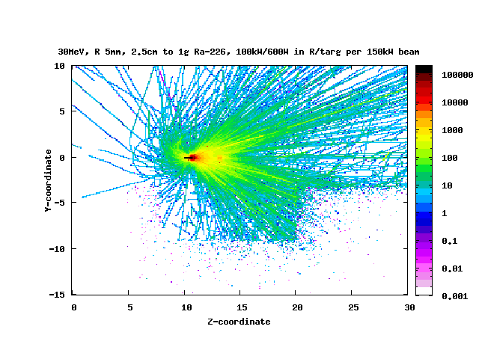
Low energy, medium radiator run
Colors represent dose rates in arbitrary units

Slide 20
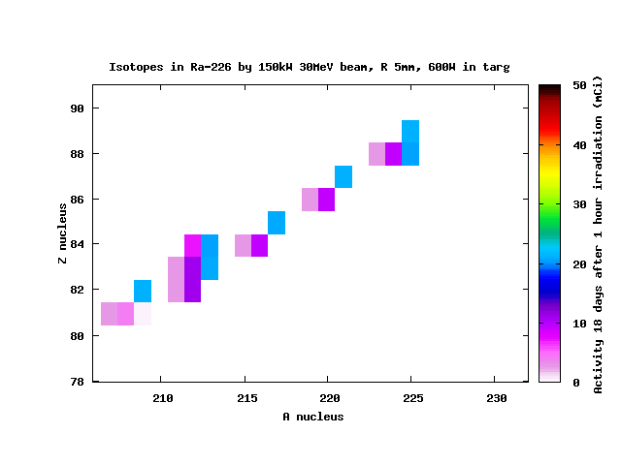
Low energy, medium radiator run
Colors represent activities in mCi

