Slide 1
Projections of ⁶⁷Cu, ¹⁷⁷Lu, and ²²⁵Ac Photoproduction at LERF
George Kharashvili, JLab RadCon
10/2/15

Slide 2
Cross Sections – TENDL 2014

Slide 3
Cross Sections – TENDL 2014

Slide 4
FLUKA Modeling
40 to 150 MeV e⁻ beam
σ = 0.5mm
Targets (natural composition)
Gallium
Thorium
Hafnium
Setups
Tungsten radiator + magnetic field to sweep e⁻
Targets 10-15 cm downstream from radiator
Beam dumped in target

Slide 5
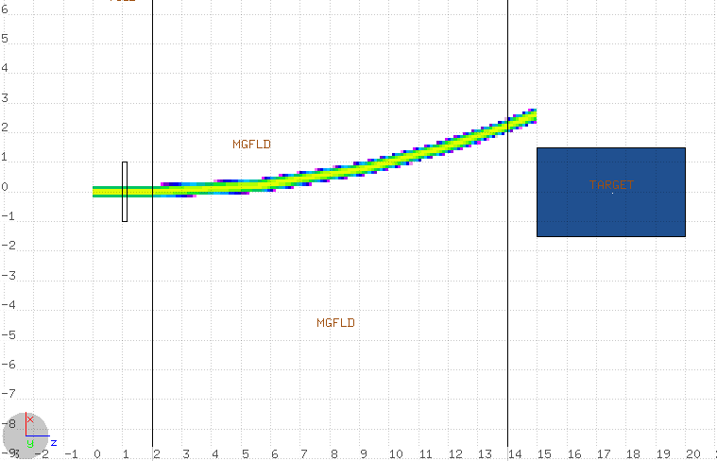
Radiator + Magnet Setup
1.5mm W
radiator
Target (Hf, Th, Ga)
Electron Beam
swept by 10kG field

Slide 6
Target | Setup | Electron Energy (MeV) | Power to Radiator (kW) | Power to Target (kW) | Product Isotope | Production Rate (µCi/kW/h)
Ga 0.5”x0.5”x0.5” | 1.5mm W 6 kG field | 40 | 0.21 | 0.0015 | ⁶⁷Cu | 10
Ga D=3cm L=5cm | Target = dump | 40 |  | 0.85 | ⁶⁷Cu | 180
Th D=2cm L=10cm | 1.5mm W 11 kG field | 150 | 0.06 | 0.27 | ²²⁵Ac ²²⁹Th | 11 0.005
Th D=2cm L=11cm | Target = dump | 150 |  | 0.93 | ²²⁵Ac ²²⁹Th | 23 0.01
Hf D=3cm L=5cm | 1.5mm W 10 kG field | 100 | 0.09 | 0.19 | ¹⁷⁷Lu | 8
Hf D=2cm L=10cm | Target = dump | 100 |  | 0.93 | ¹⁷⁷Lu | 23

Slide 7
Model validation
Ga and Ta activation checked at low energies (<10MeV) in the injector
No signs of ¹⁷⁷Lu in Ta
Trace levels of ⁶⁷Cu detected in Ga
Need more validation experiments at higher energies
Low power
Simple setup based on availability
More materials and more energies = better

Slide 8
Input needed for continuing FLUKA work
LERF beam energy and current limitations – upper and lower bounds?
Beam size and rastering limitations
Availability of bending magnets, beam dumps and shielding
Target / radiator cooling capabilities
Material availability
Ga available
Ra
Hafnium
Natural Thorium
²³⁰Th

Slide 9
General questions
Specific activities – desirable ranges for ⁶⁷Cu, ¹⁷⁷Lu, ²²⁵Ac?
Other restraints
Copper separation from gallium?
Actinium separation from thorium?
Actinium separation from radium?

