Slide 1

Production of ²²⁵Ac on ²³⁰Th Target at 12 MeV
Pavel Degtiarenko
Radiation Physics Group at RadCon
October 5, 2015

Slide 2
Thorium-230
²³⁰Th may be separated from ²³⁸U decay products
Readily(?) available at DOE (Oak Ridge?)
Must be cheaper than ²²⁶Ra, and in larger volumes
Small intrinsic radioactivity
Large cross section ²³⁰Th (γ,n) ²²⁹Th
²²⁹Th decays to ²²⁵Ra (half life 7880 years)
Time to regenerate 1 mCi of ²²⁵Ac from 1 mCi of ²²⁹Th, in equilibrium with ²²⁵Ra: ~18 days
At Eγ < 12 MeV the production of accompanying radioactivity is small, some fission is present, no ²³³U generated
Proposal: to generate few mCi of ²²⁹Th once, and then extract ²²⁵Ac once every 18 days afterwards

Slide 3
Test Setup
Standard technique for gamma irradiators:
  Use ~1 mm of W to generate “useful” gammas, and then place low-Z material (Be, Al) to stop electrons and to suppress low energy gammas
Test Setup: 1.2 mm W, 2.5 cm Be, 500 g ²³⁰Th
At 100 kW 12 MeV electron beam: radiator absorbs 50 kW, filter – 33 kW, and the target – 5 kW
Mechanically radiator and filter could be designed in a single device, or separately. The method of the rotating wheel, suspended in the flow of coolant can be implemented, as it was discussed in the proposal
Separate design for cooling the ²³⁰Th target is needed
Expected productivity: 1-2 mCi of ²²⁹Th in 1000 hours

Slide 4
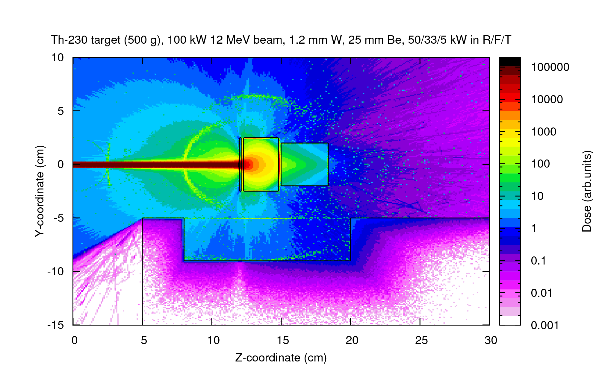
Test Setup
Filter: Be, 25 mm
Radiator: W, 1.2 mm
Target: ²³⁰Th, 500 g

Slide 5
Results
The following two slides show activities of different radioactive isotopes produced in the ²³⁰Th target after running for 1000 hours in the Test Setup, using 12 MeV electron beam delivering 100 kW
Color of every square shows activity of the isotope ^{A}Z
When viewed in “Presentation Mode” every plot will show several distributions corresponding to different times after irradiation end, from 0 to 365 days
Activity of produced ²²⁹Th is about 2 mCi, activities of ²²⁵Ra and ²²⁵Ac come into equilibrium in 60-90 days
Activities of the fission products are significant during the irradiation and in the first hour after, but then decay fast

Slide 6
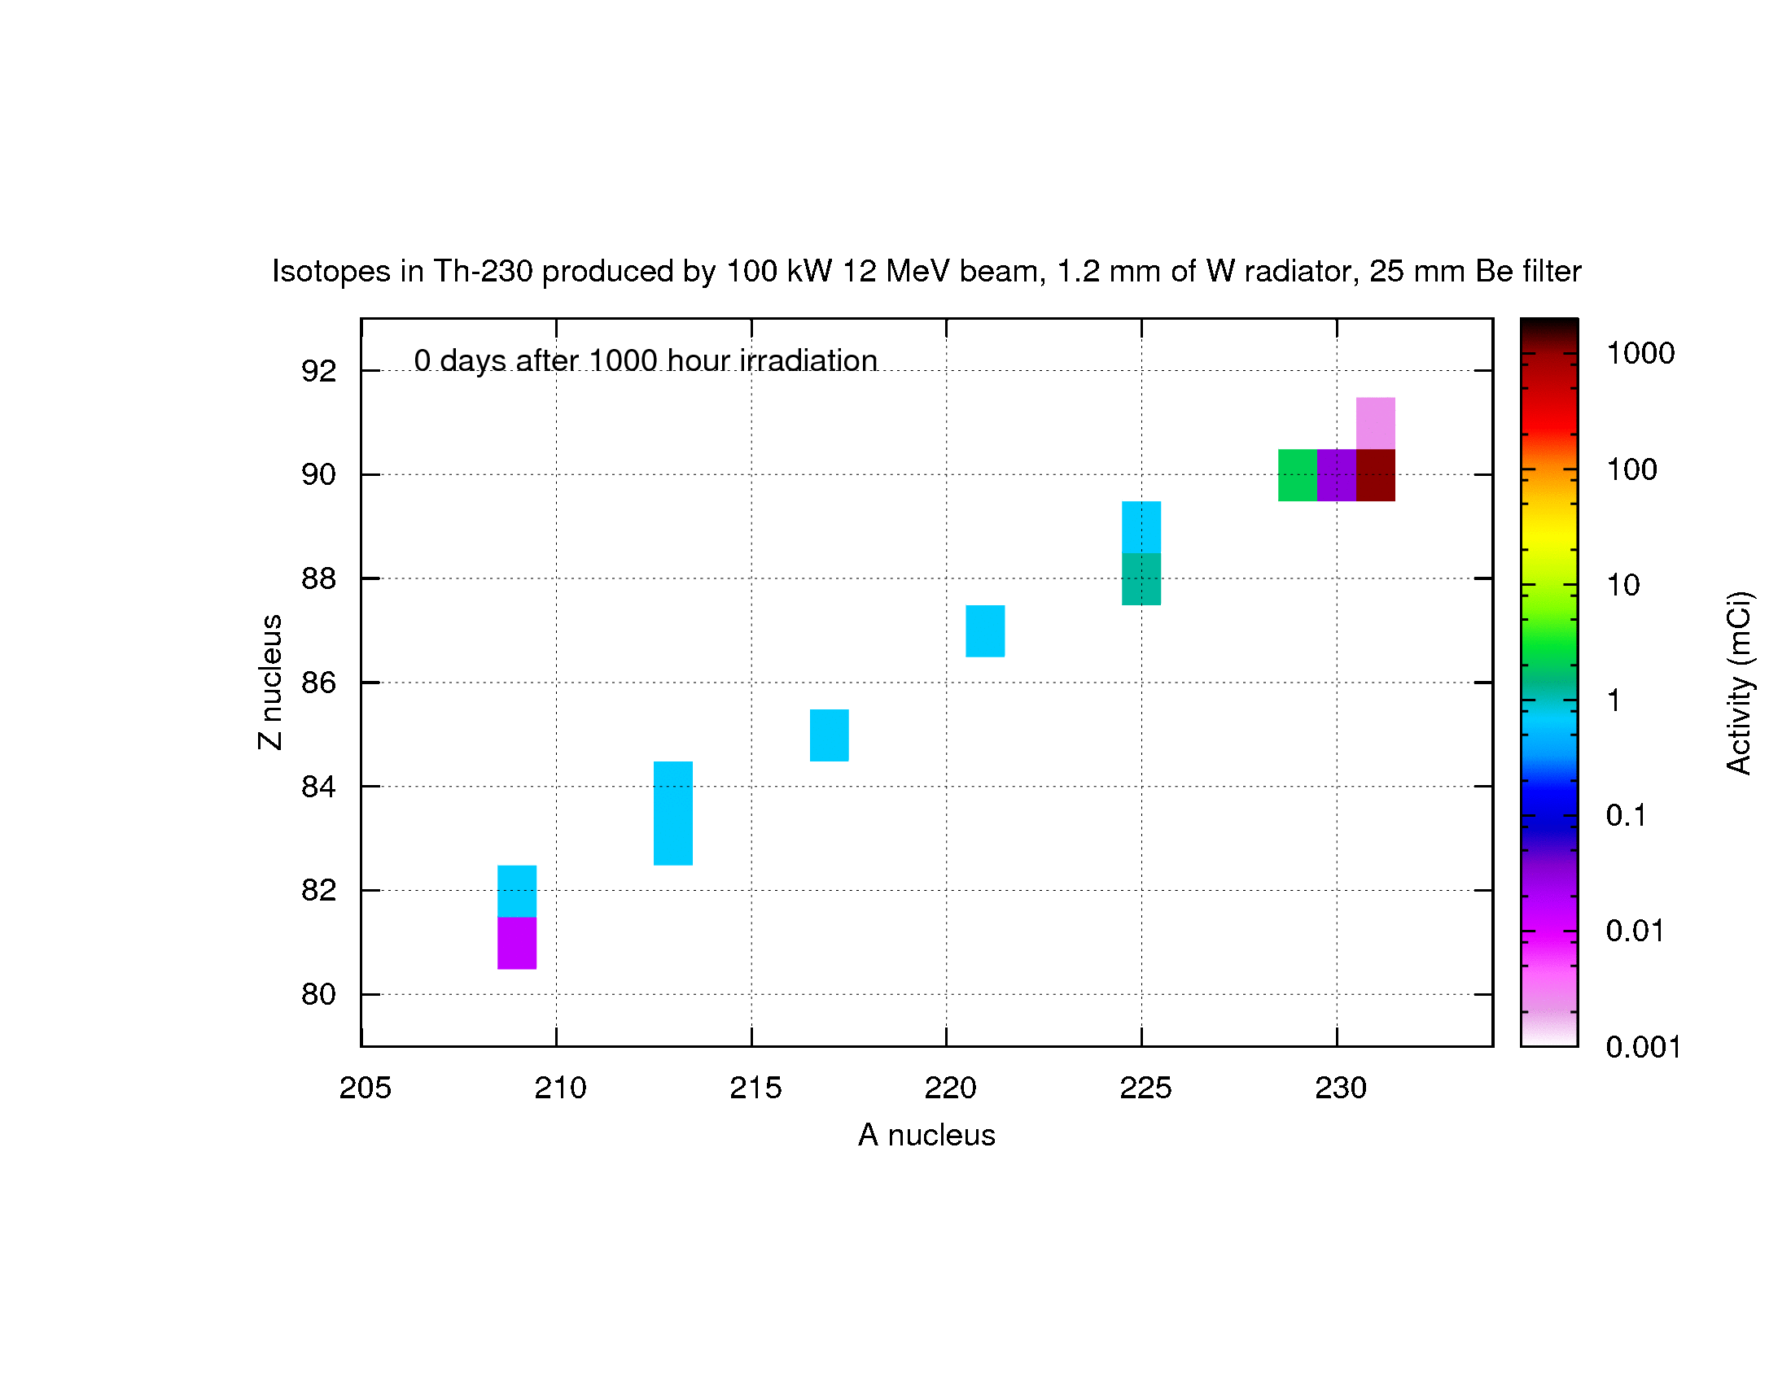
Results: ²²⁹Th and its decay chain
²²⁵Ac
(9.9d)
²⁰⁹Bi
(stable)
²¹³Po (164μs)
²⁰⁹Pb (3.2h)
²²⁹Th
(7880y)
²²⁵Ra (14.9d)
²²¹Fr
(4.9m)
²³⁰Th (7.5 10⁴y) parent
²¹⁷At (1.5s)
²¹³Bi (46m)

Slide 7
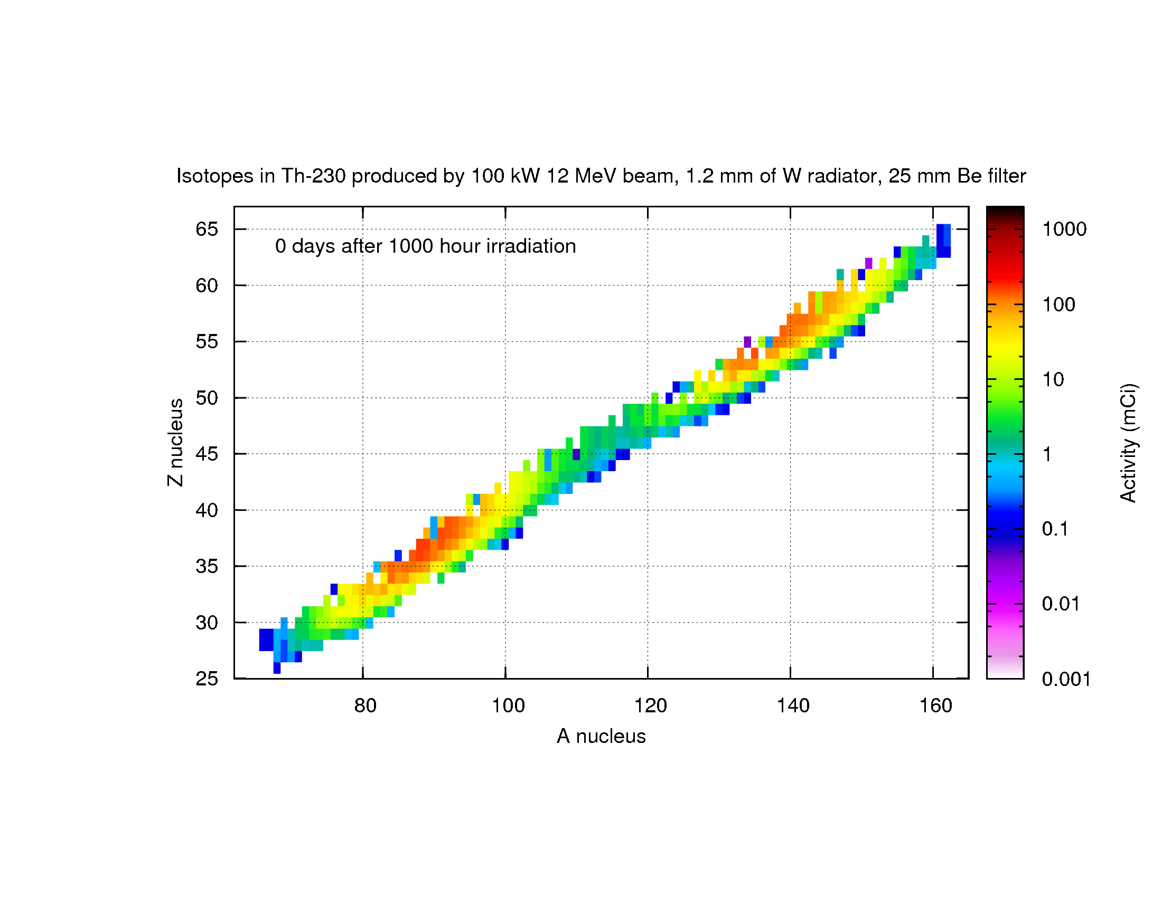
Results: ²³⁰Th fission products

Slide 8
Extras

